Slide 1
THE CHECKER AI GAME EC9640

Slide 2
GROUP MEMBERS
2017/E/035 : GUNATHILAKA J.M.R.S
2018/E/003 : AKALANKA K.V.S
2018/E/028 : DHARMASENA T.A.P.
2018/E/085 : NUWANSIRI W.D.A.
2018/E/151 : MUNASIGHE M.H.A.

Slide 3
CONTENT
Introduction
Rules
Goals
How to work
Used Algorithms
Reference

Slide 4
INTRODUCTION
Checker is a 2 player game played on an 8*8 board, the object is the game is to capture all the checkers of the opponent or traps the checker of the opponent so no move can be made.
There are 5 part in this game.
The board
The pieces
Kings
Jumps
Game over
05

Slide 5
RULES
Checkers is played with 2 players sitting across from each other.
The board is positioned with the light-colored square in the bottom right corner.
A single checker can only move and jump going forward, in the diagonal direction.
If a player can make a capture, he can decide whether to capture or not. There is no penalty if he did not capture.
If a player cannot make a move, he loses.
A kinged checker can move forward and backward of the board only for one square distance.
06

Slide 6
GOAL
The game will be end,
When the board is only containing one player’s checkers or checker, that particular player is the winner.
When the board is only containing one player’s checkers or checker, that particular player is the winner
07

Slide 7
Solving Problems
The board
is consisted of 64 alternating light and dark squares; the sport is played on the dark squares, where the sunshine corner is placed at each player’s right-hand side.
The pices
each player has 6 playing pieces of an equivalent color (white or black), the sport starts with the pieces laid out on the 6 dark squares nearest to him, each bit can move only towards the enemy side diagonally, one step at a time, except the cases where a jump (capture) or more are often made.
07

Slide 8
Solving Problems
Kings
When a bit gets to the enemy side of the board it gets promoted to a king state, which allows it to maneuver backwards to the player’s own side also because of the enemy side.
Jumps
a jump is feasible only over the enemy pieces towards the forward direction,
08

Slide 9
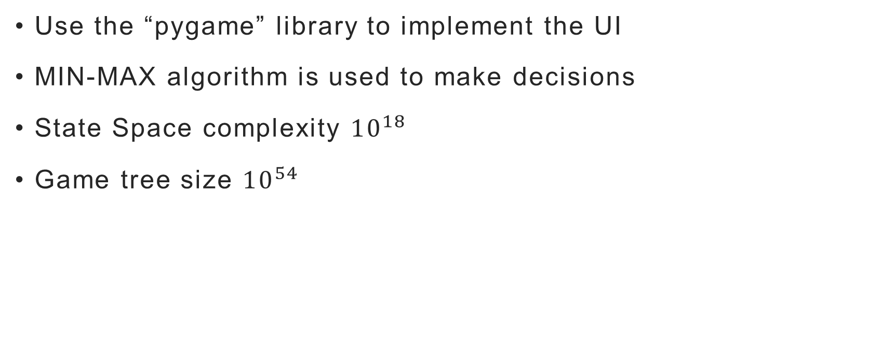
USED ALGORITHMS AND IPLIMENTATION
Use the “pygame” library to implement the UI
MIN-MAX algorithm is used to make decisions
State Space complexity ${10}^{18}$
Game tree size ${10}^{54}$
09

Slide 10
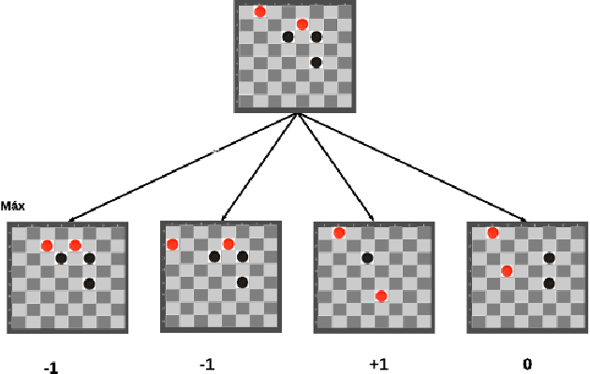
Game tree sample
10

Slide 11
REFERENCE
Escandon, E.R. and Campion, J., 2018, August. Minimax checkers playing GUI: A foundation for AI applications. In 2018 IEEE XXV International Conference on Electronics, Electrical Engineering and Computing (INTERCON) (pp. 1-4). IEEE.
https://www.youtube.com/watch?v=vnd3RfeG3NM&t=2s
11

Slide 12

Thank you

