Slide 1



TEAM GSW
Scam Shield
Scam Shield
AI-Powered Real-Time Digital Fraud Detection Platform
Defeating Fraud & Digital Arrest Scams

Slide 2
01
Problem & Urgency
02
Solution & User Value
03
Innovation: Intelligence Flywheel
04
Technical Architecture
05
Product Experience & Features
06
Business Impact
07
Scalability & Roadmap
08
Closing
Table of Contents

Slide 3










Problem & Urgency
Reactive (Current)
Scam message
User action
LOSS
Report (too late)
Digital fraud types users face daily:
Phishing links & fake support
UPI/OTP/PIN social engineering
Romance & investment fraud
“Digital arrest” intimidation scams
Preventive (Scam Shield)
Why current solutions fail:
Scam message
SAFE ACTION
Most tools help after the loss; users need instant verification before acting.
VERIFY
What makes it hard:
High emotional pressure (fear/urgency)
Non-technical and elderly users
Reactive vs Preventive Timeline
Rapidly evolving scam scripts + spoofed caller IDs

Slide 4
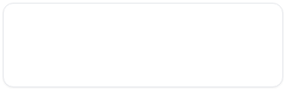

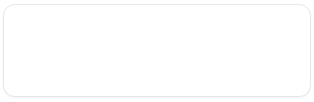


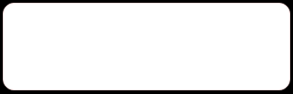


Key Red Flags We Target
UPI/OTP Scam Red Flags
PIN Request
Collect Request
“Enter PIN to receive money” (UPI PIN is for sending, not receiving)
Unexpected “collect request” disguised as refund/cashback
Explainable, Not Just a Label
Remote Access
Fake QR Code
Scam Shield identifies specific behavioral and technical cues to provide users with transparent reasoning for every verdict.
Requests to install remote access apps (e.g., AnyDesk/TeamViewer)
QR code sent to “receive” money (QR is typically to pay)
Detection Logic:
“Digital Arrest” Scam Red Flags
We map message cues to known pressure tactics and payment steps used by modern fraudsters.
Impersonation
Isolation
Impersonation of police/CBI/ED; threats of arrest via video call
Isolation tactics: stay on call, don’t contact family/lawyer
Red-flag checklist categories:
Message cues & keywords
“Safe Account”
High-pressure tactics
“Safe account” transfers for “verification” purposes
Irregular payment steps

Slide 5
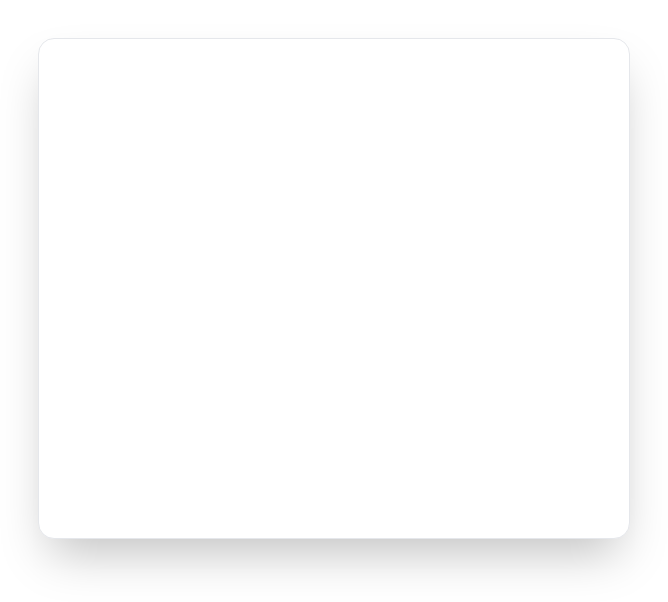
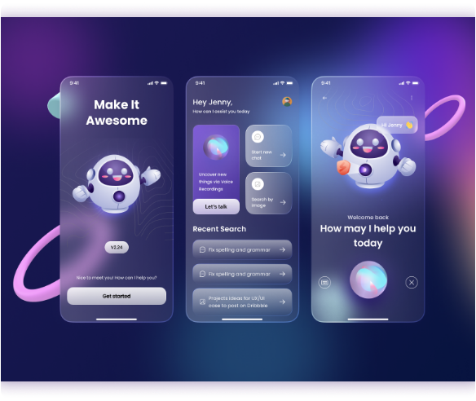

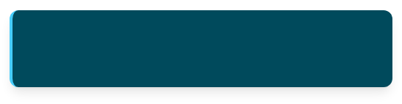
Solution Overview
Real-Time Analysis
What the user does:
paste a suspicious message / call script / email snippet
What Scam Shield returns in seconds:
Verdict:
Scam / Suspicious / Safe
Confidence score
Red flags detected (explainable)
Suggested next steps (do/don’t)
Pre-transfer interception
Stop the scam before money moves or sensitive info is shared.
Conversational follow-up:
Ask clarifying questions
Product Interface Preview
Provide safe response templates
Guide to reporting channels

Slide 6





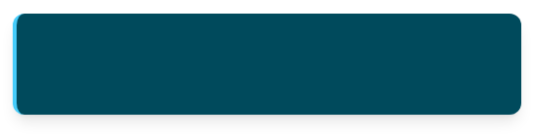

RAG-Grounded Verdicts
User text
Why grounding matters:
Scam scripts evolve daily; model memory can be stale
Retrieve tactics
Users (and judges) need auditable reasoning, not a black box
Grounded in Pinecone Vector DB with up-to-date scam tactics.
How Scam Shield grounds decisions:
Retrieve matching tactics from a curated scam corpus
Cite matched patterns/phrases and known scam playbooks
LLM reasoning
Combine with red-flag heuristics to produce a verdict + confidence
Grounded Evidence
Explainable verdict
Decisions are backed by real-world scam-tactics patterns, not just LLM probability.
What the user sees:
RAG Flow: User Text to Explainable Verdict
“Why this is risky” bullets + referenced scam pattern snippets

Slide 7






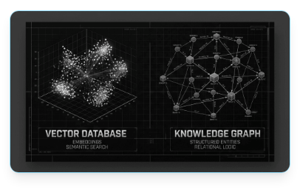




Technical Architecture
System Flow
1
React (Vite + Tailwind) frontend
2
FastAPI backend (async)
Client Layer
3
Detection Engine (Digital Arrest / Scam Classifier)
React (Vite + Tailwind)
4
RAG Engine (scam tactics corpus via Pinecone)
5
Threat Intelligence Module (clustering + trending)
API Router
6
LLM Client → OpenAI API
FastAPI Backend (Async)
Server-Sent Events
7
MHA / NCRB Alert Generator
8
Server-Sent Events (streaming responses)
Core Engines & Modules
Detection Engine
RAG Engine
Intelligence Module
MHA / NCRB Alert Generator
External Services
OpenAI API
Pinecone Vector DB
Vector Database Grounding & Similarity Search

Slide 8
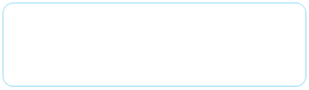

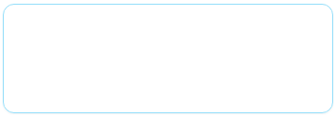




Product Capabilities
Core Features
Real-time Analysis
AI Assistant
Real-time scam analysis with explainable red flags
Real-time scam analysis with explainable red flags
Interactive AI assistant for follow-up guidance
Interactive AI assistant for follow-up guidance
RAG Knowledge Base
Threat Intelligence
RAG-powered knowledge base (continuously updatable)
RAG-powered knowledge base (continuously updatable)
Threat-intelligence view: similar submissions + trending campaigns
Threat-intelligence view: similar submissions + trending campaigns
MHA/NCRB-style alert generation for auditable reporting
Alert Generation
Modern UI
MHA/NCRB-style alert generation for auditable reporting
Modern glassmorphism dark UI
Modern glassmorphism dark UI
Feature-to-Value Map
FEATURE
USER BENEFIT
Real-time Detection
Safety & Prevention
Explainable Red Flags
Clarity & Understanding
Interactive Guidance
Confidence in Action

Slide 9



Business Impact
Why it matters: Preventing the first mistake is cheaper than recovering losses—especially for digital arrest scams.
1
B2C
2
B2B
3
B2G
Go-to-market path:
Go-to-market path:
Go-to-market path:
free instant checks + premium guidance (family protection plans; elderly-friendly)
license to banks/fintechs/telecom — fraud-risk endpoints embedded at point of risk
government & cybercrime partnerships — intelligence packages + dashboards for cyber cells (e.g., I4C workflows)
Monetization:
Monetization:
Premium tiers (unlimited scans, family plans)
Enterprise API (pay-per-call risk scoring)
Monetization:
Government licensing (state cyber-cell subscriptions)
Expansion Ladder

Slide 10

Scalability, UX & Roadmap
Execution-Ready: Building for massive scale and intuitive safety.
Scalability
UX Principles
Roadmap
Stateless FastAPI services (horizontal scaling)
Zero-friction (no signup wall)
Near-term
Confidence score + red-flag explanations
SMS/WhatsApp bot + IVR hotline ingestion; regional language support (Indian languages)
Async I/O + SSE for responsive UX
Accessibility for elderly users (clear language, calming UI)
Pinecone offloads similarity search + clustering
Mid-term
bank/telecom API partnerships; live video-call metadata analysis for digital-arrest interception
Modular intelligence layer; cache-friendly design
Multi-tenant ready for enterprise and per-agency deployments
Long-term
mobile app + browser extension; public fraud-trend API for researchers and law enforcement
3-Lane Roadmap

Slide 11


Deployed Website
github.com/anjanabva/Scam-Shield
Thank You

