Slide 1
COVID TRACK APP
TEAM 14: SEMICOLON
Anjali Dileepkumar
Anjana Dileepkumar
Fahmida Minna K
Shilpa Sadanandan.T
Sumi Prasad

Slide 2
PROBLEM DEFINITION
Due to covid 19, the colleges shut down for the past one and half years. As per the order from the State government, now colleges will be back to their offline work.
To keep track of student activities registers are maintained by colleges.
If a student is affected with covid 19, it will be hard to find the primary contacts of the student and inform them, as it takes hours of work.

Slide 3
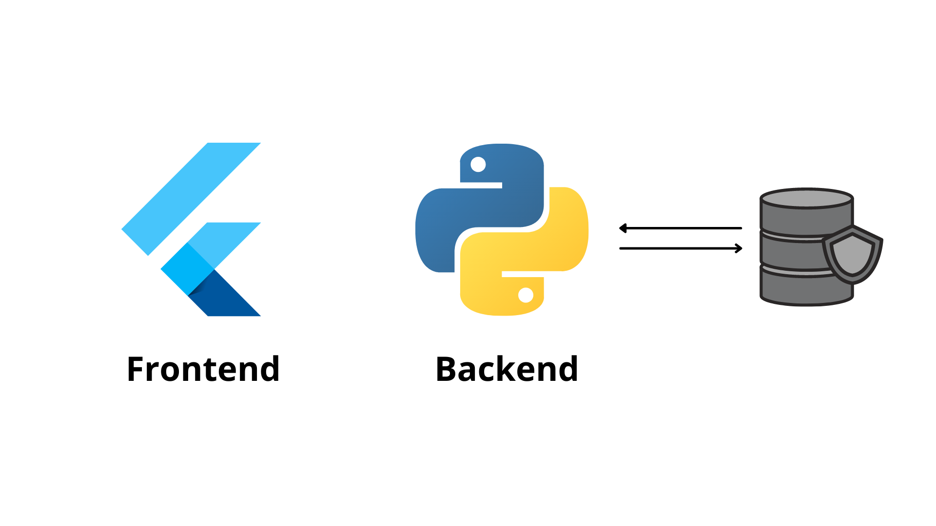
TECHNOLOGIES USED
Fig: 1 Technologies used

Slide 4
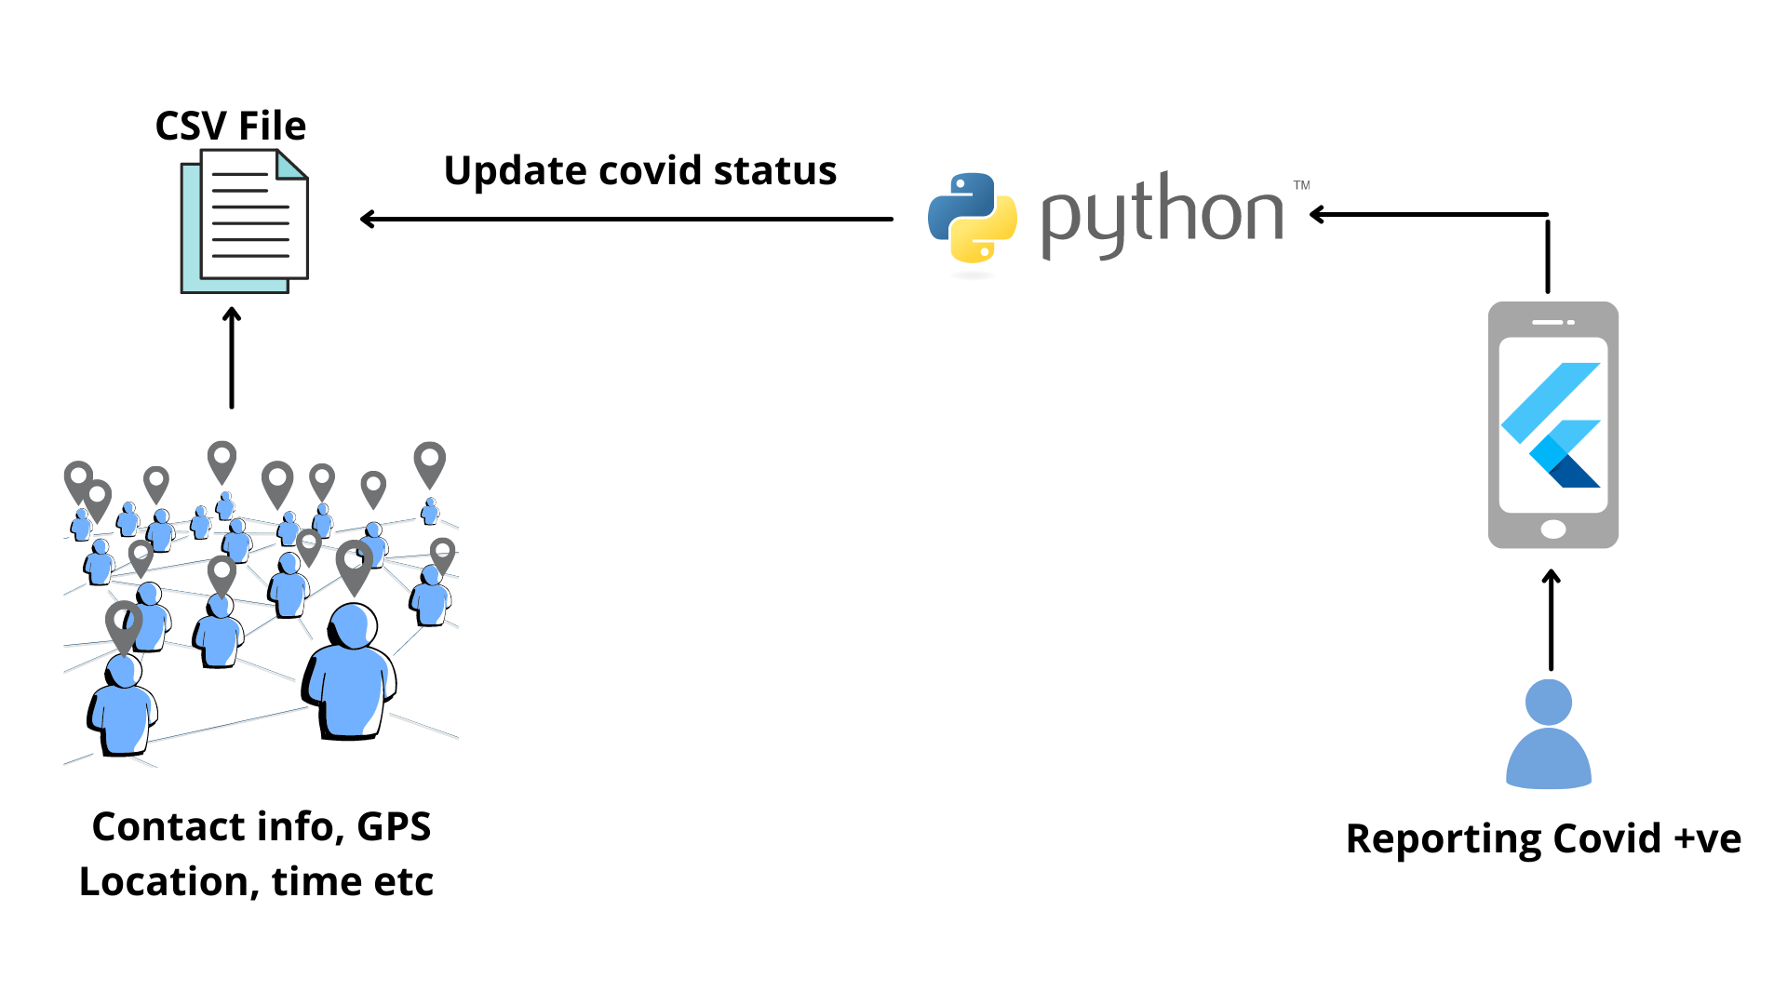
SYSTEM ARCHITECTURE - 1
Fig: 2 System architecture - user

Slide 5
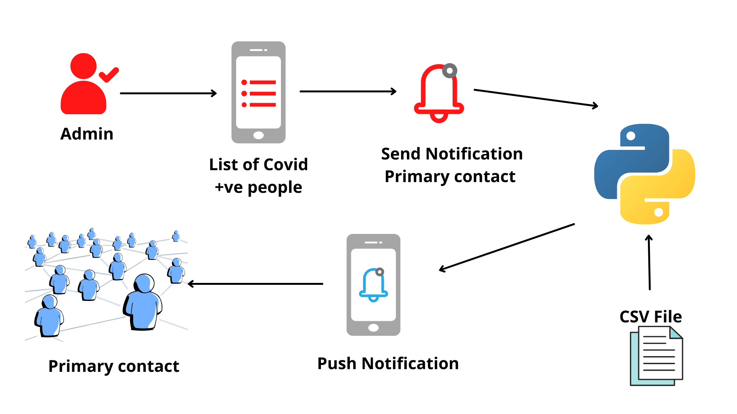
SYSTEM ARCHITECTURE - 2
Fig: 3 System architecture - admin

Slide 6
DEMO
<!-- DEMO VIDEO -->

Slide 7
CONCLUSION
The Application helps in monitoring people who have been tested positive for covid 19.
It is an excellent way to alert people, they are primary contact with a person suffering from covid 19 which will reduce the hours of work needed to that in traditional way.

Slide 8
FUTURE WORKS
Integrate application by connecting flutter app to python using starflut plugin.
GPS location tracking using Geolocation plugin
Converting csv file to real-time database like firestore.

Slide 9
THANK YOU

