Slide 1
MediSmart
Smart Pharmacy & Prescription System
PRESENTED BY
Anjana Jayan
MLM25MCA-2020
Department of Computer Applications
Academic Year 2025–27
GUIDE
Mr. Eldhose K Paul
Associate Professor
Department of Computer Applications
Mangalam College of Engineering

Slide 2
Introduction
Background
Problem
Many pharmacies still use manual or semi-digital methods for prescriptions, stock and expiry tracking.
Manual records cause errors and delays; customers cannot check availability or order online.
Purpose of MediSmart
Importance
A web-based platform connecting customers and pharmacies: search, prescription upload, ordering and pharmacy management.
AI-assisted prescription reading saves effort, while admin review keeps verification safe.

Slide 3
Abstract
Overview
Web-based smart pharmacy system with a customer interface and an administrator interface.
Problem
Inventory, prescription verification and ordering are handled separately and mostly by hand.
Solution
One platform for medicine search, prescription upload, AI-assisted verification, ordering, stock and expiry management, and chatbot help.
Technologies
HTML, CSS, JavaScript, Bootstrap · Python Flask · SQLite · Tesseract OCR, TrOCR, Google Gemini API

Slide 4
Problem Definition
Pharmacy inventory, prescription verification and customer ordering are handled separately and largely by hand, with no shared digital platform connecting customers and pharmacies.
Data inaccuracy
Slow verification
Expiry wastage
No digital link
Manual entry gives wrong stock levels and medicine details.
Prescriptions are read and checked by hand.
Expiry dates are hard to track on paper.
Customers cannot check availability or track orders.

Slide 5
Objectives
MAIN OBJECTIVE
Provide an efficient, convenient digital platform for pharmacy services with reliable prescription verification and reduced manual work.
Objective 1
Objective 2
Online medicine search and ordering
AI-assisted prescription verification with admin review when required
Objective 3
Objective 4
Stock and expiry management to reduce wastage
Order tracking and chatbot support
Expected outcome
Benefits to users
Customers and pharmacy staff work on one organised platform.
Customers: less waiting, online availability check. Admins: organised stock, prescriptions and orders.

Slide 6
Existing System
The existing pharmacy system uses manual and basic digital methods to manage stock and records. Prescription verification is done by pharmacists, and customers visit pharmacies directly to purchase medicines .The system works effectively but mainly depends on human effort.
Manual records
Stock, expiry dates, availability tracked on paper
Human errors
Mistakes in recording
Details Medicine
Medicine wastage
Expired medicines not tracked properly

Slide 7
Proposed System
AI-Based Prescription verification
Online ordering
Uploaded prescriptions read with OCR + Gemini and Admin reviews doubtful ones.
Search medicines, upload prescription, Place order with delivery or take-away.
Stock & expiry management
Order tracking & chatbot
Central stock records and expiry dates to reduce wastage.
Order status tracking and rule-based chatbot for common queries.

Slide 8
Scope of the Project
Target users
Included in the project
Application areas
Customers: search, upload, order, track
Pharmacy administrators: manage medicines, stock, prescriptions, orders
Registration & login
Medicine search, category filter
Prescription upload & AI-assisted verification design
Cart, delivery / take-away option
Stock & expiry management
Chatbot assistance
Admin management
Retail pharmacies
Online medicine purchasing
Possible future applications
Multi-branch pharmacies
Hospital integration

Slide 9
Literature Review
Title & Year | Author / Publication | Algorithm / Method | Feature / Methodology | Performance / Result | Key Finding
AI-Based Prescription Reader (2026) | Amal Mariya Sibi & Bijimol T.K., NCECA 2026 | Image processing, OCR, CNN, NLP | Preprocessing, text extraction, medicine identification | 95.4% recognition accuracy (reported by the study) | OCR pipeline can read prescriptions reliably
Medicine Management System(2023) | Ruth G. Luciano et al., IJEME | HTML, PHP, XAMPP, MariaDB; Agile | Online requisition, prescription upload, authentication | Usability evaluation (no figure in report) | Digital requisition & upload are core modules
PharmaGo: An Online Pharmaceutical Ordering Platform (2021) | Ranula Gihara Gamage et al., IEEE ICAC | OCR, image processing, LSTM, AI chatbot | Prescription reading, pharmacy recommendation, demand prediction, chatbot | Demand-prediction performance (value not given) | OCR + ordering + chatbot is a valid approach
Patient Satisfaction with Online Pharmacy Services (2022) | Etidal-Mihaela Manoliu-Hamwi et al., IEEE EHB 2022 | Questionnaire, SPSS, Pearson Chi-square | Service evaluation, patient satisfaction | Satisfaction %, p-value (values not given) | High patient satisfaction with online pharmacies
PharmAI (2025) | Roshni Patane & Ramesh D. Jadhav | AI, predictive analytics, UML | Inventory, billing, reporting, demand prediction | System efficiency (figures not given) | Improves inventory management and decisions

Slide 10
Technologies Used
Frontend
Backend
Database
HTML · CSS · JavaScript · Bootstrap
Python · Flask
SQLite
AI Technologies
AI Interpretation
Chatbot
Tesseract OCR · TrOCR
Google Gemini API
Rule-based + basic NLP

Slide 11
Software & Hardware Requirements
Software Requirements
Hardware Requirements
Frontend: HTML, CSS, JavaScript, Bootstrap
Backend: Python with Flask
Database: SQLite
OCR / AI: Tesseract OCR, TrOCR, Google Gemini API
Web browser for accessing the application
Computer or laptop able to run a web browser and Python / Flask
Stable internet connection (needed for online features and the Gemini API)

Slide 12
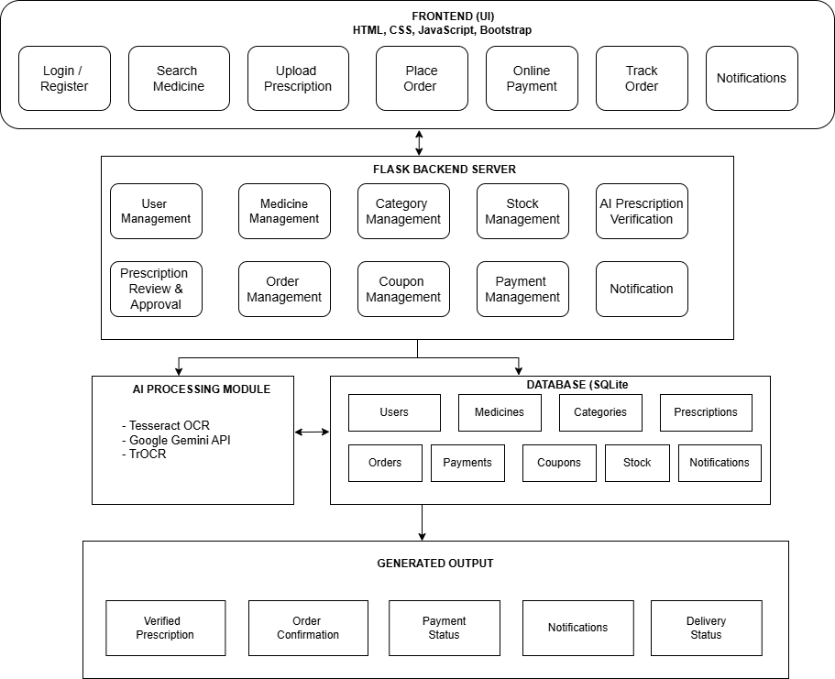
System Architecture
Presentation layer
HTML, CSS, JavaScript, Bootstrap · user & admin interfaces
Application layer
Flask · user, medicine, stock, order, payment, coupon, notification logic
AI processing layer
Tesseract OCR, TrOCR, Gemini API
Data layer
SQLite · users, medicines, prescriptions, orders, payments, stock

Slide 13
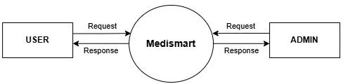
DFD Level 0

Slide 14
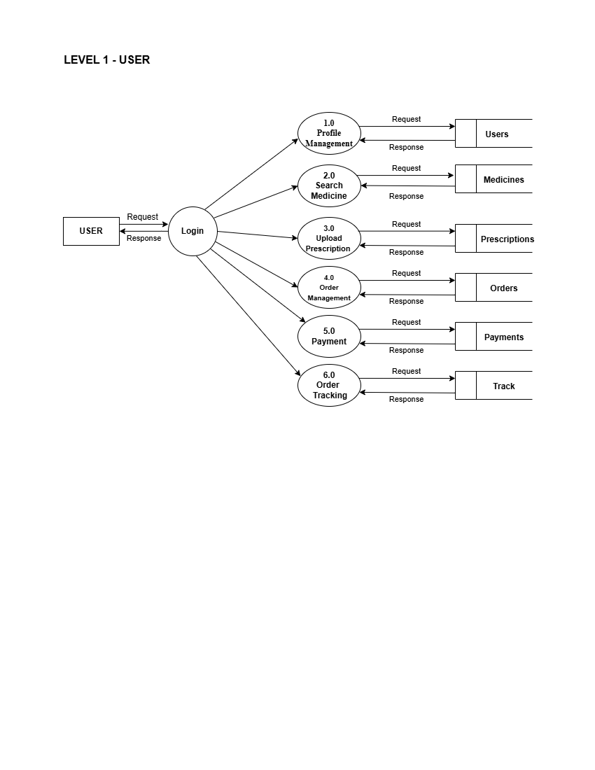
DFD Level 1 – User

Slide 15
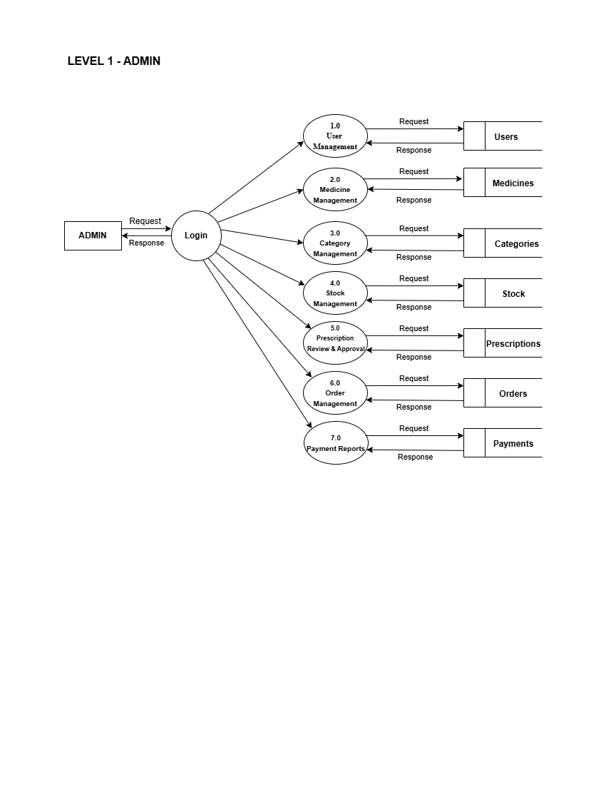
DFD Level 1 – Admin

Slide 16
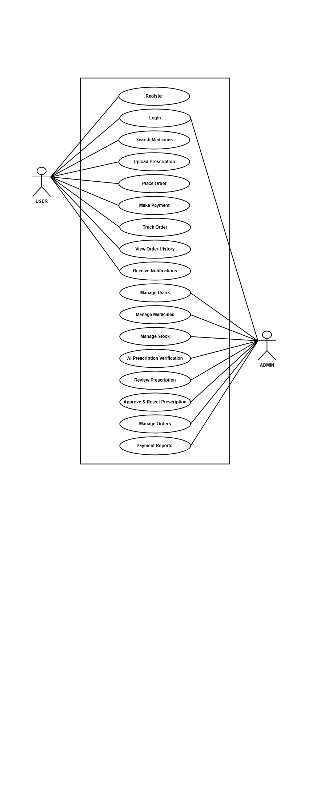
Use Case Diagram

Slide 17
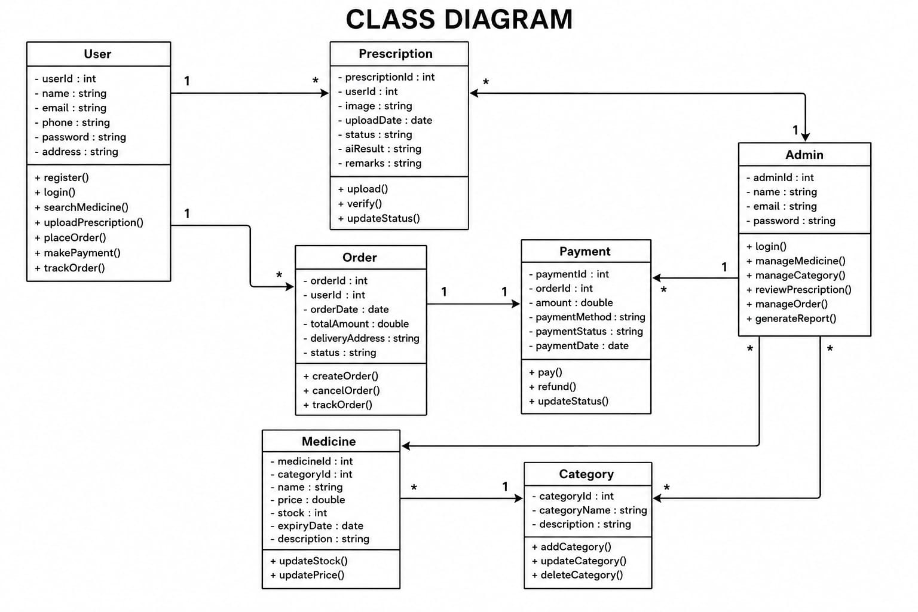
Class Diagram

Slide 18
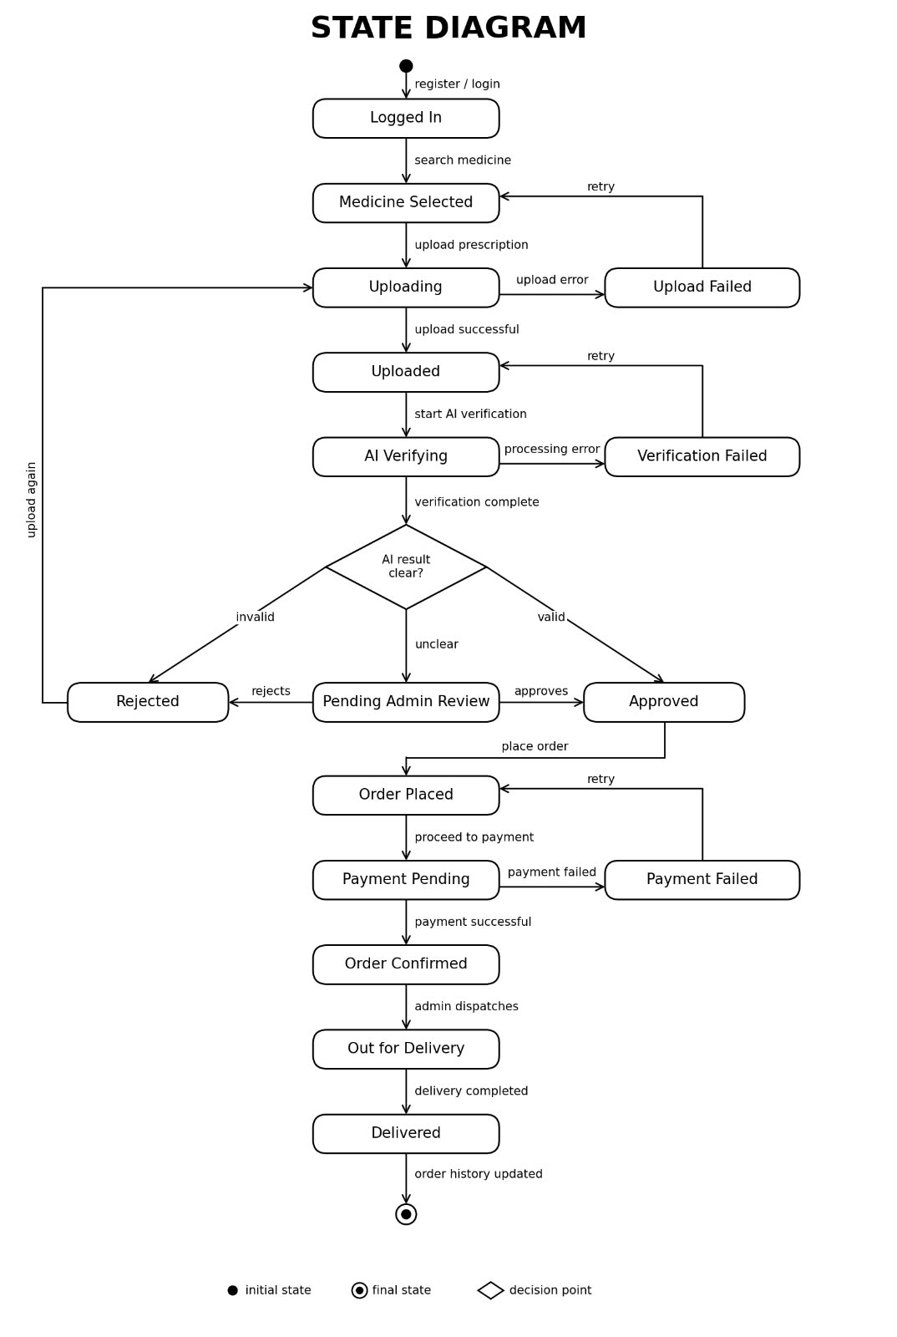
State Diagram

Slide 19
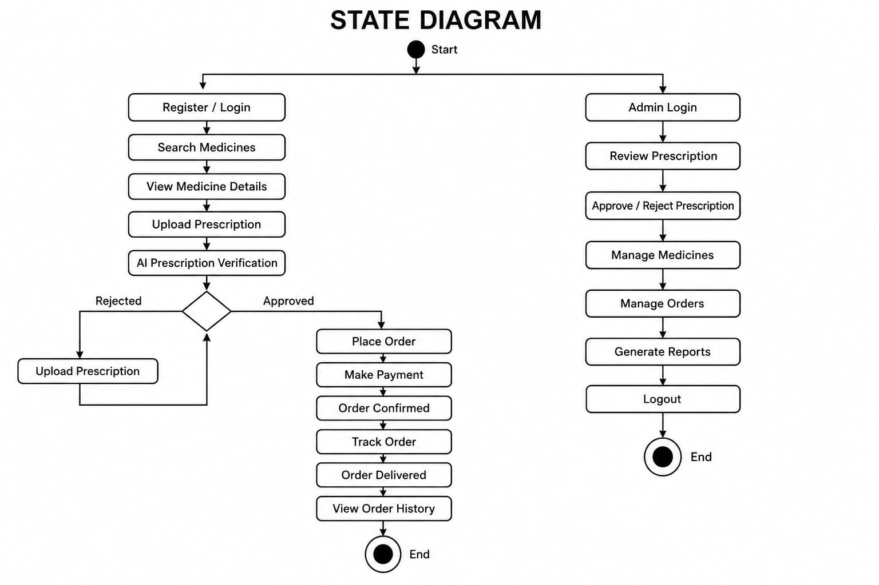
Activity Diagram

Slide 20
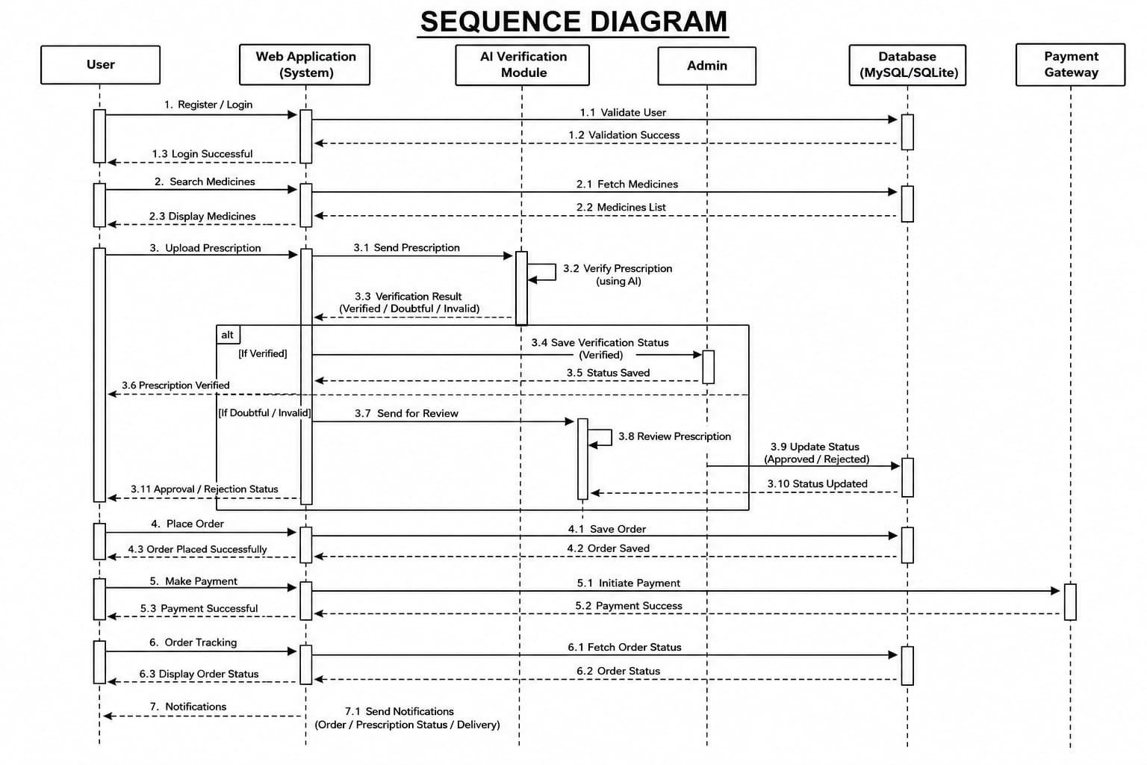
Sequence Diagram

Slide 21
Module Description
1. User
2. Prescription
3. Order & Search
Registration, login, profile and dashboard
Upload prescription; AI-assisted verification; admin review if doubtful or invalid
Search and filter medicines, cart, delivery or take-away, order status
4. Chatbot
5. Stock
6. Expiry Tracking
Rule-based answers on medicines, prescriptions and delivery
Central stock records and availability
Stores expiry dates; identifies medicines nearing expiry

Slide 22
Methodology
Prescription upload
Image + optional note
Image processing
Preprocess image
Tesseract OCR / TrOCR
Extract text
Google Gemini API
Identify medicines, classify
→
→
→
Prescription classification
Verified
Proceeds to ordering
Doubtful
Sent to admin review
Invalid
Sent to admin review
Admin approves or rejects; final status is stored and shown to the user.
Development methodology
Requirement analysis
System design
Front-end
Back-end
AI verification
Testing

Slide 23
Implementation
Frontend
Backend (Flask)
Login, registration, home, medicine search, prescription upload, dashboard, chatbot pages (Bootstrap, responsive)
Modular structure: user, medicine, category, stock, prescription, order, coupon, payment, notification
Implemented · ~80%
Designed / partly integrated
Database (SQLite)
AI integration
Users, medicines, categories, prescriptions, orders, payments, stock, coupons, notifications
Tesseract OCR + TrOCR + Gemini API pipeline; interface shows simulated / preview responses
Designed from ER diagram
Live integration planned
Core registration, login, search and filtering are verified; AI verification, live payment and admin functions still need end-to-end testing.

Slide 24
Results / Analysis
💊 Medicine Search
Users can search for medicines and view relevant information.
📄 Prescription Upload
Users can upload prescription images for further processing.
🏠 User Dashboard
Dashboard provides access to user-related features and activities.
🤖 AI Chatbot
Chatbot assists users with basic medicine-related queries.
🔍 Medicine Filtering
Category-based filtering helps users find medicines easily.
👤 User Management
User profile and account-related functio…

Slide 25
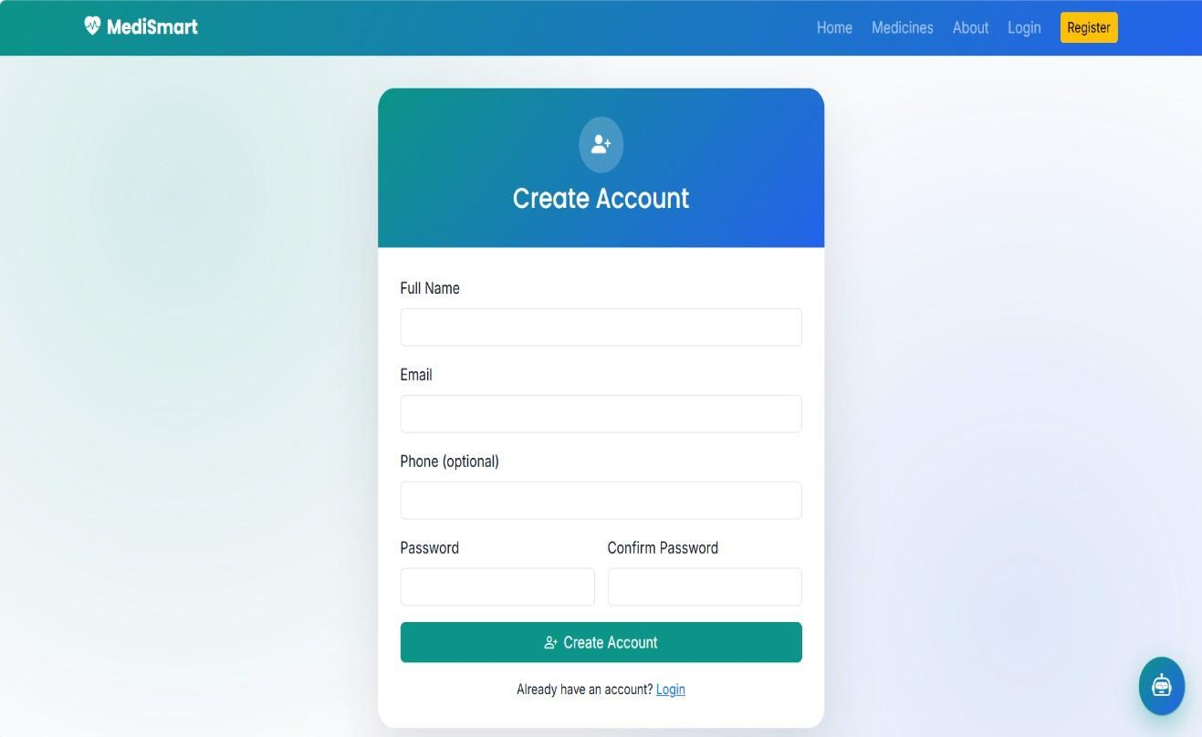
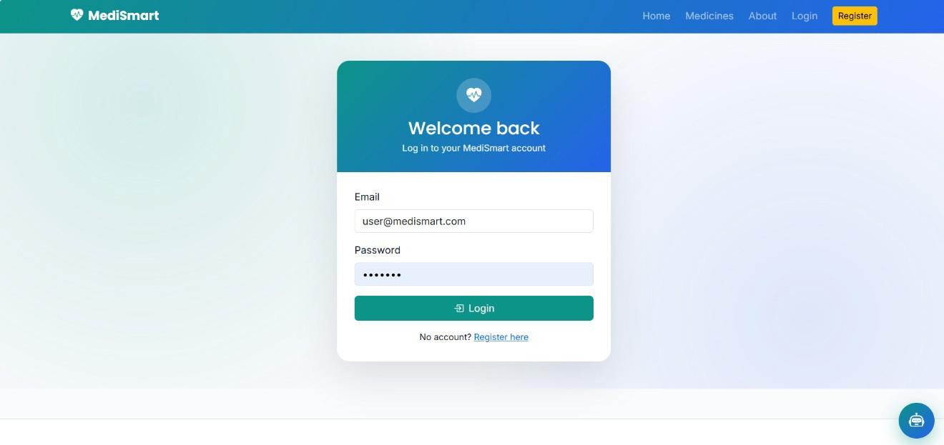
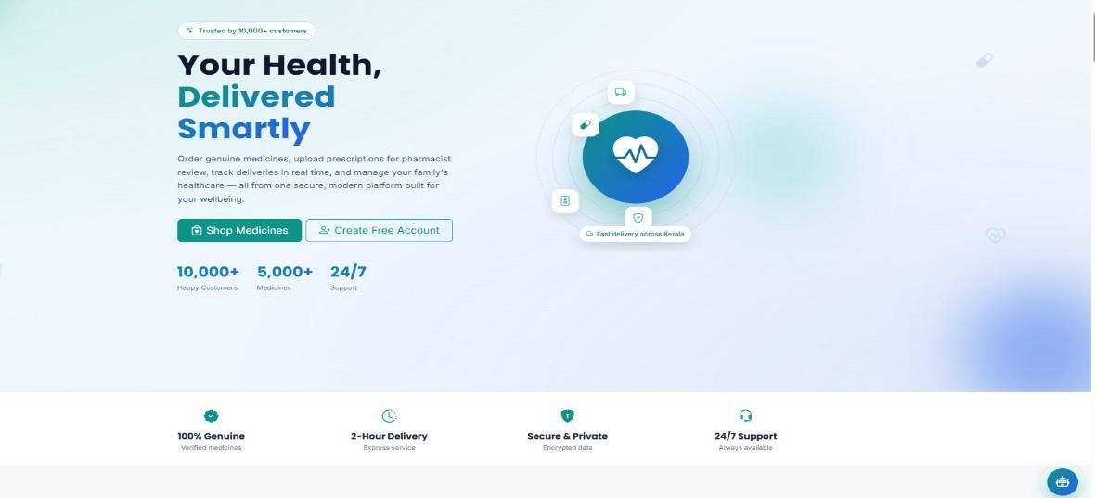
Screenshots
Login
Registration
Home page

Slide 26
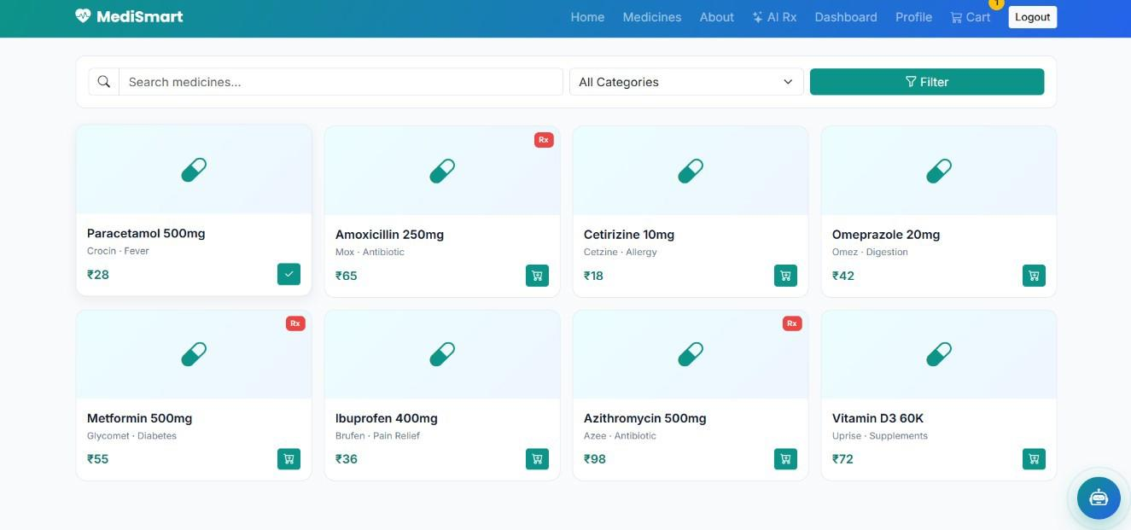
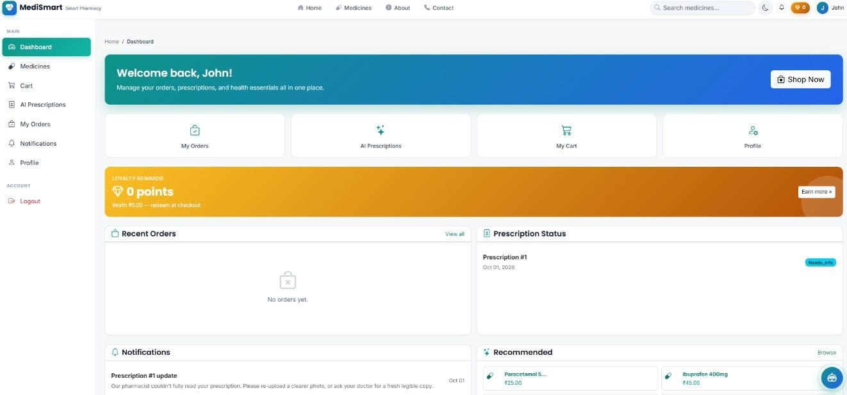
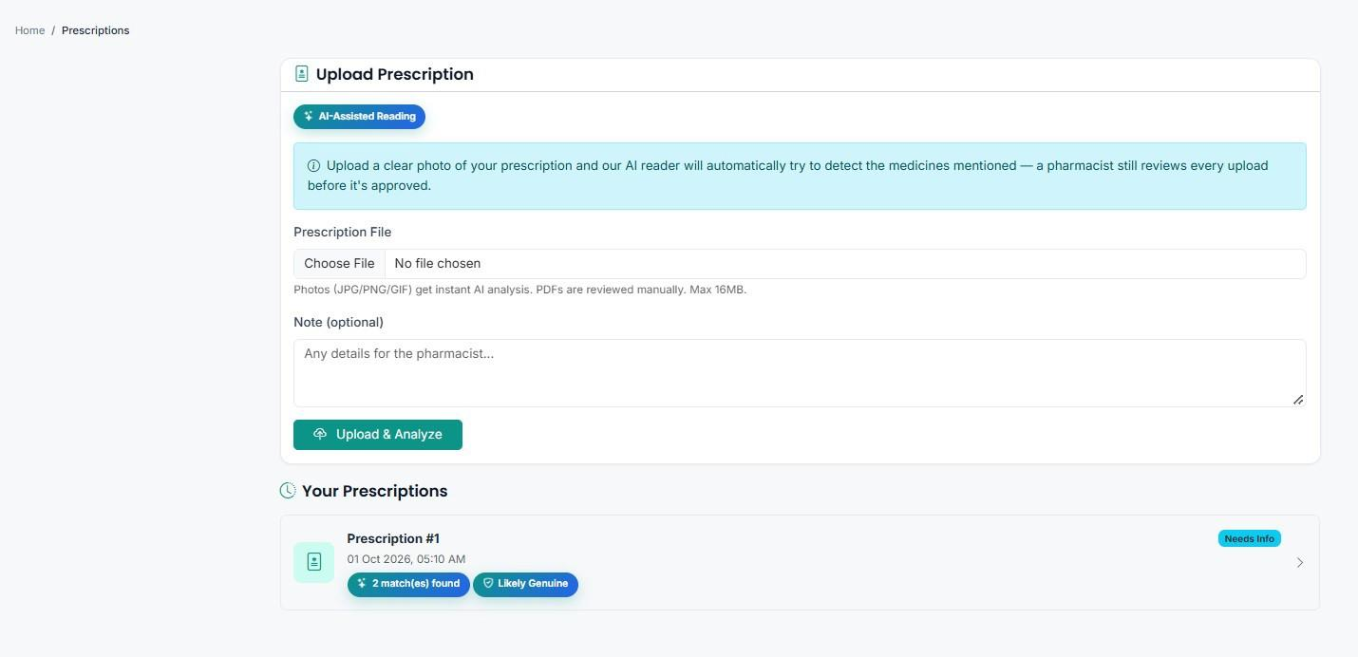
Medicine search / catalogue
User dashboard
Prescription upload

Slide 27
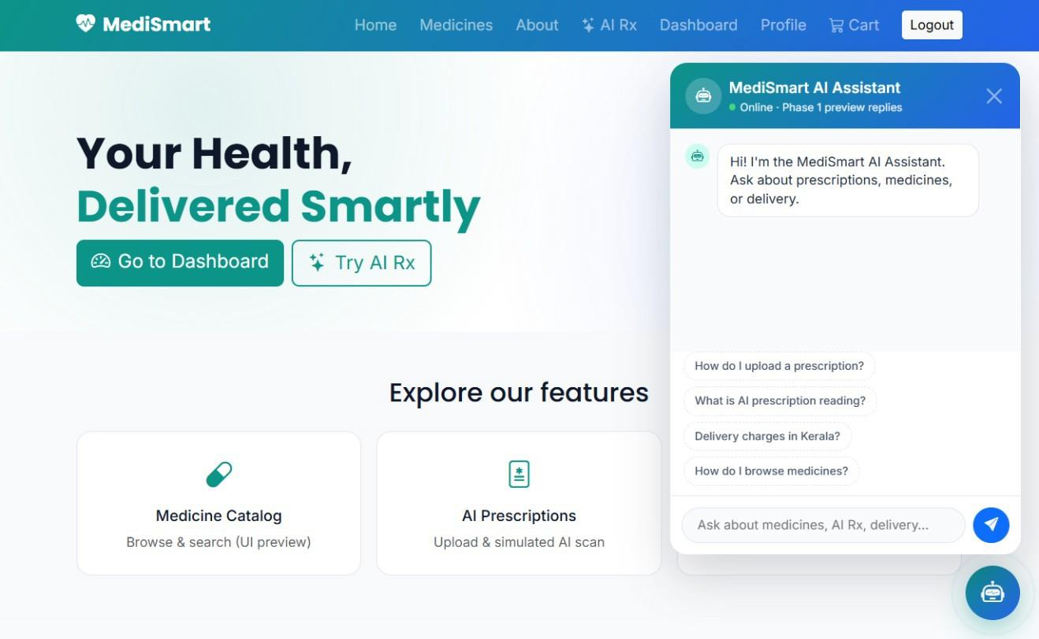
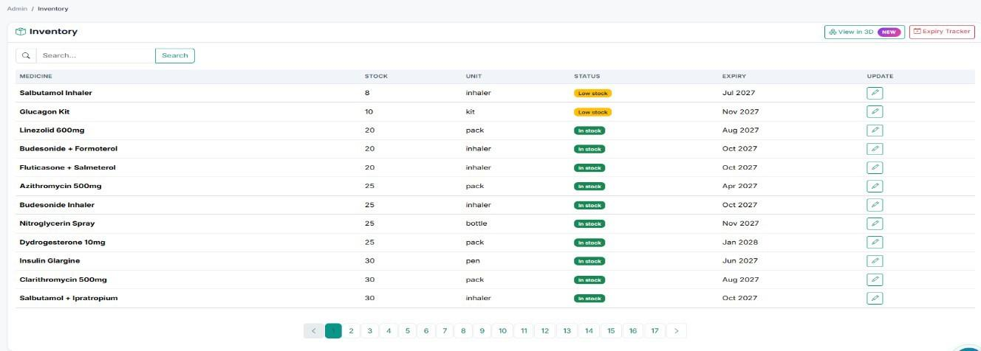
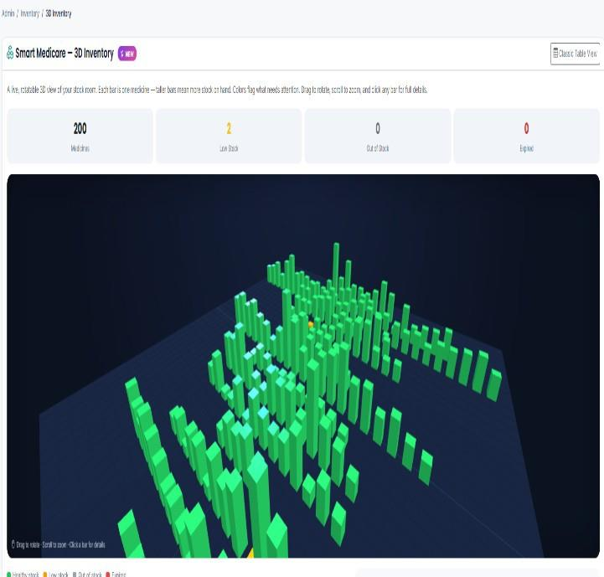
Stock management
AI assistant (chatbot)
3D expiry timeline

Slide 28
Comparison with Existing System
Feature | Existing System | MediSmart
Medicine search | Visit or call the pharmacy | Online search and category filter (tested)
Prescription processing | Manual reading by pharmacist | AI-assisted OCR + Gemini with admin review (preview level)
Stock management | Paper registers / spreadsheets | Central database stock records
Expiry tracking | Not tracked systematically | Expiry date stored; timeline view
Online ordering | Customer visits pharmacy | Cart, delivery / take-away (interface level)
Order tracking | No online tracking | Order status tracking (designed)
Customer–pharmacy link | No direct online channel | Single web platform
Chatbot assistance | None | Rule-based chatbot (preview level)
Admin management | Manual registers | Admin dashboard (not independently verified)
Green: verified at tested stage. Amber: designed or interface-level; full integration pending.

Slide 29
Testing
Test Case | Expected Result | Actual Result | Status
Registration (valid data) | Account created | Account creation flow worked | Pass
Login (registered user) | Authentication succeeds | Login worked | Pass
Medicine search | Matching medicines listed | Expected results | Pass
Category filtering | Filtered catalogue | Expected results | Pass
Prescription upload | Upload and display | Works at UI level | Interface-level
Chatbot | Answers common queries | Preview / quick replies | Interface-level
AI verification (live) | OCR + Gemini result | Simulated response only | Not tested
Admin functions, live payment | Work end to end | Not independently verified | Not tested
Functional testing
Usability testing
Integration-path testing

Slide 30
Demo Video
Suggested demo flow
Registration and login
Medicine search and filter
Prescription upload
Chatbot
Stock and expiry view

Slide 31
Advantages
Single platform
Online availability
Customers and pharmacy on one system
Search medicines without visiting
AI-assisted verification
Central stock
OCR + Gemini, with admin review
Organised medicine records
Expiry tracking
Chatbot support
Helps reduce medicine wastage
Handles routine queries
Modular architecture
Low-cost stack
Easy to maintain and extend
Open-source tools suit small pharmacies

Slide 32
Limitations
Image quality
Integration pending
OCR accuracy depends on clear images; handwriting is harder
Live AI, chatbot backend and admin functions need further testing
AI is support only
Scalability
Cannot replace a pharmacist; doubtful cases need admin review
SQLite may not suit many simultaneous users
Internet dependency
Security & testing
Online features and Gemini API need connectivity
Needs stronger data protection and real-world testing

Slide 33
Conclusion
MediSmart establishes the foundation of a smart pharmacy and prescription system on one web platform.
Achieved
Still pending
Takeaway
Six functional modules designed
Core pages built (~80% front-end)
Registration, login, search, filtering tested
Live OCR + Gemini integration
Full backend and admin testing
Live payment
Modular design, AI-assisted verification with human review, and a clear path to complete integration.

Slide 34
Future Scope
Planned – not implemented
Advanced AI prescription verification (handwritten and printed)
Dynamic chatbot with real-time responses
Online payment integration
Delivery tracking
Mobile application
Automatic stock updates, low-stock and expiry alerts
Hospital system integration
Enhanced security and encryption
Multi-branch pharmacy support
Performance and scalability upgrade

Slide 35
References
[1] “PharmaGo—An Online Pharmaceutical Ordering Platform,” in Proc. 3rd Int. Conf. Advancements in Computing (ICAC), 2021.
[2] “Medical Prescription Recognition using Machine Learning,” IEEE Conf. Publication, 2021.
[3] “Medical Handwritten Prescription Recognition Using CRNN,” in Proc. Int. Conf. Computer, Information and Telecommunication Systems (CITS), 2019.
[4] “Doctor’s Handwritten Prescription Recognition System in Multi-Language Using Deep Learning,” in Proc. ICPECTS, 2022.
[5] “Intelligent System for Decision-Making in Hospital Pharmacy,” in Proc. IEEE 4th Eurasia Conf. Biomedical Eng., Healthcare and Sustainability (ECBIOS), 2022.
[6] “Extraction and Classification of Medicines from Handwritten Medical Prescriptions,” in Proc. 18th Int. Conf. Emerging Technologies (ICET), 2023.
[7] “A Deep Neural Network Approach with Pioneering Local Dataset to Recognize Doctor’s Handwritten Prescription in Bangladesh,” in Proc. iCACCESS, 2024.
[8] “Enhancing Patient Safety with Machine Learning: Automating the Interpretation of Handwritten Medical Prescriptions,” in Proc. 4th Int. Conf. Ubiquitous Computing and Intelligent Information Systems (ICUIS), 2024.
[9] “OCR-Based Extraction of Expiry Dates and Batch Numbers in Medicine Packaging for Error-Free Data Entry,” in Proc. 7th Int. Conf. Circuit Power and Computing Technologies (ICCPCT), 2024.
[10] “A Deep Learning-Driven OCR Framework for Medical Prescription Analysis Using Hybrid Preprocessing and Multi-Model Architecture,” in Proc. 2nd Int. Conf. Circuits, Power and Intelligent Systems (CCPIS), 2025.

Slide 36
Thank You
MediSmart – Smart Pharmacy & Prescription System
Questions & Discussion
Anjana Jayan · MCA(S3) · 2025-27 . Guide: Mr. Eldhose K Paul

