Slide 1

SUMMER INTERNSHIP
Python Developer Internship
Anjana Kumari
Enrollment No. 2410031184
B.Tech CSE • 3rd Year
IILM University, Greater Noida
02 July 2026 — 01 August 2026

Slide 2
Intern Profile
Academic details and internship identity
Student
Anjana Kumari
Enrollment No. 2410031184
B.Tech CSE • 3rd Year
Institution
IILM University
Greater Noida
Computer Science & Engineering
Internship
Summer Internship • Python Developer Intern
Host Organization: Codec Technologies Pvt. Ltd.
Duration: 1 Month
Summer Internship 2026 • IILM University, Greater Noida
2

Slide 3
Internship at a Glance
Key details recorded on the internship certificate
Host Organization
Codec Technologies Pvt. Ltd.
Role
Python Developer Intern
01
02
Duration
02/07/2026 to 01/08/2026
Program
1 Month AICTE & ICAC Approved Internship
03
04
Summer Internship 2026 • IILM University, Greater Noida
3

Slide 4
Internship Organization
Codec Technologies Pvt. Ltd.
Host Organization
Codec Technologies Pvt. Ltd.
Internship role: Python Developer Intern
Program duration: 1 month
Program status: AICTE & ICAC approved
PYTHON
DEVELOPER INTERN
Summer Internship 2026 • IILM University, Greater Noida
4

Slide 5
Internship Timeline
One-month internship journey
02 JUL
WEEK 1
WEEK 2–3
01 AUG
START
Internship begins
ORIENT
Program & role onboarding
DEVELOP
Python developer internship phase
COMPLETE
Internship completed
The certificate confirms the internship was conducted from 02/07/2026 to 01/08/2026.
Summer Internship 2026 • IILM University, Greater Noida
5

Slide 6
Internship Role
Python Developer Intern
Role Focus
Python development
The internship certificate identifies the assigned role as “Python Developer Intern.”
This presentation intentionally avoids adding project tasks or technologies that are not stated in the certificate.
Documented Outcome
1 Month internship completed
AICTE & ICAC approved internship program
Certificate issued by Codec Technologies Pvt. Ltd.
Program Manager: Dr. Anurag Shrivastava
Summer Internship 2026 • IILM University, Greater Noida
6

Slide 7
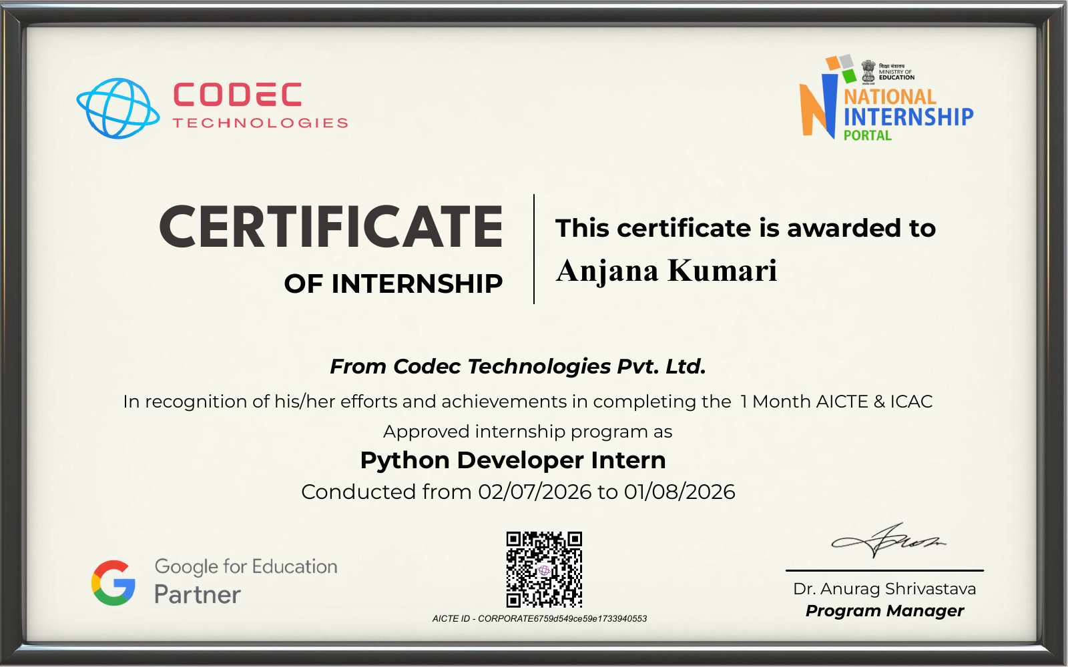
Internship Certificate
Certificate issued by Codec Technologies Pvt. Ltd.
Summer Internship 2026 • IILM University, Greater Noida
7

Slide 8
Internship Takeaways
A concise closing summary
Professional Exposure
Completed a structured 1-month internship as a Python Developer Intern.
Academic Relevance
The internship complements the B.Tech CSE academic journey with industry-oriented exposure.
Completion
Internship conducted from 02 July 2026 to 01 August 2026 and formally certified.
Summer Internship 2026 • IILM University, Greater Noida
8

Slide 9
THANK YOU
Anjana Kumari
B.Tech CSE • 3rd Year • IILM University, Greater Noida
Summer Internship • Python Developer Intern • 2026

