Slide 1

Karnataka Company Registration Analysis
SQL Data Cleaning & Power BI Dashboard
Prepared by: Gouri N Parvatagoudar & Anjana Nadig
Role: Data Analyst

Slide 2

Project Objective & Dataset
Objective:
Dataset:
Clean and standardize Karnataka RoC data
Assign accurate districts
Build interactive dashboard
Source: Open Government Data (OGD) Platform India
Dataset Name: RoC Company Master Data
Key fields: CIN, Address, Registration Date, Capital, Status

Slide 3

Data Cleaning in SQL
Data Exploration & Profiling
Duplicate Record Elimination
NULL Value Management
Row_ID Creation & Primary Key Enforcement
District Column Creation
Address Format Standardization
District Normalization via Address-Based Validation
Controlled Updates & Final Validation

Slide 4
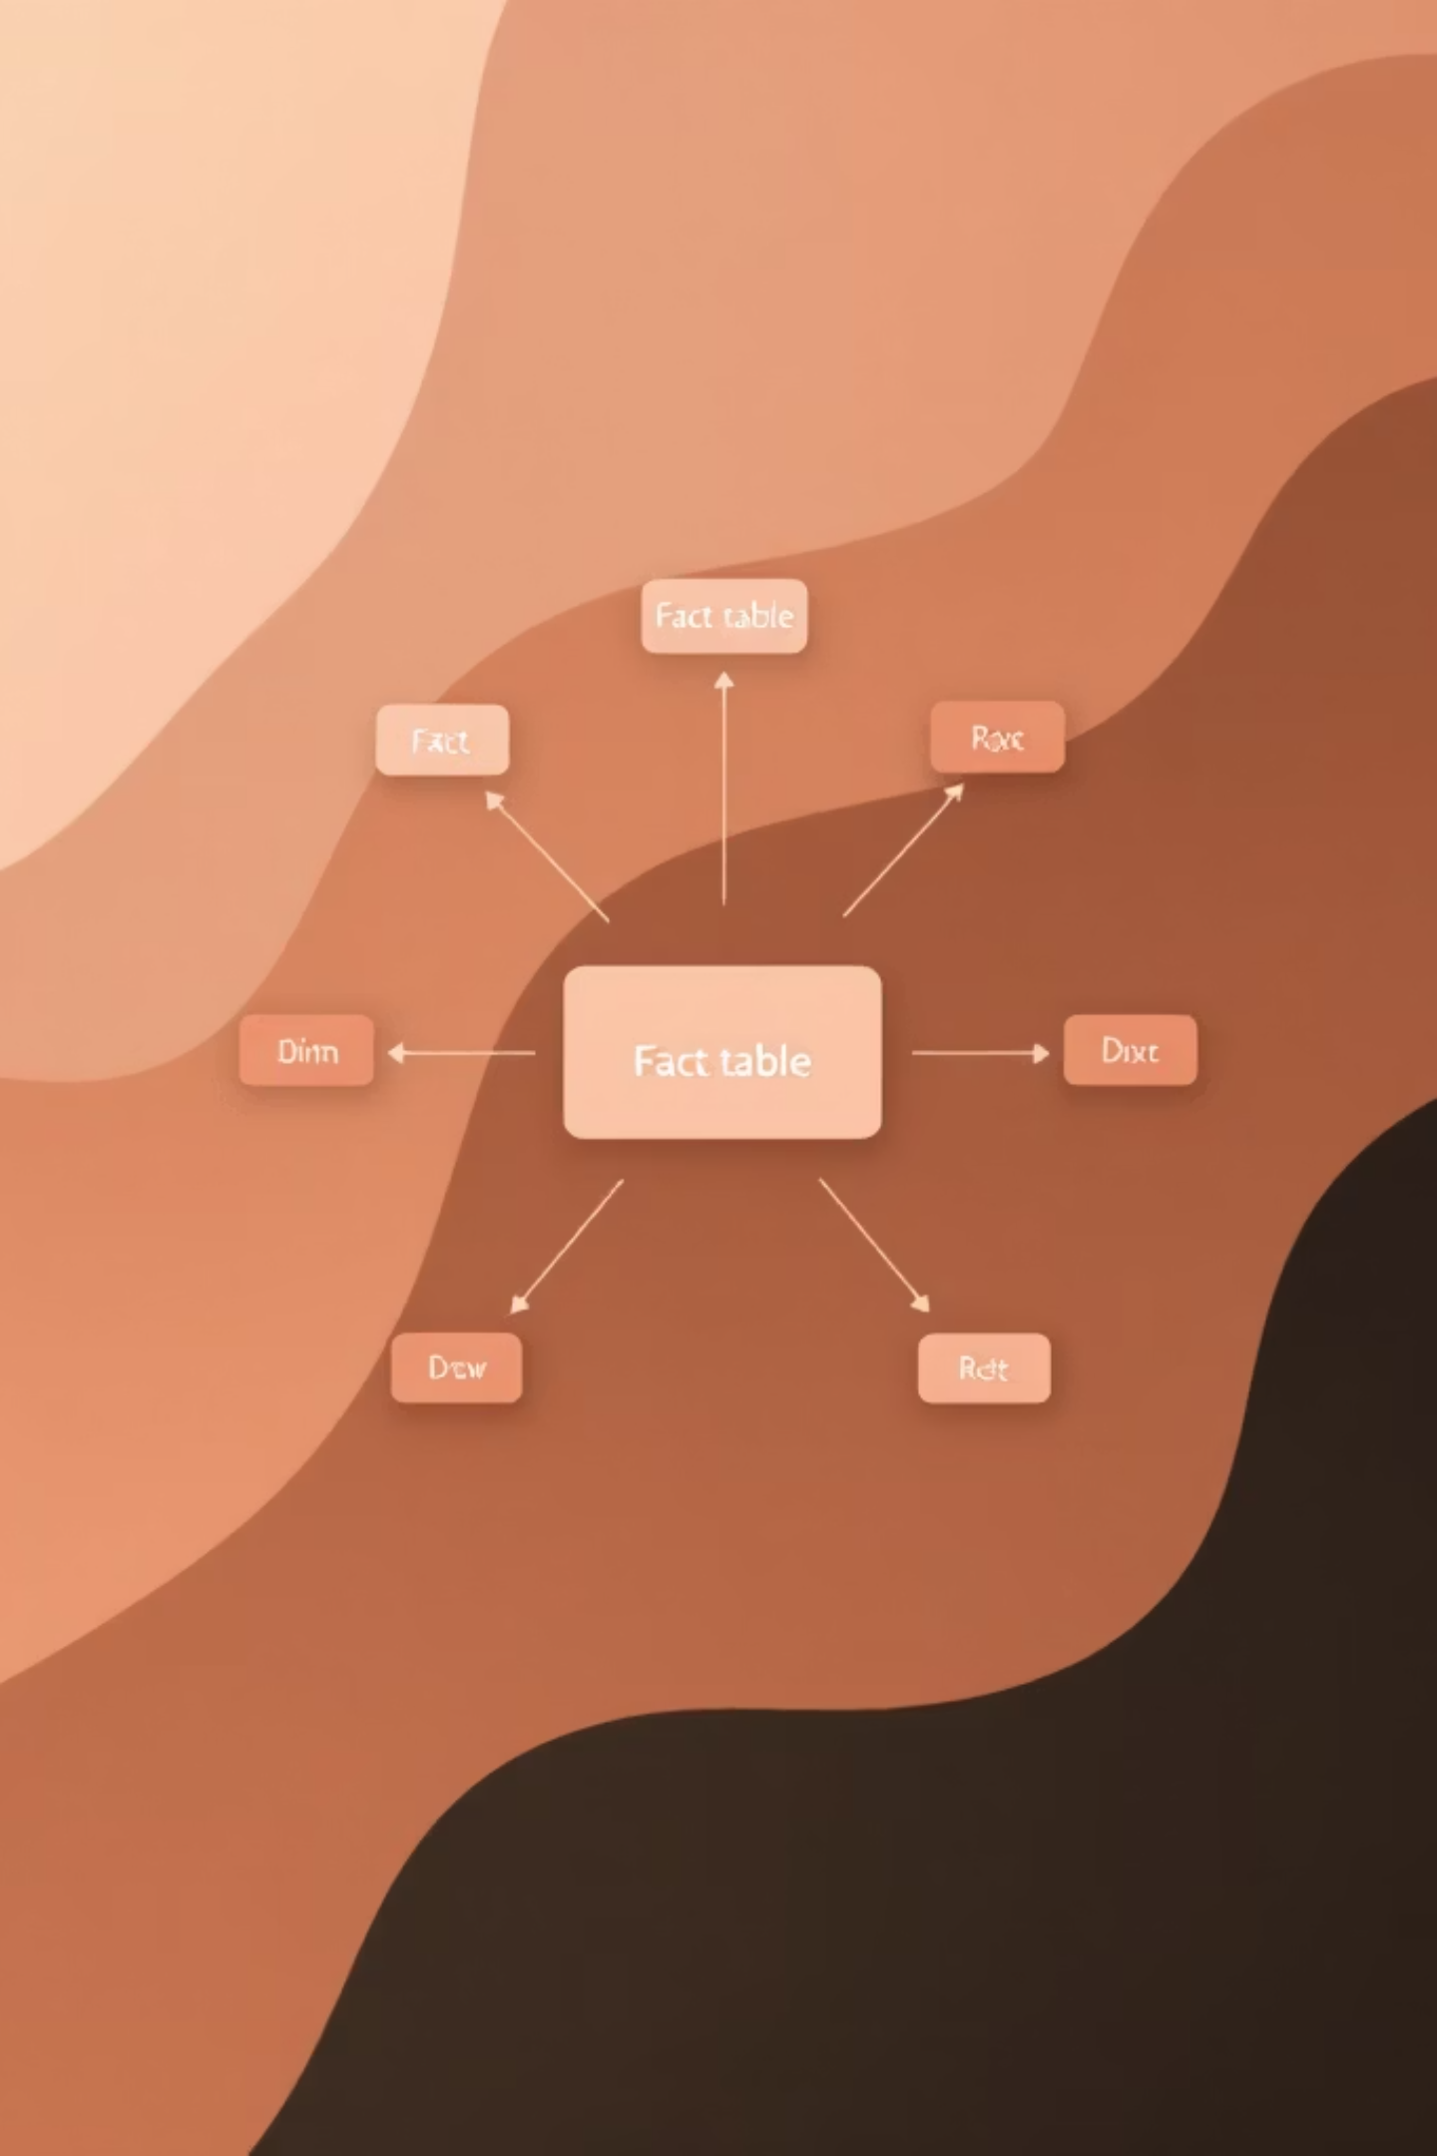
Data Modeling in Power BI
01
02
Imported cleaned SQL dataset
Created Star Schema
03
Established One-to-Many relationships
Fact Table:
Dimensions:
Company Master
Date
District
Status
Company_Type
NIC

Slide 5
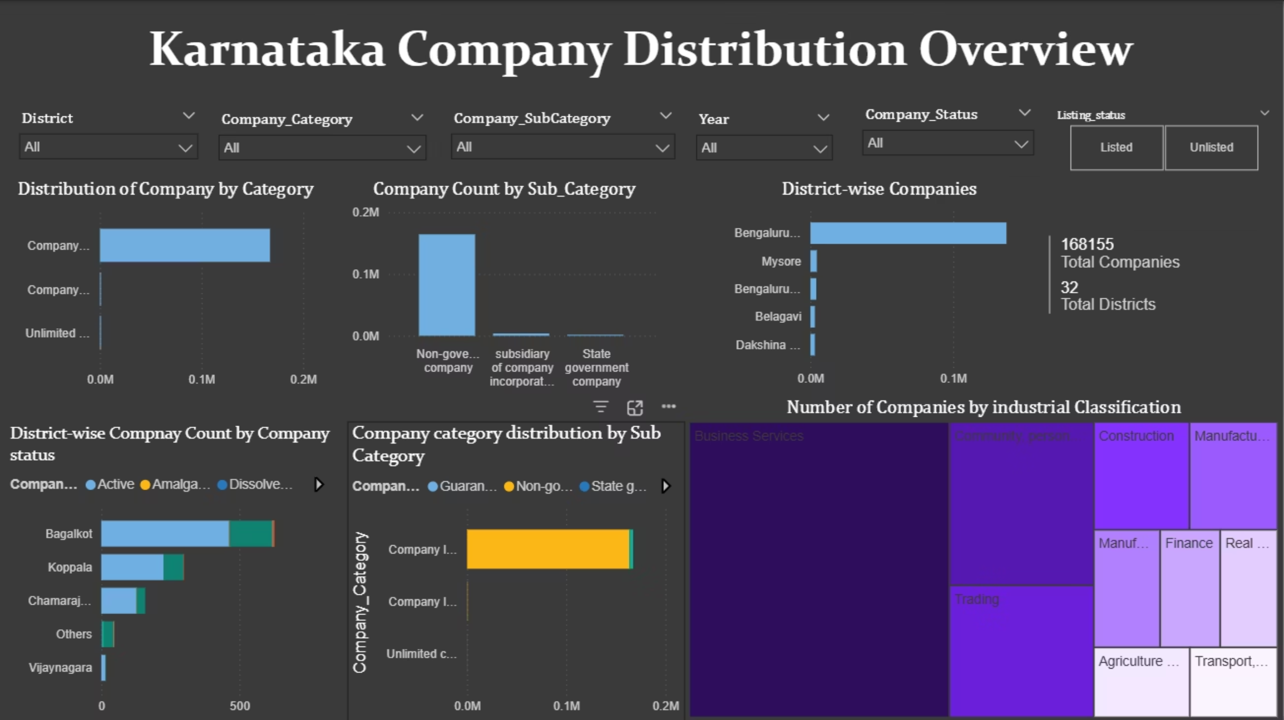
Dashboard Overview

Slide 6

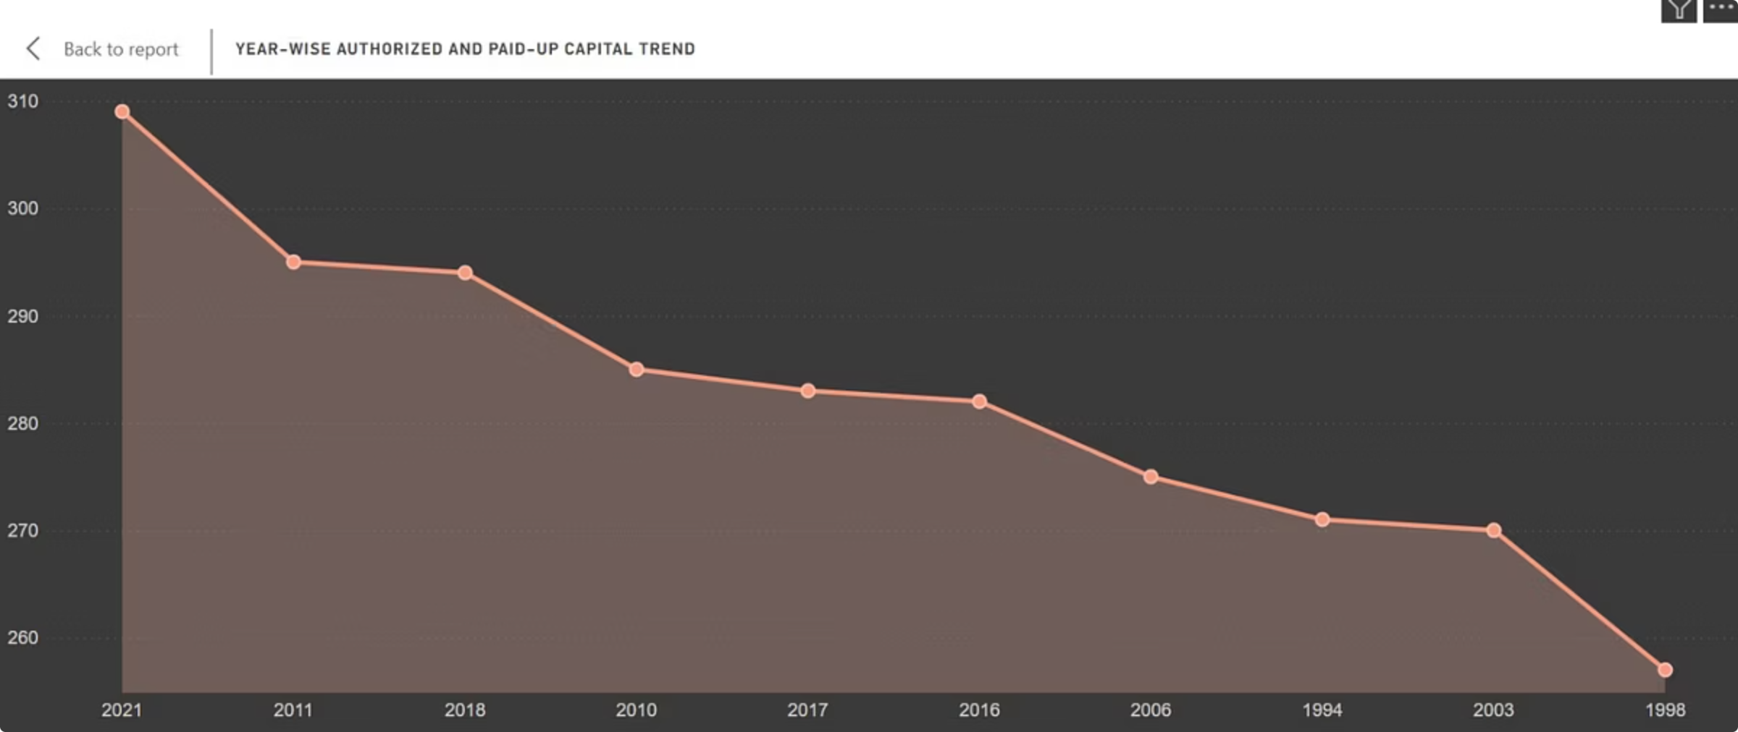
Registration Trend Analysis
The year-wise trend reveals clear patterns in company registration activity across Karnataka.
Analysis Shows:
Growth pattern
Peak registration years

Slide 7

Key Insights & Challenges
Insights:
Challenges:
Bengaluru Urban dominates company registrations
Majority companies are Active
Clear year-wise growth trend observed
Standardized district mapping improved analytical accuracy
Duplicate and inconsistent records
Address-based district ambiguity
Extensive address verification for district normalization
Many-to-one relationship modeling issue
Raw district spelling variations

Slide 8
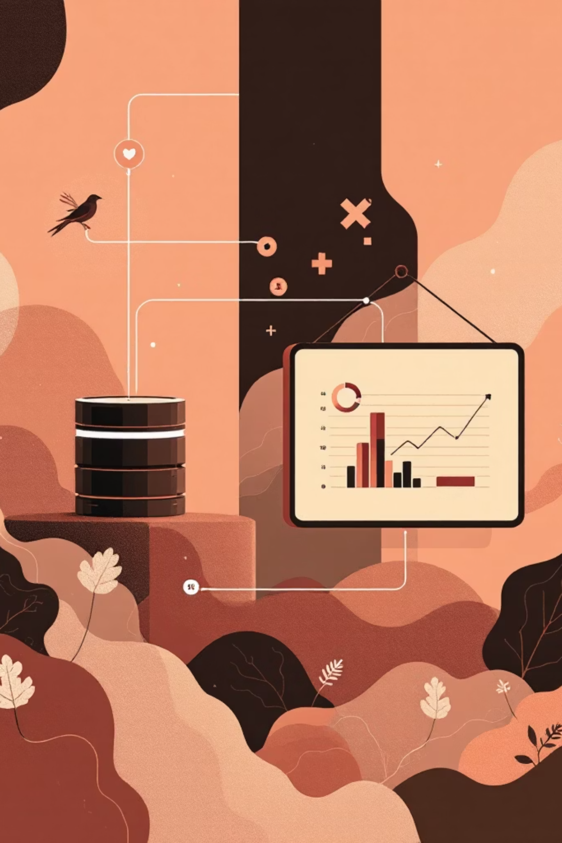
Conclusion
This project successfully standardized and modeled RoC Karnataka data to deliver reliable district-level business insights through structured SQL processing and Power BI visualization.
Demonstrates end-to-end data analytics workflow from raw data processing to insight generation.
Future Scope
Industry and capital-based segmentation
Predictive growth analysis
Automation of mapping logic
Scalable deployment for multi-state analysis

Slide 9
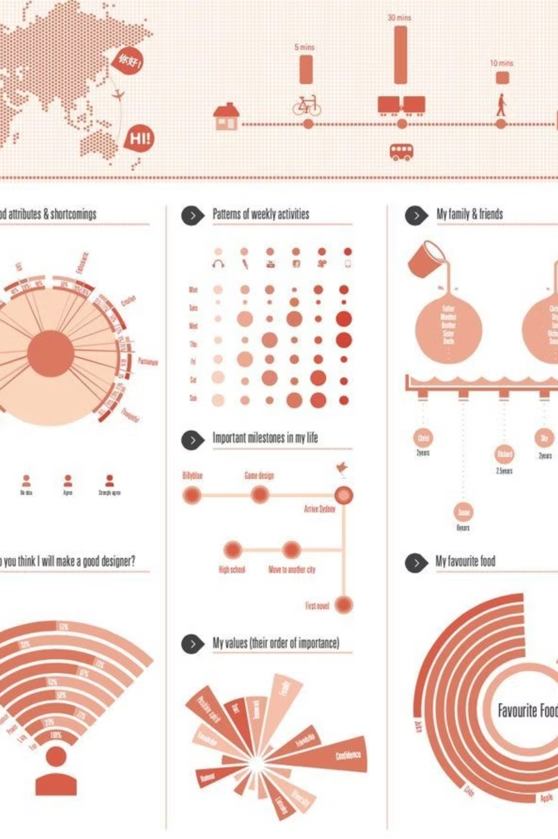
Thank You!
We appreciate your time and attention.

