Slide 1
Popularity insights

Slide 2
agenda
Top 5 Popular categories
Popularity Growth
Types of reaction by category
Reaction by sentiment
Insights

Slide 3
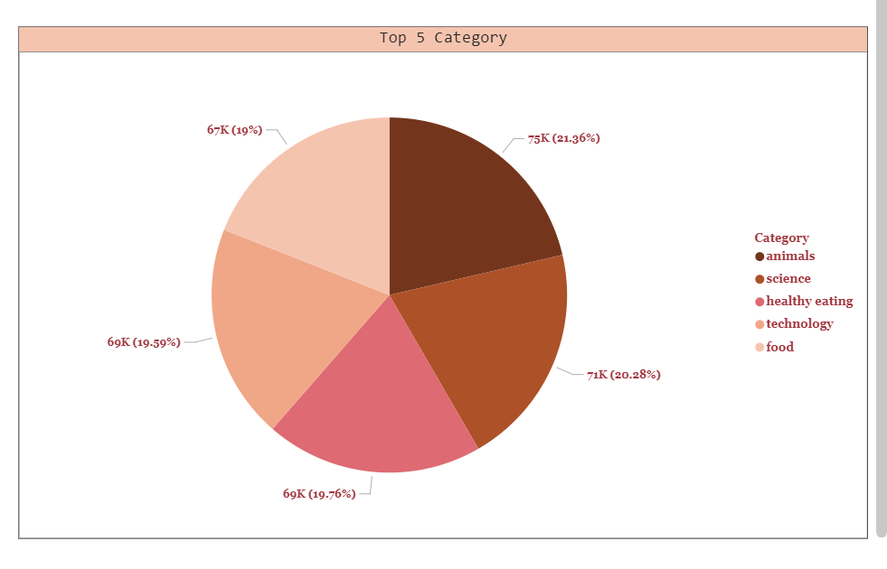

Top 5 Popular categories

Slide 4
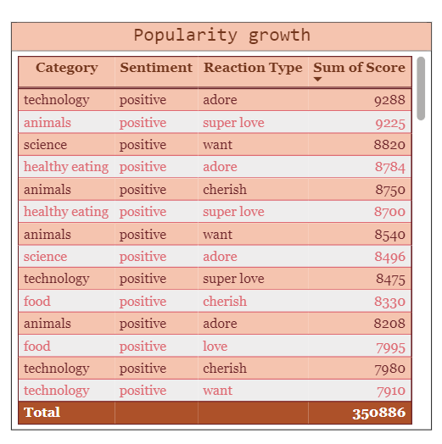
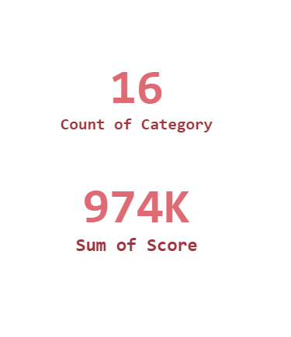

Popularity Growth

Slide 5
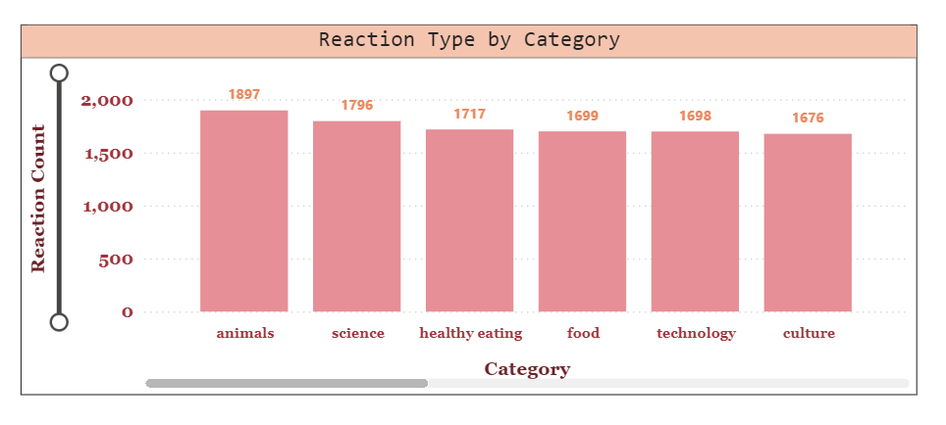

Types of reaction by category

Slide 6
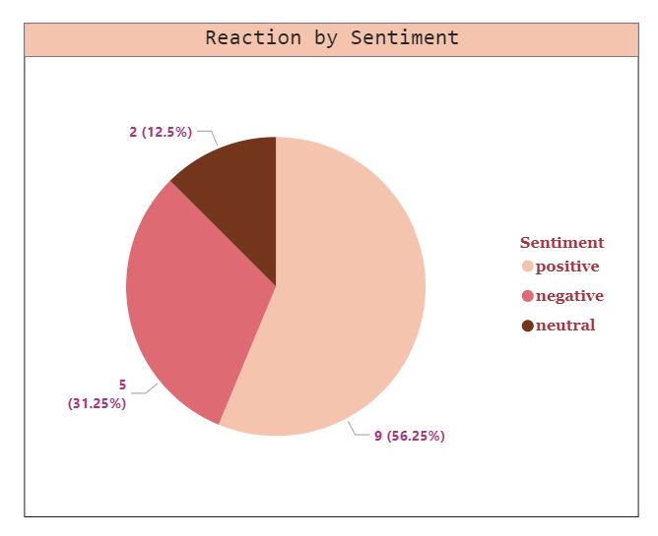
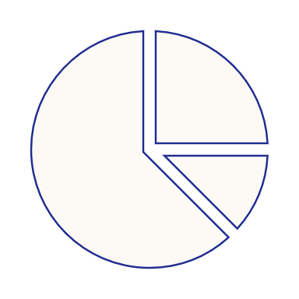
Reaction by sentiment

Slide 7

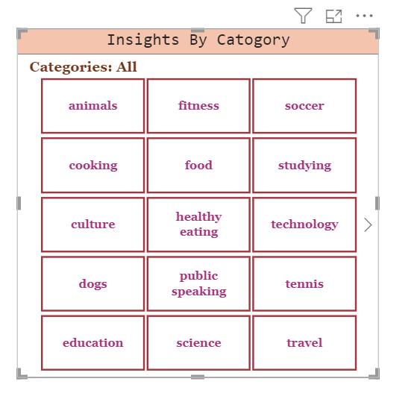
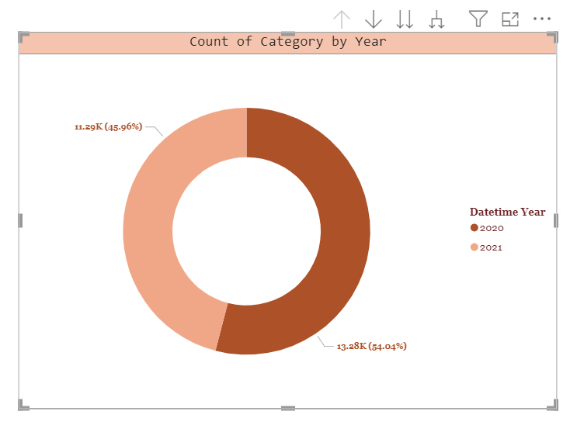

Insights : year and category

Slide 8
Summary insights
Animals
Science
Healthy Eating
Technology
Food
ANALYSIS
The categories of Animals and Science are the most popular among users.
Since the trend for new technology takes 4th place , a wide range of audience favor science and technology.
Animals tops the chart with the most engagements.
INSIGHT
Healthy Eating and Food takes 3rd and 5th place respectively as a prominent theme among the top five categories, suggesting that this resonates well with your audience.
This insight could be leveraged to develop a campaign in partnership with healthy eating brands, enhancing user engagement.

Slide 9
Thank you

