Slide 1

Project Title: Blood Bank Management System (BBMS) Course: CST8334 Software Development Project

Slide 2
Project Overview
Purpose: To provide a seamless platform for blood donors and recipients.
Technologies Used: React (Frontend), Node.js/Express (Backend), MongoDB (Database)

Slide 3
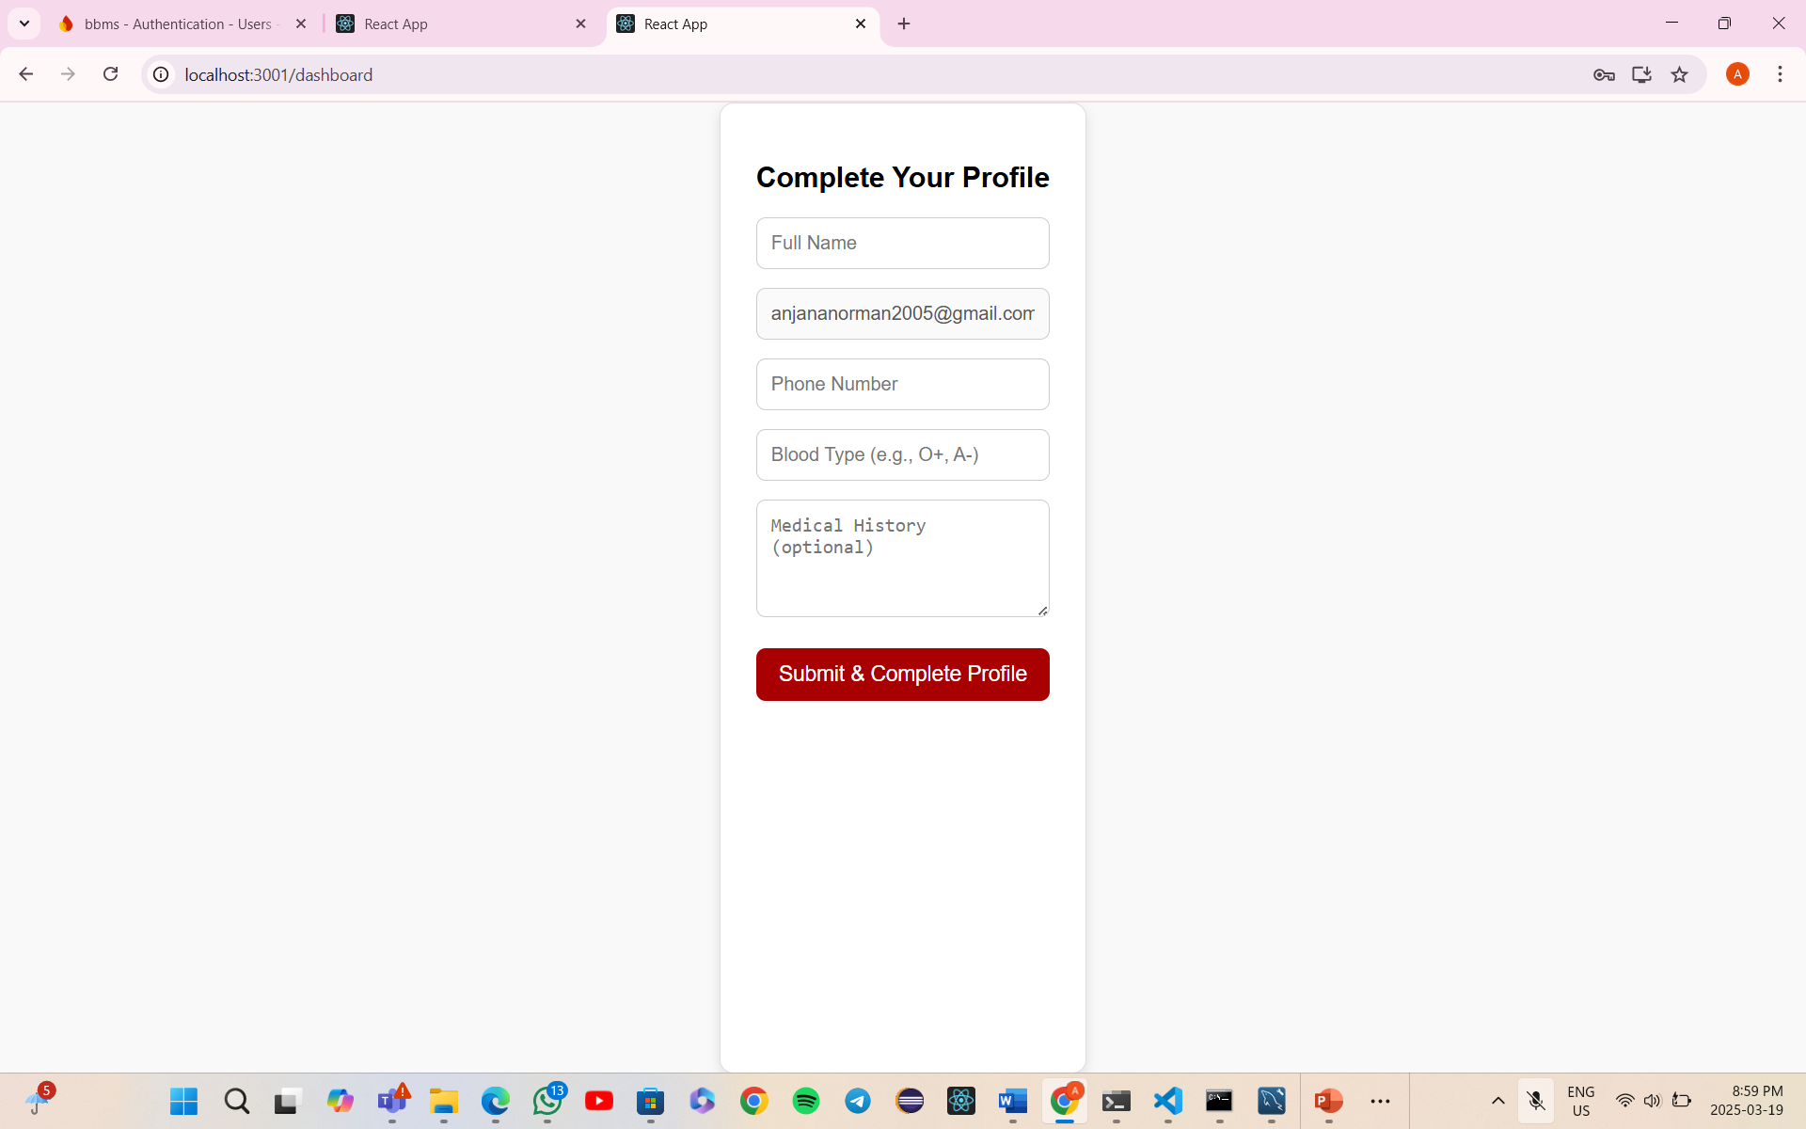

Slide 4
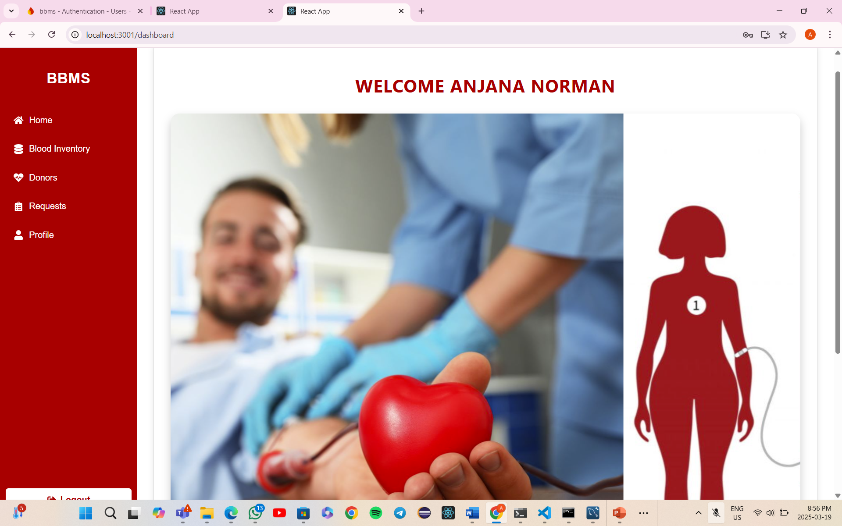

Slide 5
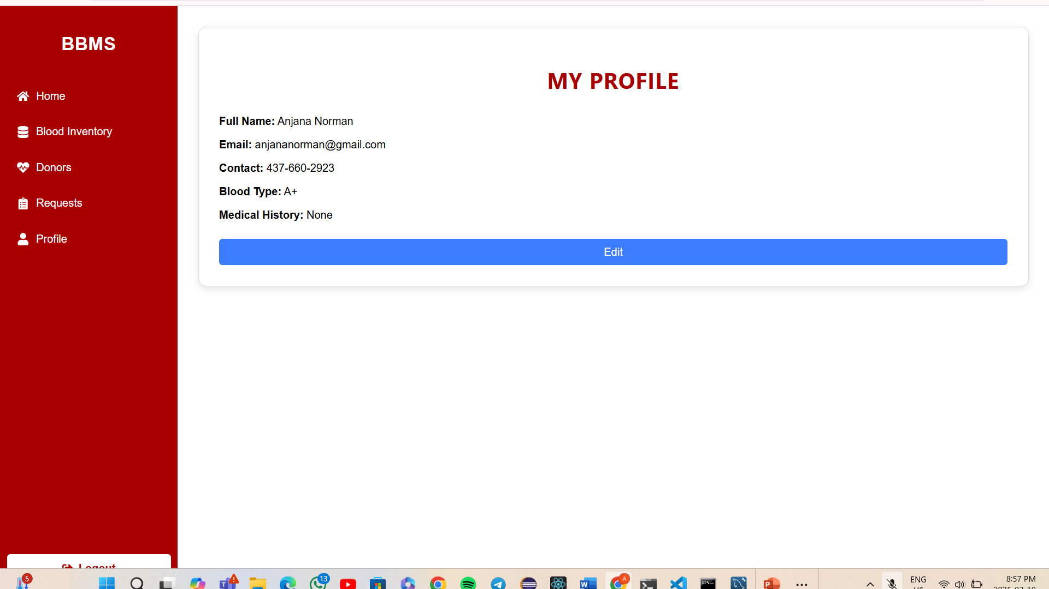

Slide 6
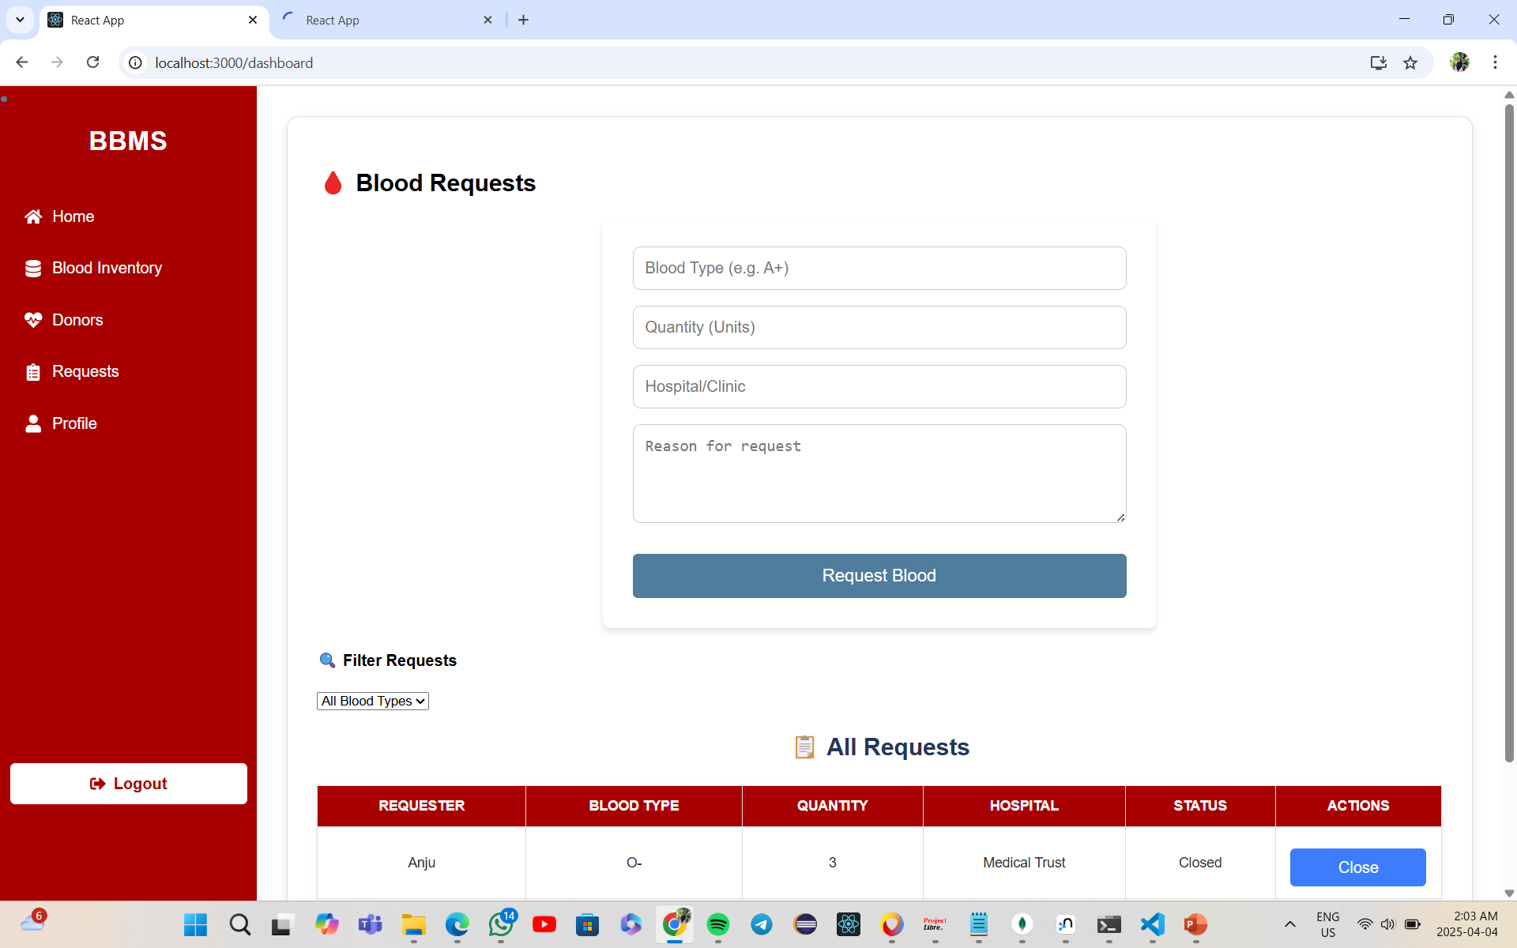

Slide 7
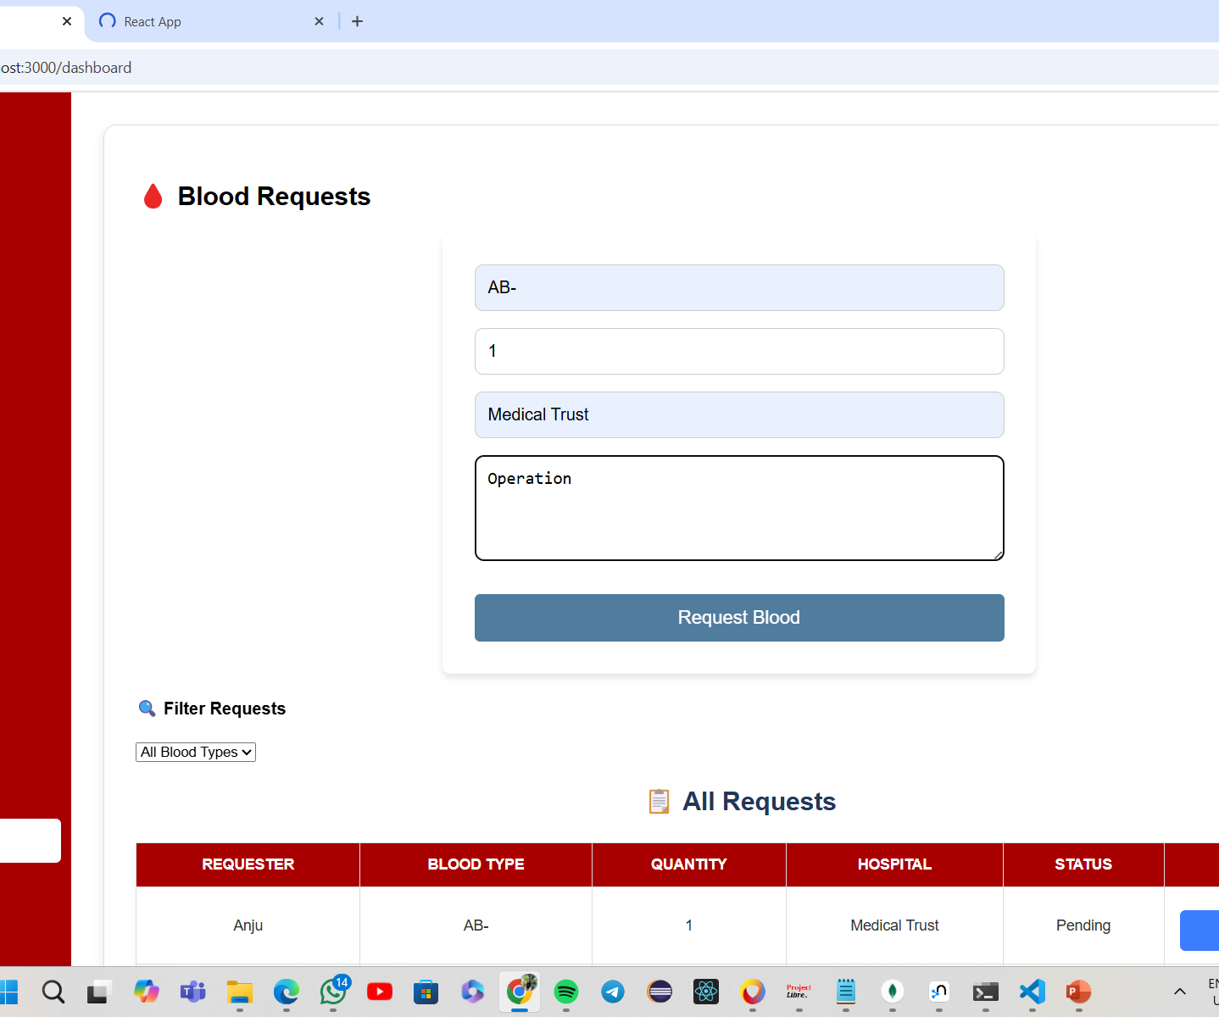
Request feature

Slide 8
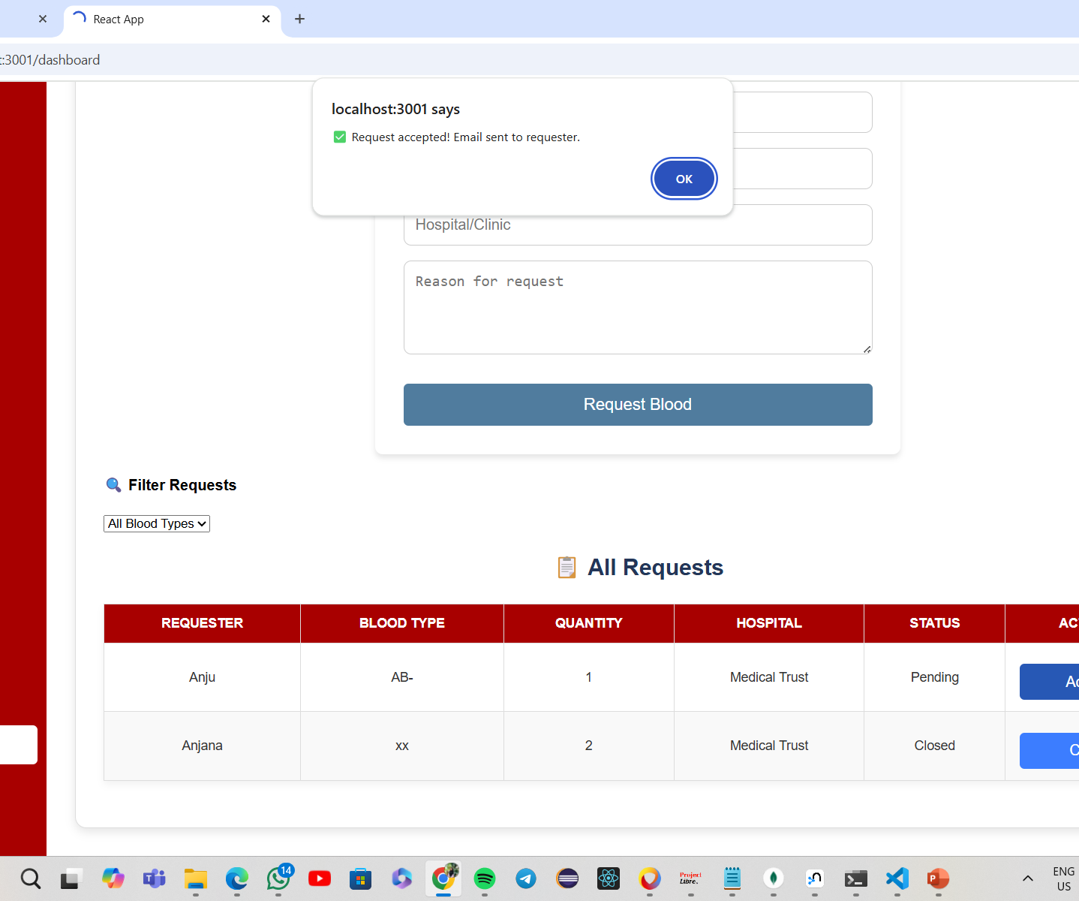
Accepting Request

Slide 9
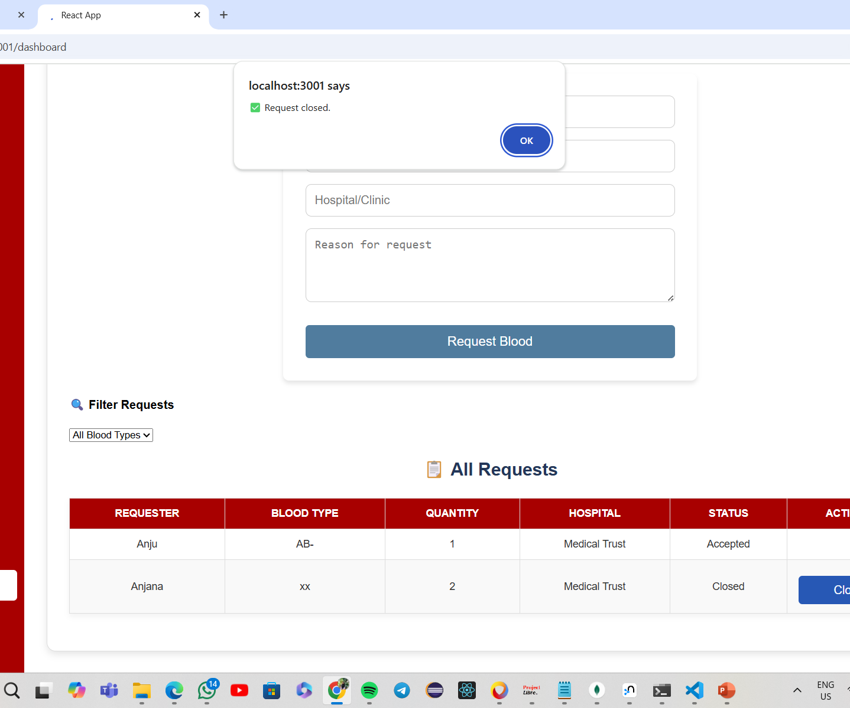
Closing Request

Slide 10
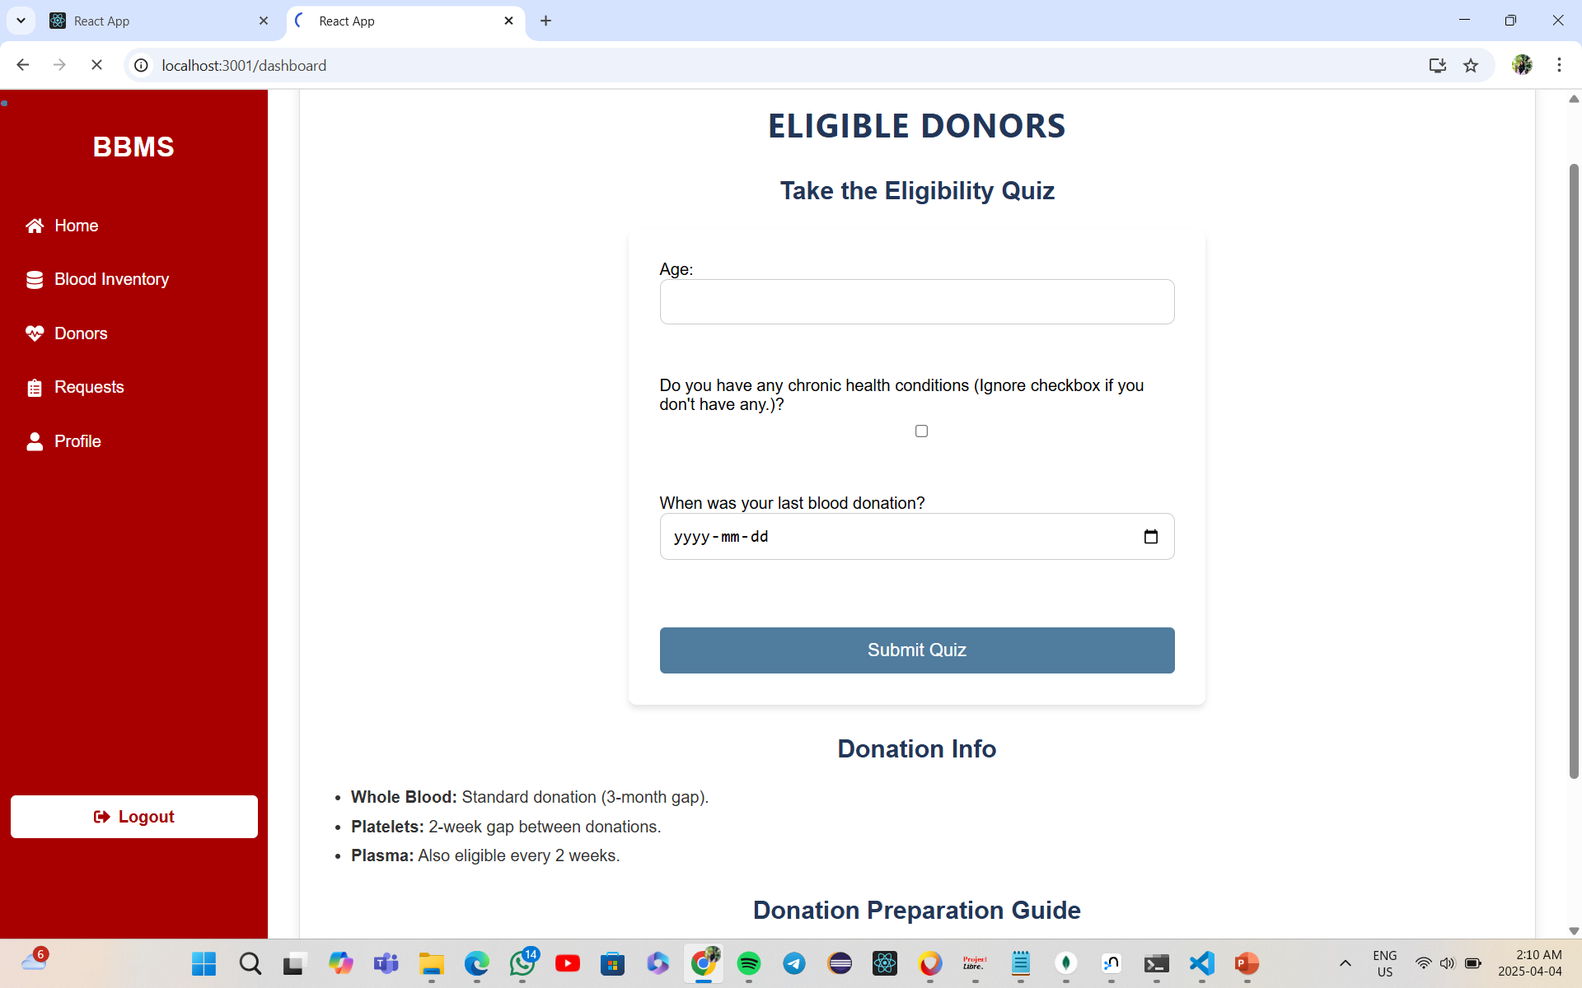

Slide 11
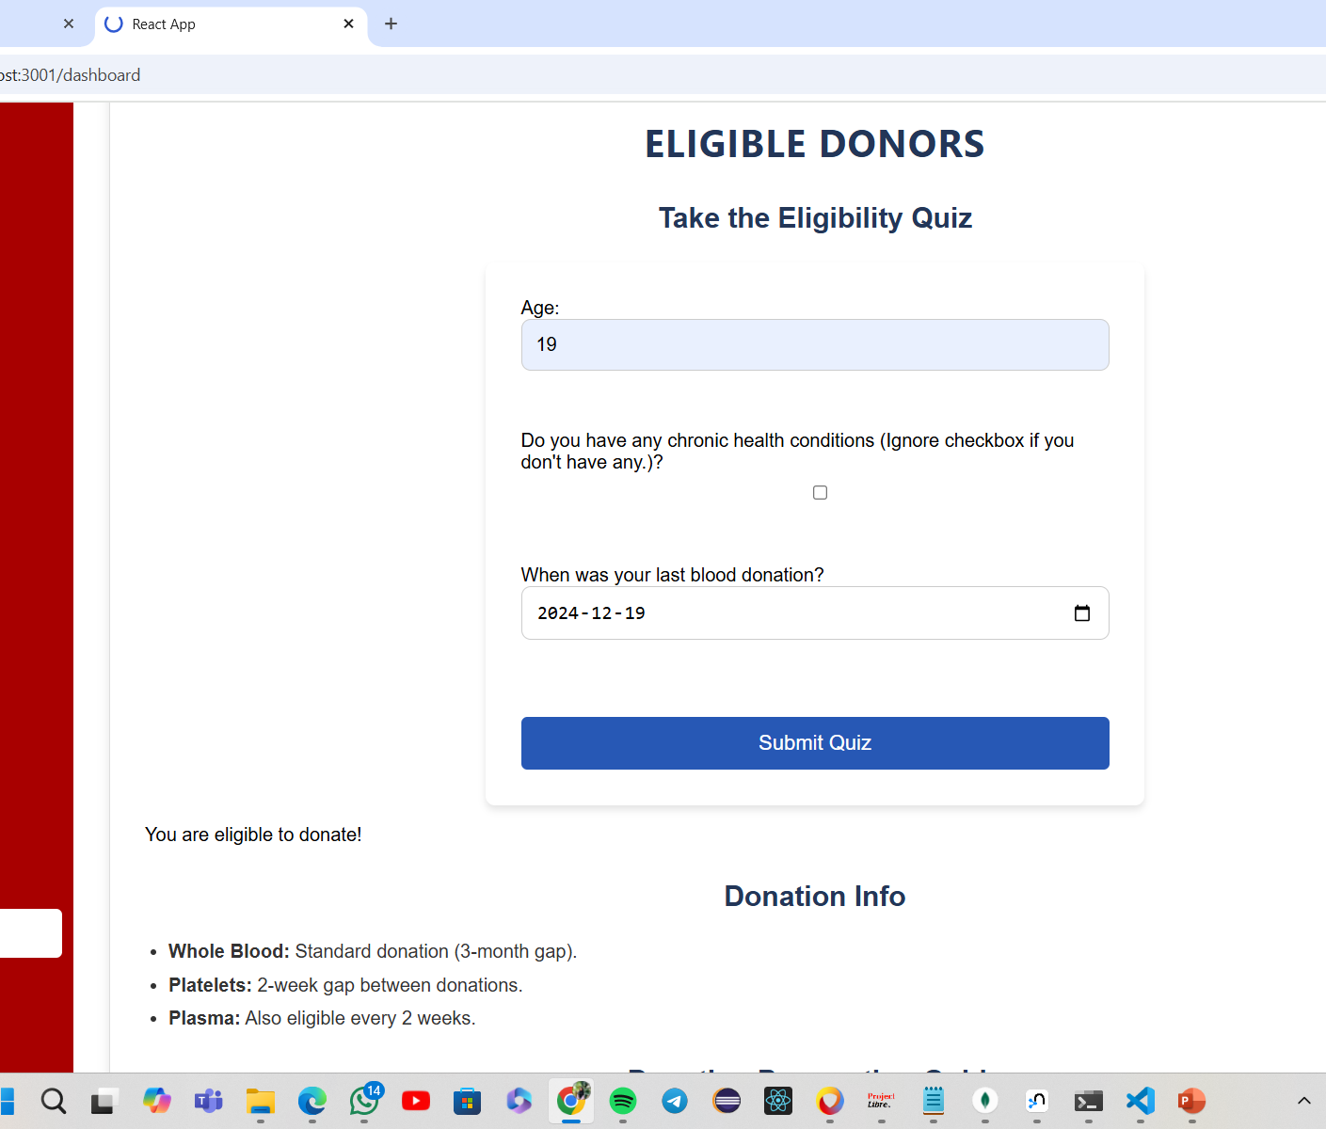
Eligibility Quiz

Slide 12
