Slide 1
SCENARIO: how to change password of a logon user.

Slide 2
CHANGE PASSWORD OF LOGON FACEBOOK USER
User login – username and password.
Home page – top right corner scroll down arrow.
Click the arrow and select SETTINGS from scroll list.
There are few settings with edit option corresponding to them.
Select edit option corresponding to PASSWORD.
There appears three text boxes i.e. CURRENT PASSWORD, NEW PASSWORD and RE – TYPE NEW PASSWORD.
Enter the same in all text boxes and click SAVE to save the changes.
Dialog box appears in response responding to password change request with either successful or unsuccessful password change result.

Slide 3
TEST CASE
Title: CHANGE PASSWORD – Authenticate successful password change.
Description: A logged in user must be able to change the password successfully.
Precondition: The user must be logged in facebook before changing the password.
Assumption: A supported browser is used.
Test Steps:
Log in to Facebook.
In home page top corner scroll down arrow click SETTINGS
option in scroll list.
Choose edit option corresponding PASSWORD.
Fill in the mandatory text boxes satisfying field
requirements.
Click on the SAVE button to save the changes.
Expected Result: A dialog box must appear displaying
password change is successful.

Slide 4
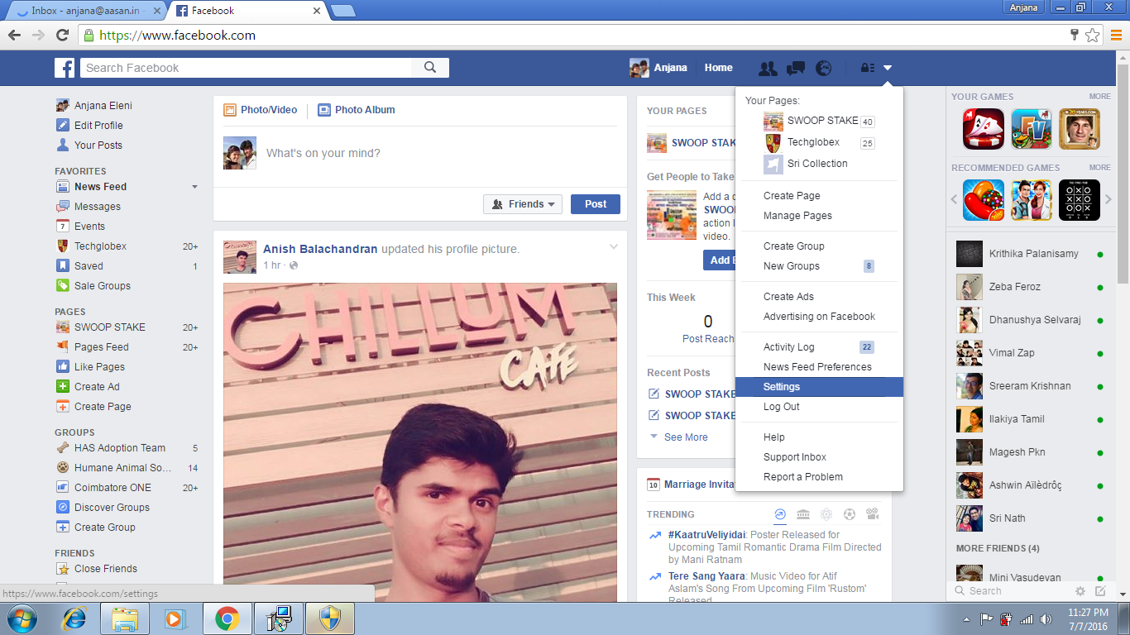

Slide 5
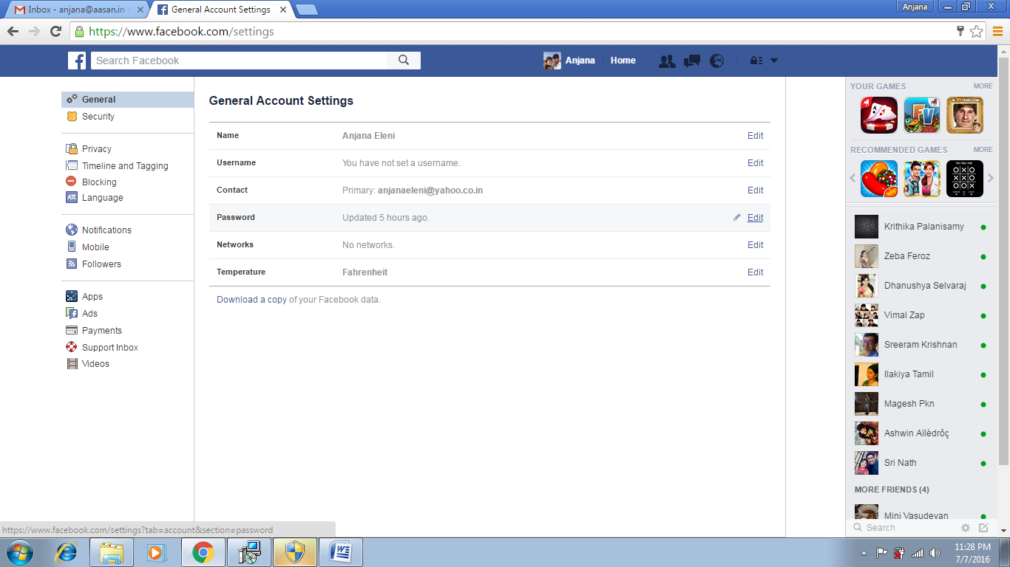

Slide 6
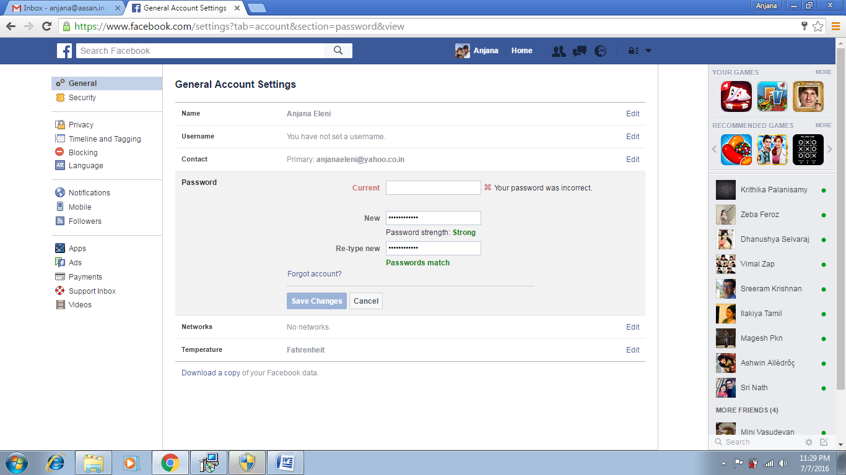

Slide 7
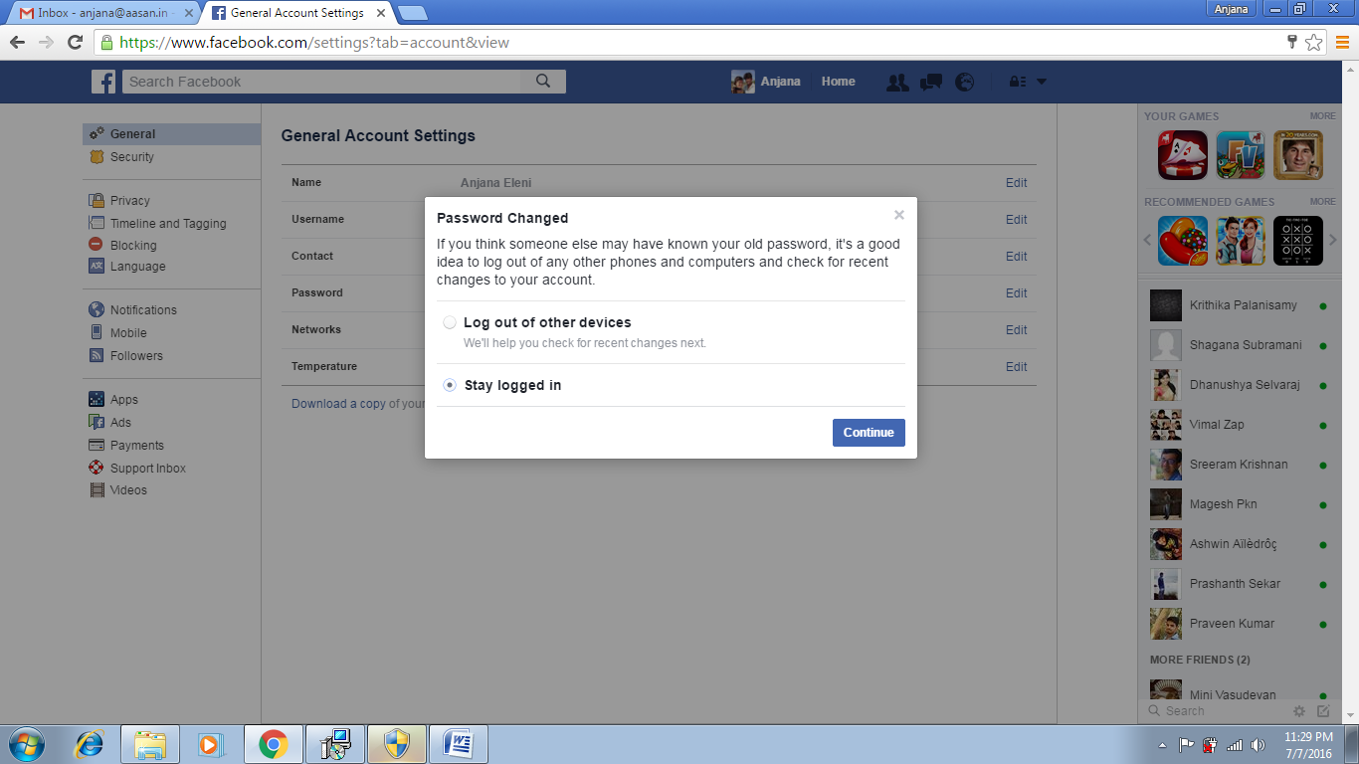

Slide 8
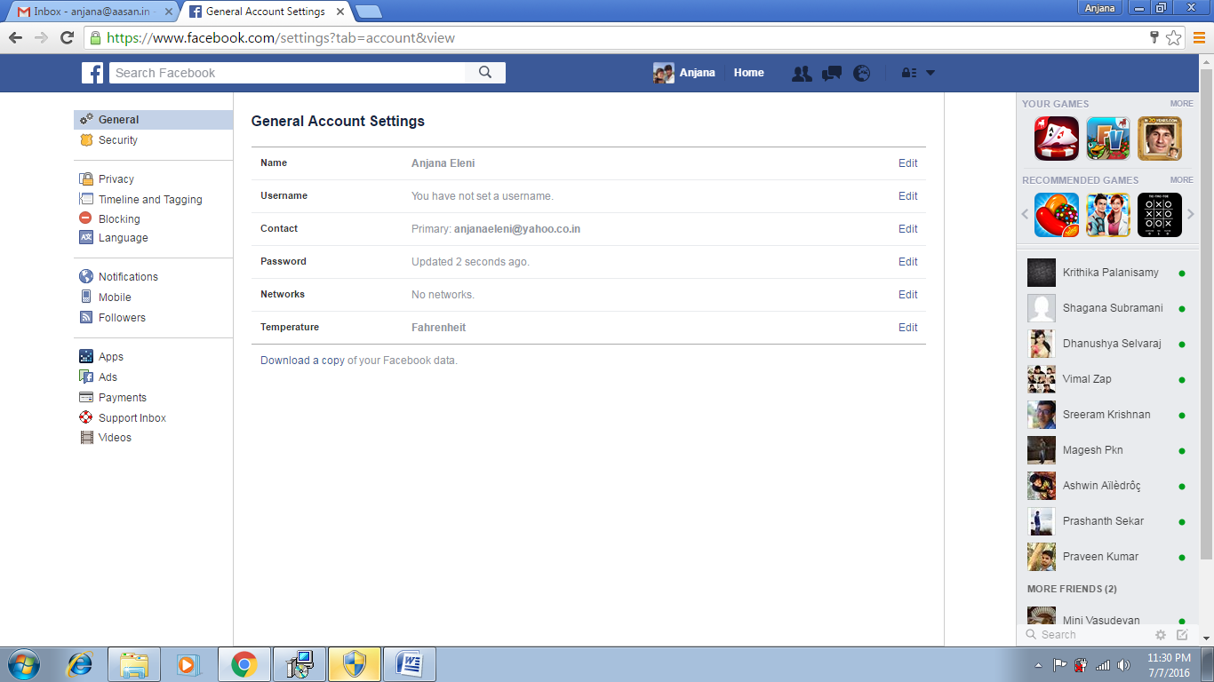

Slide 9
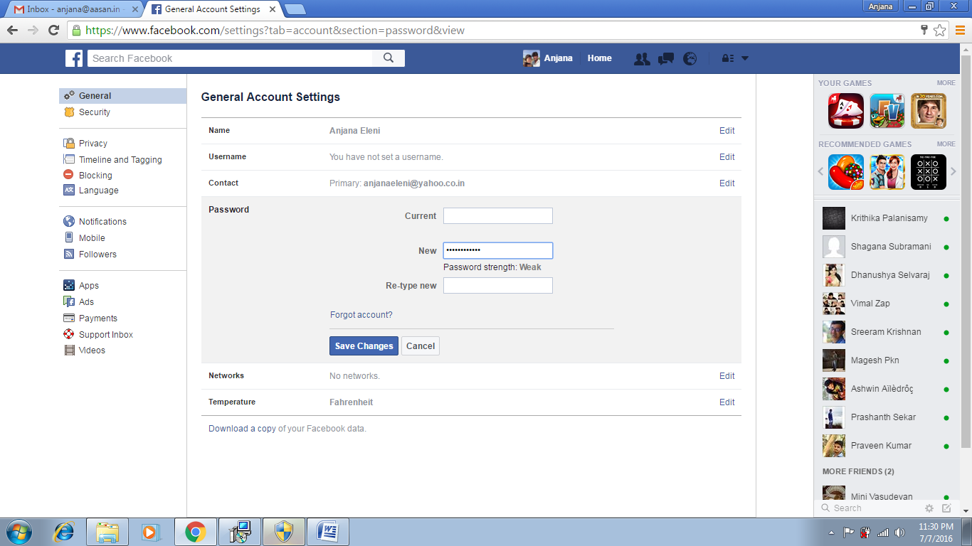

Slide 10


Slide 11
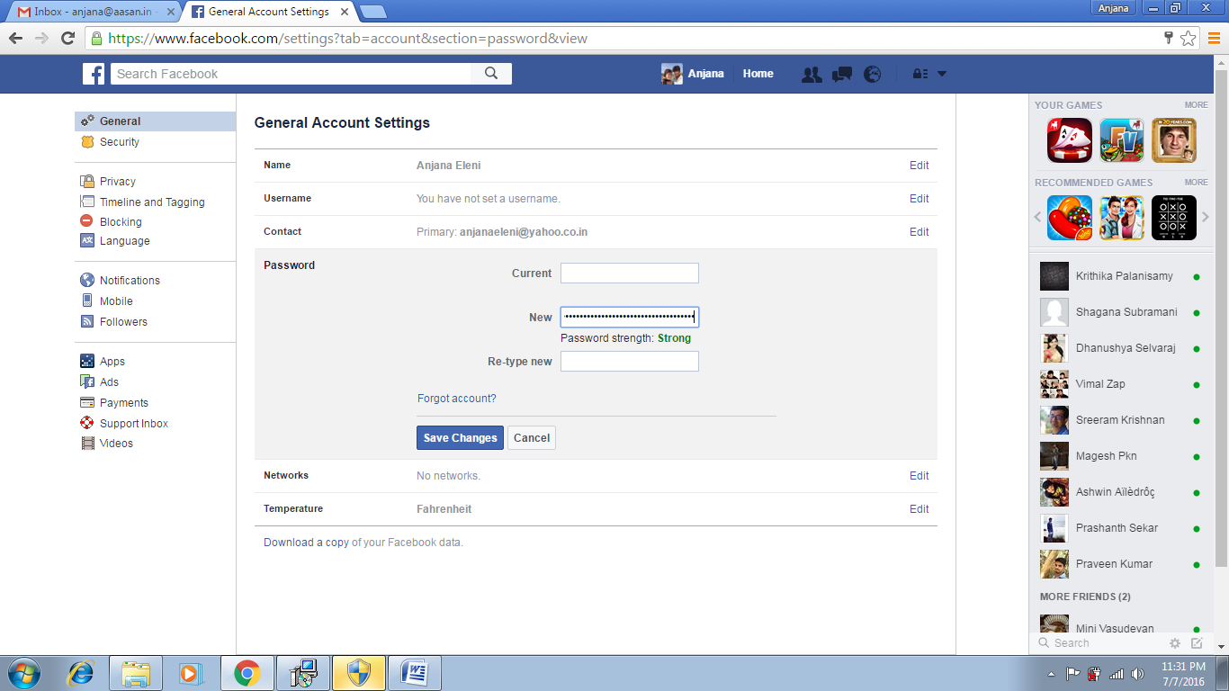

Slide 12
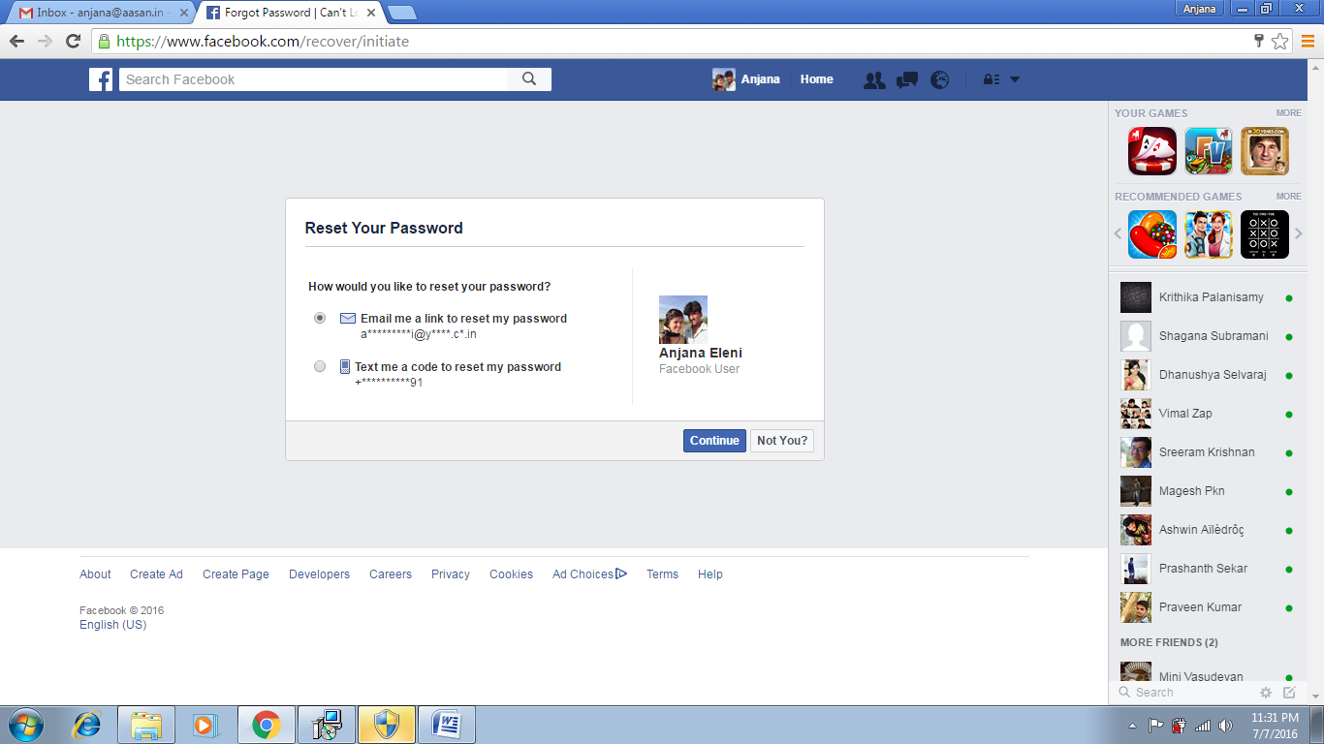

Slide 13
