Slide 1
Final Project A Deepdive on Regork Campaigns completejourney
STATISTICAL COMPUTING

Slide 2
Improve Sales through Overall Campaign Performance and suggest Operational changes Regork
Regork ran multiple campaigns in the year 2017 to boost sales and increase revenue.
The goal of the case-study is to analyze the campaigns performance, select optimal package sizes and suggest the best ways to issue coupons to customers to enhance the total sales.
We utilized the completejourney dataset to identify trends and patterns in the data and generated insights to help the leadership make effective data-driven decisions.
Throughout the analysis, we identify the best-case practices and patterns in certain campaigns and suggest areas of improvement to simulate the poorer performing campaigns.

Slide 3
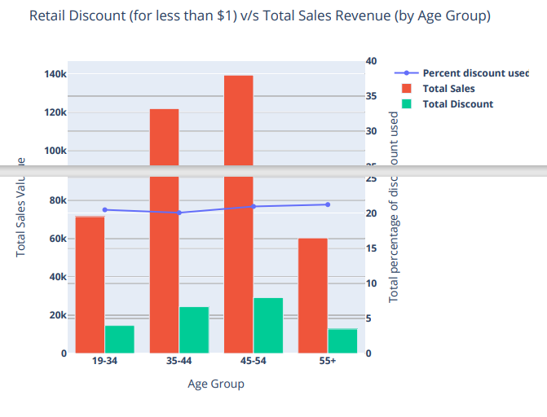
Retail distribution in relation to age groups
We noticed from plot below that revenue generated by issuing discounts to the 45-54 age group was higher compared to another age group. Discounts of above 5 dollars have produced little sales, so we can scale down on them.
Compared to other age categories, the 55 and older age group received the largest percentage of discounts.

Slide 4
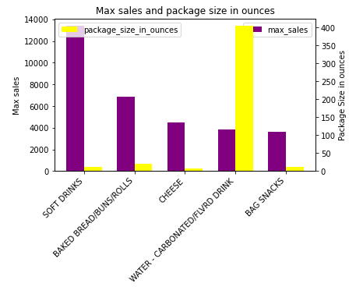
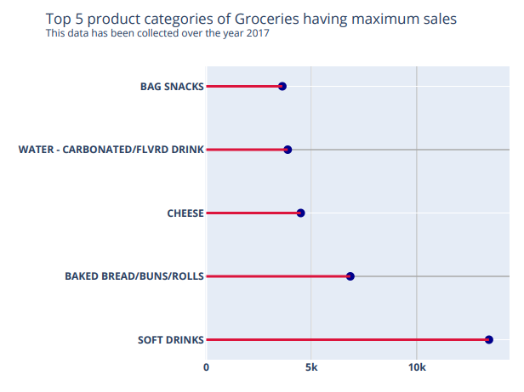
Package sizes generating highest sales for top 5 Grocery products
Drinking water and soft drinks packaged in 12-ounce portions generate the best sales.
Soft drinks are the top product based on sales value.

Slide 5
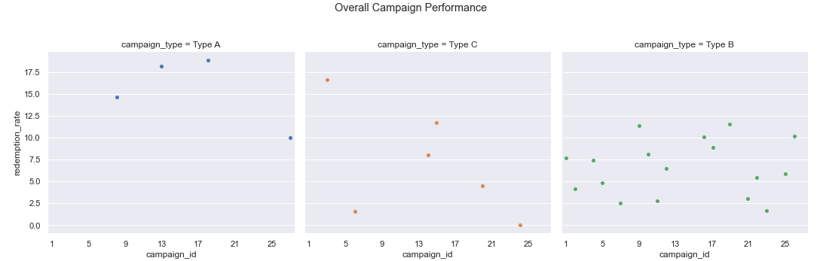
Overall Campaign Performance
The plot shows the overall performance of the campaigns based on the total redemption rates of the campaigns.
Clearly, Type A campaigns are performing better than the rest of the campaigns.

Slide 6
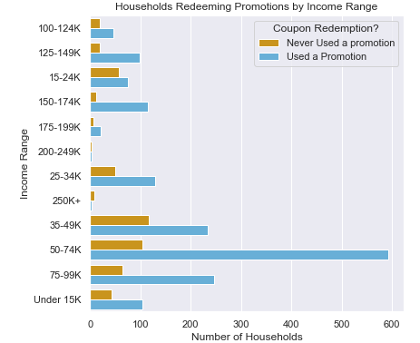
Coupon Redemptions Of Household – By Income Range
The graph shows income wise split for the households who redeemed the promotional benefits at least once versus the households who have not redeemed the coupons.
Notice that, households with a family income between 50-74K are more likely to
redeem the coupons followed by households with income range between 35-49K.
Proposed Solution:
Households with a family income of 100K and above have been least targeted
by campaigns. As they are high income generating households, there is a good
Probability that focused campaigns on these income ranges can boost the overall
Sales.

Slide 7
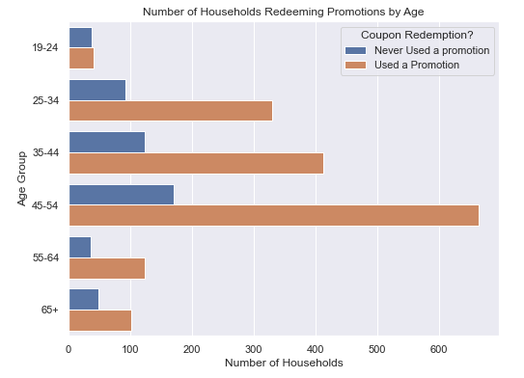
Coupon Redemptions Of Household – By Age
The graph shows age wise split for the households who have redeemed the promotional benefits at least once versus the households who have not redeemed the coupons.
Age group between the period of 45-54 has the highest number of campaign
promotional redemption users followed by the age group 35-44.
Proposed Solution:
Young adults in the age group of 19-24 and older citizens above age 55 have
been least targeted by campaigns and have the least promotional benefit users.
This represents an opportunity to specifically direct efforts to launch campaigns
for these age groups.

Slide 8
Summary and Future Scope
Target 45-54 age group while giving discounts since its yielding higher sales.
Drinking water and soft drinks packaged in 12 ounce portions to be sold more as they generate the best sales.
To attain Maximum redemption Rate, we should run the campaign on Households with a family income of 100k and above.
Young adults in the age group of 19-24 and older citizens above age 55 have been least targeted by campaigns and have least promotional benefit users. We can launch personalized campaigns for these age groups to boost sales.
Limitations
Coupon related sales information is not reflected in the transaction dataset. Hence the analysis was made for the total sales of the products targeted by the campaigns.
We have transaction data only for 2017 whereas campaign data is present from 2016 - 2018. Hence the analysis was limited to 2017. There is no granular information about the characteristics and other attributes about campaigns and coupon.
There were too many scales of package sizes. We have carried out our analysis towards pounds and ounces.

