Slide 1
AI ML

Slide 2
Topics Covered
KNN Model
Getting the data ready
Treating Missing Values
Outliers
Confusion Metrix
Accuracy
Precision
Recall
AUC Curve
Cross validation
Benchmark models
EDA techniques

Slide 3
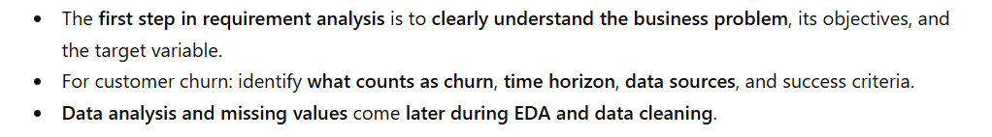
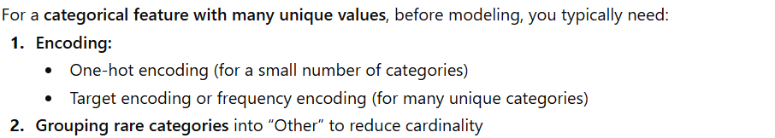
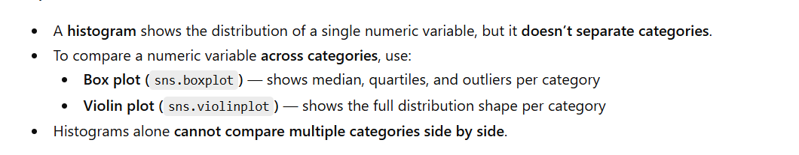

Slide 4
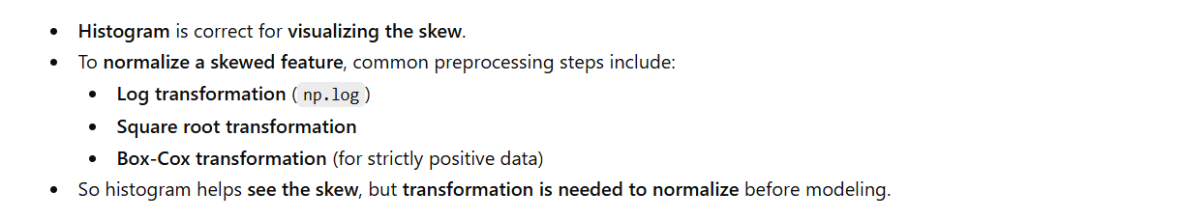
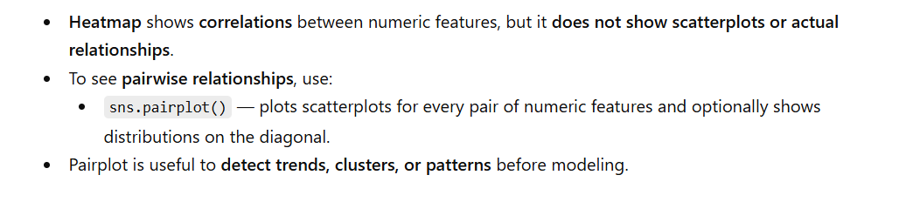
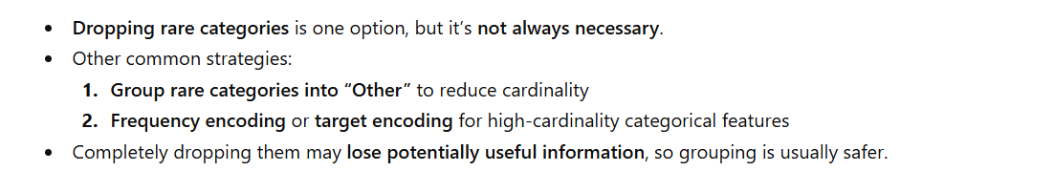

Slide 5
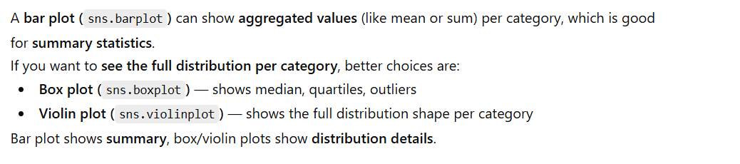
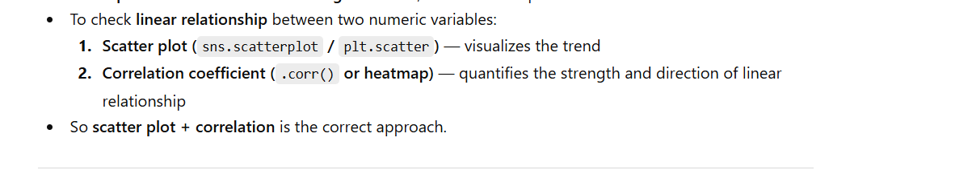

Slide 6
Definitions
Prediction: Model response. TP out of TP+FP. For unbalanced dataset
Recall: TP out of TP+FN. Useful for disease detection. FN to be kept low. This is for unbalanced data set.
Actual: Existing test values
Accuracy: How many predictions are correct. Accuracy is for balanced dataset.
Decision boundary: A decision boundary is the line or surface that separates different classes in a model’s feature space.
RMSE: This is an error matrix. To be kept low.
R2 Square: Calculate Model efficiency. To be High.
Hypothesis Testing: If there are less columns in a data set we go for hypothesis testing.

Slide 7
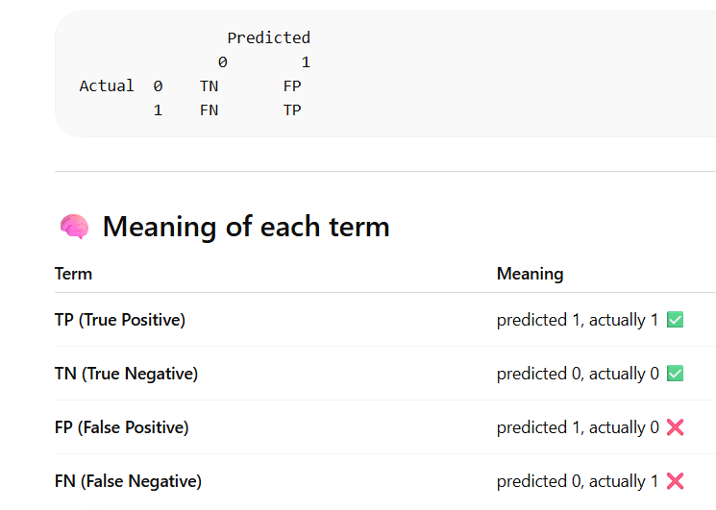
Confusion Matrix

Slide 8
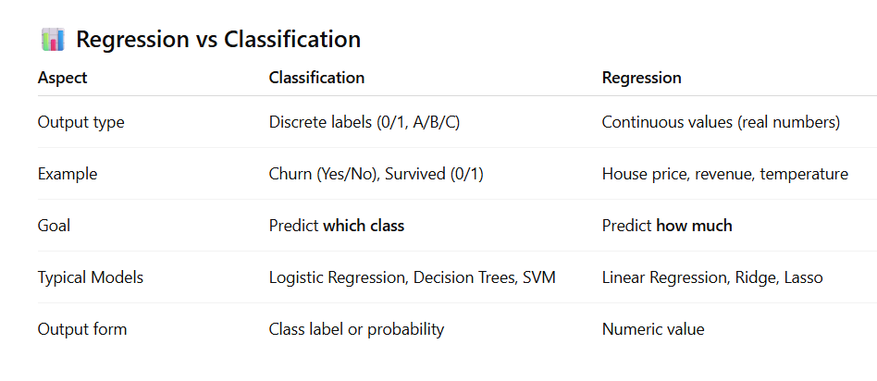

Slide 9
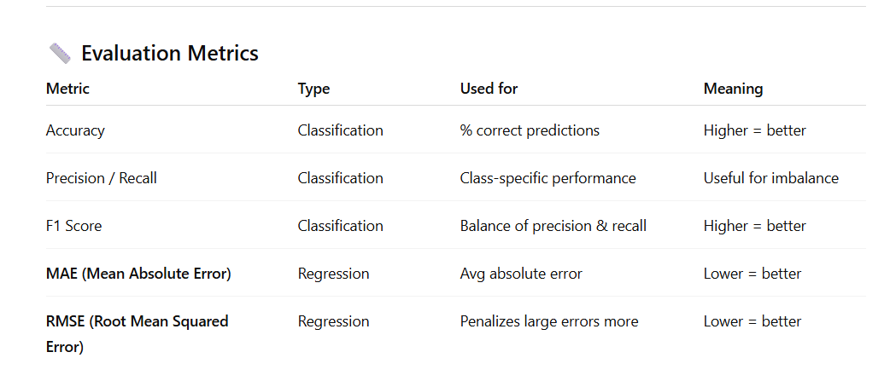

Slide 10
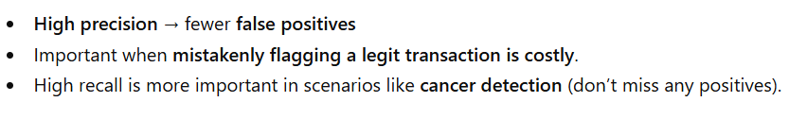
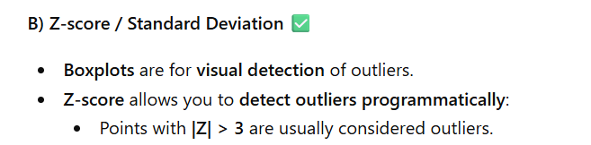
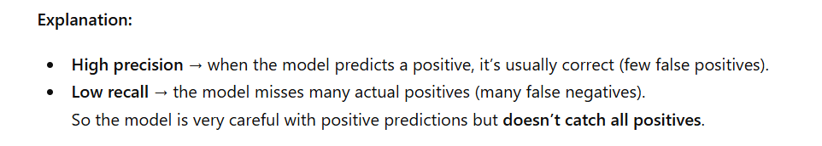

Slide 11
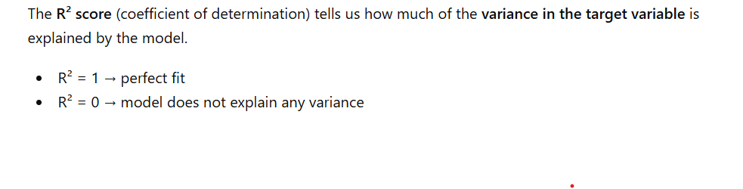

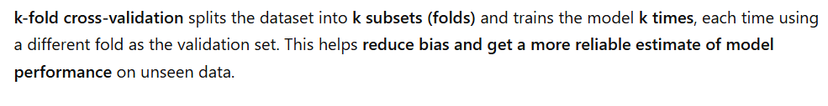
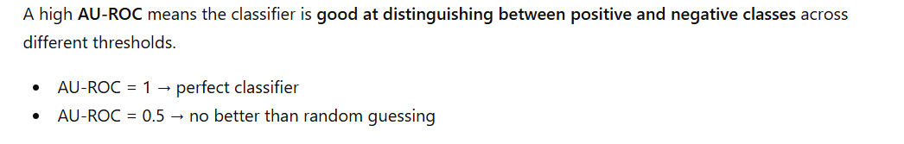

Slide 12
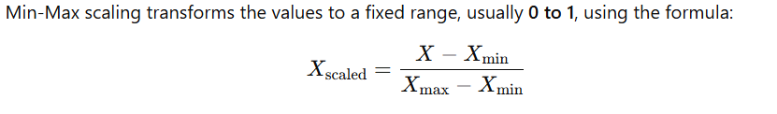

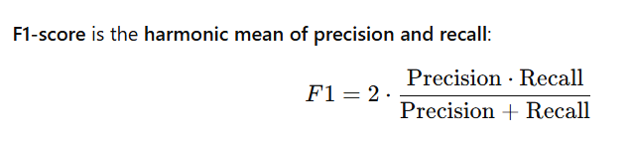
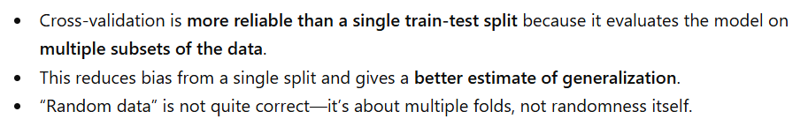

Slide 13
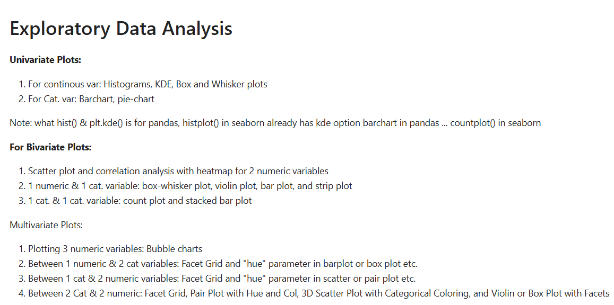

Slide 14
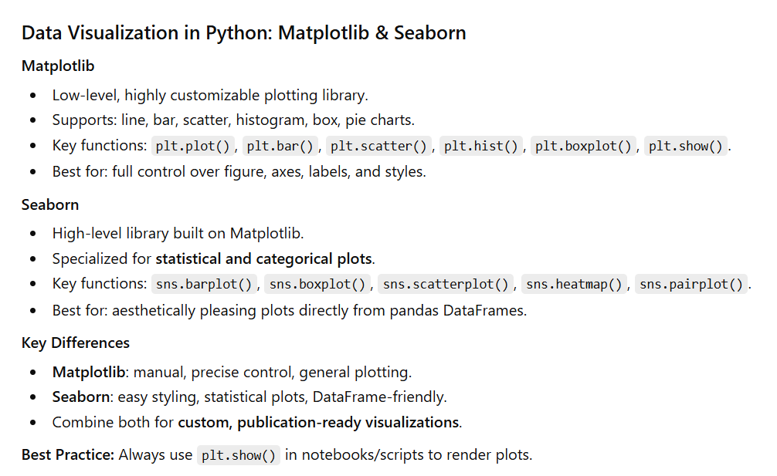

Slide 15
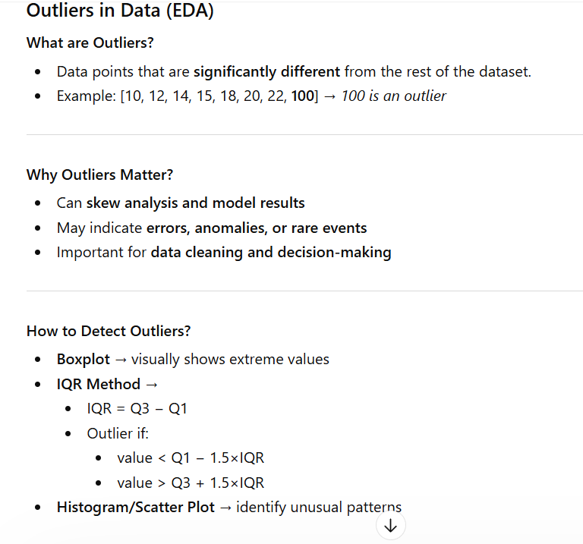

Slide 16
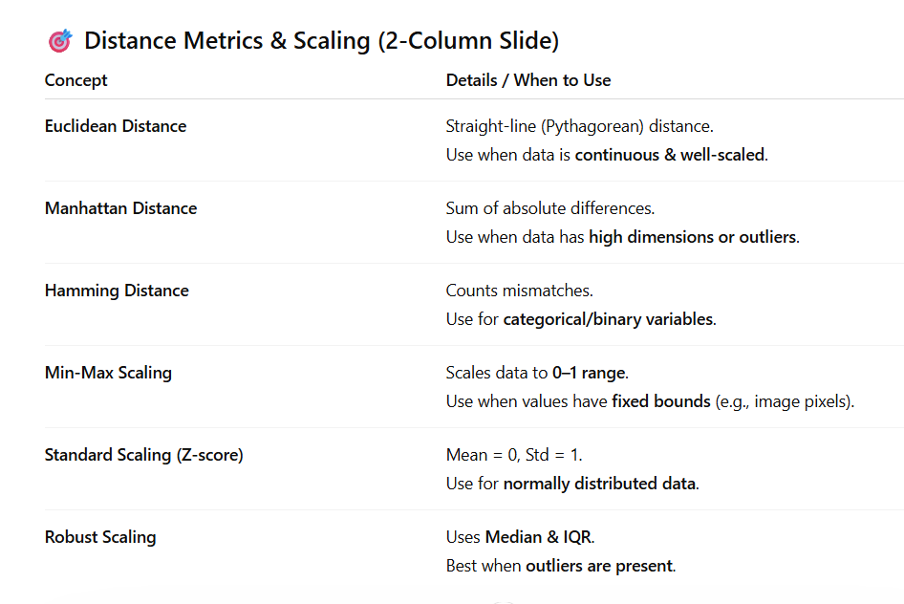

Slide 17
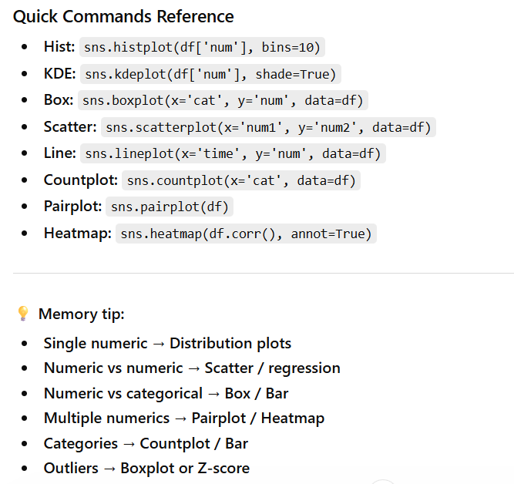

Slide 18
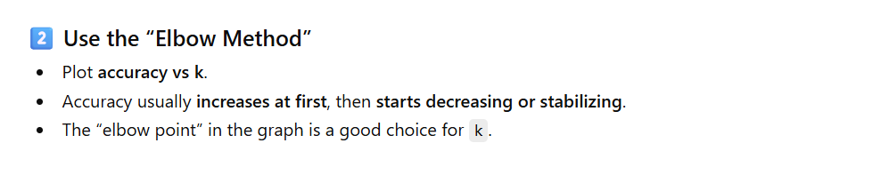
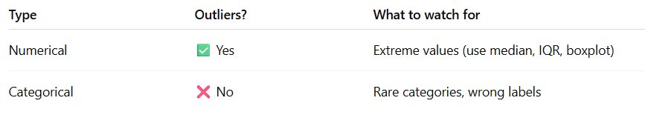
KNN
Mean - Impacted by outliers
Median - Centralized Value
Mode - Frequent value for categorical value.

Slide 19
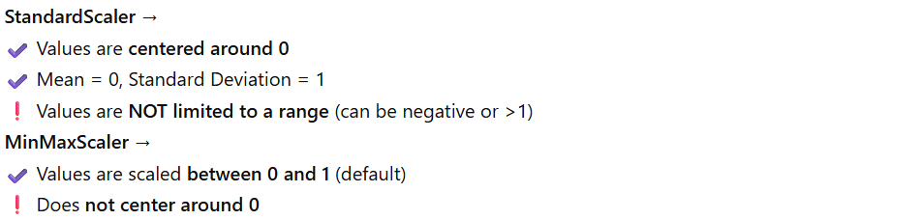
random_state=42 means the data will be split the same way every time
RandomForestRegressor is an ensemble model that builds multiple decision trees and averages their predictions to predict continuous numerical values. It reduces overfitting compared to a single tree and works well on noisy or complex datasets.

