Slide 1
AI ML

Slide 2
Definitions
Prediction: Model response
Actual: Existing test values
Accuracy: How many predictions are correct.
Decision boundary: A decision boundary is the line or surface that separates different classes in a model’s feature space.

Slide 3
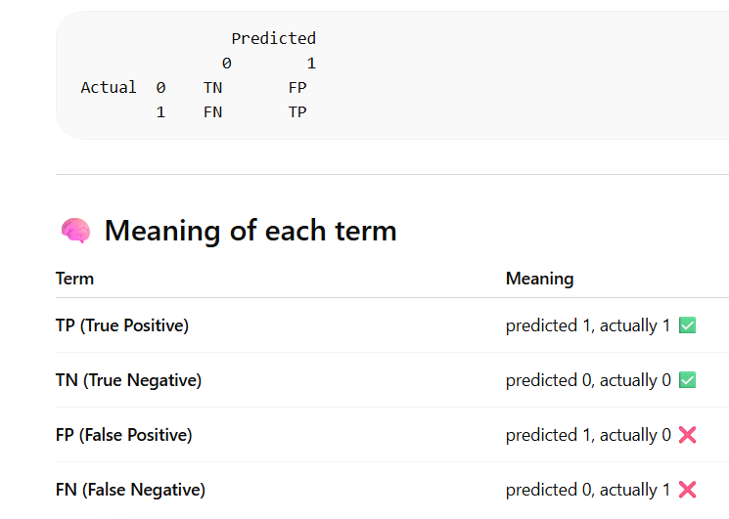
Confusion Matrix

