Slide 1

POC · TECHNICAL ARCHITECTURE
Local AI Voice Agent for Card Services
A voice assistant that reports lost cards, freezes / unfreezes cards, and answers
policy questions from the bank's own documents — running entirely on one machine.
100% local
No cloud
No API keys
Voice + LLM + tools
Policy-doc Q&A
Stack: Browser Web Speech · Spring Boot (Java 21) · Ollama (qwen2.5:3b) · SQLite · Piper neural TTS

Slide 2
What we built
A phone-style voice agent for everyday card tasks — built to run with zero external dependencies.
Report lost card
Freeze a card
Unfreeze a card
Policy Q&A
Permanently blocks a card and issues a replacement.
Temporarily disables a card; fully reversible.
Re-activates a previously frozen card.
Answers questions from official policy PDFs — phone numbers, opt-outs, terms.
Why fully local?
Privacy
Zero cost
Self-contained
Customer, card and document data never leaves the laptop.
No Vapi / OpenAI / ElevenLabs accounts or billing.
Runs offline; ideal for a controlled demo.

Slide 3
Architecture
Four local components plus two local data sources — all on localhost.
💻 YOUR LAPTOP — localhost only · nothing leaves the machine
1
Browser
2
Spring Boot
3
Local LLM
4
Piper TTS
Chrome Web Speech
· Speech → Text
Plays Piper WAV audio
Login + verified badge
index.html
Java 21 · :8787
/chat /login /tts
Auth gate (phone+DOB)
Tool execution
Policy-doc retrieval
Ollama · qwen2.5:3b
127.0.0.1:11434
Understands intent
Function / tool calling
Answers from excerpts
Neural voice 'Amy'
Persistent process
Text → WAV ~1s
Cached phrases instant
100% offline
→
⇄
←
↕ read / write
↑ search
🗄 SQLite — securebank.db
customer · phone · DOB · cards[ last4, type, status ]
📄 Policy_Docs\ — PDFs (knowledge base)
auto-indexed on change · PDFBox text + Tesseract OCR

Slide 4
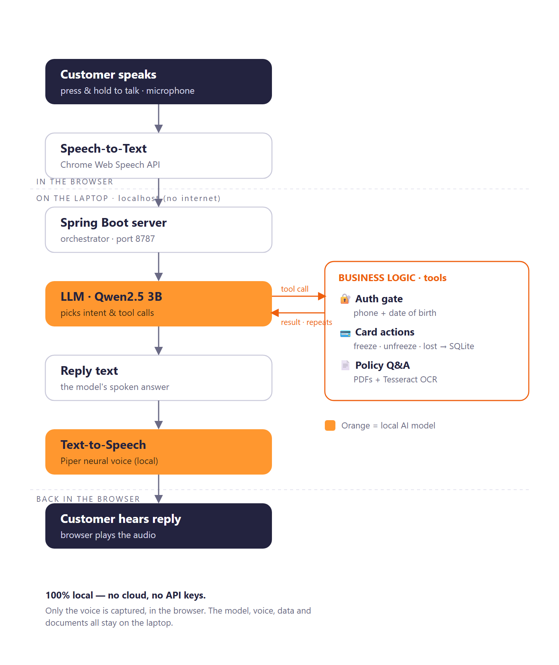
How a call flows — end to end
From the customer's voice to the spoken reply — every step runs on one laptop.
Follow one call — top to bottom
1
You talk — say what you need, like a phone call
2
Speech-to-Text — the browser writes down your words
3
Spring Boot server — runs the conversation and the rules
4
Local LLM — works out what you want, picks a tool
5
Business logic — verify you, then act or look it up
6
Text-to-Speech — a local neural voice speaks the reply
7
You hear it — the browser plays the answer back
Everything but speech-to-text runs on the laptop — no cloud, no API keys.

Slide 5
Technology stack
Each layer is a small, swappable, open component.
Layer | Technology | Role
Voice input | Chrome Web Speech API (SpeechRecognition) | Converts the caller's speech to text — free, in-browser
Voice output | Piper neural TTS — voice 'Amy' (local process) | Server renders WAV; cached phrases play instantly
Web UI | HTML + vanilla JS (index.html) | Conversation view, login, verified badge
Brain / LLM | Ollama running qwen2.5:3b (3B params) | Understands intent, decides which tool to call
Orchestration | Spring Boot (Java 21) on :8787 | Prompt assembly, tool-call loop, auth gate
Business logic | BankingService + PolicyDocsService | authenticate / freeze / unfreeze / report-lost / search docs
Data store | SQLite (securebank.db) via Spring Data JPA | Customers, DOB, cards and their status
Knowledge base | Policy_Docs PDFs · PDFBox + Tesseract OCR | Auto-indexed policy documents for customer Q&A

Slide 6
Request lifecycle — "Freeze my card"
What happens between the caller speaking and hearing a reply.
Speak
Send
1
2
Caller says it. Chrome converts voice → text.
Browser POSTs the text (+ caller number) to the Spring Boot server.
..
Think
Verify
3
4
Server sends the prompt + tool list to the local LLM.
Model asks for date of birth → calls authenticate_customer; server checks phone + DOB.
Act
Reply
5
6
Once verified, model calls freeze_card; server updates the card row in SQLite.
Model phrases the result; Piper renders it to audio and the browser plays it.

Slide 7
Tools & function-calling
The LLM doesn't touch data directly — it requests one of five well-defined tools.
Tool | Argument | Effect
authenticate_customer | dateOfBirth | Verifies caller (phone already known). Required before card actions.
freeze_card | cardLast4 | active → frozen
unfreeze_card | cardLast4 | frozen → active
report_lost_card | cardLast4 | → lost (permanent block)
search_policy_documents | query | Returns best policy-document excerpts — no auth needed
Card status states
active
freeze ↓ ↑ unfreeze
frozen
report lost ↓
lost
'lost' is terminal — a lost card cannot be frozen or reactivated.
Security note: the server enforces 'authenticate before any card action' regardless of what the model outputs. Informational searches are read-only and need no verification.

Slide 8
Policy-document Q&A — RAG, the lite way
Customers ask informational questions; the agent answers from the bank's own PDFs.
Ingest
Drop PDFs (or .txt) into Policy_Docs\. The index rebuilds automatically when files change — no restart.
LIVE EXAMPLE
1
“What's the customer service number for personal loans?”
Extract
PDFBox pulls the text. Scanned, image-only PDFs fall back to Tesseract OCR; results are cached.
2
“Call 1-877-256-2632 — our menu will prompt you through your choices.”
Retrieve
~900-character passages ranked by IDF-weighted keywords, plus a phone-number boost. Excerpts come from the single best-matching document.
3
Source: DiscoverPersonalLoans_PrivacyPolicy-2025.pdf — a scanned PDF, read via OCR.
Answer
The LLM calls search_policy_documents and answers only from the returned excerpts. No authentication required.
4
Add a new product brochure today — the agent answers questions about it minutes later.

Slide 9
Summary
A private, self-contained AI voice agent
for bank card services.
Browser speech · local LLM (Ollama) · Spring Boot + SQLite · Piper voice · policy-document Q&A
— no cloud, no keys, no data leaving the device.

