Slide 1
Dagger2

Slide 2
Dagger2 components
The first thing that you have to understand are the following 3 terms: module, provides, inject. Module means the class which contains methods who will provide dependencies. Provides means the methods who provide dependency. Inject means who accepts the object provided by the @Provides method.

Slide 3
How Dagger create objects?
By default, Dagger doesn’t know how to create objects. To make Dagger know the correct way to instantiate an object, there is module. Module is a place where Dagger looks up for the proper way to instantiate an object. If nothing is defined inside a Module, Dagger won’t know any way to instantiate an object.

Slide 4
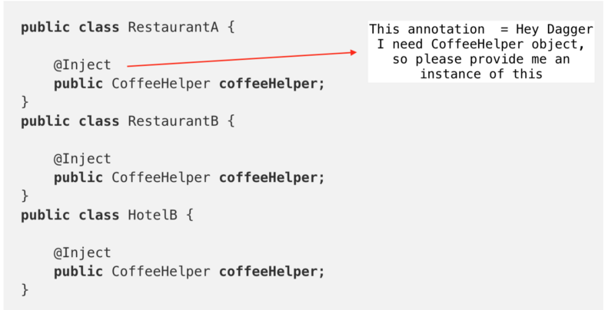
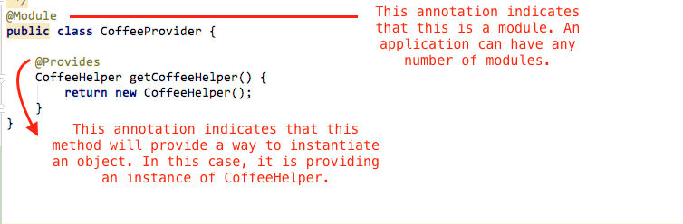

Slide 5
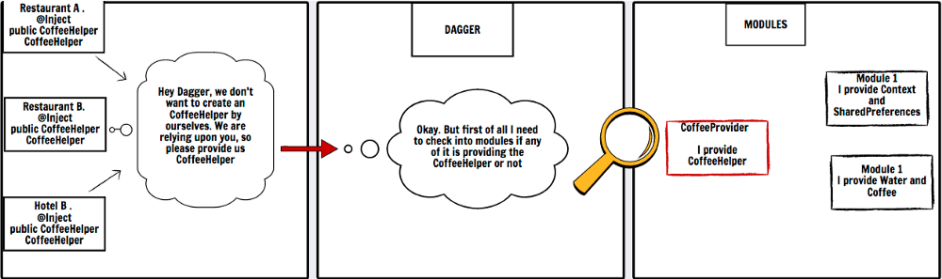
So, now the Dagger knows how to create an instance of CoffeHelper as there is a module named CoffeeProvider which educates the Dagger on creating instance of CoffeeHelper.
Still we don’t get the instance of CoffeeHelper
From the Restaurant and Hotel classes.

Slide 6
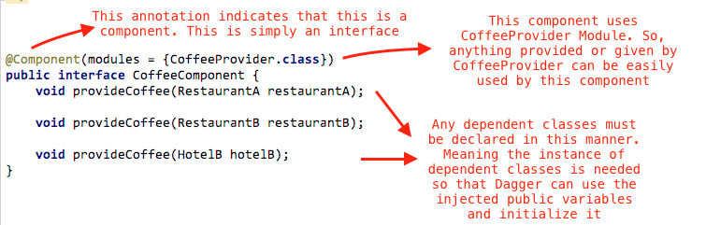
Component
We can’t use the module directly. To use the modules we need Component. Component is simply a bridge between module and the classes which requires any instance of a class.

Slide 7
