Slide 1
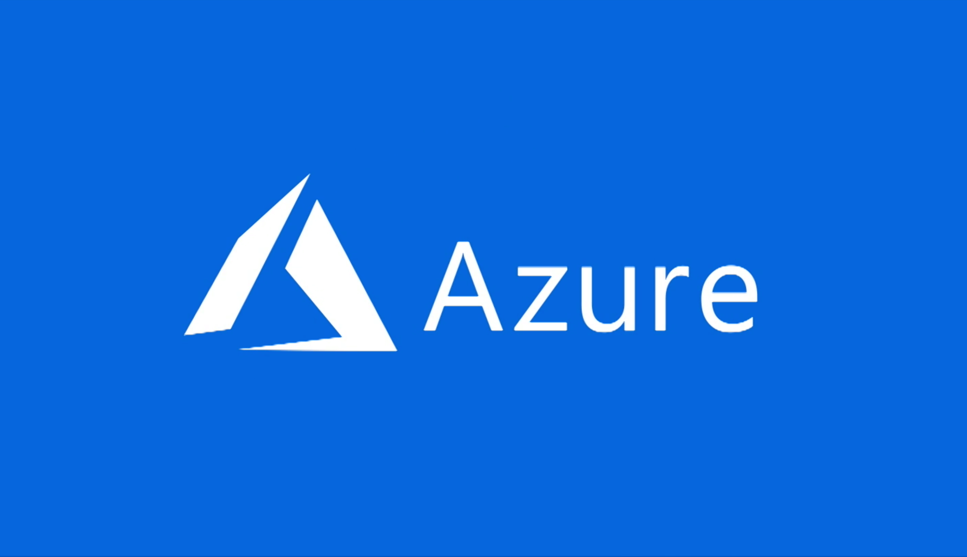
Azure Cloud Basics

Slide 2
Agenda
What is cloud Computing
History of cloud
Azure components
Infrastructure as a service(Iaas)
Platform as a service(Paas)
Software as a service(Saas)

Slide 3
What is cloud Computing :-
Cloud computing is the delivery of computing services—servers, storage, databases, networking, software, analytics and more—over the Internet (“the cloud”).
(Or)
Computing as a service over the internet
Cloud computing, often referred to as simply “the cloud,” is the delivery of on-demand computing resources — everything from applications to data centers — over the internet on a pay-for-use basis.
Elastic resources — Scale up or down quickly and easily to meet demand
Metered service so you only pay for what you use
Self service — All the IT resources you need with self-service access
Companies offering these computing services are called cloud providers and typically charge for cloud computing services based on usage, similar to how you are billed for water or electricity at home.

Slide 4
History:-
In August 2006, Amazon created subsidiary Amazon Web Services and introduced its Elastic Compute Cloud (EC2)
In April 2008, Google released Google App Engine in beta
In February 2010, Microsoft released Microsoft Azure, which was announced in October 2008.
In July 2010, Rackspace Hosting and NASA jointly launched an open-source cloud-software initiative known as OpenStack.
On March 1, 2011, IBM announced the IBM SmartCloud framework to support Smarter Planet.
In May 2012, Google Compute Engine

Slide 5
Life before cloud computing
Traditional business applications have always been very complicated and expensive. The amount and variety of hardware and software required to run them are daunting. You need a whole team of experts to install, configure, test, run, secure, and update them.
When you multiply this effort across dozens or hundreds of apps, it’s easy to see why the biggest companies with the best IT departments aren’t getting the apps they need. Small and midsize businesses don’t stand a chance.
Uses of cloud computing
You are probably using cloud computing right now, even if you don’t realize it. If you use an online service to send email, edit documents, watch movies or TV, listen to music, play games or store pictures and other files, it is likely that cloud computing is making it all possible behind the scenes. The first cloud computing services are barely a decade old, but already a variety of organizations—from tiny startups to global corporations, government agencies to non-profits—are embracing the technology for all sorts of reasons. Here are a few of the things you can do with the cloud:
Create new apps and services
Store, back up and recover data
Host websites and blogs
Stream audio and video
Deliver software on demand
Analyze data for patterns and make predictions

Slide 6



Top benefits of cloud computing
Cloud computing is a big shift from the traditional way businesses think about IT resources. What is it about cloud computing? Why is cloud computing so popular? Here are 6 common reasons organisations are turning to cloud computing services:
1. Cost
Cloud computing eliminates the capital expense of buying hardware and software and setting up and running on-site datacenters—the racks of servers, the round-the-clock electricity for power and cooling, the IT experts for managing the infrastructure. It adds up fast.
2. Speed
Most cloud computing services are provided self service and on demand, so even vast amounts of computing resources can be provisioned in minutes, typically with just a few mouse clicks, giving businesses a lot of flexibility and taking the pressure off capacity planning.
3.Global scale
The benefits of cloud computing services include the ability to scale elastically. In cloud speak, that means delivering the right amount of IT resources—for example, more or less computing power, storage, bandwidth—right when its needed and from the right geographic location.

Slide 7


4. Productivity
On-site datacenters typically require a lot of “racking and stacking”—hardware set up, software patching and other time-consuming IT management chores. Cloud computing removes the need for many of these tasks, so IT teams can spend time on achieving more important business goals.
5. Performance
The biggest cloud computing services run on a worldwide network of secure datacenters, which are regularly upgraded to the latest generation of fast and efficient computing hardware. This offers several benefits over a single corporate datacenter, including reduced network latency for applications and greater economies of scale.
6. Reliability
Cloud computing makes data backup, disaster recovery and business continuity easier and less expensive, because data can be mirrored at multiple redundant sites on the cloud provider’s network.

Slide 8
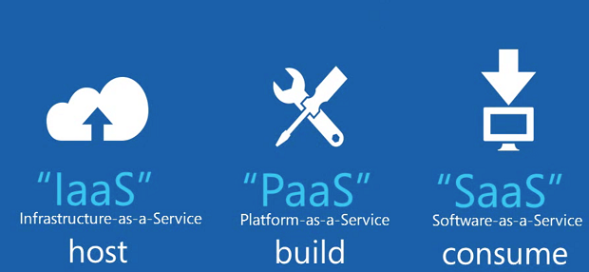
Azure Components:-
Most cloud computing services fall into three broad categories:
Infrastructure-as-a-service (IaaS)
Platform as a service (PaaS)
Software as a service (SaaS)

Slide 9
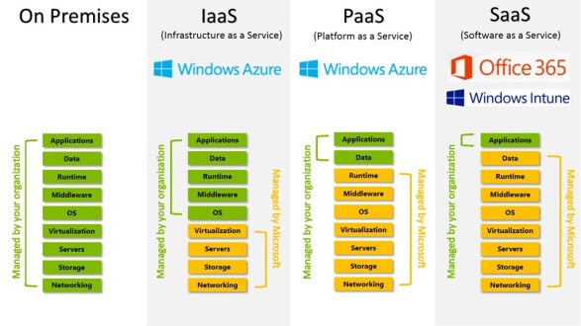

Slide 10
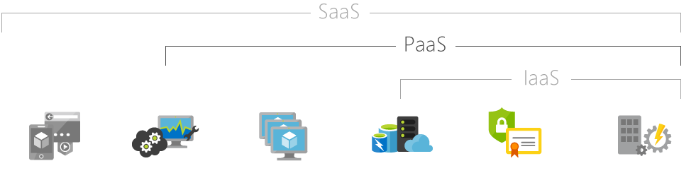
Hosted applications/apps | Development tools, database management, business analytics | Operating systems | Servers and storage | Networking firewalls/security | Data center physical plant/building

Slide 11
Infrastructure-as-a-service (IaaS)
Infrastructure as a service (IaaS) is an instant computing infrastructure, provisioned and managed over the Internet. Quickly scale up and down with demand and pay only for what you use.
IaaS helps you avoid the expense and complexity of buying and managing your own physical servers and other datacenter infrastructure. Each resource is offered as a separate service component and you only need to rent a particular one for as long as you need it. The cloud computing service provider manages the infrastructure, while you purchase, install, configure and manage your own software—operating systems, middleware and applications.
Common IaaS business scenarios
Typical things businesses do with IaaS include:
Test and development. Teams can quickly set up and dismantle test and development environments, bringing new applications to market faster. IaaS makes it quick and economical to scale up dev-test environments up and down.
Website hosting. Running websites using IaaS can be less expensive than traditional web hosting.
Storage, backup and recovery. Organisations avoid the capital outlay for storage and complexity of storage management, which typically requires a skilled staff to manage data and meet legal and compliance requirements. IaaS is useful for handling unpredictable demand and steadily growing storage needs. It can also simplify planning and management of backup and recovery systems.
Web apps. IaaS provides all the infrastructure to support web apps, including storage, web and application servers and networking resources. Organisations can quickly deploy web apps on IaaS and easily scale infrastructure up and down when demand for the apps is unpredictable.
High-performance computing. High-performance computing (HPC) on supercomputers, computer grids or computer clusters helps solve complex problems involving millions of variables or calculations. Examples include earthquake and protein folding simulations, climate and weather predictions, financial modeling and evaluating product designs.
Big data analysis. Big data is a popular term for massive data sets that contain potentially valuable patterns, trends and associations. Mining data sets to locate or tease out these hidden patterns requires a huge amount of processing power, which IaaS economically provides.

Slide 12
Advantages of IaaS
Eliminates capital expense and reduces ongoing cost. IaaS sidesteps the upfront expense of setting up and managing an on-site datacenter, making it an economical option for start-ups and businesses testing new ideas.
Improves business continuity and disaster recovery. Achieving high availability, business continuity and disaster recovery is expensive, since it requires a significant amount of technology and staff. But with the right service level agreement (SLA) in place, IaaS can reduce this cost and access applications and data as usual during a disaster or outage.
Innovate rapidly. As soon as you have decided to launch a new product or initiative, the necessary computing infrastructure can be ready in minutes or hours, rather than the days or weeks—and sometimes months—it could take to set up internally.
Respond quicker to shifting business conditions. IaaS enables you to quickly scale up resources to accommodate spikes in demand for your application— during the holidays, for example—then scale resources back down again when activity decreases to save money.
Focus on your core business. IaaS frees up your team to focus on your organisation’s core business rather than on IT infrastructure.
Increase stability, reliability and supportability. With IaaS there is no need to maintain and upgrade software and hardware or troubleshoot equipment problems. With the appropriate agreement in place, the service provider assures that your infrastructure is reliable and meets SLAs.
Better security. With the appropriate service agreement, a cloud service provider can provide security for your applications and data that may be better than what you can attain in-house.
Gets new apps to users faster. Because you don’t need to first set up the infrastructure before you can develop and deliver apps, you can get them to users faster with IaaS.
EX:- Microsoft Azure , Amazon Web Services (AWS),igitalOcean, Linode, Rackspace, Cisco Metapod, Google Compute Engine (GCE) are some popular examples of Iaas.

Slide 13
Platform as a service (PaaS)
Platform as a service (PaaS) is a complete development and deployment environment in the cloud, with resources that enable you to deliver everything from simple cloud-based apps to sophisticated, cloud-enabled enterprise applications. You purchase the resources you need from a cloud service provider on a pay-as-you-go basis and access them over a secure Internet connection.
Like IaaS, PaaS includes infrastructure—servers, storage and networking—but also middleware, development tools, business intelligence (BI) services, database management systems and more. PaaS is designed to support the complete web application lifecycle: building, testing, deploying, managing and updating.
PaaS allows you to avoid the expense and complexity of buying and managing software licenses, the underlying application infrastructure and middleware or the development tools and other resources. You manage the applications and services you develop and the cloud service provider typically manages everything else.
Common PaaS scenarios
Organisations typically use PaaS for these scenarios:
Development framework. PaaS provides a framework that developers can build upon to develop or customise cloud-based applications. Similar to the way you create an Excel macro, PaaS lets developers create applications using built-in software components. Cloud features such as scalability, high-availability and multi-tenant capability are included, reducing the amount of coding that developers must do.
Analytics or business intelligence. Tools provided as a service with PaaS allow organisations to analyse and mine their data, finding insights and patterns and predicting outcomes to improve forecasting, product design decisions, investment returns and other business decisions.
Additional services. PaaS providers may offer other services that enhance applications, such as workflow, directory, security and scheduling.

Slide 14
Advantages of PaaS :-
By delivering infrastructure as a service, PaaS offers the same advantages as IaaS. But its additional features—middleware, development tools and other business tools—give you more advantages:
Cut coding time. PaaS development tools can cut the time it takes to code new apps with pre-coded application components built into the platform, such as workflow, directory services, security features, search and so on.
Add development capabilities without adding staff. Platform as a Service components can give your development team new capabilities without your needing to add staff having the required skills.
Develop for multiple platforms—including mobile—more easily. Some service providers give you development options for multiple platforms, such as computers, mobile devices and browsers making cross-platform apps quicker and easier to develop.
Use sophisticated tools affordably. A pay-as-you-go model makes it possible for individuals or organisations to use sophisticated development software and business intelligence and analytics tools that they could not afford to purchase outright.
Support geographically distributed development teams. Because the development environment is accessed over the Internet, development teams can work together on projects even when team members are in remote locations.
Efficiently manage the application lifecycle. PaaS provides all of the capabilities that you need to support the complete web application lifecycle: building, testing, deploying, managing and updating within the same integrated environment
EX:- AWS Elastic Beanstalk, Windows Azure, Heroku, Force.com, Google App Engine, Apache Stratos.

Slide 15
Software as a service (SaaS)
Software as a service (SaaS) allows users to connect to and use cloud-based apps over the Internet. Common examples are email, calendaring and office tools (such as Microsoft Office 365).
SaaS provides a complete software solution which you purchase on a pay-as-you-go basis from a cloud service provider. You rent the use of an app for your organisation and your users connect to it over the Internet, usually with a web browser. All of the underlying infrastructure, middleware, app software and app data are located in the service provider’s data center. The service provider manages the hardware and software and with the appropriate service agreement, will ensure the availability and the security of the app and your data as well. SaaS allows your organisation to get quickly up and running with an app at minimal upfront cost.
Common SaaS scenarios
If you have used a web-based email service such as Outlook, Hotmail or Yahoo! Mail, then you have already used a form of SaaS. With these services, you log into your account over the Internet, often from a web browser. The email software is located on the service provider’s network and your messages are stored there as well. You can access your email and stored messages from a web browser on any computer or Internet-connected device.
The previous examples are free services for personal use. For organisational use, you can rent productivity apps, such as email, collaboration and calendaring; and sophisticated business applications such as customer relationship management (CRM), enterprise resource planning (ERP) and document management. You pay for the use of these apps by subscription or according to the level of use.

Slide 16
Advantages of SaaS
Gain access to sophisticated applications. To provide SaaS apps to users, you don’t need to purchase, install, update or maintain any hardware, middleware or software. SaaS makes even sophisticated enterprise applications, such as ERP and CRM, affordable for organisations that lack the resources to buy, deploy and manage the required infrastructure and software themselves.
Pay only for what you use. You also save money because the SaaS service automatically scales up and down according to the level of usage.
Use free client software. Users can run most SaaS apps directly from their web browser without needing to download and install any software, although some apps require plugins. This means that you don’t need to purchase and install special software for your users.
Mobilise your workforce easily. SaaS makes it easy to “mobilise” your workforce because users can access SaaS apps and data from any Internet-connected computer or mobile device. You don’t need to worry about developing apps to run on different types of computers and devices because the service provider has already done so. In addition, you don’t need to bring special expertise onboard to manage the security issues inherent in mobile computing. A carefully chosen service provider will ensure the security of your data, regardless of the type of device consuming it.
Access app data from anywhere. With data stored in the cloud, users can access their information from any Internet-connected computer or mobile device. And when app data is stored in the cloud, no data is lost if a user’s computer or device fails.
Ex:- Microsoft office365, Google docs, Gmail, Google Apps, Facebook.

Slide 17
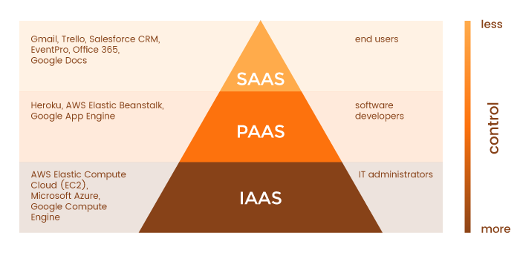

Slide 18


