Slide 1
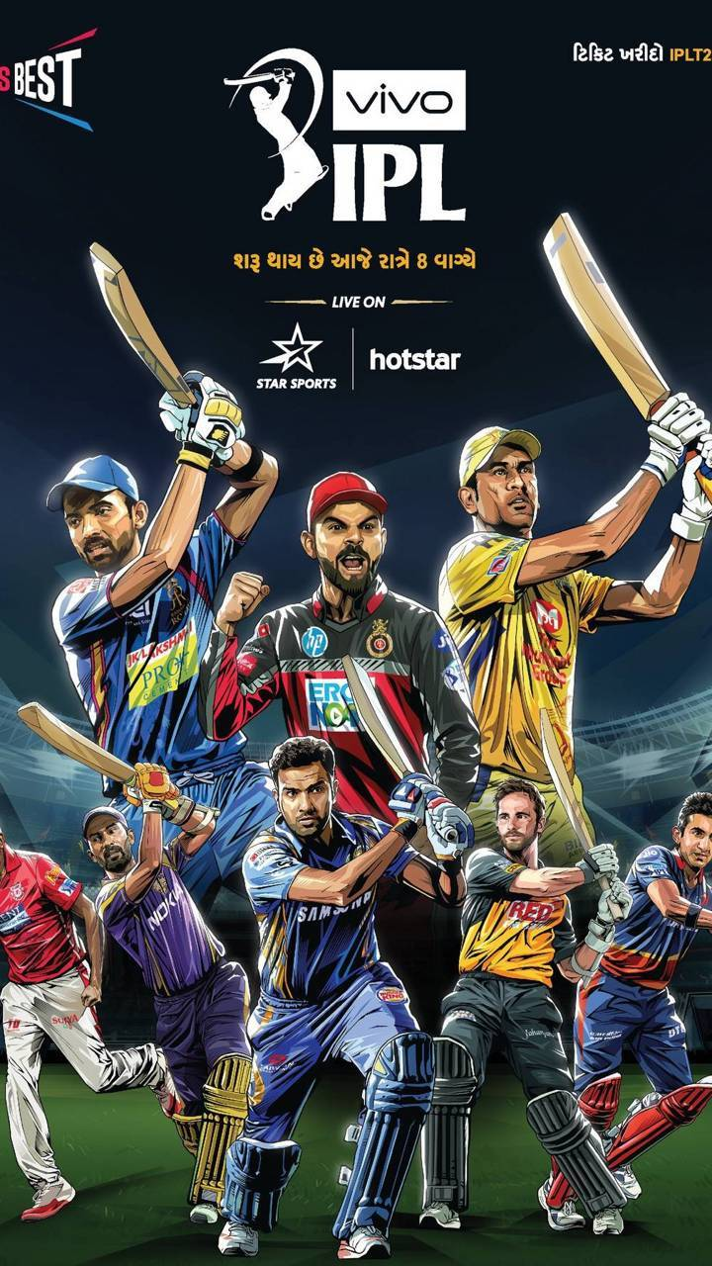
IPL (Indian Premier League) Match Prediction
Author: Anjani Bonda
DSC680 Applied Data Science, Bellevue University
Date: 7/22/2023

Slide 2
Summary
Introduction
Data Mining & EDA
Predictive Modeling & Analysis
Findings & Recommendation
Ethical Considerations

Slide 3
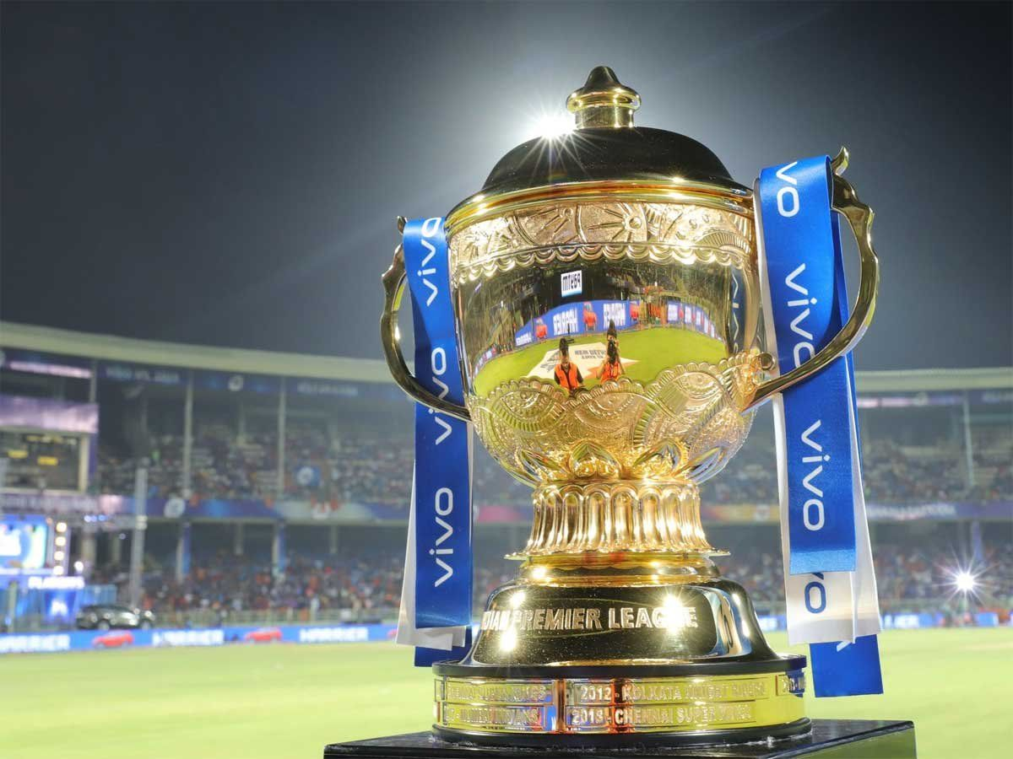
Introduction
IPL has only started in 2008 and it is already one of the fastest growing sports leagues in the world taking 2nd spot recently. The viewership and revenue have been in an uptrend too. Data Analytics has been a part of sports entertainment for a long time. As a sports enthusiast, I am curious to build a predictive analysis model to predict the winning team in an IPL match/tournament using various available stats available for all seasons (2008-2022).
3

Slide 4
Data Mining - Data Structure
The data provided in match level summary as well as ball-by-ball details format for all matches from 2008 till 2022 season.
all_season_summary.csv - Summary of all matches across all seasons
The main dataset to be used in this model is “all_season_summary.csv” which has about 45 columns and 958 records summarizing every single match from the beginning of season (2008 – 2022).
4

Slide 5
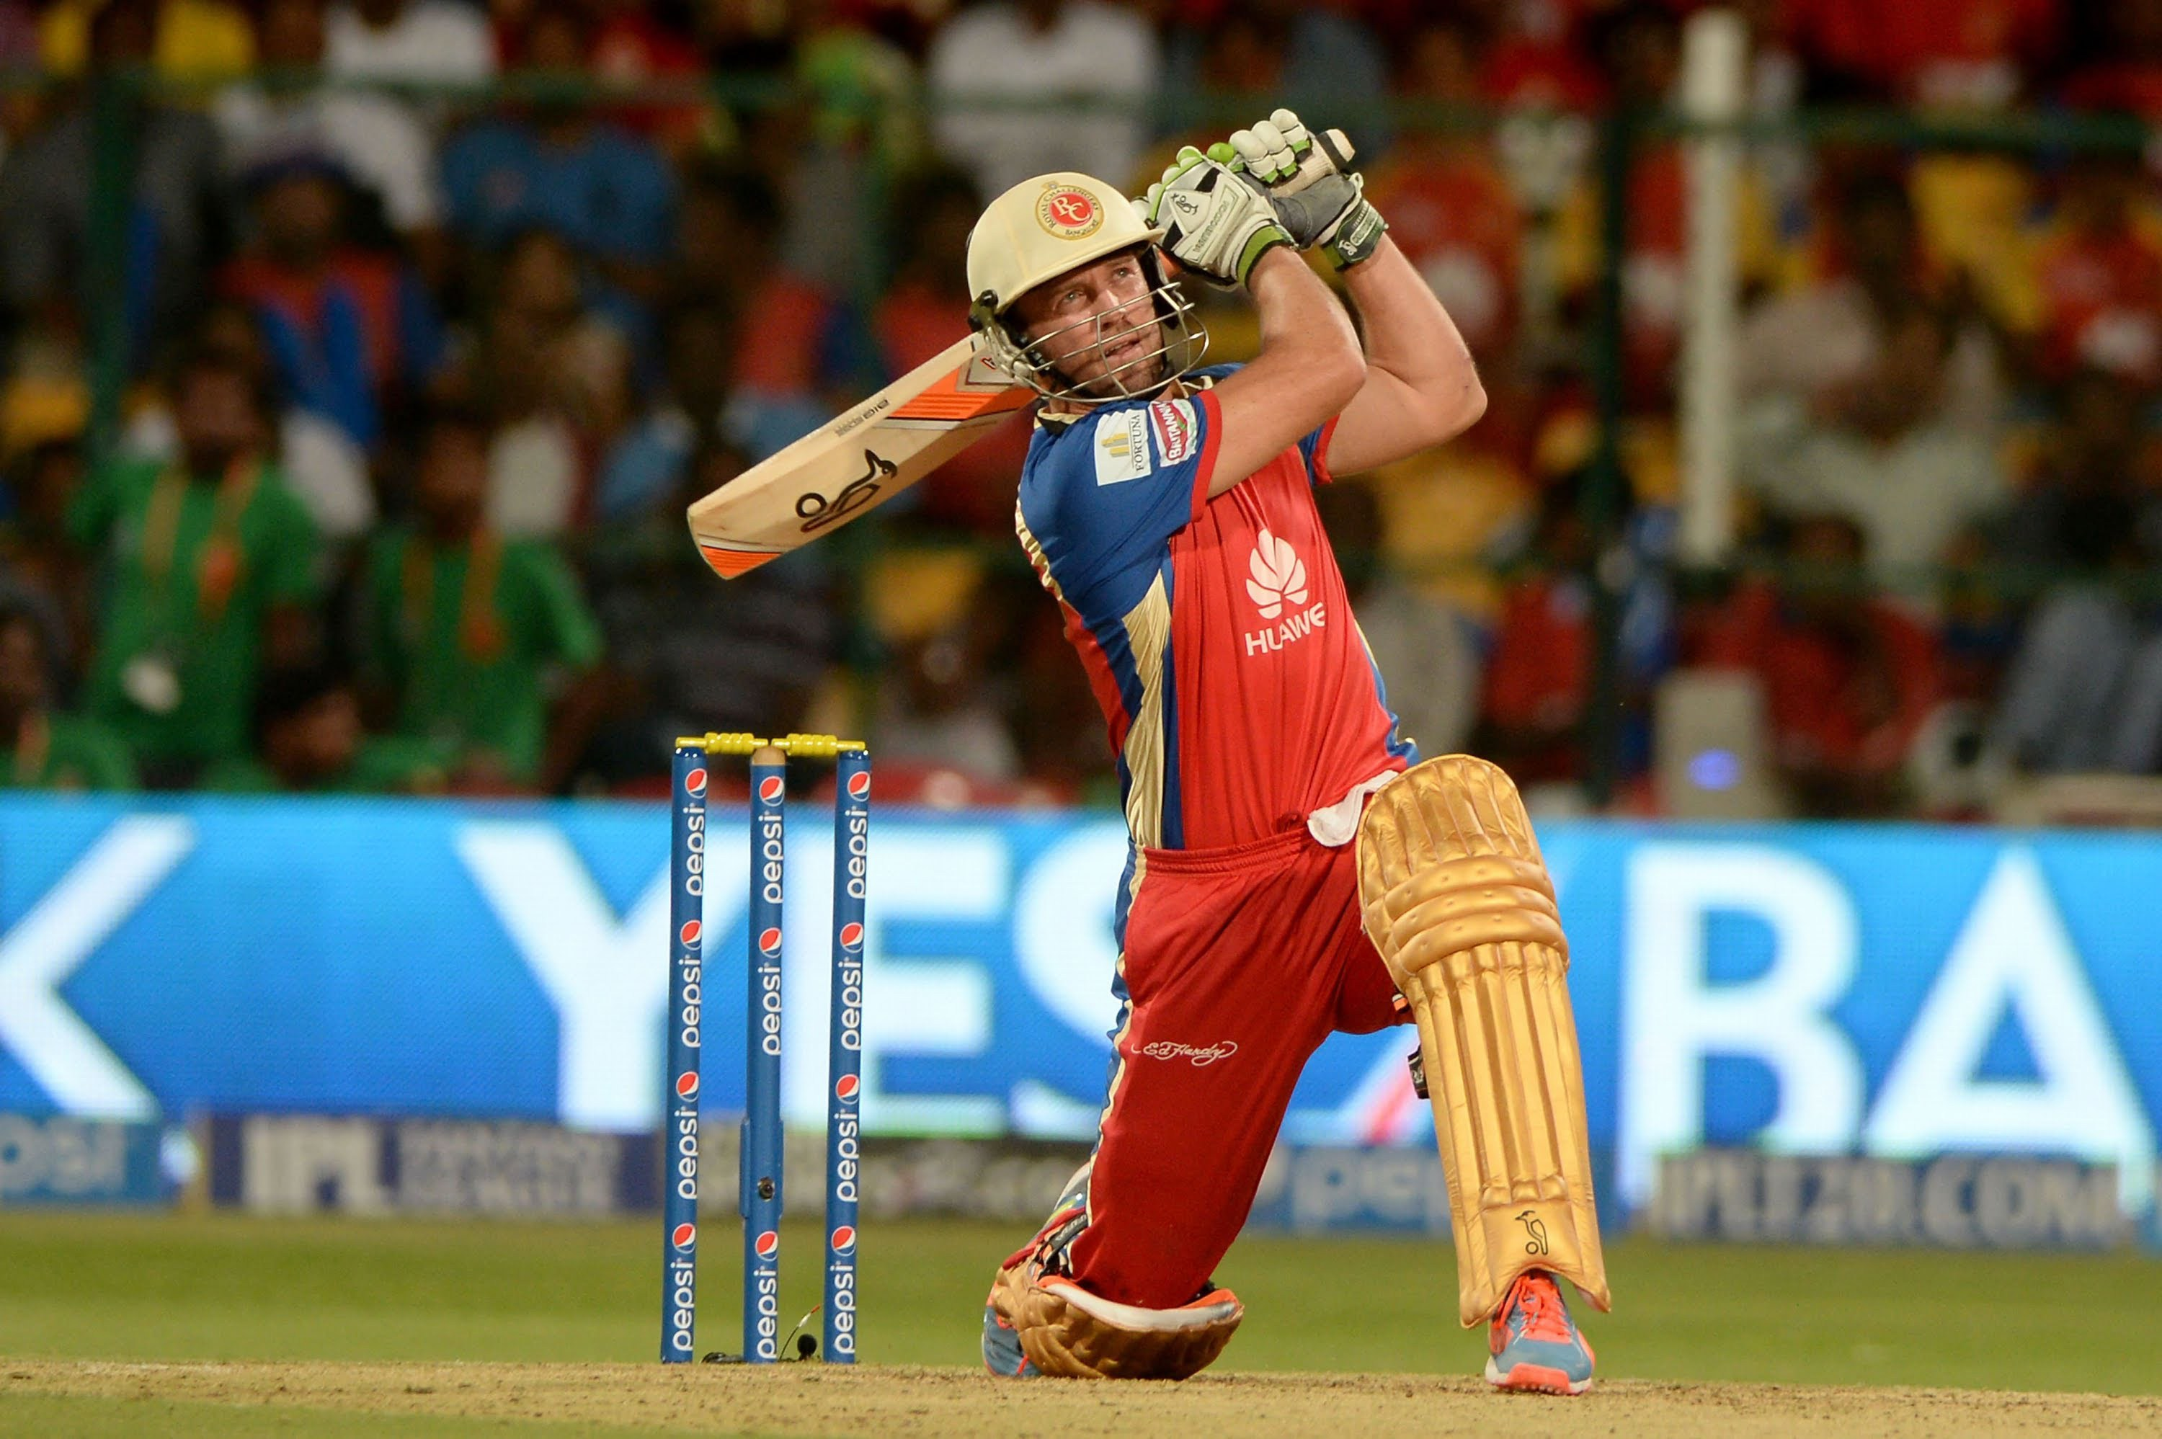
Data Cleaning
Missing/Null Check - No missing value present in any of the feature. Null values are present in few.
Unwanted features Removal –Some features are excluded from the dataset
Umpire1
Referee
Highlights
Third Umpire
Batting/Bowling stats
5

Slide 6
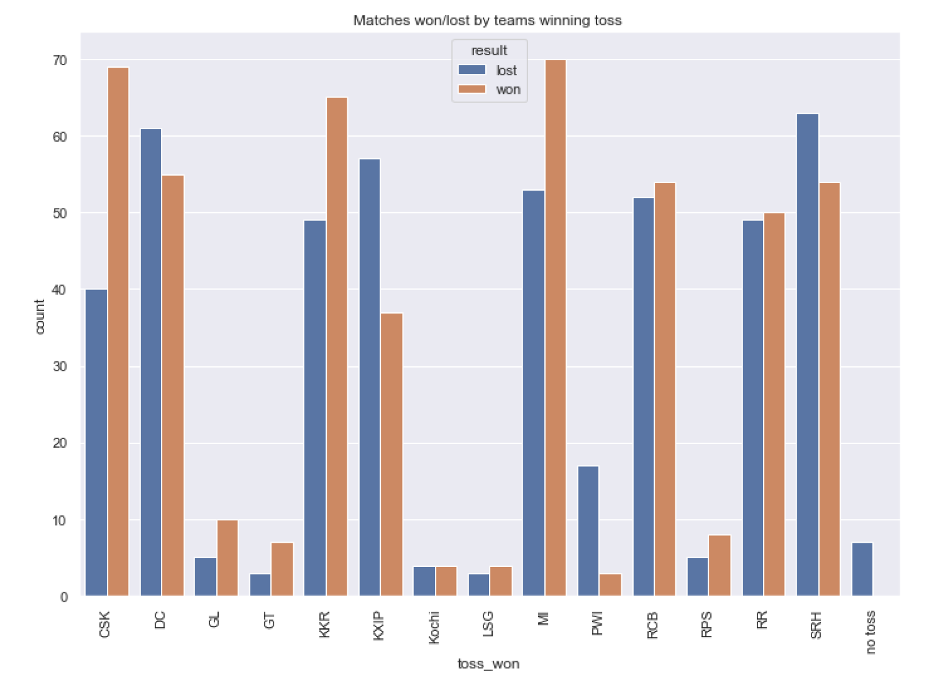
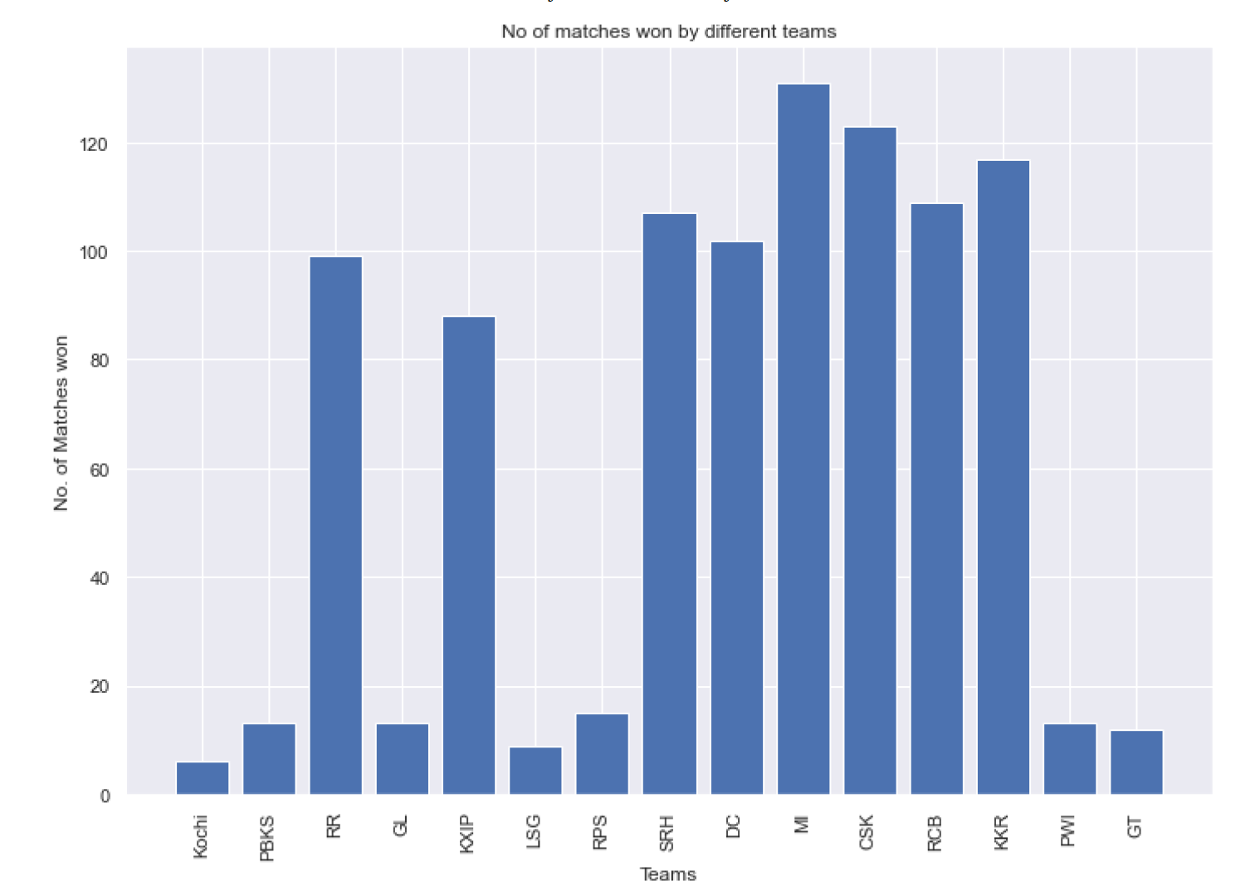
EDA – Features/Variables & Visualizations
Home Team
Away Team
Toss Won
Decision
Winner
Venue name
Observation:
Teams that win toss often win more matches.
Teams winning more matches often won more titles and making it to play-offs.
6

Slide 7
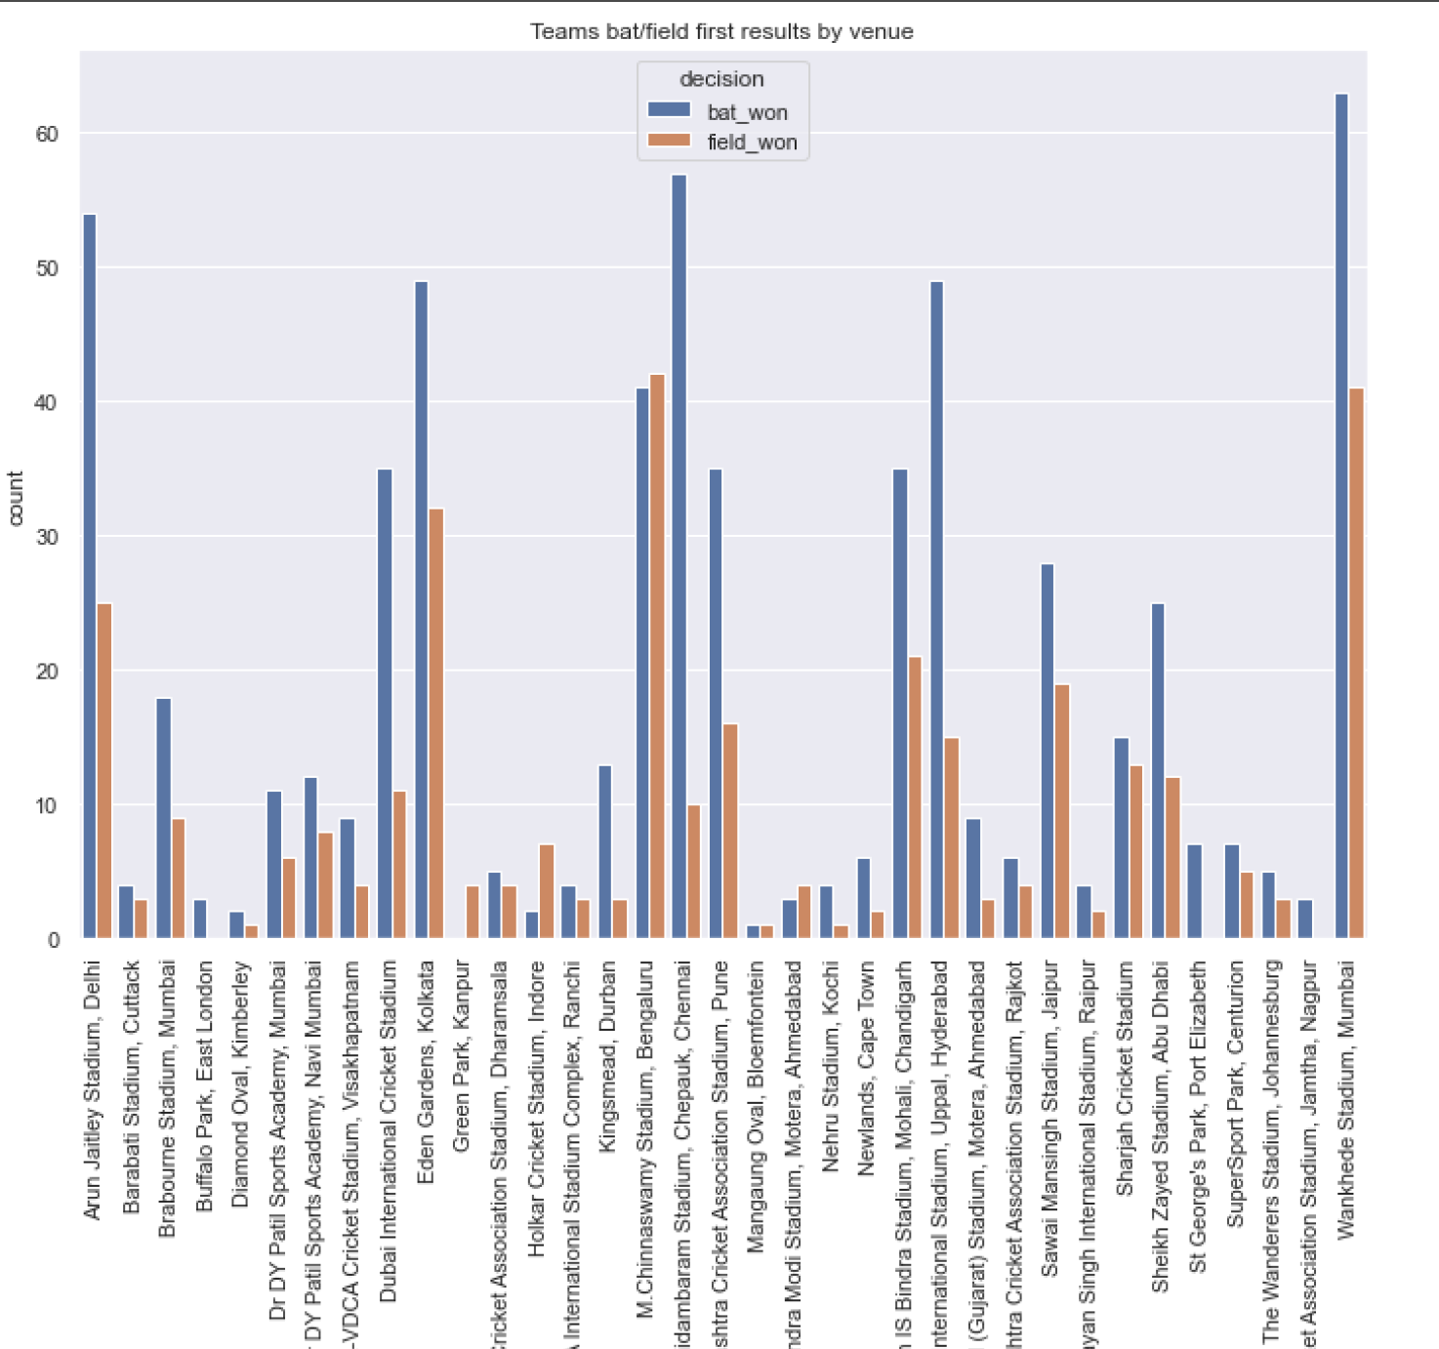
Visualization (contd.)
Here is a bar chart showing the Teams that bat or field first results by venue.
Shows the count of matches that won between the teams that bat first and field first.
Quick observation from chart shows that teams that bat first often win more matches than teams who field first.
7

Slide 8
Model Efficiency
Model | Accuracy
Logistic Regression | 68.75%
SVM | 68.75%
Decision Tree | 66.67%
Random Forest | 66.67%
8

Slide 9
Findings and Recommendation
This model predicts the match/league winner and relevant useful features that impact the match prediction with better accuracy with a caveat that the model should be regressed when more or better real-world data is available.
9

Slide 10
References
https://www.kaggle.com/datasets/rajsengo/indian-premier-league-ipl-all-seasons/versions/27?resource=download
https://www.kreedon.com/top-10-biggest-sports-leagues-in-the-world/
https://towardsdatascience.com/support-vector-machines-svm-c9ef22815589
10

