Slide 1
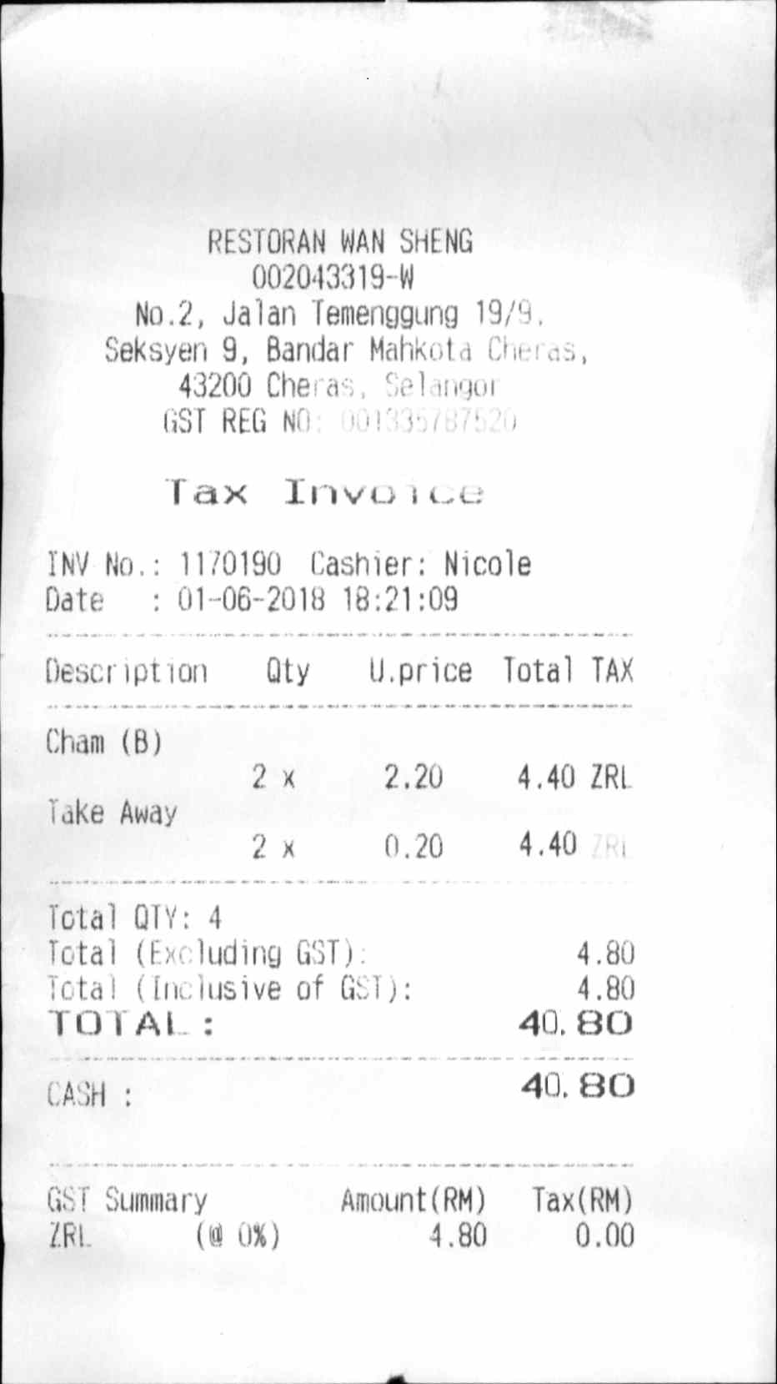
Receipt for reimbursement

