Slide 1

Department of Information Technology
III B.Tech I Sem - AD
Industry Oriented Internship – Deep Learning Techniques Development MR24-1IT0163
Financial Document Tampering Detection System Using EfficientNetV2B0 and Grad-CAM
Batch no. 13
1. 2411IT010142 (M.Udayini)
2. 2411IT010063(C.Anjani)
3. 2411IT010067(C.Sai Kiran)
Maisammaguda, Kompally, Medchal - Malkajgiri District Hyderabad - 500100, Telangana State. www.mallareddyuniversity.
(Telangana State Private Universities Act No. 13 of 2020 &
G.O.Ms. No. 14, Higher Education (UE) Department)
Guide
Mrs.G.Devi Priya

Slide 2
Table of Contents
Introduction
Literature Survey
Limitations of Existing Algorithms/Methodologies
Abstract
Proposed System and Methodology
Hardware/Software Requirements
Results on the Test Receipts
From 97.85% to a Working Detector
Screenshots of the Application
Conclusion and Future Scope

Slide 3
Introduction:
Financial document fraud has become increasingly common with the widespread use of digital editing tools. Documents such as invoices, receipts, bank statements, and bills can be manipulated to alter financial information, resulting in significant losses for organizations. Traditional manual verification methods are time-consuming and prone to human error. This project proposes an Explainable AI-based system that automatically detects whether a financial document is genuine or tampered. The system uses EfficientNetV2B0 for document classification and Grad-CAM to highlight suspicious regions, making the prediction transparent and easy to understand.

Slide 4
Literature Survey:
Several researchers have applied deep learning techniques to document forgery detection using Convolutional Neural Networks (CNNs), EfficientNet, and Vision Transformers. These methods have shown improved accuracy compared to traditional image processing approaches. Explainable AI techniques such as Grad-CAM have also been introduced to visualize the regions responsible for model predictions. However, many existing systems focus on document classification without providing clear visual explanations, making their decisions difficult to interpret.

Slide 5
Limitations of Existing Algorithms/Methodologies:
Manual verification is slow and depends on human expertise.
Traditional image processing techniques cannot detect complex digital manipulations.
Many deep learning models act as black boxes and do not explain their predictions.
Existing systems often fail to generalize across different types of financial documents.
Several methods require expensive computational resources or specialized datasets.

Slide 6
Abstract:
Financial document tampering is a serious problem for banks, insurance companies and businesses. FinDoc AI detects tampered receipts and invoices and explains every decision. It is trained and evaluated on the public “Find it again!” dataset of 988 scanned receipts. Error Level Analysis (ELA) re-saves the page as JPEG and finds text regions whose compression error differs from the rest, which is typical of pasted or re-typed content. EfficientNetV2B0, fine-tuned on ELA maps, classifies the most suspicious regions, and Grad-CAM heatmaps with plain-language reasons explain the result. Typed Word, PowerPoint and digital PDF files are checked through their metadata. The Flask web application is deployed on Vercel and accepts images, camera photos, PDF, Word and PowerPoint files. On 218 test receipts the system reaches 71.10% accuracy and a document-level AUC of 79.16%, detecting 23 of 35 tampered receipts.

Slide 7
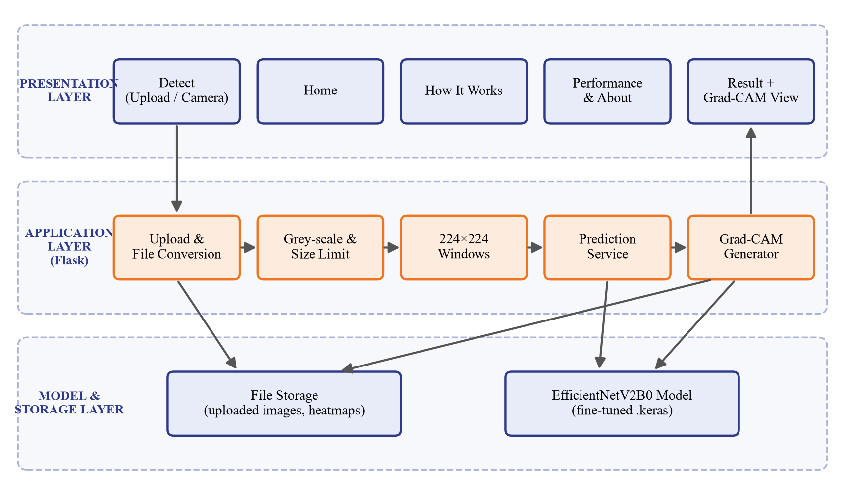
Proposed System:
Upload an image, PDF, Word or PowerPoint file, or capture with the camera
Scanned pages: Error Level Analysis, re-saved as JPEG (quality 70) and compared
Score = how far the most unusual 64x64 text region differs (z-score); EfficientNetV2B0-ELA checks it
Grad-CAM heatmap, flagged regions and plain-language reasons
Digital files: metadata check (editor, dates, re-saves) instead of pixels

Slide 8
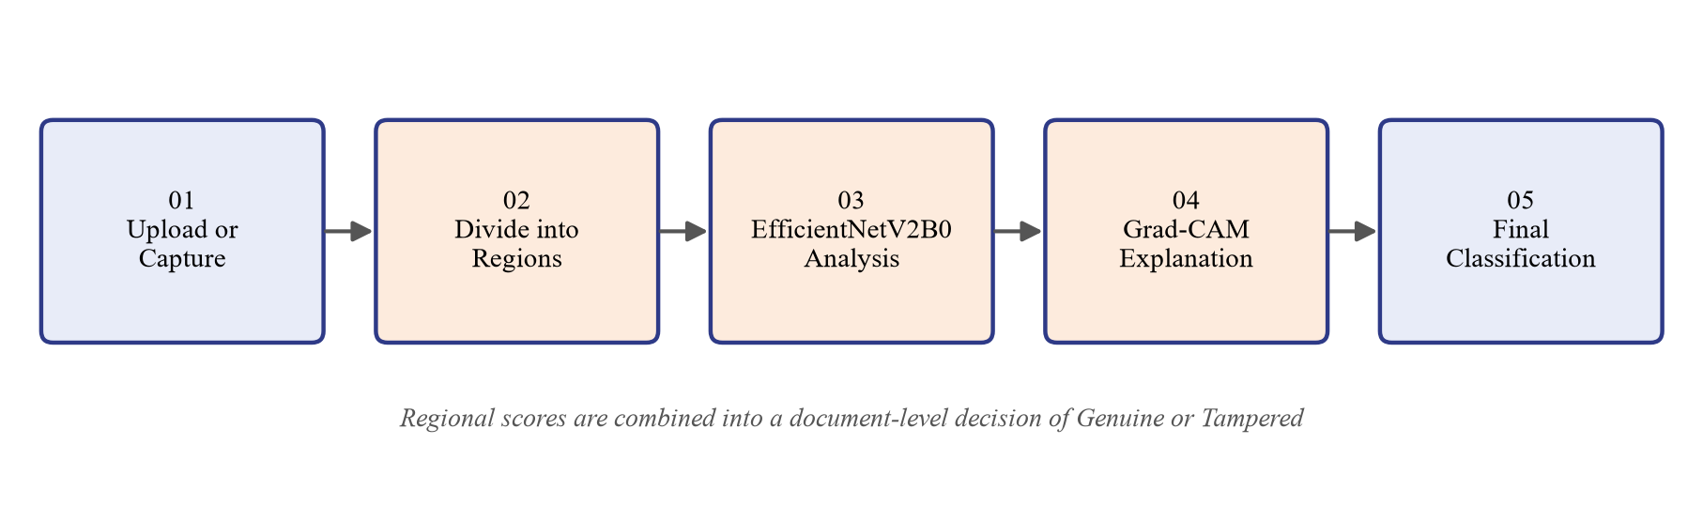
Methodology:
ELA re-saves the page as JPEG and measures the re-compression error of every text pixel; edited areas were compressed a different number of times and stand out. EfficientNetV2B0 (ImageNet weights) is fine-tuned on 4,333 ELA patches (1,638 tampered), reaches 80.4% patch AUC, and runs in the web app with ONNX Runtime.

Slide 9
Hardware Requirements:
Processor: Intel Core i5 or above
RAM: 8 GB (16 GB for training)
Storage: 10 GB free space
Camera (optional, for capturing documents)
Software Requirements:
Windows 10/11, Python 3.10+ (tested with 3.13)
TensorFlow 2.20 with Keras 3.12 (EfficientNetV2B0)
Flask 3.1, HTML, CSS, JavaScript
Pillow, NumPy, PyMuPDF, scikit-learn, matplotlib
Microsoft Word / PowerPoint (for DOC, DOCX, PPT, PPTX files)

Slide 10
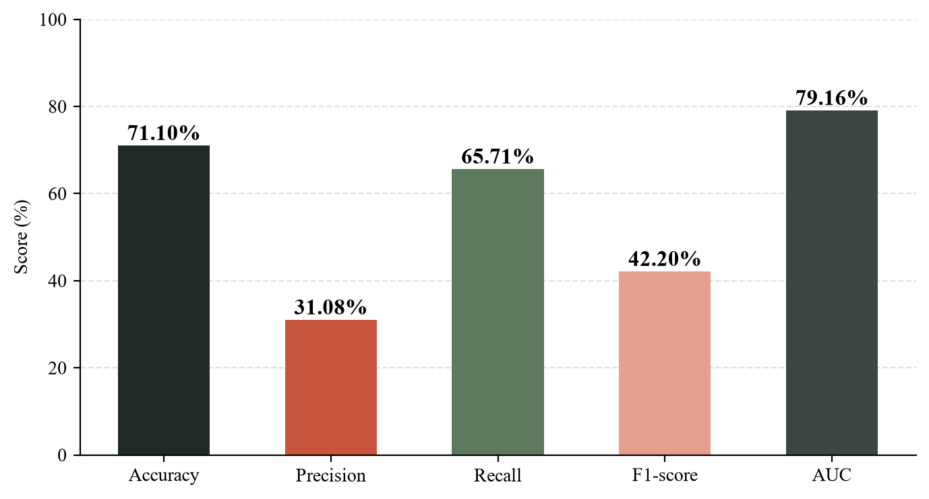
Results on 218 Test Receipts:
Accuracy: 71.10%
Precision: 31.08%
Recall: 65.71%
F1-score: 42.20%
ROC-AUC: 79.16% (50% = random guessing)
Tampered receipts caught: 23 of 35
Genuine wrongly flagged: 51 of 183

Slide 11
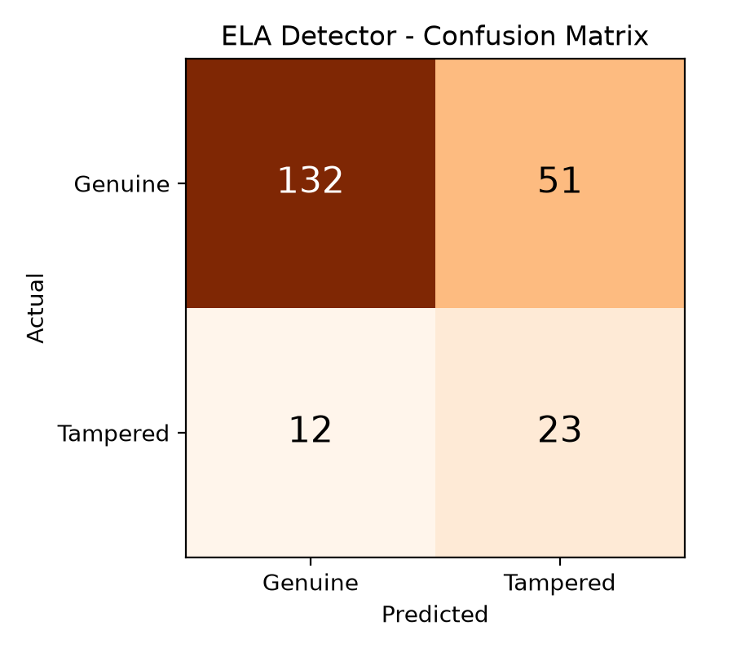
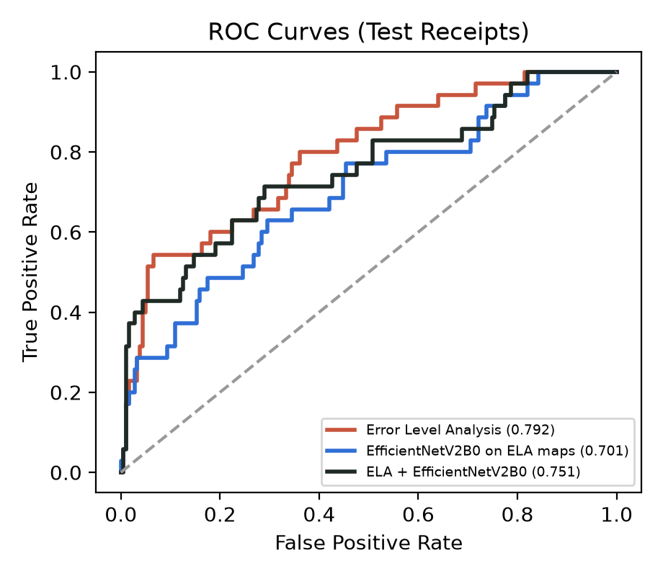
Confusion Matrix and ROC Curve:

Slide 12
From 97.85% (Misleading) to a Working Detector:
Initial CNN: tiny crops enlarged 3× vs large crops shrunk, so it learned the zoom level (97.85% on patches)
Tested on whole receipts: 49.5% accuracy, AUC 0.44, i.e. chance level
Retrained on same-scale pixel patches: still chance level (AUC 0.47, 110 of 183 genuine wrongly flagged)
Final system with Error Level Analysis: 71.10% accuracy, AUC 79.16%, 51 of 183 genuine flagged
Lesson: evaluate on whole documents, exactly as the application is used

Slide 13
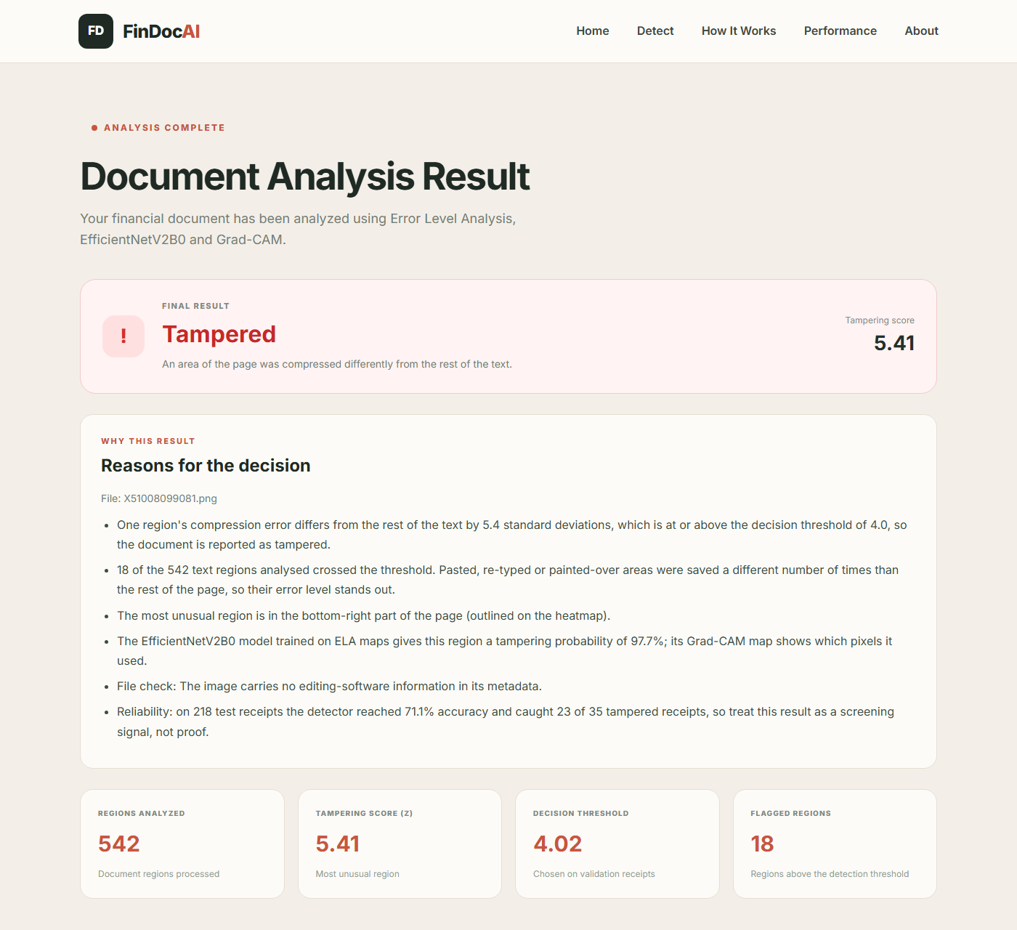
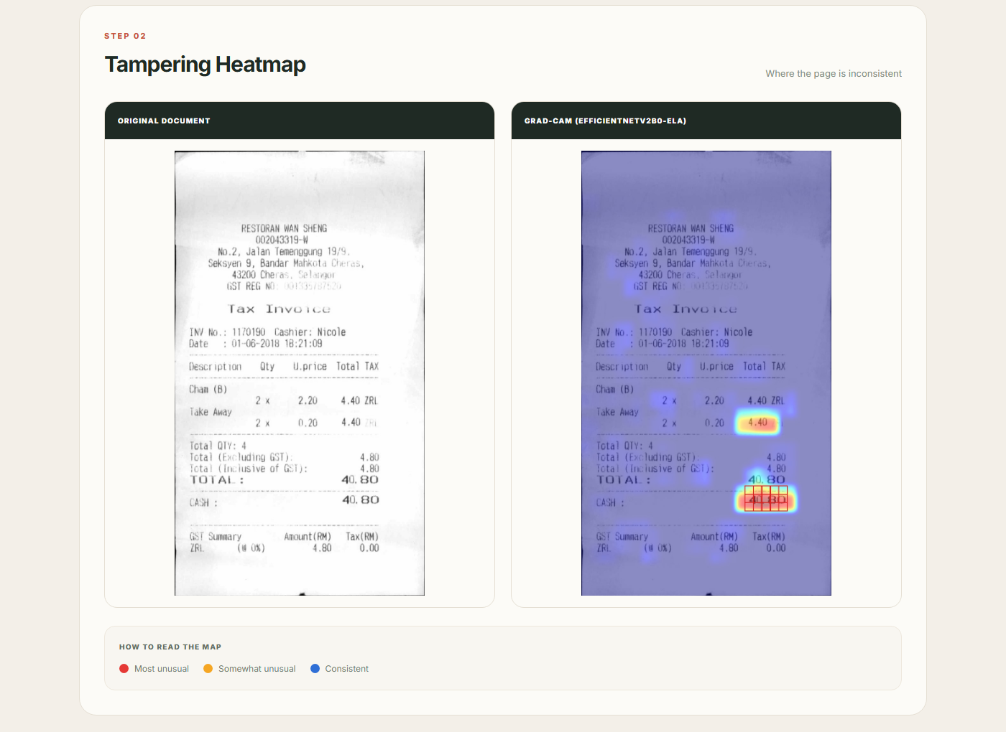
Screenshots – Tampered Receipt Detected:

Slide 14
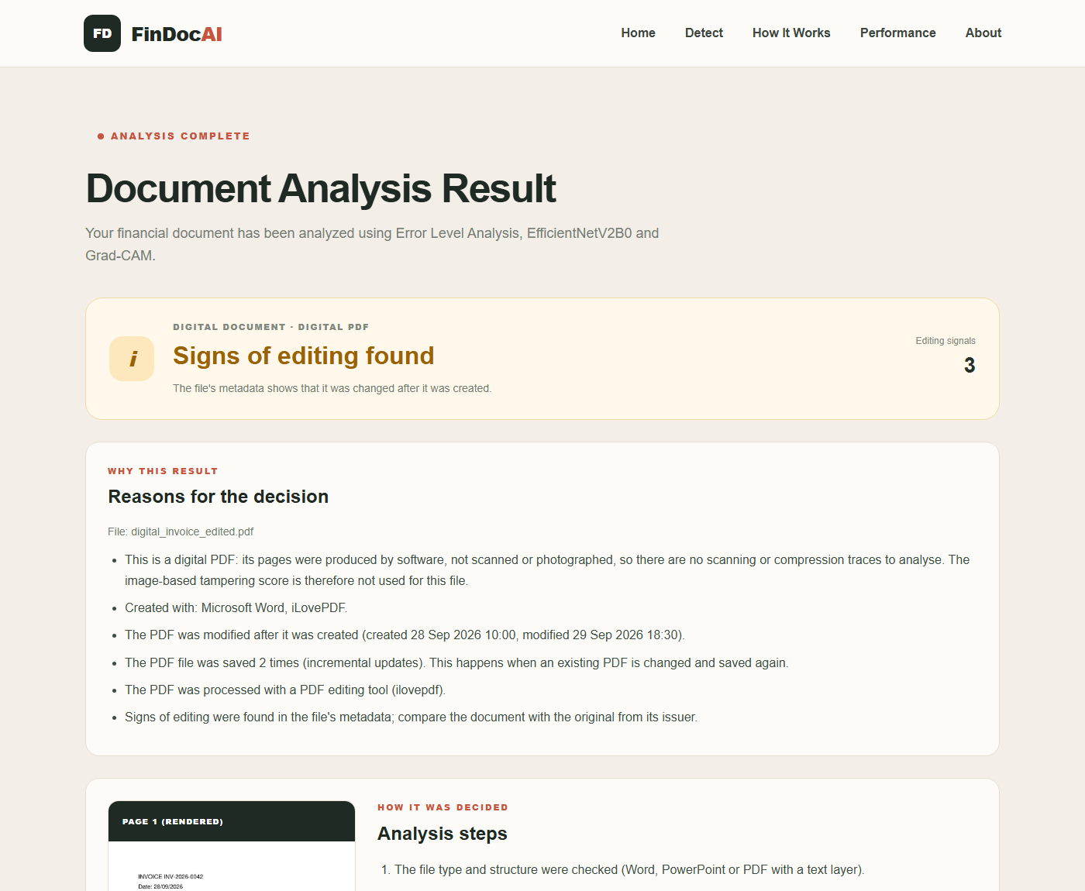
Screenshots – Digital Files (PDF, Word, PowerPoint):
Typed Word, PowerPoint and digital PDF files have no scan traces
The system checks the file metadata instead
Example: an invoice PDF whose amount was changed and re-saved with iLovePDF
Result: 3 editing signals found

Slide 15
Conclusion and Future Scope:
FinDoc AI provides a complete, explainable pipeline: images, PDF, Word and PowerPoint files are analysed with Error Level Analysis and an EfficientNetV2B0 model trained on ELA maps, digital files are checked through their metadata, and every result is explained with heatmaps, Grad-CAM and reasons. On whole test receipts it reaches 71.10% accuracy and an AUC of 79.16%; it is an explainable screening aid, live at findoc-ai.vercel.app.
Data: More tampered training data, e.g. automatically generated forgeries
Text checks: OCR-based checks that item prices, totals and tax add up
Forensics: Copy-move and double-JPEG analysis for images compressed many times

Slide 16
THANK YOU

