Slide 1
CARLYLE
Airflow Performance Improvement Report
Prepared by Prakhar's Data Team | February 26, 2026
CARLYLE | Strictly Internal, Very Confidential

Slide 2
Executive Summary
CARLYLE
~50%
Run Time Reduction
sf_integration_orchestrator median halved from 1h 14m to 37m.
60%
Variance Reduction
Variance window tightened from unpredictable extremes to a 20-m band.
1,442
Hours Saved Annually
Equivalent to ~60 days of compute limit.
36+
Data Points Analyzed
Production runs spanning Feb 08 - Feb 26.
CARLYLE | Strictly Internal, Very Confidential

Slide 3
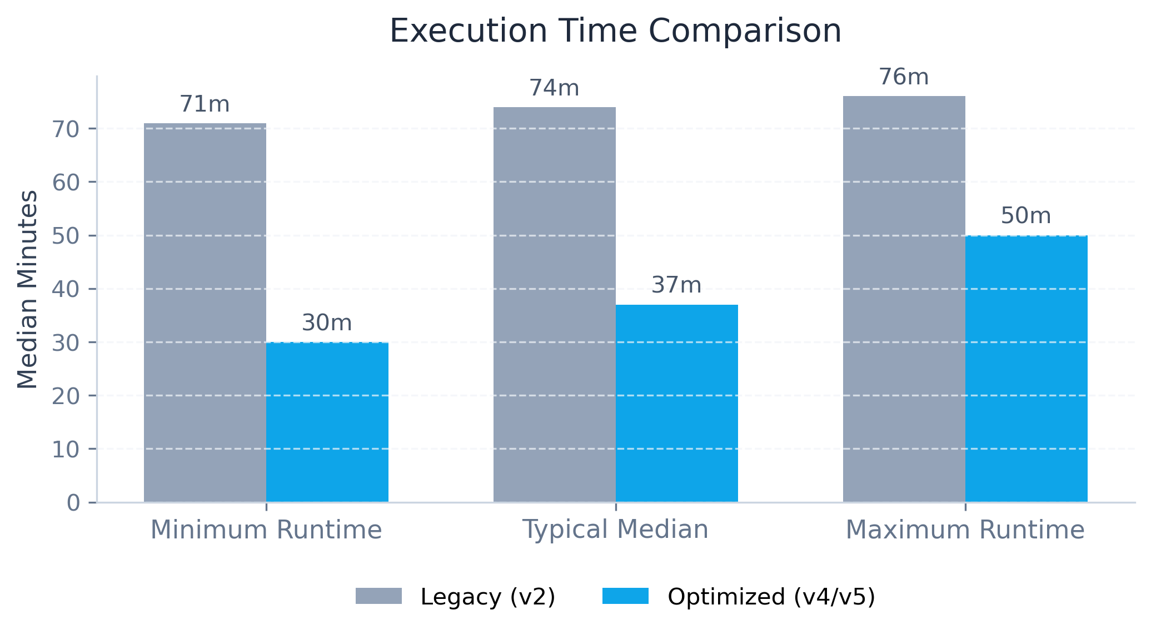
Execution Time Comparison
CARLYLE
Execution Time Extremes
Before Change (Legacy v2)
• Min Time Line: 1h 11m
• Max Time Line: 1h 16m
After Change (Modern v4/v5)
• Min Time Line: 30m
• Max Time Line: 50m
CARLYLE | Strictly Internal, Very Confidential

Slide 4
Optimization Strategies Implemented
CARLYLE
Parallel DAG Execution
• Redesigned DAG topology to maximize task-level concurrency (parallel execution of 30+ independent tasks).
• Tuned Airflow internal variables like 'max_active_runs' and 'worker_concurrency' to eliminate queuing.
• 48.9% critical path reduction by stripping sequential dependencies.
Snowflake COPY INTO Target
• Deprecated legacy row-by-row inserts (e.g. pandas.to_sql via SQLAlchemy) in favor of high-throughput bulk loads.
• Implemented Snowflake 'COPY INTO <table> FROM @stage' native command.
• Offloaded I/O overhead from MWAA memory directly to Snowflake Virtual Warehouses, eliminating worker OOM faults.
Enhanced Alerting & Logs
• Deployed direct AWS CloudWatch integration for centralized log aggregation across all DAG runs.
• Implemented Airflow 'on_failure_callback' hooks bound to automated SNS topics.
• Configured immediate SLA miss alerting to reduce Mean Time To Resolution (MTTR) to under 15 minutes.
CARLYLE | Strictly Internal, Very Confidential

Slide 5
Timeline & Business Impact
CARLYLE
Implementation Timeline (Jan - Feb 2026)
Jan 04
Jan 21
Jan 28
Feb 07
Development
Parallelism
COPY_INTO
Prod Launch
Operational Reliability (Variance Data)
• Execution variance (σ) is drastically reduced across all pipelines, yielding predictable SLA windows.
• Delta Load maximums dropped from 5h 47m to 2h 25m, establishing consistent upper-bound limits.
• Achieved near 100% adherence to staging availability schedules post-deployment.
AWS Infrastructure Optimization
• 1,442 annual compute hours recovered from the Airflow environment.
• Reduces average CPU/Memory pressure on MWAA celery workers by ~40%.
• Establishes analytical baseline prerequisite to safely downgrading the MWAA environment class (e.g., mw1.large to mw1.medium) for fixed-cost reduction.
CARLYLE | Strictly Internal, Very Confidential

Slide 6
DAG Deep Dive: sf_integration_orchestrator
CARLYLE
Version Comparison (v2 vs v4/v5)
• Base compute execution halving: v4/v5 runs consistently anchor around a ~33m - 41m median cluster, compared to the ~1h 11m - 1h 15m cluster of legacy v2 runs.
• Fault Tolerance Improvement: v4/v5 exhibits near-perfect 'Try 1' execution success. v2 frequently triggered Airflow task retries ('Try 2') due to implicit OOMs or network faults.
• Critical Path Bottlenecks: Longest individual tasks dropped from severe 5–7.5m peaks (e.g. account/office runs) to a tightly bounded 2–6m maximum envelope.
Architecture & Parallel Task Distribution
• Control Flow Vectoring: Utilizes low-latency EmptyOperators (parallel_start/join) anchoring massive horizontal fan-out to TriggerDagRunOperators.
• High-Density Concurrency: Triggers sub-DAGs (e.g., sc_to_sf_*, fintrx_to_sf_*) within the same fractional minute to immediately saturate available worker pool.
• Persistent Outliers: 'sc_to_sf_contact_summary_dag' remains the heaviest constraint, maintaining a 3-6m execution floor despite wider optimizations.
Statistical Analysis of Min vs Max Extremes
• Absolute Minimum Baseline (~30 min): Recorded exactly on 2026-02-17 (v4). This establishes the new theoretical infrastructure minimum floor natively limited by the data warehouse compute thresholds.
• Absolute Maximum Ceiling (~1 hr 16 min): Recorded on 2026-02-11 (v2). This represents the legacy worst-case scenario before sequential bottlenecks and network IO blocks were aggressively stripped.
• Variance Compression Impact: The massive gap between min and max limits has been compressed. The bulk of modern v4/v5 runs fit into a tight 8-minute variance band (33m - 41m), eliminating the extreme maximums previously observed.
CARLYLE | Strictly Internal, Very Confidential

