Slide 1

Home Foods
Business plan and design
-Anjan Khatri

Slide 2
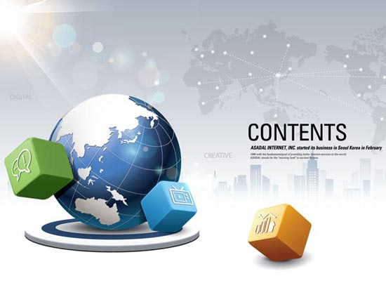
Content
1. Problem Statement
2. Objective Statements
4. Market Need
7. Competition Analysis
6. Targeted audience
8. Customer Acquisition Model
9. Brand Voice
10. Requirement Analysis
11. Case Diagram
12. App user flow chart
13. ER diagram for database
14. App sample framework
16. Reference
3. Project Timeline
5. Startup Process
15. Prototype demonstration

Slide 3
1. Problem Statement
There is not a delivery service in the market that delivers a home prepared food. Most of the delivery service use the restaurant as vendor.

Slide 4
2. Objective Statements
Research on a business model plan for a startup app development to develop and deploy home food delivery app. Focus on market research, target audience, marketing strategy and design a frame of the application.

Slide 5
3. Project Timeline
Project Plan and Strategy
Feb 13 - Feb 17
Research on business model
Feb 18 - Feb 24
Finalizing project plan
Feb 25 - Mar 11
Finalize the literature review
Mar 12 - Mar 24
Research on requirement and design idea of the app
Mar 25 - Apr 1
Prepare case diagram and activity diagram
Apr 2 - Apr 5
Build a prototype
Apr 6 - Apr 9
Presentation
Apr 7 - Apr 19
Final Report
Apr 15 - Apr 22
Feb
Mar
Apr
2021
Today

Slide 6
4. Need
Give extra income to people who are passionate about cooking
Provide a platform for self employment
People do not have to worry about restaurant licensing and regulation if they can sell their food from home
People will have access to home made healthy food in a reasonable price

Slide 7
5. Startup process
“Most business fails without proper business planning” SBA
Requires series of legal activities and Does not require huge capital to start a company.
Small Business Administration in the US helps startup company in term of registration and liability protection as well as loan service
Registered company requires license and permit along with the tax ID called EIN (Employer Identification Number)

Slide 8
6. Target Audience
Specific target to college students, young adults, parents and working professionals.
In the food delivery business, most popular demographic are college students and young adults (Baldwin, 2018).
Fitness concern users
User who are looking for self employment including parents, and laid off employee
“Self-employment is often perceived to be a desperate effort of workers who have been laid off and unable to find work again” (Goetz and et al. 2012).

Slide 9
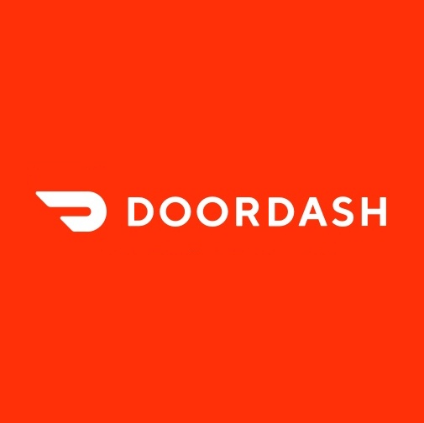
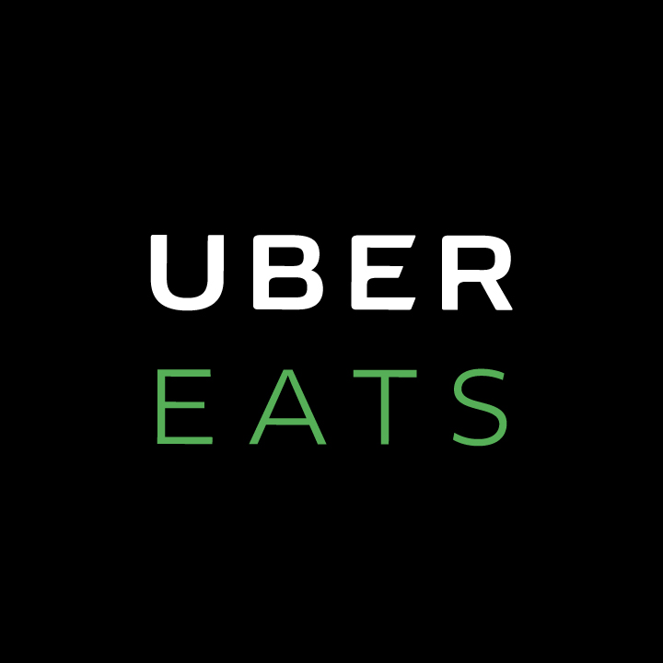


7. Competition Analysis
Delivery service from Restaurant to Customer | Delivery service from home to user
Local restaurant as well as customer will pay them for service | Only a user who sell will pay the app service
Employed food delivery people only | Encourage self employment and employ delivery people as well.
Service centric app | Service as well as social media centric app
Vs

Slide 10
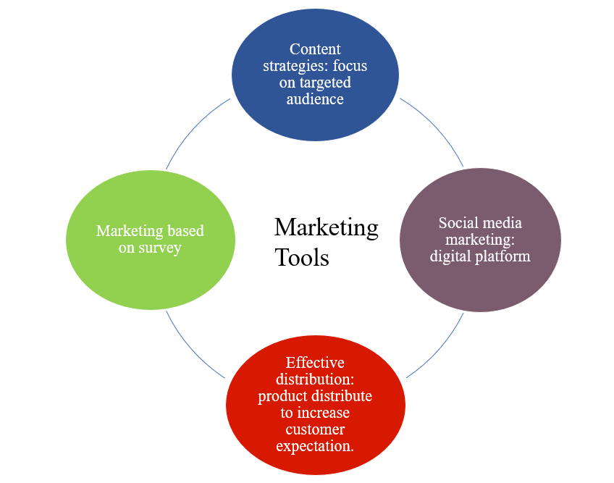
8. Customer Acquisition Model
Public outreach
Marketing based on survey
Social media marketing
Sales
Effective distribution includes free service
Content strategies focused on targeted audience

Slide 11
9. Brand Voice
Collaboratives:
We strive to bring people together and provide employment. We do not isolate users.
Intuitive:
Simplicity and ease of user.
Innovative:
Push boundary in Tech and improve user experience frequently

Slide 12
10. Requirement Analysis
Functional Requirement
Registration
Login
Username or Password retrieve
Profile
Area selection
Search
Post area as customer
Post area as vendor
Order
Menu and quantity
Special Request
Payment
Confirmation
Cancel
Non-Functional Requirements
Data requirement
Compatibility
User interface
Security
Reliable
Availability
Latency
Testability

Slide 13
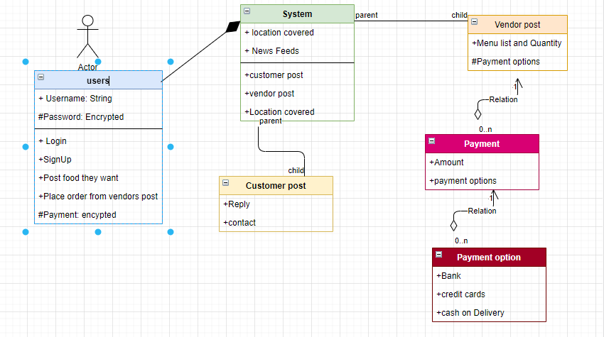


11. Case Diagram
User is the main Actor.
n has a relation with strongest association (composition)
has a relation with strong bond (aggregation)
0. n and 1 is many to one relation and vise versa

Slide 14
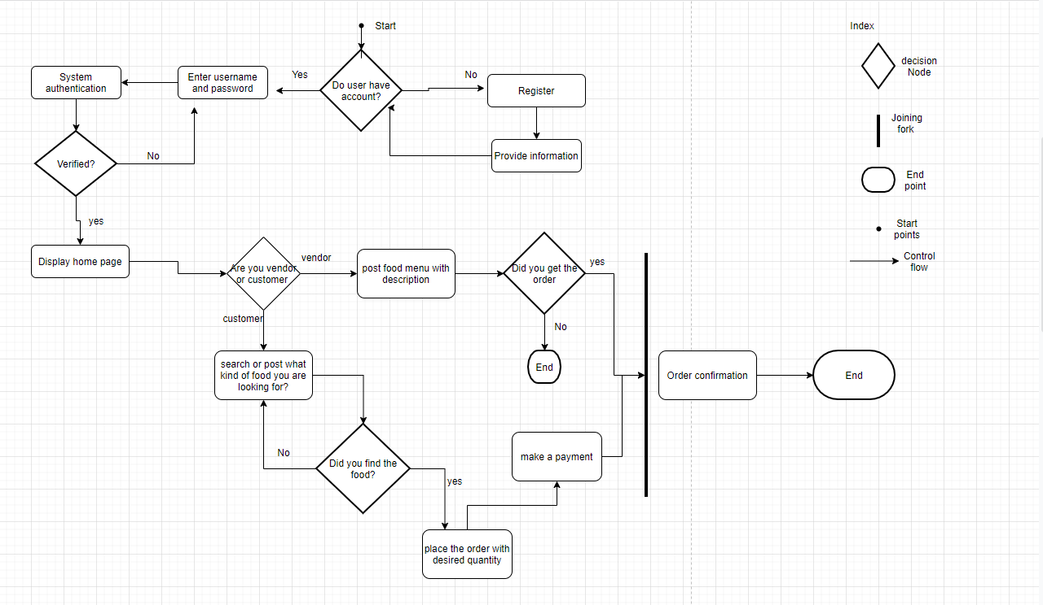
12. App user Flow Chart

Slide 15
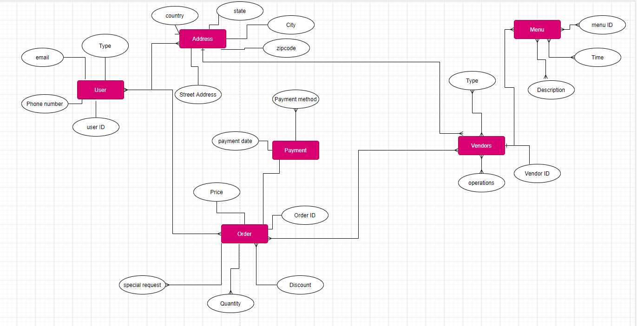
13. ER Diagram for Database

Slide 16
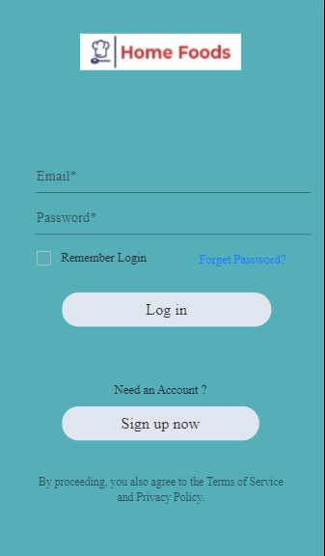
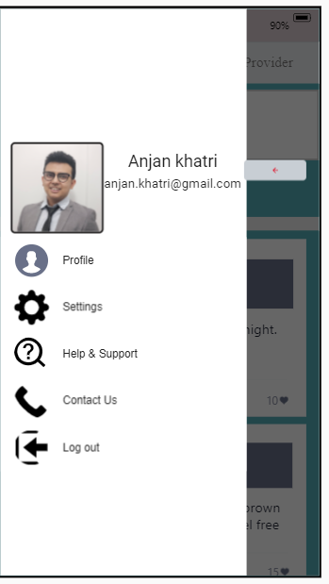
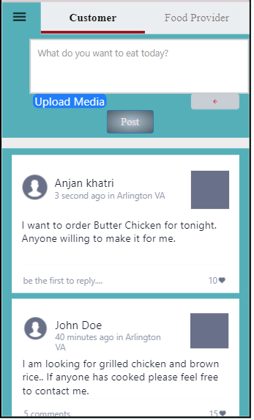
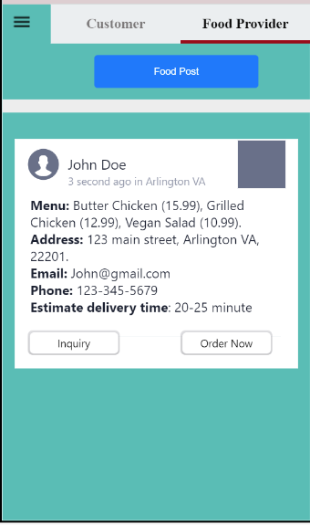
14. App Sample Prototype

Slide 17
15. Prototype demonstration
Home Foods Prototype

Slide 18
16. Reference
Baldwin, Daniela (Mar 13, 2018). 3 Target Audience to Market Your Meal Service To. Anthem Branding. https://medium.com/@anthembranding_boulder/3-target-audiences-to-market-your-meal-delivery-service-to- a4f18e353527
Basri, Wael & Siam, Mohammed. (2017). Maximizing the Social Media Potential for Small Businesses and Startups: A Conceptual Study. International Journal of Economic Perspectives. 11. 241-245.
Fletcher, A. C., & Bourne, P. E. (2012). Ten simple rules for starting a company. PLoS computational biology, 8(3), e1002439. https://doi.org/10.1371/journal.pcbi.1002439
Goetz, Stephan & Fleming-Muñoz, David & Rupasingha, Anil. (2012). The Economic Impacts of self-Employment. Journal of Agricultural and Applied Economics. 44. 10.1017/S1074070800000432.
Li, C., Mirosa, M., & Bremer, P. (2020). Review of Online Food Delivery Platforms and their Impacts of Sustainability. Sustainability, 12(14), 5528. MDPI AG. Retrieved from http://dx.doi.org/10.3390/su12145528
Mojica, I., Adams, B., Nagappan, M., Dienst, S., Berger, T., & Hassan, A. (2014). A Large-Scale Empirical Study on Software Reuse in Mobile Apps. IEEE Software, 31(2), 78–86. https://doi.org/10.1109/MS.2013.142
Spaeder, K. E. (2019). Retrieved from How to Research Your Business Idea: https://www.entrepreneur.com/article/70518
Starkey, A. (2010). e-Retail — Using home delivery as a service differentiator and strategic marketing tool. Journal of Direct, Data and Digital Marketing Practice, 12, 165-173.
U.S. Small Business Administration: https://www.sba.gov/business-guide/launch-your business/register-your-business
YATES, D. (2015, July 1). Study: Restaurant meals can be as bad for your waistline as fast food is. Illinois News Bureau. https://news.illinois.edu/view/6367/236713

Slide 19

Special Thanks
Dr. Natalia Ermicioi
Micheline Al Harrack

Slide 20
