Slide 1
Basic VBA for Excel
Presenter Name:
Notes:
1

Slide 2
Course Objectives
1
Introduction to VBA
2
Understanding and Writing codes in VBA
3
Automating tasks in Excel
4
Building User Interface
Prerequisites
Knowledge on Excel including (and not restricted to) basic functionalities - functions, charts, pivot tables etc.
System Requirement
Microsoft Excel (2010 version is illustrated in this presentation)

Slide 3
Day 1
1 | What are Macros and how to Record Macros
2 | VBA Development Environment
3 | Writing first Macro
4 | Objects, Properties and Methods
Day 2
1 | Variables, Constants and Data Types
2 | Visual Basic Statements
3 | Subroutines and Functions
4 | Conditional Branching
Day 3
1 | Working with Loops
2 | User Interface
3 | Userform
4 | Question & Answers

Slide 4
DAY 1

Slide 5

Introduction
What is VBA?
All MS Office Applications allow users to write programs within the Application to extend its capabilities. These programs are written in the language VBA – “Visual Basic for Applications”
VBA is a powerful programming language that enables you to develop
programs that accomplish complex tasks in a few minutes
What are macros?
Macros are programs written using the VBA language in the VBA Development Environment (VBE) within Excel.
Macros help you automate tasks.

Slide 6

Recording Macros
MS Office Application,including Excel, have a built-in Macro Recorder
Macros Recorder records anything that you do in the Application using the keyboard or mouse
Why use macro recorder?
It is the simplest way to create a macro in Excel
You can record anything you want to automate without using excel commands
Macros that are recorded are saved in excel workbook
Always save the workbook which has macro (recorded/coded) in .xlsm format.
Notes:
Every enterprise is a collection of common processes strung together by technologies that help deal with massive and mutating amounts of data from an increasingly complex and interconnected world. The intelligent enterprise differentiates itself and outcompetes by turning common processes into smarter processes with superior analytics and class-leading technology and in turn, delivering superior business outcomes.
Process
Companies structure themselves using functions and organizational policies; people and culture tune themselves to this functional view of the organization. Companies across all industries have a set of common, core enterprise-level processes that determine how they acquire new customers, retain them and grow existing relationships, hire and retain their workforce, develop and distribute their offerings and manage their supply chains. What differentiates the leaders from the laggards is how they view processes as a key component of business outcomes. For example, many organizations focus on driving process efficiencies -- saving money within the process -- and not effectiveness, which means setting enterprise-level strategies for processes to achieve desired business outcomes.
Intelligent Enterprises understand very well that while efficiency of business processes is a necessary condition, effectiveness drives better business outcomes and allows them to outcompete in global markets.
Analytics
The emergence of big data, regulatory changes and social media developments are causing a big shift in the way businesses operate. Most companies know data is an asset and yet, even as a majority of this data sits within their organization, they have not been able to tap its true potential. How one company harnesses this data compared to others, makes all the difference. Intelligent enterprises innovate with data and employ analytics to identify trends and issues, uncover new insights, identify and prevent future risks and fine-tune operations to meet business goals.
Technology
Technology has become a clear driver of flexibility and innovation in all business models. New technology and social connectivity are creating a deluge of opportunities, paving the way for cloud and other collaboration tools to transform internal operations, customer relationships and industry value chains. Intelligent enterprises must move quickly to seize the technology dividend. When applied intelligently – using insights from existing operations and emerging opportunities, with minimal capital expenditure along a variable cost model, and delivered in a scalable fashion using new mobile, SaaS and social media-based channels – technology can have an exponential impact on outcomes.

Slide 7
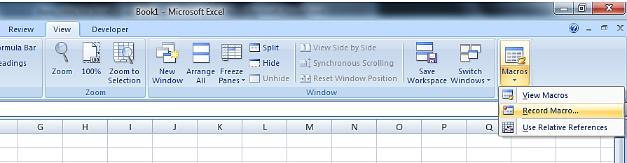
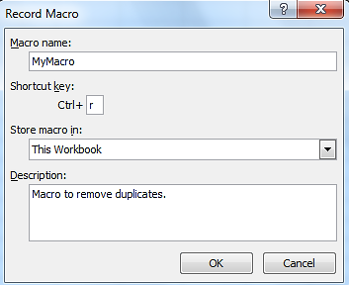
Steps to Record Macro
Open the Excel file in which you wish to record macro
On the Excel menu bar, click on View>>Macro>>Record New Macro
Fill in the ‘Record Macro’ dialogue box that pops up
Name – type a name for your macro
Shortcut key (optional) – it has to be a letter. Macro will execute every time we press Ctrl+r
Store macro in – Default is ‘This workbook’
Description (optional) – Enter description for the macro for easy understanding
After filling, Click OK

Slide 8
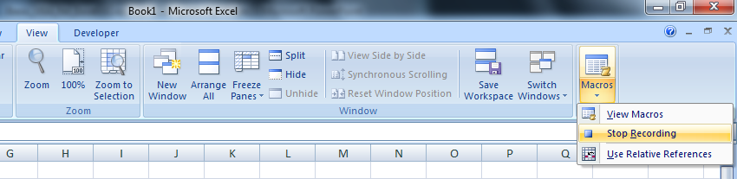
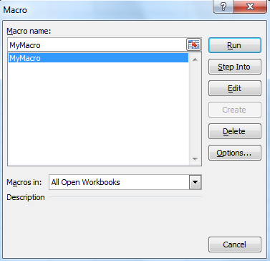
Recording and Executing Macros
Once you click OK anything that you do (with keyboard or mouse) is recorded
Manually go through the process that you want the macro to reproduce to avoid unnecessary steps
When you are done, click ‘Stop’ button to stop recording
Executing
On the Excel menu bar, click on View>>Macro>>Macros
Macro dialogue box appears with list of macros available
Select the macro you wish to run and click Run

Slide 9
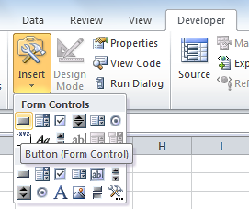
3 ways to run a Macro
1
Using Shortcut key
Use the shortcut key you entered while recording Macro (in our example it is Ctrl+r)
2
Using Macro Dialogue Box
On the Excel menu bar, click on View>>Macro>>Macros
Double click the macro you wish to run (or) select macro and click Run
3
Assigning macro to a button
On the Excel menu bar, click on Developer>>Insert
Select button under ‘Form Controls’ as shown in fig.
Now, click on the spreadsheet. A button is created and ‘Assign Macro’ dialogue box appears
Select the macro you wish to run and click OK
If dialogue box does not appear, Right click on the button and select ‘Assign Macro’

Slide 10


Limitations of Recorded Macro
Recorded macros exactly replicate what you did when you recorded the macro.
However it will hard coded references and it will not replicate the
task – say formatting a cell – in another part of the workbook
One cannot record a macro
To perform iterative task such as repeating a format/calculation across several rows
To make a decision – such as a IF…Then…else statement
To create a customized dialog box and other complex processes
How to overcome?
To get exactly what you want, you will have to edit the Visual Basic code
Learn VBA!! ☺

Slide 11


Recap
What is VBA, Macros, Recording Macros, Ways of running a macro & Limitations of Recording
Self evaluation
What is a macro?
What are the limitations of recording a macro?
Exercise
You have a list of numbers (say 1 to 10) in cells A1 to A10 and B1 to B10
The task is to multiply the numbers in each row in column C
Can you record a macro to do this task?
Use any one of the 3 methods to execute the macro

Slide 12
VBA Coding
Getting to know VBA development Environment
Project Explorer Window
Property Window
Code Window
Writing Our First Code
Debugging
Methods to debug the code
Examples

Slide 13
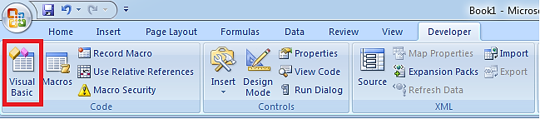
The VBA Development Environment
All VBA code is developed, tested and modified in the Excel Visual Basic Editor (VBE). It is user-friendly development environment
The VBA procedures developed in the Excel Visual Basic Editor become part of the workbook in which they are developed and when the workbook is saved the VBA components (macros, modules, userforms) are saved at the same time.
How to open Visual Basic Editor?
The VBE is integrated into Excel. Open it from the Excel menu bar using Developer>>Visual Basic
You can also use the short cut key ‘Alt+F11’

Slide 14
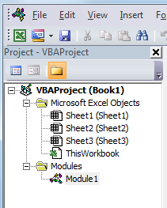
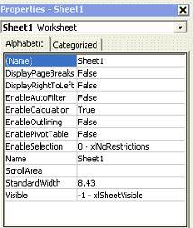
Windows in VBE
1. Project Explorer Window
If Project Explorer window is not visible in VBE, click the View >> Project Explorer (or) Ctrl+R keyboard shortcut
Displays a tree diagram of all the Workbooks currently open in Excel. Each Workbook is called a Project
It works very much like Windows Explorer. Each Project has several folders
1. For all sheets 2. For Userforms 3. For Modules
2. Property Window
If Project Explorer window is not visible in VBE, click the View >> Property Window (or) F4 keyboard shortcut
The Properties window shows all the editable properties for the currently active object like Name, Color etc. which varies for each object
Properties can be viewed in Alphabetic or Categorized order

Slide 15
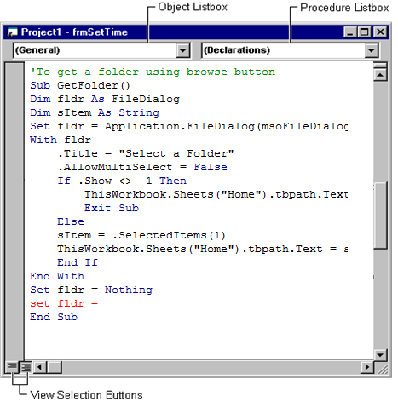
Windows in VBE contd.
3. Code Window
If Project Explorer window is not visible in VBE, click the View >> Code (or) F7 keyboard shortcut
The Visual Basic Code Editor is a window where you write the macros
It is color coded and auto formatted for ease of use
Comment Lines – starts with apostrophe) and are green
Executable code is in black
Reserved VBA words are in blue
Any error line are highlighted in red

Slide 16
Writing Our First Macro
Go to VBE (use Alt F11)
Add a new module to the workbook (Right click on Project >> Insert >> Module)
Write down the below code
Sub myfirstmacro()
MsgBox "Hello World"
End Sub
Most macro begin with ‘Sub’ (meaning subroutine) followed by the macro name (any name except keywords). It ends with ‘End Sub’ - this displays automatically as you hit Enter after
Run the macro using any one of the 3 methods discussed earlier
Code written in VBA is not case sensitive except the string variables

Slide 17
Let’s try one more..
Macro should be able to do the below task
Add a new sheet
Name the sheet as ‘Mysheet’
Below is the code
‘This code adds new sheet and names the sheet
Sub addnewsheet()
Worksheets.Add
Activesheet.Name = “Mysheet”
End Sub
Why can’t I run this code second time??
If you wonder how a certain operation is done, record it and look at the code and modify it to suit your needs.

Slide 18

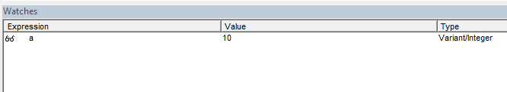
Debugging
Debugging is the art of identifying causes of errors in the code and correcting it
VBA has several options to debug the code to find the cause of problem
Watch window can be used to monitor the values of expressions and variables while stepping through the statements in the application
Use breakpoint in the code to find where the error exists
Commenting out lines – VBA do not execute the commented lines. The objective is to remove the suspect lines to see performance of the macro
Step by step monitoring the code – Use F8, to run complete code – Use F5

Slide 19
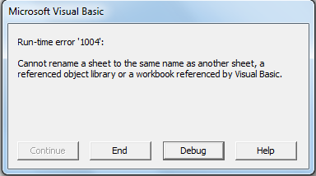
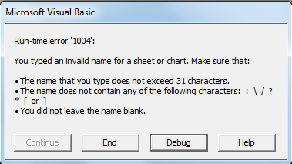
Examples
Whenever error appears in the code, try to read the message in the message box
Try to debug the code and find out what is causing the error
Read the message as it sometimes describes the error

Slide 20

Recap
VBE, Windows in VBE, Writing macro, Debugging
Self evaluation
How do you open up the VB Development Environment from Excel?
What is displayed in the Properties window?
What command do you use to run the code line by line?
How can one interrupt code when it is running?
Exercise
Write a macro that will
Select last sheet in the workbook
Name the last sheet as ”Lastsheet”

Slide 21
Application Object Model
Understanding Objects, Properties, and Methods
Object properties
Size
Color
Object method
The object has ’Move’ method.
Objects represent program entities or elements of Excel application E.g. Workbook, Sheet, Range
Properties is attribute/features of an object. Like some people have black hair, others blonde hair. E.g. Name of the Sheet, Color of the cell
Method is an action that an object can perform. Like people are able to walk or cars able to drive. Eg. Move sheet, Save Sheet, Print Range

Slide 22
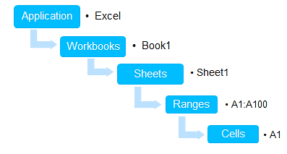
Objects
Objects are the fundamental building block of Visual Basic
Excel (and the other Office applications) consists of a number of Objects.
Macro programming is actually just manipulation of these Objects, their Properties and their Methods
Objects in Excel
Application: Represents the entire Excel
Workbook: Collection of worksheet objects
Worksheet: Collection of Range objects
Ranges: Collection of Cells

Slide 23
Accessing Objects
Fully Qualified References
To access a certain sheet we would write: Application.Workbooks(”name.xls”).Sheets(”Name”)
To access a certain range: Application.Workbooks(”name.xls”).Sheets(1).Range(”A1”)
To access a chart object in a sheet: Application.Workbooks(”name.xls”).Sheets(1).ChartObjects(1)
Partial Qualified References
If a certain workbook is already active we could write: Sheets(”Name”)
We can refer to a range in a sheet named ”Name” by writing: Sheets(”Name”).Range(”A4”)

Slide 24

Range and Cells
A Range object is one of the most common objects that we will use in VBA. A Range is a single Cell or a collection of Cells
Accessing ranges
To access single cell using range : Range(”A1”)
To access collection of cells: Range(”A1:B10”) (or) Range(”A1”,”B10”)
Using Cell Notation/ Index Number
For the single cell range C2 we can write as Cells(2,3)
Format – Cells(<row>,<column>)
We can use cell notation to refer range of cells as below
Range(Cells(1,1) ,Cells(10,2))
What does Range(Cells(1,3), Cells(2,3)) refer to?

Slide 25
Basic Range Manipulation
To set value to range: Range(”A1”).Value= 123
To set formula to range: Range(”C1”).Formula = ”=Average(”A1:A10”)”
To set font to a range: Range(”A1:B16”).Font.Bold = True Range(”A1:B16”).Font.Size=10 Range(”A1:B16”).Font.Name=”Arial”
To set color to range: Range(”A1:B16”).Interior.Color = rgbRed Range(”A1:B16”).Interior.Color = RGB(141,141,141)
Other Referencing
Multiple Area Selection: Range("C5:D9,G9:H16")
Refer entire Column: Range("A:A")
Multiple Column: Range(“A:A, C:C”)
Refer entire Row: Range(“1:1”)
Multiple Row: Range(“1:1, 3:3”)

Slide 26
Named Ranges
Cells are generally named for a column and row that intersect, like A1 or C3.
Named Range allows user to define name, like “Scores,” for score numbers typed in cells A1 through C3. Uses - Data Validation, Formulas etc.
Refer to the range named "MyRange" in the workbook Range("MyRange").Font.Bold = True Range("MyRange").Value = 10 Range("MyRange").ClearContents
Referring Multiple Ranges: Range(”Range1, Range2”).ClearContents
Do we have to give the sheet name before range?
Manage Named Ranges in ‘Name Manager’ under Formulas. We can also change scope of the range while creating it.

Slide 27
Properties and Methods
Below are few examples to understand Properties and Methods in Excel
Count Property: ActiveWorkbook.Worksheets.Count
Name Property: Sheets(1).Name= “Stats”
Activate Method: Sheets(1).Activate Sheets(1).Chartobjects(1).Activate
Add and Open Method Workbooks.Add Workbooks.Open(“D:\MyFolder\MyBook.xls")
Save As Method: ActiveWorkbook.SaveAs Filename:=“D:\MyBook.xlsx"
In VBE, icon represents property and represents method

Slide 28
Recap
Excel VBA Objects, Accessing and Manipulating objects, Properties and Methods
Self evaluation
The VBA code that will delete Sheet3 is
1) Sheets(“Sheet3”).Delete 2) Sheets(“Sheet 3”).value=Delete
3) Delete.Sheet 3 4) Delete.Sheets(“Sheet 3”)
How would you reference cells A1, A2 and A3 by means of VBA code?
1) Cells(A1,A3) 2) Range(“A1,A3”)
3) Range(“A1:A3”) 4) Cells(A1-A3)
Which of the below is property?
1) Find 2) Value
3) Select 4) Autofit

Slide 29
DAY 2

Slide 30
We will learn..
Variables & Constants
Why Variables
Declaring Variables
Datatypes and Example
Declaring Constants
Visual Basic Statements
Types of Statements
Example
Subroutine & Functions
Conditional Branching
If…Then
If…Then…Else
Select…Case

Slide 31

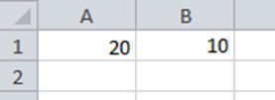
Variables
Why are Variables needed?
I would like to exchange values in Cell A1 and B1
Hence I do the following: Range(”A1”).value= Range(”B1”).value Range(”B1”).value= Range(”A1”).value
The above code does not accomplish the required task because code is executed line by line. So, the value of ”A1” cell is lost
To overcome the above problem, we need to temporarily store the value of A1
Consider the below code-
temp = Range(”A1”).value Range(”A1”).value= Range(”B1”).value Range(”B1”).value= temp

Slide 32
Variables - Definition
Variables are named areas of the computer’s memory
That part of the computers memory can hold a value
The value can be changed during the execution of the programs
The value can be accessed with the variable’s name
Variables contain specific types of data with specific data types. We’ll learn more about this shortly.
Rules for naming Variables
Must start with letter and can’t contain spaces and special characters (such as “&”, “%”, “\”)
Can’t be any excel keyword (“if”, “while”, etc…)
Must be unique inside the procedure or the module it is used in
Can have up to 255 characters.

Slide 33

Declaring Variables
The declaration of a Variable has to be made before it is used
Two basic rules for the statement for declaring variables
Variables are declared with the keyword ”Dim” (Short for Dimension)
You have to state the variables data type
Dim strName as String
Dim intValue as Integer
At the top of the module before any code is written, write ”Option Explicit” to force users to declare variables explicitly
If you omit the data type, it is set to the type ’Variant’ by default.
Advantages of Declaring Variables
They take up less memory
The code runs smoother and is easier to read
VBA checks for misspelled variable names
You cannot put the wrong data type into a variable
It’s good programming style

Slide 34
Data Types
Below is the list of most commonly used data types:
Data Type | Storage Size | Range
Boolean | 2 bytes | True/False
Integer | 2 bytes | -32,768 to 32,767
Long | 4 bytes | -2,147,483,648 to 2,147,483,647
Double | 8 bytes | –1.79769313486232E308 to –4.94065645841247E-324 1.79769313486232E308 to 4.94065645841247E-32
Date | 8 bytes | January 1, 1900 to December 31, 9999
Object | 4 bytes | Any Object Reference
String | Length of String | 1 to 65,400 characters
Variant | 16 bytes | Any numeric value up to the range of Double Range of String for non-numeric
Use a short prefix that indicates the datatype – strName, intRownum

Slide 35
Data Type Conversion
CStr(Number)
Converts Numeric to String
CStr(456) => “ 456” (A leading space is always reserved for sign)
CInt(String)
Converts String (consisting of numbers) to numeric type
CInt(“123”) => 123 (Does not work with alphanumeric)
Function | Return Type
CDbl | Convert To Double
CLng | Convert To Long
CDate | Convert To Date
CInt | Convert To Integer
CStr | Converts To String

Slide 36
Scope of Variables
Variables can be either Private or Public
1
Private Variables
Private variables can be used only by procedures in the same module. Use keyword Private to declare private module-level variables.
Private MyName As String
The Dim statement is equivalent to the Private statement. Dim MyName As String
2
Public Variables
If a public variable is declared in a module, it can also be used in any project that reference the project where the public variable is declared. Use keyword Public to declare public module-level variables.
Public strName As String

Slide 37
Declaring Constants
We declare a constant to assign a meaningful name to a value. Once a constant is declared, it cannot be modified or assigned a new value
Use the Const statement to declare a constant and set its value Const conPi = 3.14159 The compiler determines the type of the constant from the type of the expression
We can declare a constant with explicit data type as below Const DaysInYear As Integer = 365
Constants can be Public or Private Public Const DaysInYear = 365 Private Const interestRate = 7
Dim i, j as Integer. What is the data type of variable i ??
Declare multiple variable by specifying data type for each variable
Dim numrow as Integer, numcol as Integer
Const maxlen as Long = 1000 , maxnum as Integer= 200

Slide 38
Recap
Variables, different Data Types, Data Type Conversion
Public & Private Variables, Constants
Self evaluation
Find the Error in the below Code tempVal = Range("A1").Value Range("A1").Value = Range("C1").Value
Range("C1").Value = temVal
What is the value of Z after executing Test for Conversion the below Code?
Dim X, Y, Z As Integer Sub conTest()
X = 32 Dim x, y As String, z as integer
Y = 5 x = "2"
Z = X/ Y y = "20"
z = x + y
End Sub

Slide 39
Visual Basic Statements
A statement in Visual Basic is a complete instruction containing keywords, operators, variables, constants, and expressions
VB Statements belong to one of the below categories
Declaration Statements
Assignment Statements
Executable Statements
1
Declaration Statements
Declaration Statement is used to name and define procedures, variables and constants and can also specify data type Sub ApplyFormat() Dim myrange as Range Dim j as Integer End Sub
The Sub statement (with matching End Sub statement) declares a procedure ‘ApplyFormat’
The Dim statement declares variables ‘myrange’ and ‘j’

Slide 40
2
Assignment Statements
Assignment statements assign a value or expression to a variable or constant.
It always include an equal sign (=)
myNum=10
The Set keyword is used to assign an object to a variable Set myRange= Range(“A1:A10”)
Statements that set property values are also assignment statements Range(“A1”).Font.Bold=True
3
Executable Statements
An executable statement initiates action. It can execute a method or function, and it can loop or branch through blocks of code.
Executable statements often contain mathematical or conditional operators. It helps in making the program run Sub Test() Dim num as Integer If num>5 then MsgBox “Number is greater than 5” End If End Sub

Slide 41
More about Statements
Continuing a Statement over Multiple Line To continue a statement onto the next line using a line-continuation character a space followed by an ‘underscore’ at the end of line. Below is an example: MsgBox “The file is not valid. Kindly check the file”, _ “Error Message”
Adding Comments Comment lines begin with an apostrophe (') . They are highlighted in Green in VB Editor. Visual Basic ignores comments when it runs your procedures
‘To check if the file exists in folder
Checking Syntax errors The line having syntax Error will be displayed in red. Those lines must be corrected before executing the code Dim i Integer
Among 3 VB statements, What statement is Sheets(1).Activate?

Slide 42
Procedure: Subroutine & Functions
A Procedure is a named unit of code that contains that contains a sequence of statements to be executed as a group.
It can be of two types: Subroutines & Functions
Subroutine
A Sub procedure is a series of Visual Basic statements enclosed by the Sub and End Sub statements. They perform any number of activities.
It can take arguments that are passed to it by a calling procedure
Sub mysub(argument1, argument2) ‘executable statements End sub
Without arguments, must include an empty set of parentheses () Sub mysub() ‘executable statements End sub
A subroutine does not return any Value to calling procedure

Slide 43
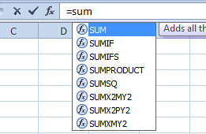
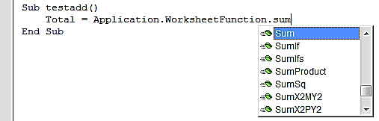
Function
A Function procedure is a series of Visual Basic statements enclosed by the Function and End Function statements
Functions are of Two types: Built-In and User Defined
A function returns Value to calling procedure
1
Built-In Function
These come with Excel and do not need VBA to define them
Above image shows accessing built-in function in Formula Bar
Built-in functions can also be accessed in VBA code by using WorksheetFunction
Few Built-in functions are Now(), Count, Substitute, Vlookup

Slide 44
2
User-Defined Function
User-defined functions are customized functions written in VBA
It is a series of statements, enclosed by the Function and End Function statements
Function myfunction(argument1,argument2)
some statements
myfunction=some value
End Function
It returns a value by assigning a value to its name
It has to be written in module
Example…Let’s try this
Let us code a very simple function – say, adder – that will take two numbers add them together and then return them to the user
Function adder (a,b)
adder= a+b End Function
Go back to Excel sheet and type =adder(5,5) in any cell. Value 10 is returned
Now, you can use this function just like you would use any built-in Excel function.

Slide 45
Few String Functions
Len(String)
Returns the number of characters in the String
Len(“Hello World”) ⇒ 11
Lcase(String)
Changes all the characters in String to Lower case
Lcase(“Hello World”) ⇒ “hello world”
Ucase(String)
Changes all the characters in String to Upper case
Ucase(“Hello World”) ⇒ “HELLO WORLD”
Trim(String)
Eliminates both leading and trailing blanks
Trim (“ Hello “) ⇒ “Hello“
Mid(String)
Returns part of the string specified by start and end position
Mid (“Good Day“, 1, 4) ⇒ “Good“
Exercise – Using built-in and User defined Function
Column A contains First Name, Column B contains Second Name
Write a function which takes two string as arguments and returns below output
john | right
JOHN RIGHT

Slide 46
Conditional Branching
1. If…Then
Used to choose an action depending on a condition If <condition> Then <statement> End If
Example: If age > 18 Then Vote = “Yes” End If
Multiple Conditions : If <condition1> AND <condition2> Then <statement>
If <condition1> OR <condition2> Then <statement>
2. If…Then…Else
This statement is used to define two blocks of conditions - True and False If <condition> Then <statement1> Else <Statement2> End If
Example: If age > 18 Then Vote = “Yes” Else Vote=“No” End If

Slide 47
Conditional Branching
3. If…Then…ElseIf
Used if there are multiple conditions If <condition1> Then <statement1> ElseIf <condition2> Then <statement2> Else <statement3> End If
The Else clause always comes at the end
4. Select Case
This is an alternative to If..Then..ElseIf branching
This is more efficient and easy to read. Select the expression to evaluate and then decide action depending on the value of expression Select Case <test expression> Case <expression1> <statement1> Case <expression2> <statement2> Case Else <statement3> End Select

Slide 48
Conditional Branching - Example
Using If…Then…ElseIf
Using Select Case
Dim Marks as Integer, Grade as String
If Marks >= 90 Then Grade= “A" ElseIf Marks >= 80 Then Grade = "B" ElseIf Marks >= 70 Then Grade = “C" ElseIf Marks >= 70 Then Grade = “D" Else Grade = “Fail" End If
Dim Marks as Integer, Grade as String
Select Case Marks Case Is >= 90 Grade = "A" Case Is >= 80 Grade = "B" Case Is >= 70 Grade = "C" Case Is >= 60 Grade = "D" Case Else Grade = “Fail" End Select
Both render same functionality. Use the one that is convenient for you to code!

Slide 49



Recap
VB Statements, Subroutine & Functions, String Operators and
Conditional Branching
Exercise
Enter any value in A1
Based on the entered value, color the cell A1 as below
Yellow if value is lesser than 10
Green if the value is greater than 10 and less than 50
Red if value is greater than 50
Assign the macro to a button and test it

Slide 50

What do you mean by workspace?
Group of Ranges
Group of Worksheets
Group of Workbooks
Group of Cells
You want to write ‘Month’ in Cell A1
Sheets(1).cells(1,1).Value = "Month"
Range("A1") = “Month”
Cells(1,1) = Month
Both A and B
If you try calculation on #DIV/0 using VBA what is the error that appears?
Run-time error '13' Type Mismatch
Run-time error '6' Overflow
Run-time error '11' Division by zero
0
Can I record macro that has to run every time the workbook opens?
Yes
No

Slide 51
Day 3

Slide 52
We will learn…
Working with Loops
Do Loops
For…Next Loop
For Each…Next Loop
User Interface
Message Box
Input Box
User Form

Slide 53

Working with Loops
Loop is a programming structure that causes a section of program code to execute repeatedly.
Three requirements in a Loop
Initialize the counter
Condition to evaluate and check
Iterate the counter
CAUTION!! If the condition for a loop is not set properly, the loop might become an Infinite Loop. Example- The condition given in a Do…While Loop never becomes false
If the code enters into infinite loop, interrupt by using ESC key or Ctrl+Break

Slide 54

Do Loops
Do While
Repeat an action as long as a condition is true and stops when condition becomes false
i = 1 Do While i =< 10 Cells(i, 1) = i i = i + 1 Loop
Do Until
Repeat an action as long as a condition is false and stops when condition becomes true
i = 1 Do Until i = 11 Cells(i, 1) = i i = i + 1 Loop
Do not miss to increment the counter. Otherwise code will go into Infinite Loop

Slide 55


For…Next Loops
Used when you want to repeat an action for a particular number of times
The counter initialization & increment are taken care of in the For statement itself. Separate statements are not needed
In the above example, the counter is from 1 to 10. Note that counter is incremented by itself and it increments by 1
For i = 1 to 10 Cells(i, 1) = i Next i
For Loop with Step
Use the Step keyword to specify an increment different from 1 for the counter variable
The Step keyword can also take negative values which will result in decrement of the loop. For i=10 to 0 Step -2
For i = 1 to 10 Step 2 Cells(i, 1) = i Next i

Slide 56
For Each…Next Loop
It is used when procedure needs to loop through all of the objects of a collection or all of the elements in an array.
Sub FormatSheet()
Dim ws as Worksheet
For each ws in Thisworkbook.worksheets
ws.Range(“A1:K1”).Font.Bold= True
Next
End Sub
Exiting Loop Early
Consider a scenario where sheet named ‘Stats’ has to be deleted. Looping is not required once the sheet is deleted.
Sub DeleteSheet()
Dim ws as Worksheet
For each ws in Thisworkbook.worksheets
If ws.Name = “Stats” Then
ws.Delete Exit For End If Next
End Sub
If there are 50 sheets and Stats is 3rd sheet, then loop still goes on if not exited!

Slide 57

Recap
Looping – Do Loops, For Loops: For..Next and For..Each, Early loop exit
Exercise
Column A has months and Column B has number of projects
Highlight (color the text or color the cell) months having projects greater than 15
Assign the macro to a button and test it

Slide 58
User Interfaces
The GUI (Graphical User Interface) is created to make the application interactive. This includes Prompts, questions to the user, Key entry, Mouse Click, Menu Selection, Text or data entry
The basic purpose is to have a user-friendly interface that can be used to get user inputs which will drive the application forward
There are 3 types of User Interface
Input Boxes
Message Boxes
User Forms

Slide 59
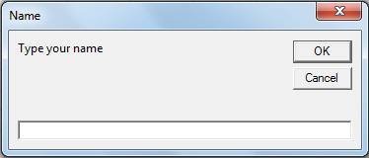
1
Input Box
This in-built feature can be used to get inputs from the user
The value that is entered by the user will be taken as Variant datatype. The value entered by the user can be assigned to a variable
Sub inputBoxtest()
Range("A1").Value = InputBox("Type your name", "Name")
End sub
Sub inputBoxtest()
Dim num as Integer
num = InputBox("Type a number", "Number")
Range("A1").Value = num + 10
End sub
How do u evaluate Cancel button?

Slide 60

2
Message Box
This in-built feature can be used to convey information to the user
Programming just consists of specifying its design and message
The basic Message Box has 3 arguments. The syntax is
MsgBox "Message",[Button/Icon],["Caption of the Title Bar"]
Sub myMessage()
MsgBox "This is my message", _
vbExclamation, “This is title"
End sub
Message Box Style | Icon
vbInformation
vbExclamation
vbCritical
vbQuestion

Slide 61
Message Box
The MsgBox function has several options for buttons like OK, Yes, No, Cancel, Abort, Retry etc.
Each button has value that will be return if clicked by the user. These can be used in programming to do the task as selected by the user
Sub myMessage()
Dim answer as long
answer= MsgBox(“Do you want to delete sheet 1?", vbQuestion, “Delete“
If answer = vbYes Then
Sheets(“Sheet1”).delete
End If
End sub
The table shows the value and constants corresponding to the function description
Description | Constant | Value
OK | vbOK | 1
Cancel | vbCancel | 2
Abort | vbAbort | 3
Retry | vbRetry | 4
Ignore | vbIgnore | 5
Yes | vbYes | 6
No | vbNo | 7

Slide 62
3
User Forms
Input Box and Message Box are built-in user interfaces that take limited input from the user and cannot be customized
User Form is an interface that can be built with the inputs as designed by the user. They are highly flexible and customizable
User forms consist of
A interface consisting of buttons, dropdown boxes, labels etc.
The design elements are linked to the code at the back
Depending on the action performed by the user on the interface, various codes are run at the back.
The skill of the programmer lies in developing an interface that is flexible enough for the user, while at the same time being easy to code at the back

Slide 63
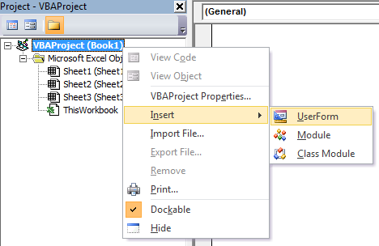
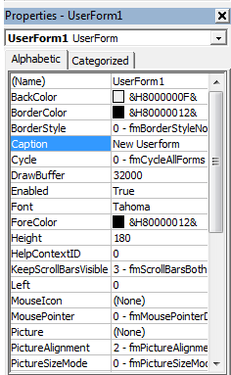
Creating a User Form
Right Click on Project in VB Editor and Choose Insert and Click User Form as shown in the Fig.
You can change properties of the User Form (Caption, Color, etc.) as shown in the Fig.

Slide 64
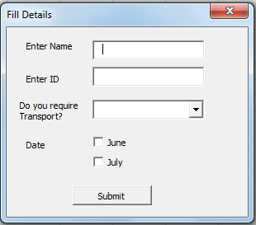
User Form Design
Design a User Form as below

Slide 65
Explanation of a project
We will learn how to build a Excel tool using VBA to accomplish small task
We will also see how we can build user interfaces and other features that makes the application user-friendly
Project – Requirement
A workbook has 6 sheets
Merge 6 sheets into one sheet
Do not start coding right away once you get problem statement!!
Steps
Check if the task is doable (standardized, generic for coding)
Build the logic and code
Test the functionality and Optimize the code
Build user interface to run the tool smoothly

Slide 66

Few Snippets required to make code generic
Get last used row in “A” column lastrow = Sheets(1).Range(“A1000000”).End(xlup).Row
Get last used column in first row lastcol = Sheets(1).Cells(1, Columns.Count).End(xlToLeft).Column
Applying Autofilter
Sheet(1).Rows(“1:1”).AutoFilter Field:=1, Criteria1:=“Outlet”
Sheet(1).UsedRange.SpecialCells(xlCellTypeVisible).Copy
Creating Chart
Charts.Add
Activechart.SetSourceData Source:=Range(“A1:B10”)
Activechart.ChartType = xlLine

Slide 67

Final Few Words
Practice makes man perfect! ☺
We now have all the building blocks in place to develop codes in Excel, What is needed now is the practice to put all these blocks together
References
BOOKS
Reference Book 1: VBA & Macros for Excel - Jelen, Techmedia Publishers
Reference Book 2: Excel 2002, Programming with VBA Bible - John Walkenbach, Wiley
Reference Book 3: Learn MS Excel 2000 VBA Programming - Korol, BPB Publications
WEBSITES
http://office.microsoft.com/en-in/training/get-in-the-loop-with-excel-macros-RZ001150634.aspx
http://www.excel-spreadsheet.com/vba/vba.htm
http://excelvbatutor.com/vba_tutorial.html

Slide 68


