Slide 1
WEB-BASED STOCK PREDICTION SYSTEM
GROUP 13
DEEP PATEL
NIKITHA MAIYA
RAGHAV PANDYA
ROHIT BOBADE
SHRUTI VENKATESH

Slide 2
KEY ADDITIONS FROM DEMO 1
Search stock
Track and remove stock
Change timeline
Add and Store Favorites
Predict short-term and long-term values.
News Feed
Compare two stocks
Real-time stock ticker

Slide 3
SYSTEM SPECIFICATIONS
Operating System : MacOSX, Ubuntu
Python : Version 2.7
Django : Version 1.9.5
HTML : HTML5
JavaScript
Yahoo Finance

Slide 4
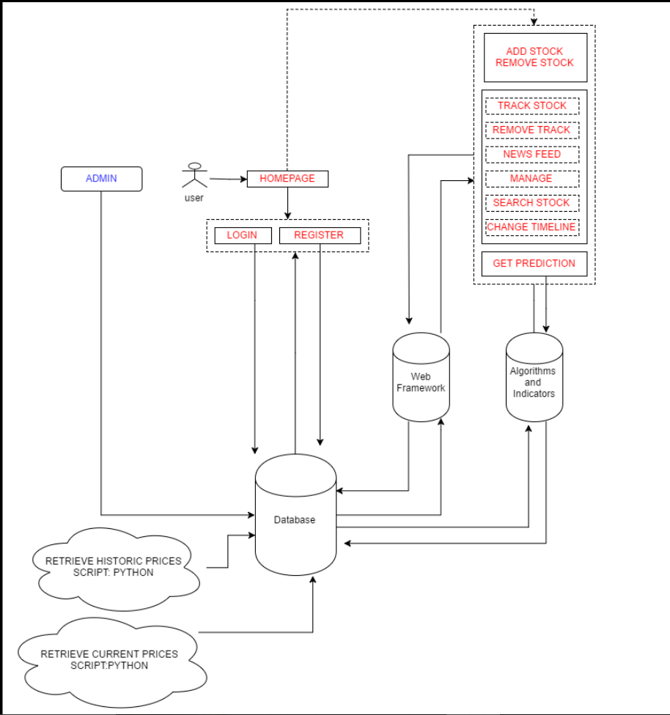
SYSTEM ARCHITECTURE

Slide 5
ALGORITHMS AND INDICATORS
Bayesian Curve Fitting
Support Vector Machine – MA, EMA and ROC
Back Propogation Algorithm
Relative Strength Index (RSI)
Moving Average Convergence Divergence (MACD)
Volume

Slide 6
DEMO

Slide 7
FUTURE WORK
Add more amount of stocks.
Group stocks by their sector ad use in analysis and recommendation
Add features: adding portfolios, system recommendation of good stocks.
K-means clustering algorithm to find good stocks.
Notifications via email and text

Slide 8
THANK YOU!!!!

