Slide 1

UNIT 6 : System Implementation
Process
Maintenance
Types
SQ
Types
Introduction
Testing
FTR
Installation
Submitted To:
Mr. Deepak Khadka
Submitted By:
Anishu Nachring Rai
Anjan Shrestha
Neelisha Shrestha

Slide 2
System Implementation
Process
Maintenance
Types
SQ
Types
Introduction
Testing
FTR
Installation

Slide 3
System Installation
Process
Maintenance
Types
SQ
Types
Introduction
Testing
FTR
Installation

Slide 4
Types of System Installation
Process
Maintenance
Types
SQ
Types
Introduction
Testing
FTR
Installation

Slide 5
Type 1
Process
Maintenance
Types
SQ
Types
Introduction
Testing
FTR
Installation

Slide 6
type3
Process
Maintenance
Types
SQ
Types
Introduction
Testing
FTR
Installation

Slide 7
Type 5
Process
Maintenance
Types
SQ
Types
Introduction
Testing
FTR
Installation

Slide 8
Type 7
Process
Maintenance
Types
SQ
Types
Introduction
Testing
FTR
Installation

Slide 9
System Quality
Process
Maintenance
SQ
Types
Types
Introduction
Testing
FTR
Installation

Slide 10
System Quality Assurance
Process
Maintenance
SQ
Types
Types
Introduction
Testing
FTR
Installation

Slide 11
Formal Technical Review
Process
Maintenance
SQ
Types
Types
Introduction
Testing
FTR
Installation

Slide 12
Walkthrough V/S Inspections
Process
Maintenance
SQ
Types
Types
Introduction
Testing
FTR
Installation

Slide 13
System Maintenance
Process
Maintenance
Types
SQ
Types
Introduction
Testing
FTR
Installation

Slide 14
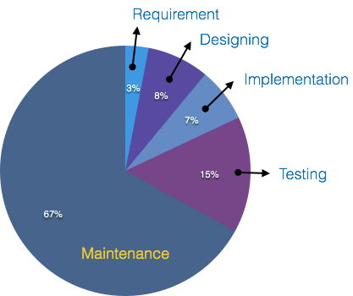
Process
Maintenance
Types
SQ
Types
Introduction
Testing
FTR
Installation
fig: - Pie chart representing the costing stages of SDLC.

Slide 15
Types of System Maintenance
Process
Maintenance
Types
SQ
Types
Introduction
Testing
FTR
Installation

Slide 16
Type 1
Process
Maintenance
Types
SQ
Types
Introduction
Testing
FTR
Installation

Slide 17
Type 3
Process
Maintenance
Types
SQ
Types
Introduction
Testing
FTR
Installation

Slide 18
System Maintenance Process
Process
Maintenance
Types
SQ
Types
Introduction
Testing
FTR
Installation

Slide 19
Testing
Process
Maintenance
Types
SQ
Types
Introduction
Testing
FTR
Installation

