Slide 1

UNIT 6 : System Implementation
Process
Maintenance
Types
SQ
Types
Introduction
Testing
FTR
Installation
Submitted To:
Mr. Deepak Khadka
Submitted By:
Anishu Nachring Rai
Anjan Shrestha
Neelisha Shrestha

Slide 2

System Implementation
﻿System implementation is the development, installation and testing of system components and delivery of that system into production (Bentley et. al., 2007). The purpose of system implementation is to build a system, install it, replace and old systems, preparing system and user documentation and train users.
﻿This lesson consists of six sections:
Overview of system implementation
Coding
Testing
Documenting the system
Training
Installation
Process
Maintenance
Types
SQ
Types
Introduction
Testing
FTR
Installation

Slide 3

System Installation
﻿Installation is the process of moving from the current system to the new or enhanced system. This is also refer to conversion activity; converting an old system to a new system. At this stage, all users must give up their reliance on the current system and begin to rely on a new system.
Process
Maintenance
Types
SQ
Types
Introduction
Testing
FTR
Installation

Slide 4
Types of System Installation
There are 7 types of System Installation:
﻿Attended Installation
﻿ Silent installation
﻿ Unattended installation
﻿ Headless installation
﻿ Scheduled or automated installation
﻿ Clean installation
﻿Network installation
Process
Maintenance
Types
SQ
Types
Introduction
Testing
FTR
Installation

Slide 5

Attendend Installation: -
Attended installers may ask users to help mitigate the errors. For instance, if the disk in which the computer program is being installed was full, the installer may ask the user to specify another target path or clear enough space in the disk.
Process
Maintenance
Types
SQ
Types
Introduction
Testing
FTR
Installation
﻿ Silent Installation: -
Silent Installation is a type of installation that does not display messages or windows during its progress. "Silent installation" is not the same as "unattended installation" .

Slide 6

﻿ Unattended Installation: -
Unattended Installation is a type of installation that is performed without user interaction during its progress or with no user present at all.
Process
Maintenance
Types
SQ
Types
Introduction
Testing
FTR
Installation
﻿ Headless Installation: -
Headless Installation is a type of installation performed without using a computer monitor connected.

Slide 7
﻿Scheduled or automated Installation: -
An installation process that runs on a preset time or when a predefined condition transpires, as opposed to an installation process that starts explicitly on a user's command.
Process
Maintenance
Types
SQ
Types
Introduction
Testing
FTR
Installation
﻿Clean Installation: -
A clean installation is one that is done in the absence of any interfering elements such as old versions of the computer program being installed or leftovers from a previous installation.

Slide 8

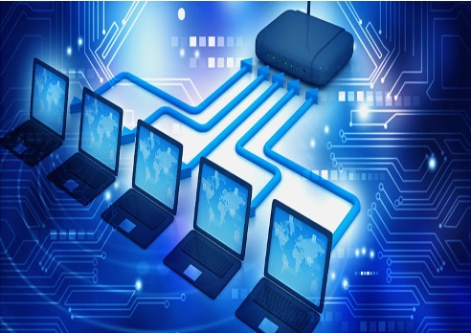
﻿Network Installation
Network installation, shortened net install, is an installation of a program from a shared network resource that may be done by installing a minimal system before proceeding to download further packages over the network.
Process
Maintenance
Types
SQ
Types
Introduction
Testing
FTR
Installation

Slide 9
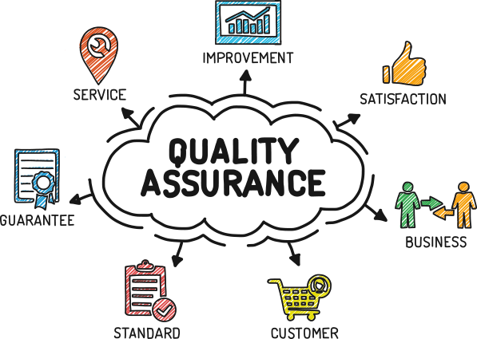
System Quality
It defines the quality of system. It depends on the reliability, durability, functionality and performance of the system. If these terms are good, the system is called of good quality if not is called bad quality.
Process
Maintenance
SQ
Types
Types
Introduction
Testing
FTR
Installation
Fig:- Quality Asurance Test Criteria

Slide 10

Quality Software
Quality software is reasonably bug-free, delivered on time and within budget, meets requirements and/or expectations, and is maintainable. It will depend on who the ‘customer’ is and their overall influence in the scheme of things. Each type of ‘customer’ will have their own view on ‘quality’
Process
Maintenance
SQ
Types
Types
Introduction
Testing
FTR
Installation

Slide 11

Software Quality Assurance
Simply a way to assure quality of the software. SQA is process within the software development life cycle (SDLC) that checks the developed software to ensure it meets desired quality measures.
It contains set of activities that ensures process, procedure during development of the software.
Such as:
Application of Technical Methods
Conduct of Formal Technical Review (FTR)
Testing of Software
Enforcement of Standards
Control of Change
Process
Maintenance
SQ
Types
Types
Introduction
Testing
FTR
Installation

Slide 12
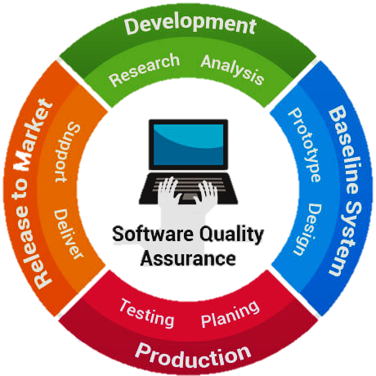
Process
Maintenance
SQ
Types
Types
Introduction
Testing
FTR
Installation
Fig: - Methods of System Quality Assurance

Slide 13

Formal Technical Review
A software quality assurance activity performed by software engineers and other participant members. FTR serves as a training ground, enabling junior engineers to observe different approaches to software analysis and designing.
FTR is actually a class of reviews that includes walkthroughs, inspections, and other small group of assessment software.
Process
Maintenance
SQ
Types
Types
Introduction
Testing
FTR
Installation

Slide 14
Walkthrough V/S Inspections
Walkthrough:-
Representative of formal technical review. In software engineering, a walkthrough or walk-through is a form of software peer review "in which a designer or programmer leads members of the development team and other interested parties through a software product, and the participants ask questions and make comments about possible errors, violation of development standards, and other problems".
Process
Maintenance
SQ
Types
Types
Introduction
Testing
FTR
Installation
Inspection: -
An organized examination or formal evaluation exercise. It is review designed to identify the problem close to the origin of the point. Inspections are usually non-destructive.
Steps:
Planning
Overviewing Meeting
Preparation
Inspection meeting
Follow up

Slide 15


System Maintenance
System Maintenance is one of the most important part of SDLC. It’s primary goal is to modify and update software applications after delivery to correct errors and improve performace. It includes inclusive activity such as :
Error Correction
Deletion of obselete capabilities
Enhancement of capabilities
Optimization
Process
Maintenance
Types
SQ
Types
Introduction
Testing
FTR
Installation

Slide 16
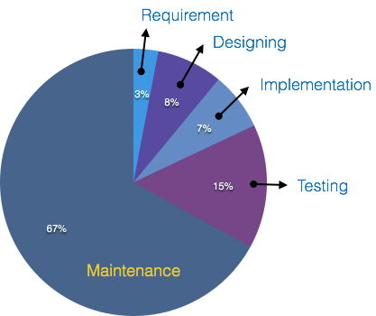
Process
Maintenance
Types
SQ
Types
Introduction
Testing
FTR
Installation
fig: - Pie chart representing the costing stages of SDLC.

Slide 17
Types of System Maintenance
Corrective Maintenance:-
This includes modifications and updates are done in order to correct or fix problems, which are either discovered by user or concluded by user error reports.
Customized Maintenance: -
This type of maintenance refers to the creation of new features of adapting existing ones as required by changes in the organization or by the users.
Enhancement Maintenance: -
It deals with enhancing or improving the performance of the system either by adding new features or by changing existing ones.
Preventive Maintenance: -
This type of maintenance may be one of the most cost effective , since if performed timely and properly, it can avoid major problems with the system.
Process
Maintenance
Types
SQ
Types
Introduction
Testing
FTR
Installation

Slide 18
System Maintenance Process
Filling up the request form
Evaluating the request
Changing the system according to the request
Testing the changes
Documenting the changes
Process
Maintenance
Types
SQ
Types
Introduction
Testing
FTR
Installation

Slide 19

Testing
System Testing is a level of testing that validates the complete and fully integrated software products . It is condected to evaluate end -to-end system specification. It is also called black box testing. The common view of testing held by users is that it is performed to prove that there are no errors in a program
Process
Maintenance
Types
SQ
Types
Introduction
Testing
FTR
Installation

Slide 20

THANK YOU EVERYONE !!!!
?
For you attention.
Any Queries

