Slide 1
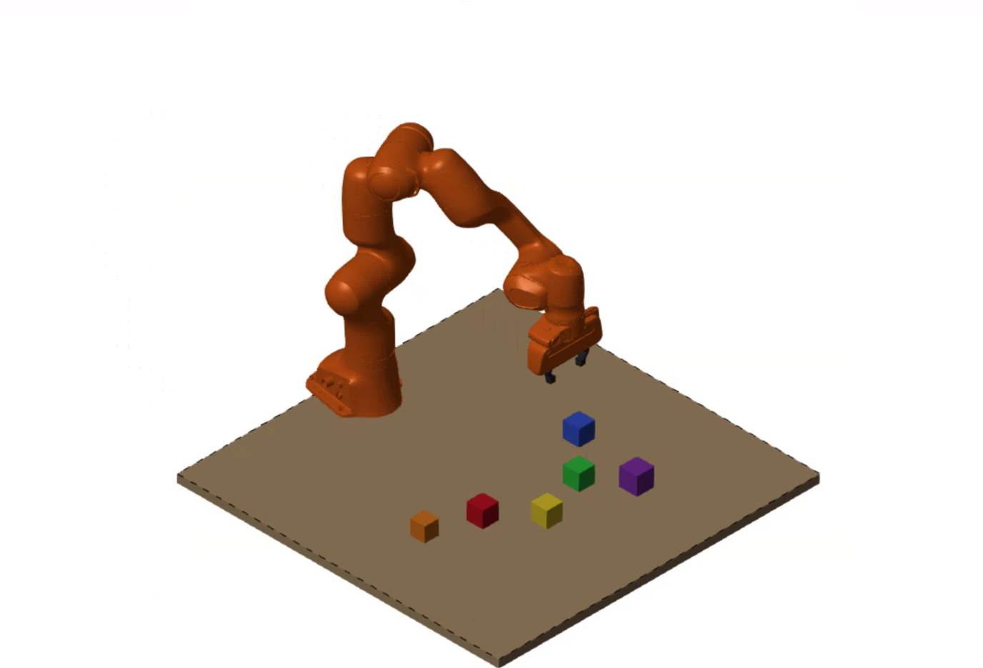
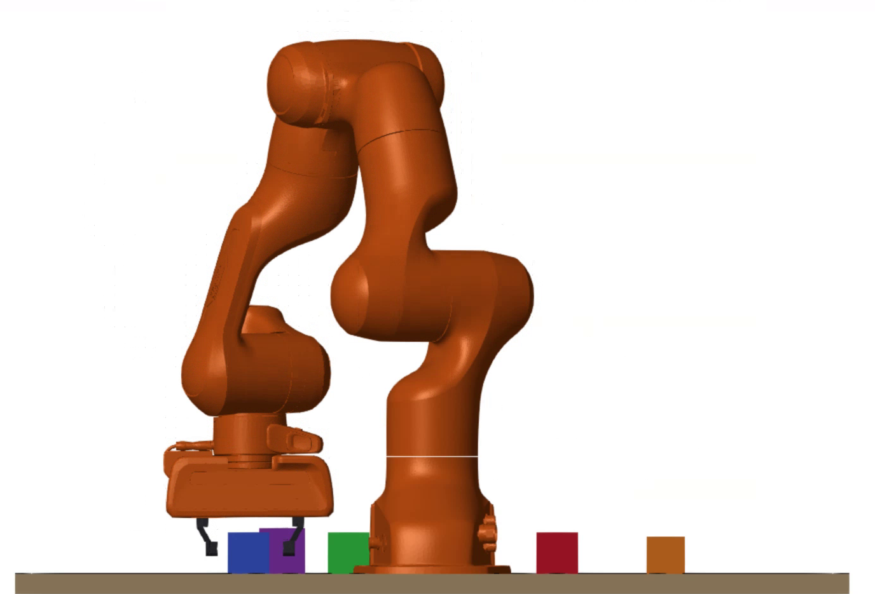
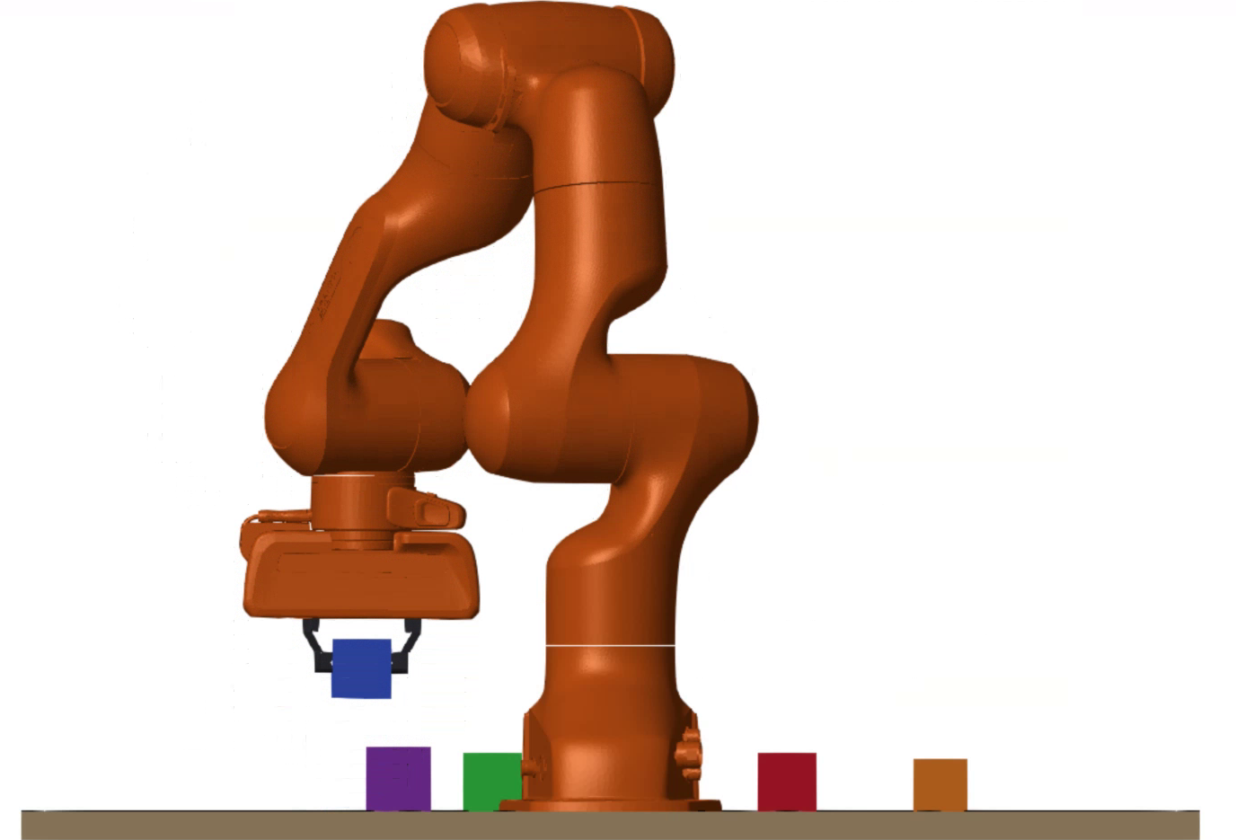
Phase-scheduled admittance and impedance control for grasping a chosen box with a simulated Franka Panda
Task. Pick up one box of a named colour from six on a table, using a 7-DOF Panda and Franka Hand in Simscape Multibody.
Scope. This work covers the control and safety layer. Box selection by a vision-language planner is separate and connects through one function, nextArmTarget.
Why two control laws. Pose error becomes contact force through task stiffness. An 8 mm error gives 20 N at 2500 N/m, above the 15 N stop limit, and 1.8 N at 220 N/m.
Method. Travel uses admittance at high stiffness for tracking. Descent, grip and lift use impedance at low stiffness. A wrist wrench monitor can stop any phase.
Workspace with six boxes, arm travelling
Fingers around the blue box, low stiffness
Box lifted and held
1

Slide 2
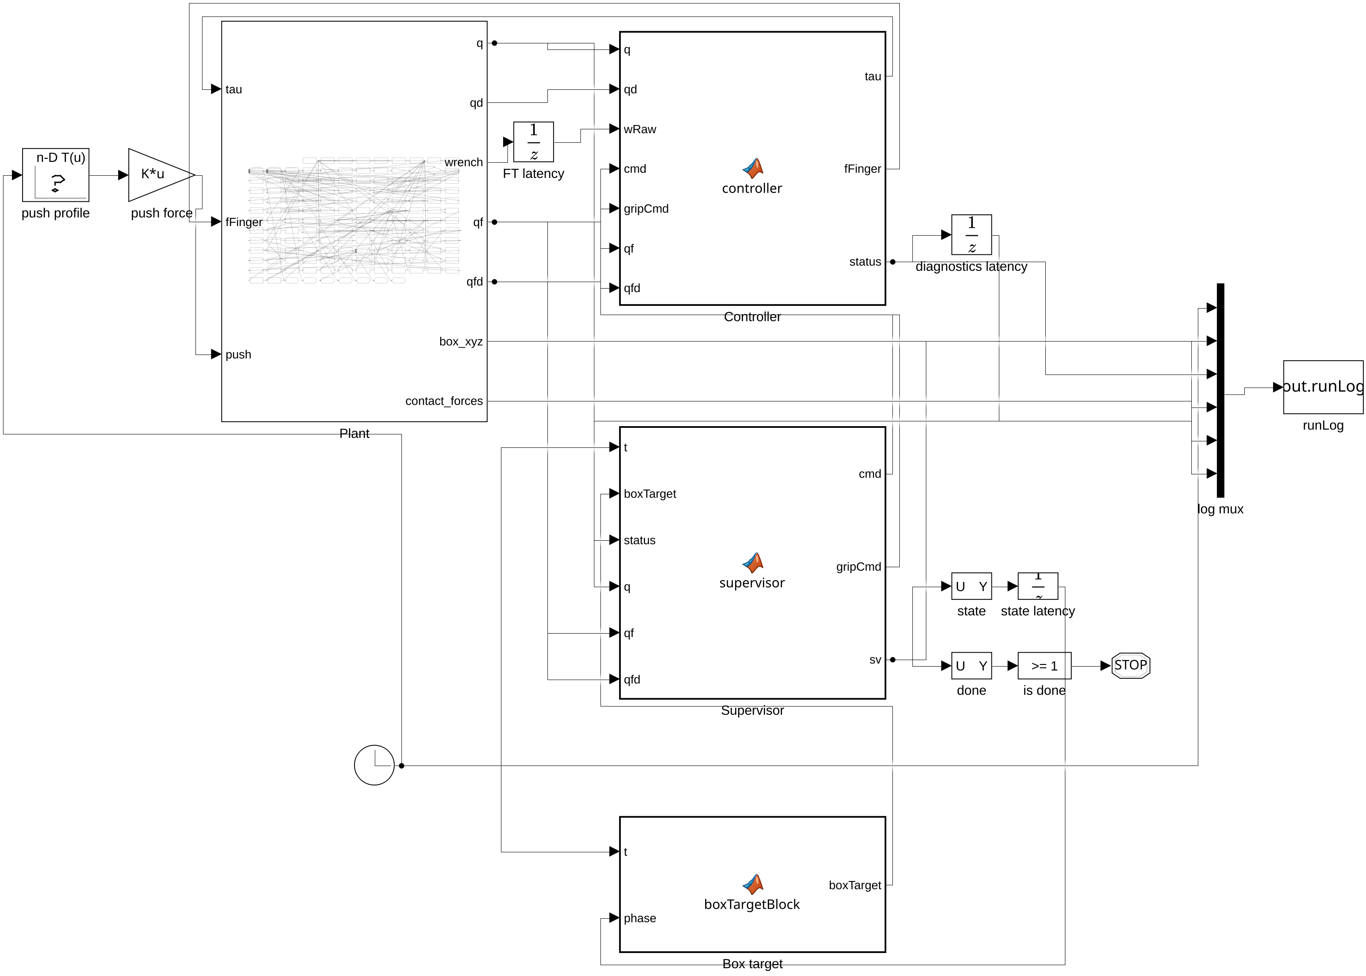
The simulation uses published arm data, with control at 1 kHz and sequencing at 50 Hz
Arm dynamics. Link inertials and joint friction from Gaz et al. (2019). Moving mass 16.07 kg. Joint torque rate limited to 1000 N·m/s.
Wrist sensor. Weld joint between flange and hand, 1 ms delay. Tool weight and inertia are removed and the offset is zeroed in the first 0.5 s.
Contact. 17 point-cloud contact pairs. k = 10⁵ N/m, c = 300 N·s/m, µ = 1.1 static and 0.9 kinetic, all chosen rather than measured.
Solver. daessc, step ≤ 1 ms. Fixed-step ode14x launched the box on contact; ode1be reported 13 N on a 1.47 N box.
Top level of the generated Simulink model.
Gaz, Cognetti, Oliva, Robuffo Giordano, De Luca, IEEE RA-L 4(4), 2019.
2

Slide 3
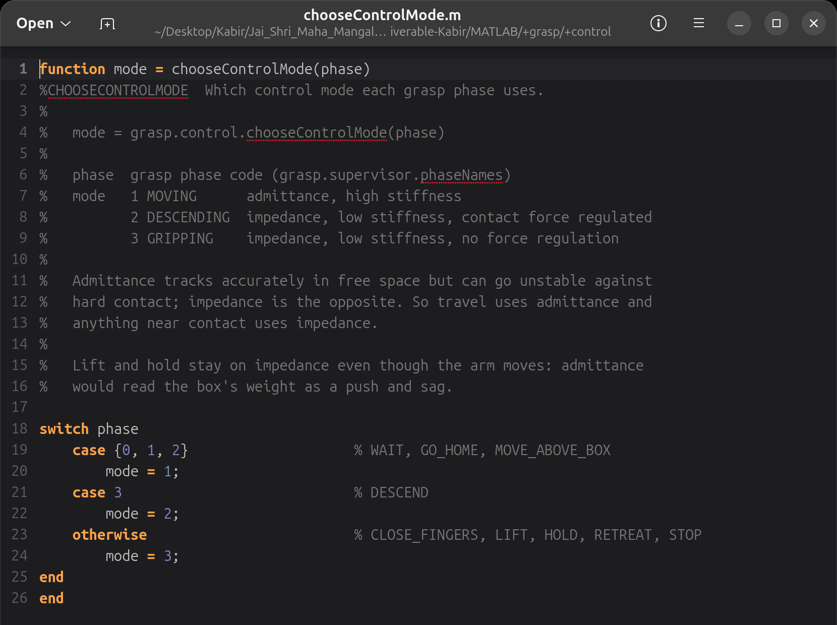
Control mode follows the grasp phase, and each parameter has a stated reason
Decision | Reason
Admittance in travel, K = 2500 N/m | Tracks accurately; measured force displaces the reference (M = 6 kg, D = 60 N·s/m, K = 150 N/m).
Impedance near contact, K = 220 N/m | An 8 mm pose error produces under 2 N.
K ramped over 1.0 s; damping ratio 0.9 in both modes | A step in K with non-zero pose error would jerk the arm.
Impedance through lift and hold | Admittance would read the 1.47 N box weight as an external push and sag.
Limits (warn/stop): 4/8 N in travel, 10/15 N in contact, 1.5/3 N·m | Contact is unexpected in travel, so thresholds are lower there.
Rigid joints | No published Panda joint stiffness or rotor inertia was found.
The schedule as implemented, chooseControlMode.m.
3

Slide 4
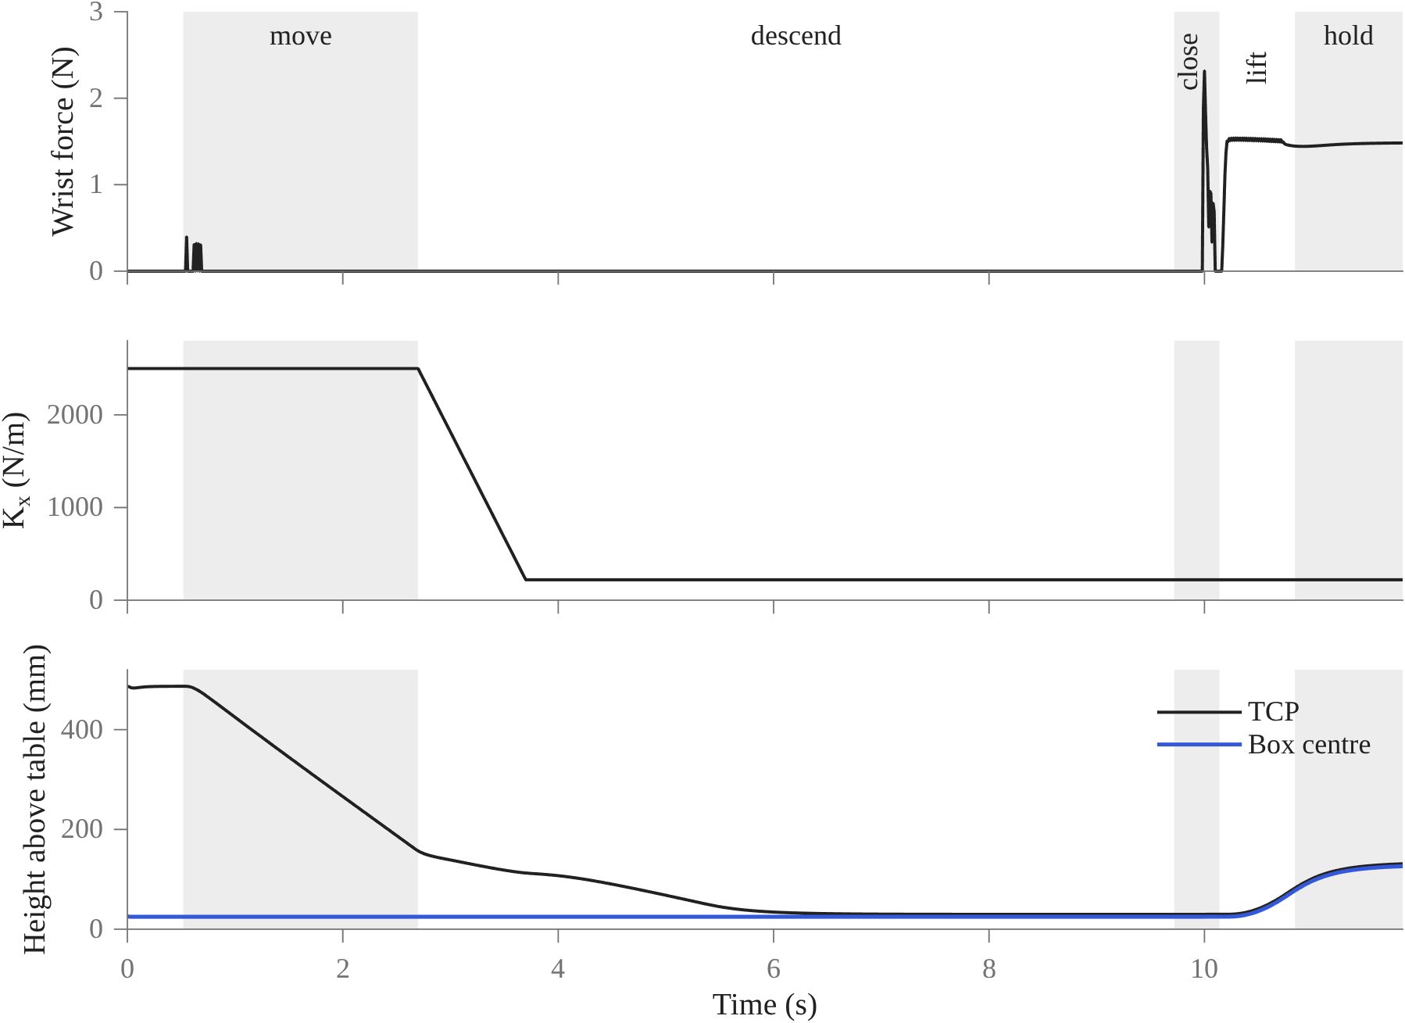
One blue-box run reached HOLD and lifted the box 100 mm with 2.3 N peak wrist force
Measure | Value
Final phase, faults | HOLD, none
Time, start to HOLD | 10.34 s
Peak wrist force (30 Hz filter) | 2.32 N
Max force in travel (120 Hz) | 0.46 N
Force during hold | 1.48 N
Box weight (0.15 kg) | 1.47 N
Grip force per finger (clamp) | 20.0 N
Box lift | 100.2 mm
Position error at grip | 14.1 mm
Safety warnings, stops | 0, 0
Unit tests passing | 40 of 40
Single deterministic run, n = 1.
4

Slide 5
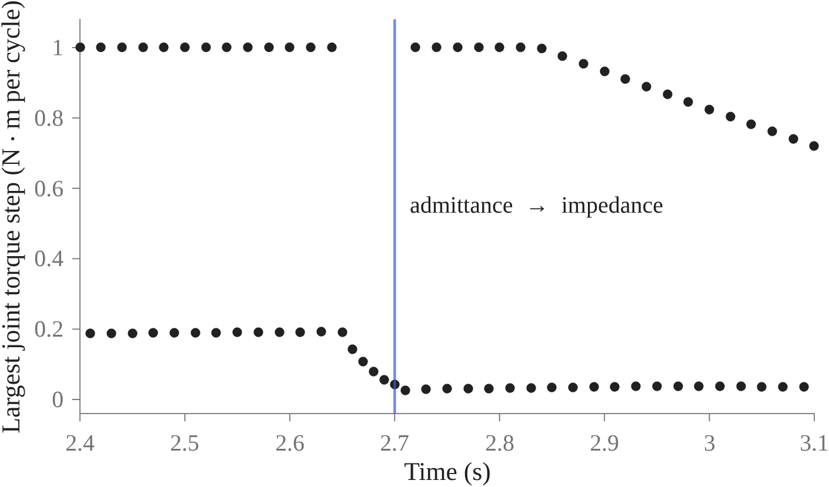
One grasp does not establish robustness; six issues remain open
1. Coverage. The other five colours have not been run.
2. Safety. The push test has not been run. The monitor is covered by unit tests only.
3. Force loop. Never engaged: wrist force in descent peaked at 0.10 N against a 1 N threshold.
4. Height error. The TCP settles 13.8 mm above target at 220 N/m, about 3 N of unexplained force.
5. Idle time. Target reached at 5.30 s, fingers close at 9.72 s. The 3 mm tolerance is never met, so a 7 s timer decides.
6. Contact model. Stiffness and friction are assumed, so forces do not predict hardware.
Torque rate saturation. The 1 N·m rate limit is reached every 20 ms during travel, at the 50 Hz setpoint update. A 4 mm setpoint step at 2500 N/m demands 10 N. The switch adds no visible step. Proposed fix: interpolate setpoints at 1 kHz.
5

