Slide 1
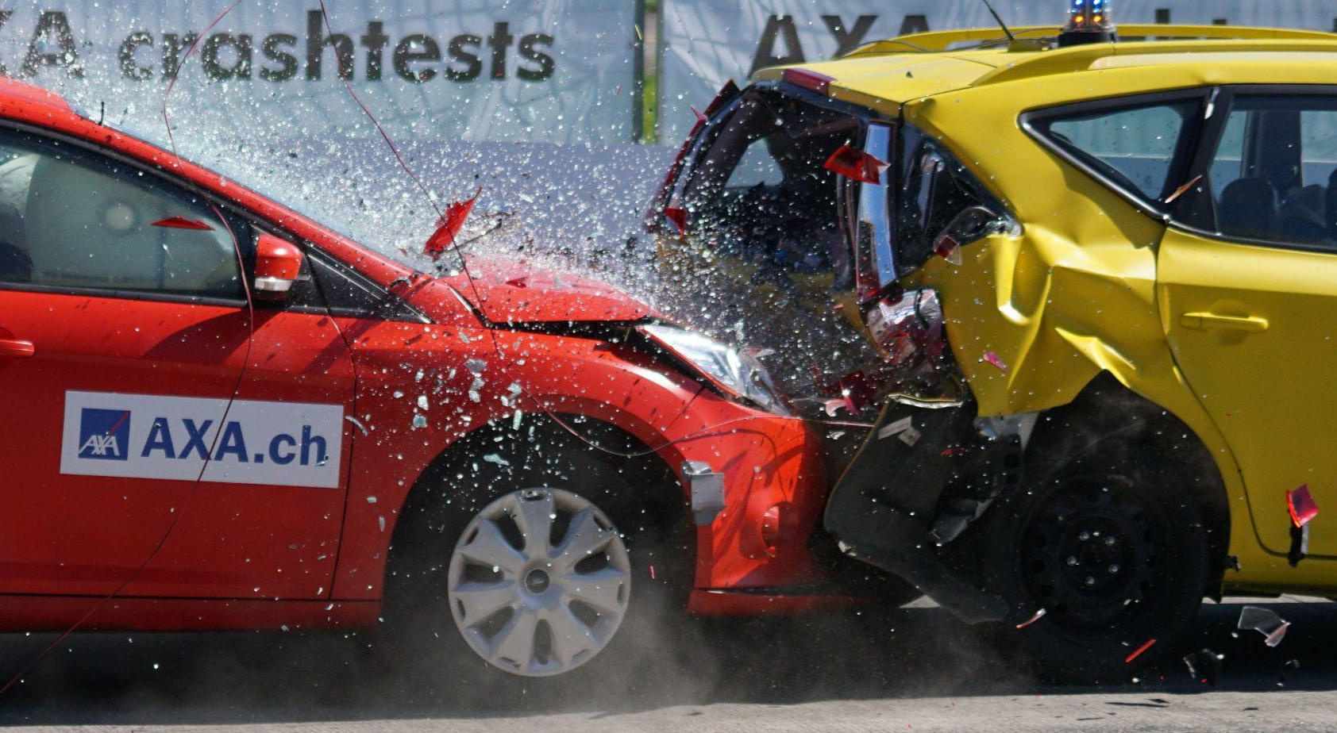
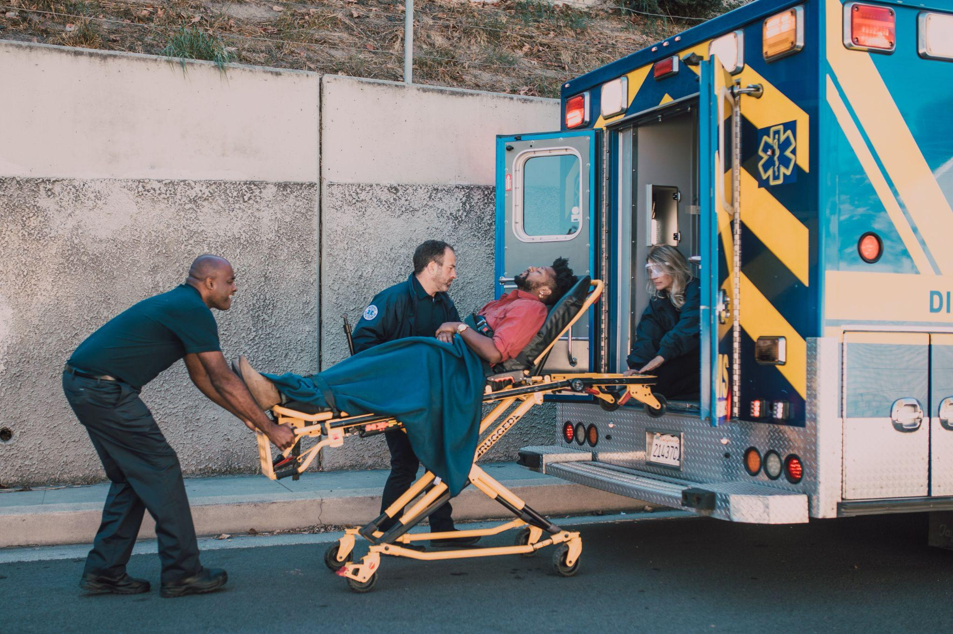
Predicting the Risk of Injury Resulting from Vehicle Collisions in Ottawa, Ontario
Anja Wu,
Ben Nikkel

Slide 2
Introduction

Slide 3
Problem to Solve and Motivation
B
B
Problem
Do collison features contribute to injuries and how?
Motivation
As a citizen of Ottawa who drives far and often (usually through Hunt Club) curious about
how bad intersections are
which need to be improved
if there are certain features contributing to injuries that can be mitigated by the city

Slide 4
Research Questions

Slide 5
Questions We Asked
B
What were the most dangerous locations?
Which have the most commonly occurring accidents?
Which locations are most dangerous in terms of injury levels?
Which accident features are correlated to injuries?
Were road/weather conditions correlated to levels of severity of injuries?
Did injuries disproportionately affect drivers, pedestrians, bicyclers or motorcycles?
Do traffic controls lead to decreases in accidents?
Can we predict whether an injury will occur or not, using specific accident features?

Slide 6
Methodology

Slide 7
Data Collection and Cleaning
A
Data collection:
https://open.ottawa.ca/ accessed September, 2023
Preprocessing:
Feature distribution analyzed for outliers, etc.
Missing values for integer columns were changed to zeros
Latitude and longitude rounded from 5 to 4 decimal points
Binary injury variable created (0: no injury collision, 1: injury collision)
Categorical predictor features converted
Using scale if ordinal
Using one-hot encoding if nominal

Slide 8
Data Analysis
A
Collision counts based on grouping truncated lat, long and location
Top 10 Locations by Number of Collisions
Top 10 Locations by Number of Injuries
Top Locations by Number of Major/Fatal Injuries
Correlation heat map (Pearson’s)
All features with predictor (removed highly correlated for predictions)
Environmental factors on severity level of injury
Calculations on proportions:
All collisions involving each mode of transportation
for each mode of transportation by each level of injury severity
Collision frequency by type of traffic control

Slide 9
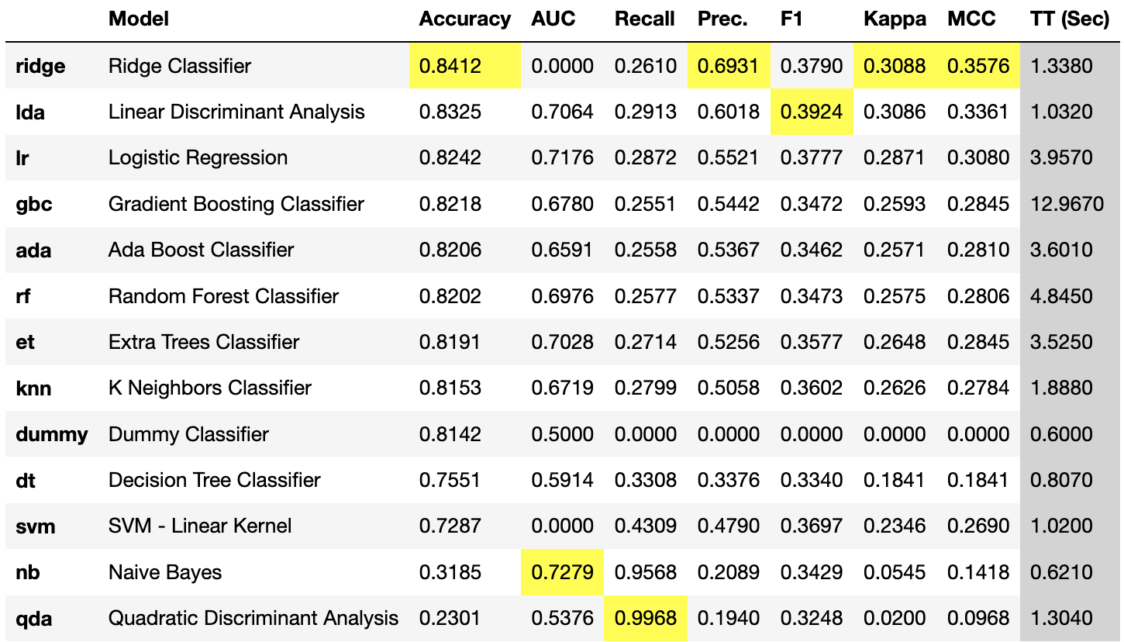
Predictive Model
A
k-Nearest Neighbours (scikit-learn)
Random OverSampling (ROS) (imblearn.over_sampling)
Synthetic Minority Oversampling Technique (SMOTE)
Decision Tree (scikit-learn)
Random OverSampling (ROS) (imblearn.over_sampling)
Random Forest (scikit-learn)
Comparative Methods (PyCaret)
List on side

Slide 10
Results

Slide 11
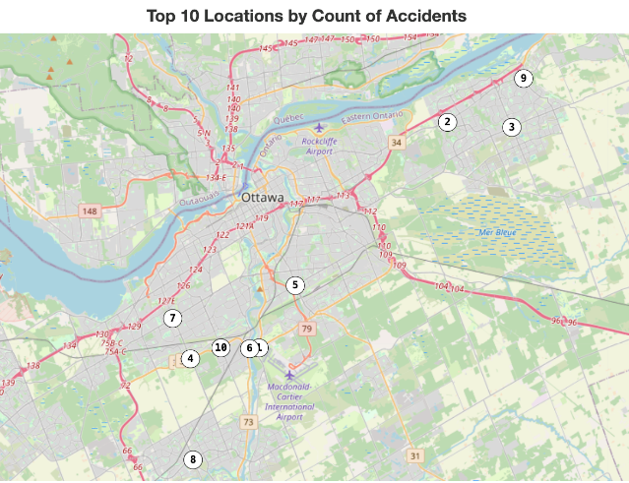
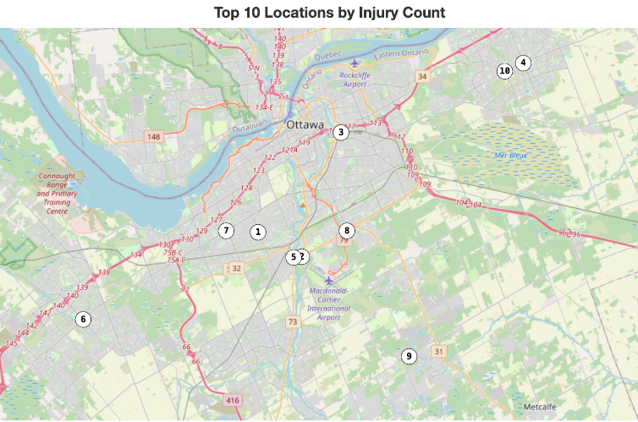
Q1) What were the most dangerous locations?
B

Slide 12
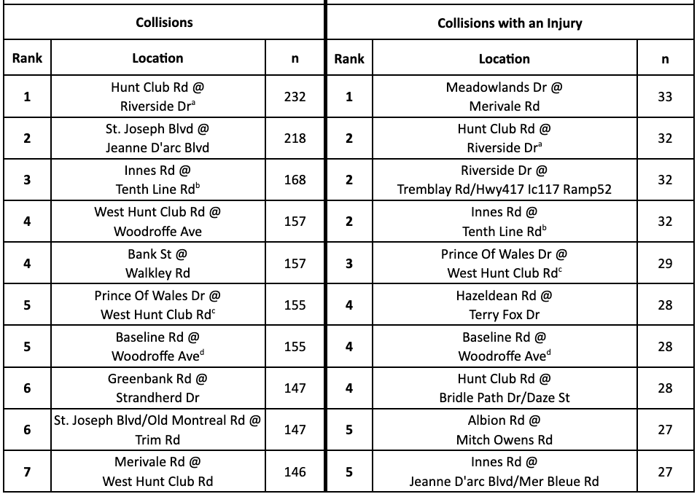
Q1) What were the most dangerous locations?
B

Slide 13
Q1) What were the most dangerous locations?
B

Slide 14
Q1) What were the most dangerous locations?
B

Slide 15
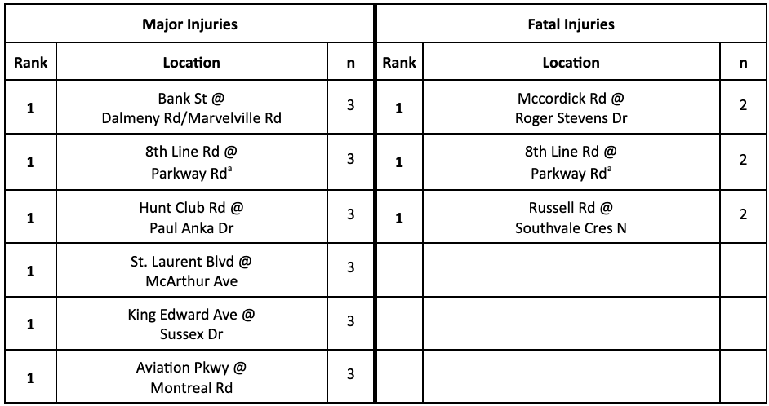
Q1) What were the most dangerous locations?
B

Slide 16
Q1) What were the most dangerous locations?
B

Slide 17
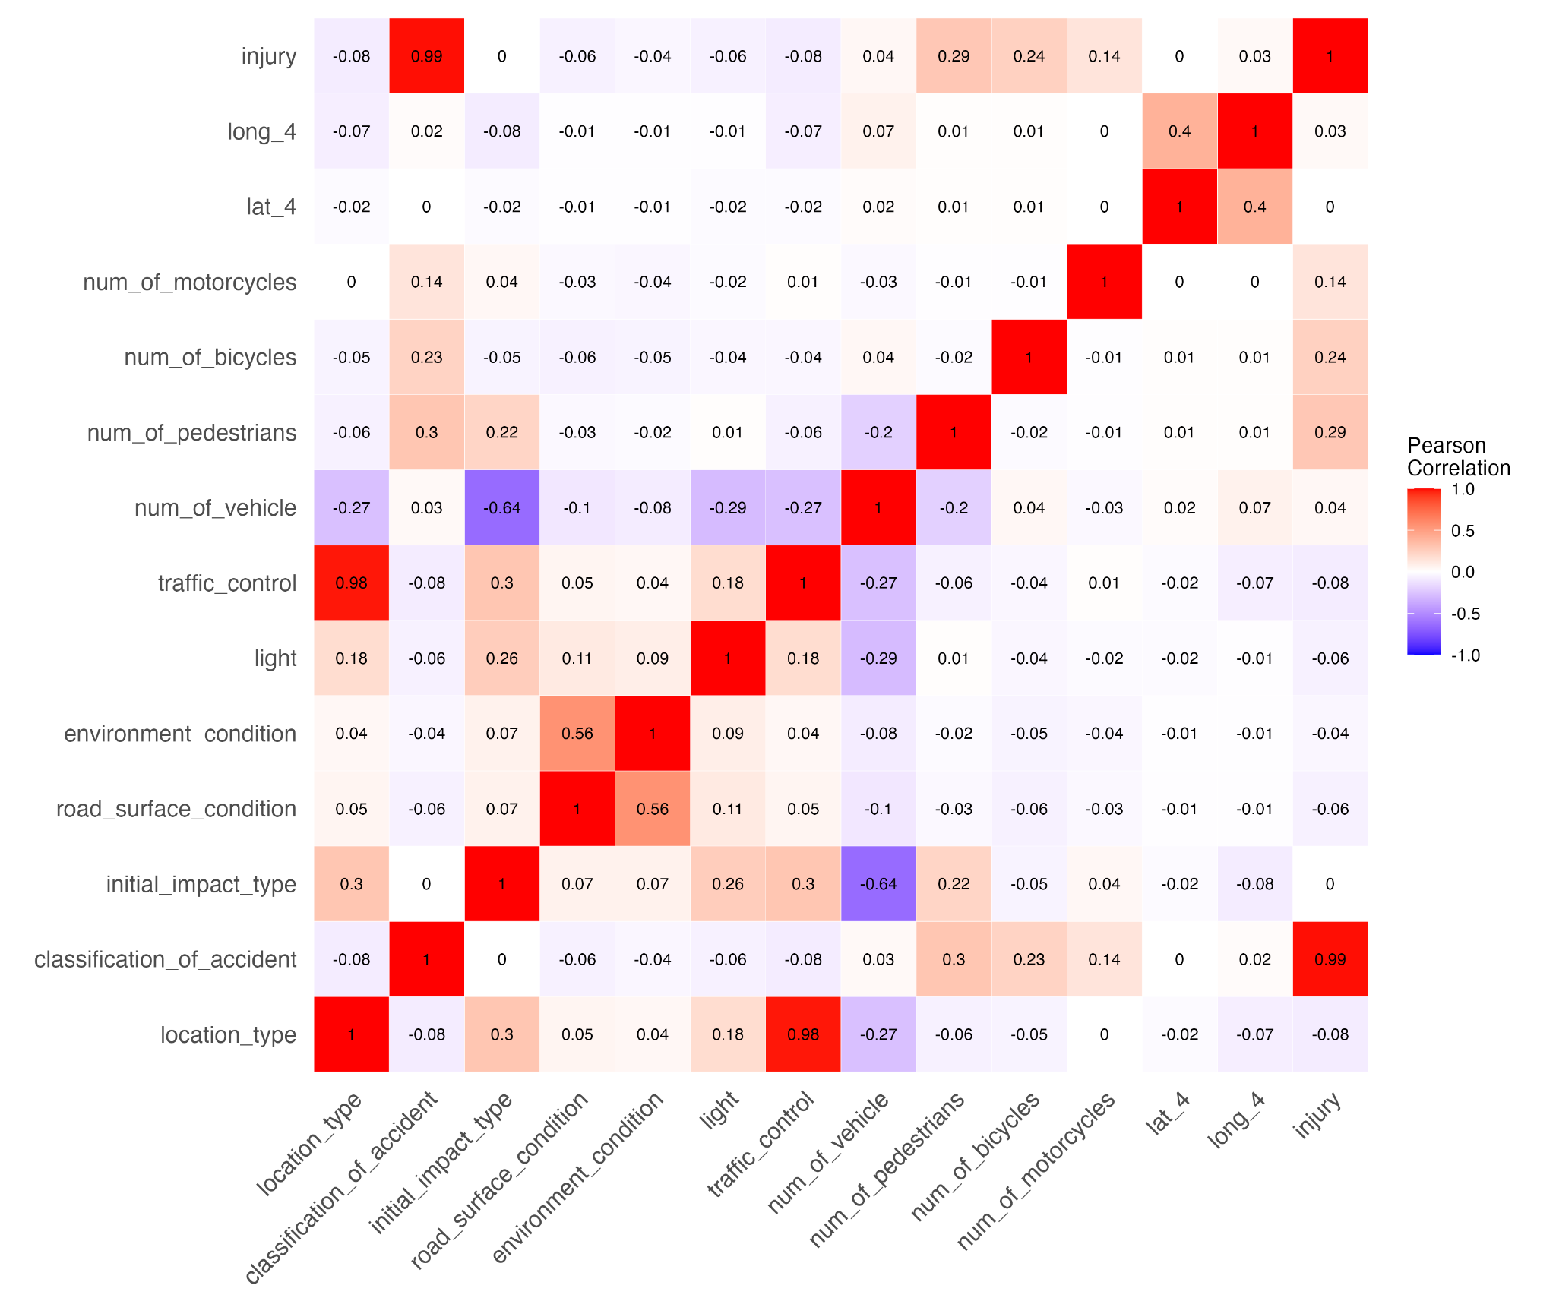
Q2) Which accident features are correlated to injuries?
B

Slide 18
Q2) Which accident features are correlated to injuries?
B

Slide 19
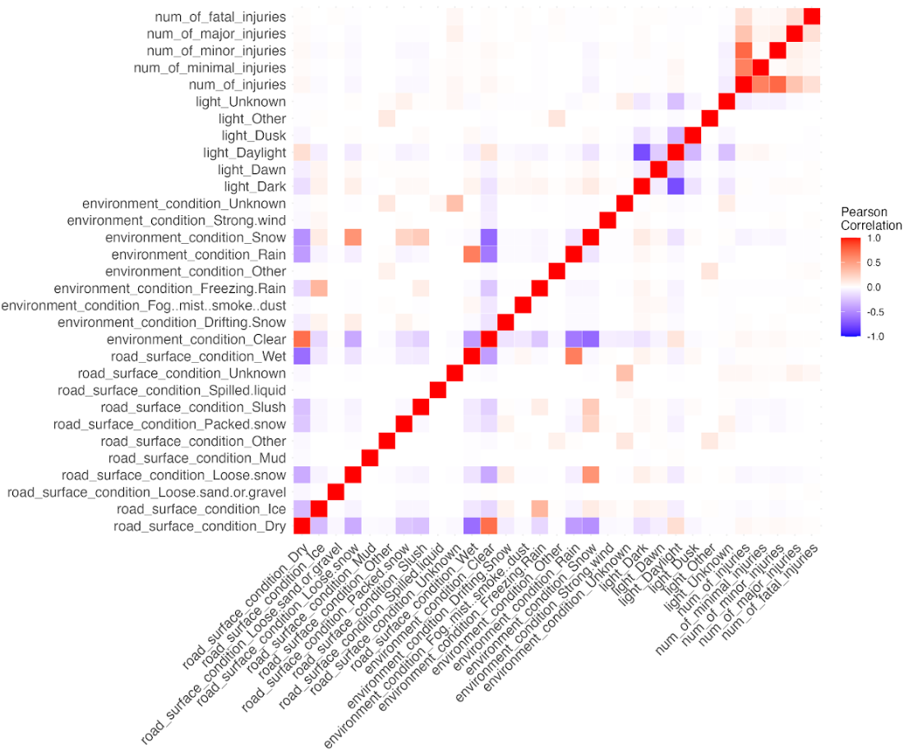
Q3) Were road/weather conditions correlated to levels of severity of injuries?
A
No correlation
* Weather categorically defined

Slide 20
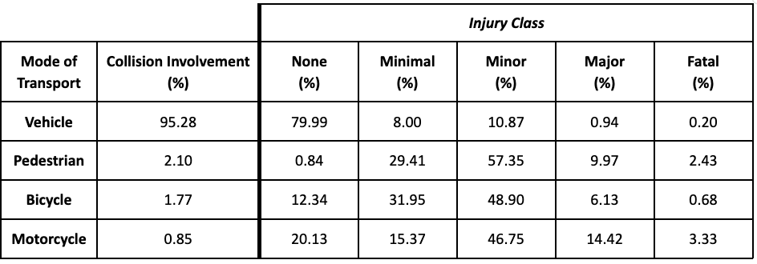
Q4) Did injuries disproportionately affect a specific mode of transportation?
A

Slide 21
Q4) Did injuries disproportionately affect a specific mode of transportation?
A

Slide 22
Q4) Did injuries disproportionately affect a specific mode of transportation?
A

Slide 23
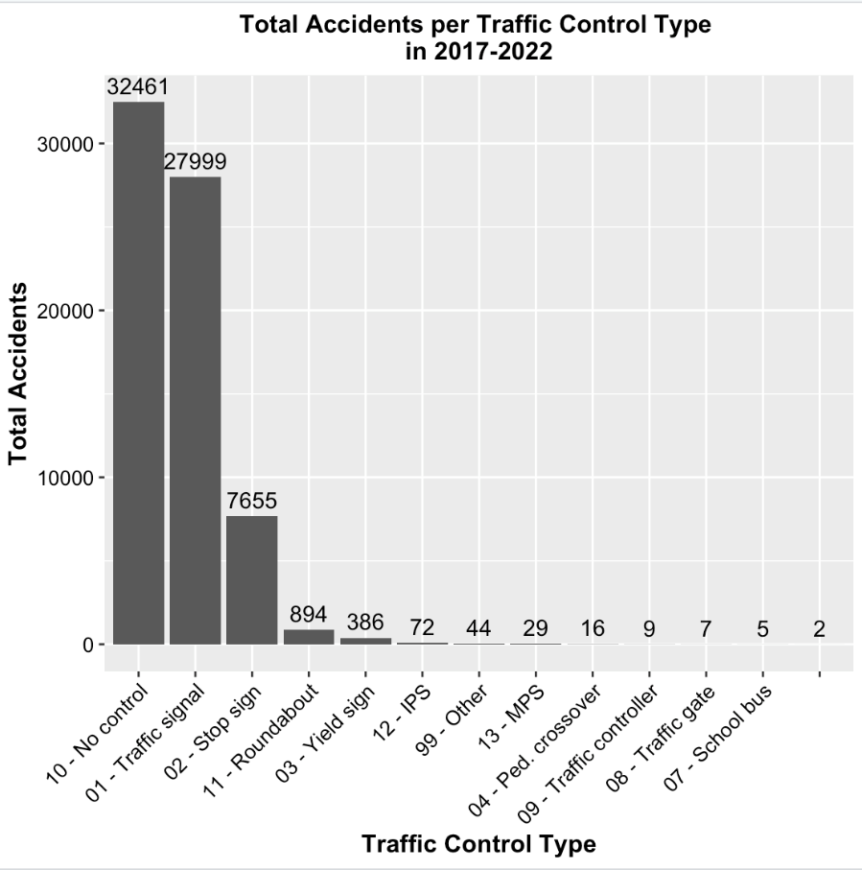
Q5) Do traffic controls lead to decreases in accidents?
A
All traffic controls together account for a higher number of accidents
*Traffic controls tend to correlate with intersections

Slide 24
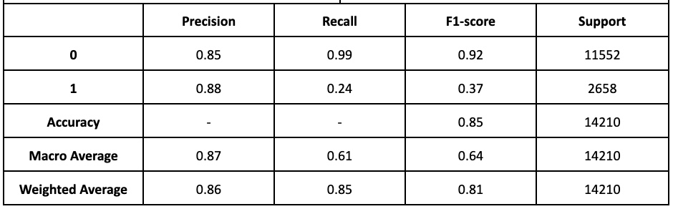
Q6) Can we predict whether an injury will occur or not, using specific accident features?
A
Decision Tree with maximum depth 6 and criterion entropy
class imbalance ~1:5

Slide 25
Q6) Can we predict whether an injury will occur or not, using specific accident features?
A
Decision Tree with maximum depth 6 and criterion entropy
class imbalance ~1:5

Slide 26
Q6) Can we predict whether an injury will occur or not, using specific accident features?
A
Decision Tree with maximum depth 6 and criterion entropy
class imbalance ~1:5

Slide 27
Q6) Can we predict whether an injury will occur or not, using specific accident features?
A
Decision Tree with maximum depth 6 and criterion entropy
class imbalance ~1:5

Slide 28
Q6) Can we predict whether an injury will occur or not, using specific accident features?
A
dt_n | Decision Tree Tuned | 0.85 | 0.6853 | 0.24 | 0.88 | 0.37 | - | - | -

Slide 29
Q6) Can we predict whether an injury will occur or not, using specific accident features?
A
Comparatively, the fine tuned decision tree did better on most metrics except 2% worse on the recall score
dt_n | Decision Tree Tuned | 0.85 | 0.6853 | 0.24 | 0.88 | 0.37 | - | - | -

Slide 30
Implications

Slide 31
Why Study This?
B
Highlighting dangerous areas
For Ottawa residents to be mindful
For City of Ottawa officials to look into these
Uncovering relevant predictors of collision injuries
Allow improvements to be made based on features most likely to end in injuries
With better predictive power → dispatchers could know if there will be an injury or not

Slide 32
Summary

Slide 33
Summary
B
Top Accident/Injury Locations
Hunt Club and Riverside/Prince of Whales
Innes and Tenth Line
Baseline and Woodroffe
Top Major/Fatal injuries Location
8th Line and Parkway
Correlated Features to Injuries
Slight correlation with modes of transportation (pedestrian, bike, motorcycle)
Modes of Transportation and Injuries
Motorcycles <1% of accidents, but 14% end in major injuries and 3% in fatal
Pedestrians account for 2% of accidents, with ~2.5% ending in fatal injuries with 57% in minor injuries
Predictive Model
85% accuracy (better than chance)

Slide 34
Things the City can do to mitigate injuries
A
Unfortunately, there were not highly correlated items from the accident features
Dataset does not have many features the City can control
e.g. does not have speed
BUT…

Slide 35
Main contributions
A
Comprehensive list of “dangerous” locations
City qualitatively analyze why these are dangerous
Levels of injury for various modes of transportation
Public Service Announcements
Predictive model (better than dummy)
Can further be improve with more data sources (e.g. speed)

Slide 36
Future Work

Slide 37
Future Work
B
Incorporating speed to improve predictions
Looking at volume to improve our analysis to be more comparative between locations
For the time trends, it seems like there continues to be a decrease on average for the years following COVID. Are the trends proportionally decreasing?
e.g. hybrid workers only go to office 2-3 times per week, is there a ⅖-⅗ decrease in accidents compared to other years?
Look at seasonal trends: are there certain weather/environmental conditions that are correlated to injuries based on season
e.g. look at just winter months and see if snow is an influencer of severity of injuries
Can we predict 2023 injuries?

Slide 38
Thank you!

