Slide 1


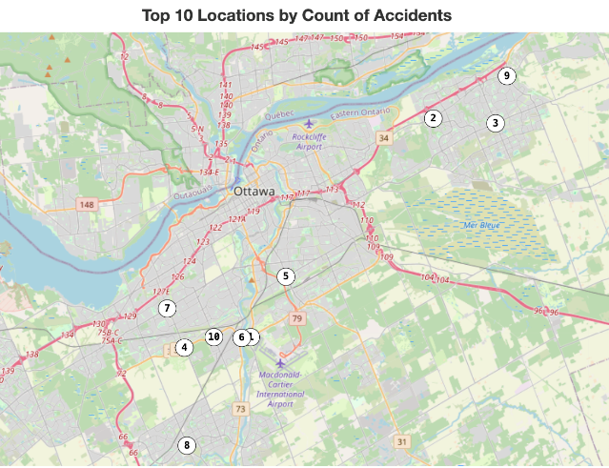
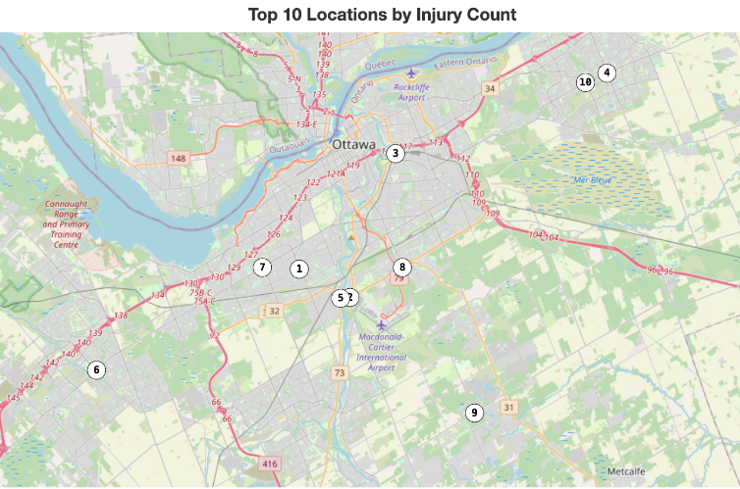
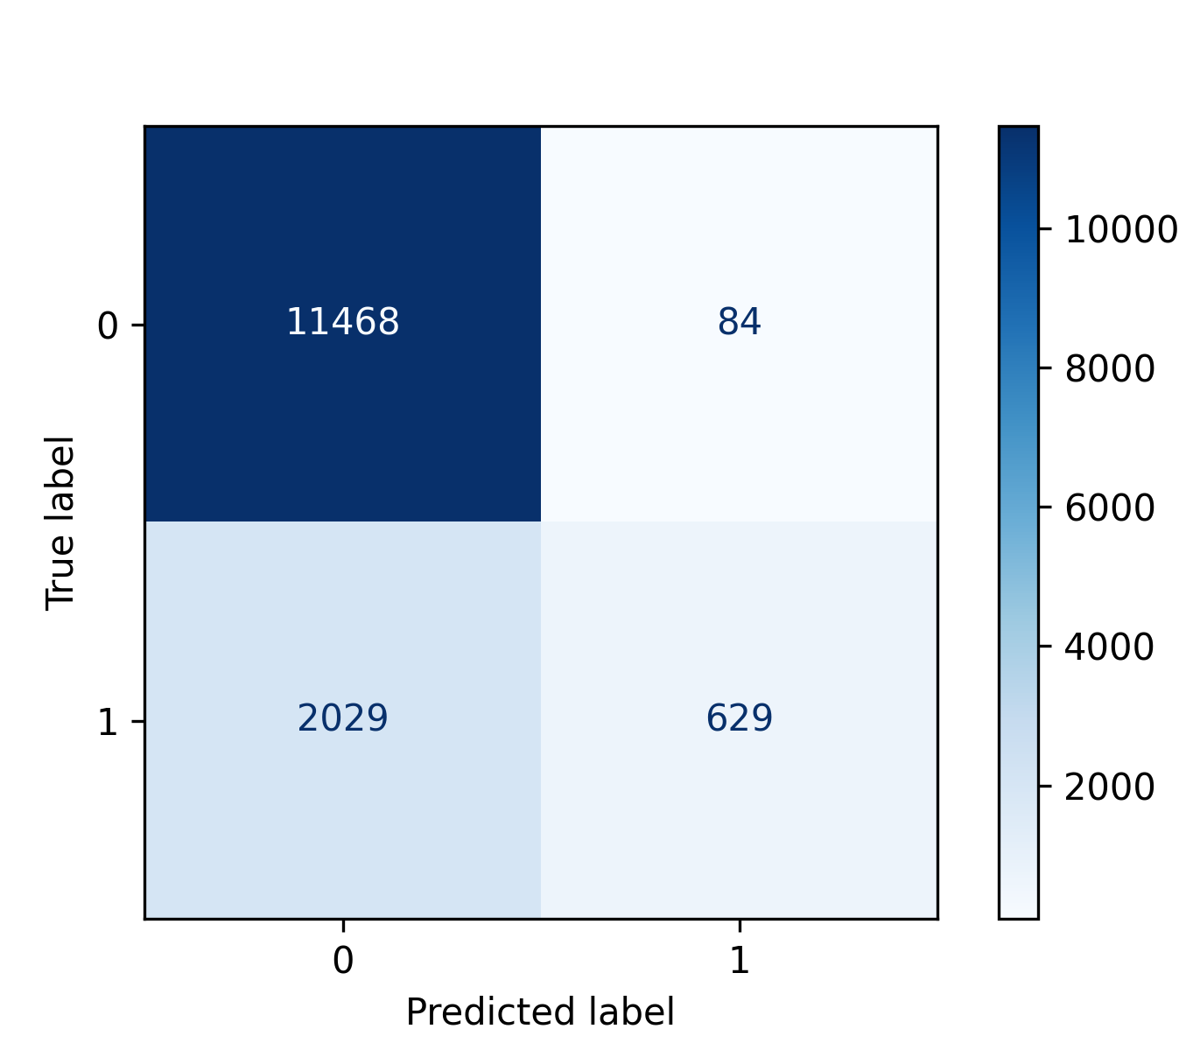
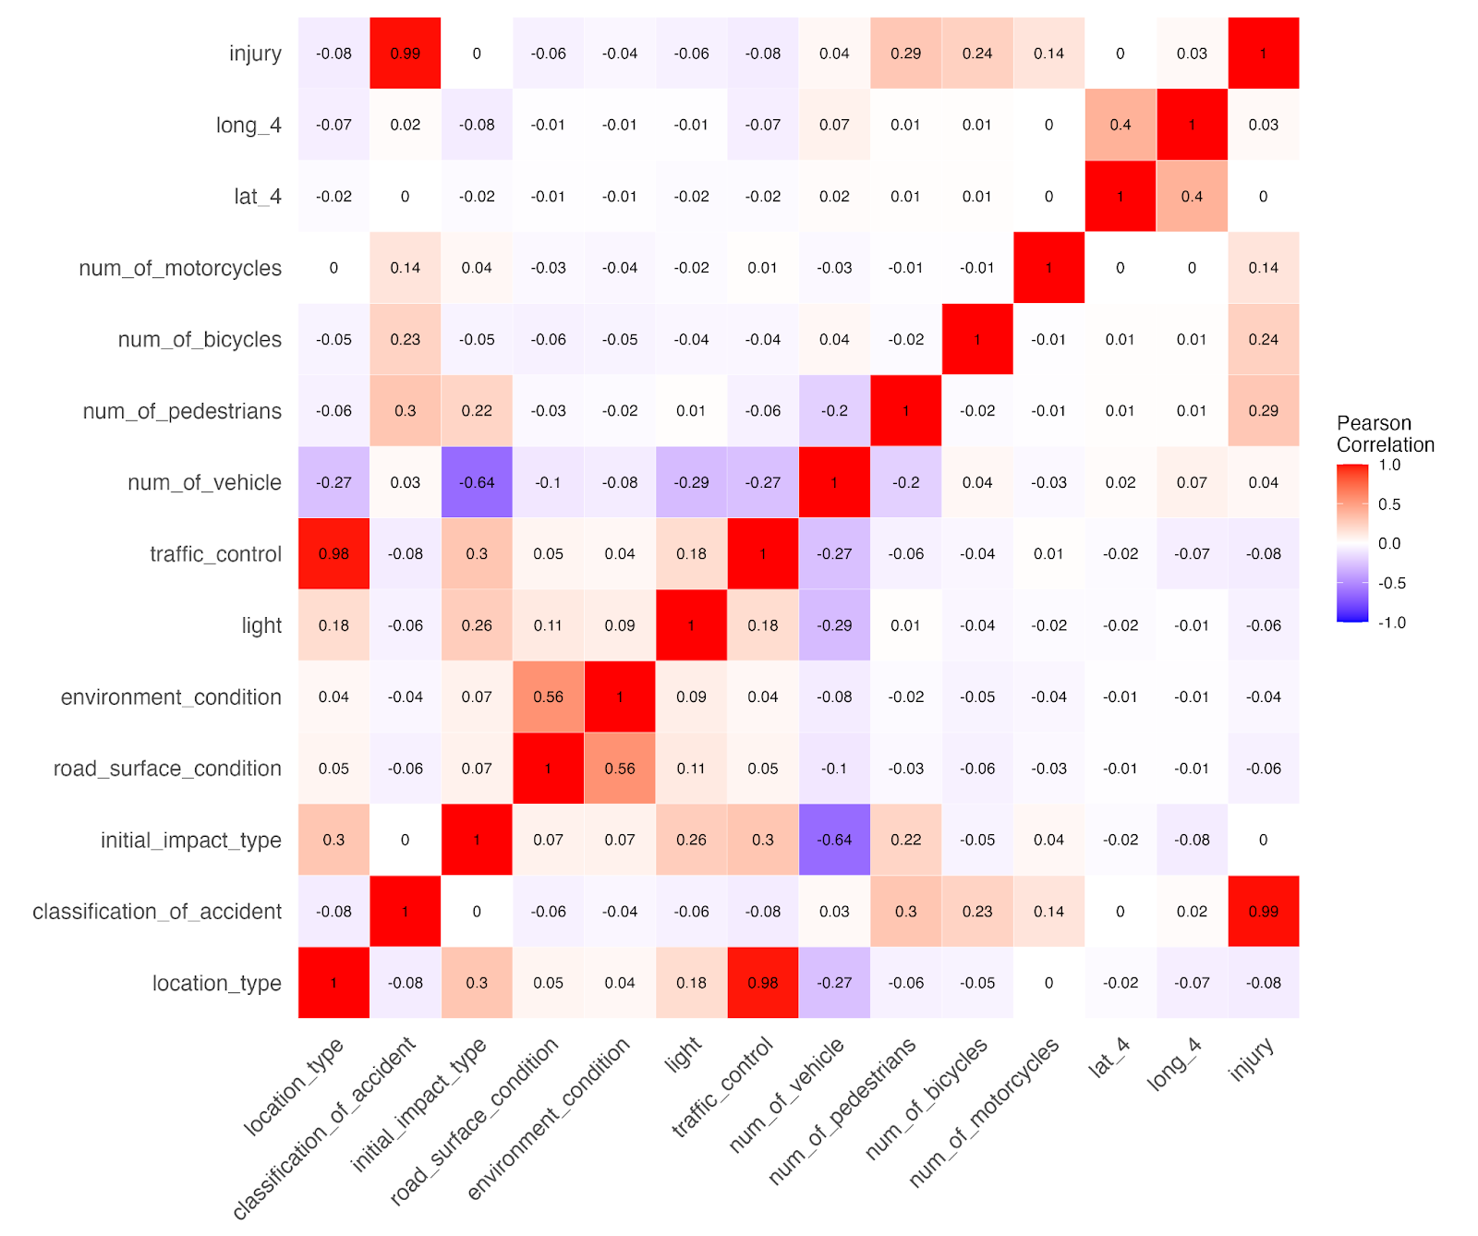
Ottawa Traffic Collisions – Describing and Predicting Injuries with Supervised Learning
Ben Nikkel, Anja Wu
Introduction
In their most recent report, the World Health Organization estimated that global deaths due to road traffic was over 1.3 million people per year.
Countries have reduced this burden by implementing road, vehicle and user safety standards strategies.
Many traffic collision features can influence an injury outcome – people, vehicle, environment, infrastructure, fuel price and climate change elements are relevant.
Supervised machine learning is suitable for relating diverse predictors to traffic collision injuries; previous work have used Decision Tree (DT) and k-Nearest Neighbour (kNN) methods.
Research Questions
How can Ottawa collision injuries be described – top locations, severity distribution per mode of transportation, occurrence correlation, severity correlation, and traffic control implications?
Can we build a model to predict the likelihood of injury using Decision Tree and k-Nearest Neighbour methods?
Methods
Data Source: https://open.ottawa.ca/ – accessed in September 2023.
Preprocessing
Missing integer values were changed to zeros.
Latitude/Longitude values were truncated to 4 decimal points.
A binary injury variable was created; 0 = no injury, 1 = at least one injury.
Ordinal features were converted to integer scales.
Nominal features were converted to one-hot encoding.
Descriptive Analysis
Correlation heat maps used Pearson correlation coefficients.
Modeling
Packages (Python): SciKit-Learn, imblearn.over_sampling
80-20 Train-Test split with nested 70-30 Train-Validate split of outer Train set.
kNN
Hyperparameters: nearest neighbours = 6
Class imbalance was addressed using Random OverSampling and SMOTE.
DT
Hyperparameters: entropy criterion, max depth = 6
Class imbalance was addressed using Random OverSampling.
Random Forest (n_estimators = 100)
Model Evaluation
DT was evaluated against a variety of techniques using PyCaret [Python].
Acknowledgements
Thank you to City of Ottawa for making the collision data publicly available and for Mahmud Hasan for guidance during this project.
Rank | Location
Precision | 0.88
Recall | 0.24
F1 Score | 0.37
Accuracy | 0.85
Figure 1. Top 10 Locations in Ottawa, Ontario with the most collisions and the most collisions involving at least one injury. Top: geographic maps marked by the locations with the most collisions (left) and most collisions with injuries (right). Bottom: Frequency tables of locations with the most collisions (left) and the most collisions with injuries (right).
Figure 3. Decision Tree model test measures (left) and confusion matrix (right).
Collisions |  |  | Collisions with an Injury
Rank | Location | n | Rank | Location | n
1 | Hunt Club Rd @ Riverside Dr | 232 | 1 | Meadowlands Dr @ Merivale Rd | 33
2 | St. Joseph Blvd @ Jeanne D'arc Blvd | 218 | 2 | Hunt Club Rd @ Riverside Dr | 32
3 | Innes Rd @ Tenth Line Rd | 168 | 3 | Riverside Dr @ Tremblay Rd/Hwy417 Ic117 Ramp52 | 32
4 | West Hunt Club Rd @ Woodroffe Ave | 157 | 4 | Innes Rd @ Tenth Line Rd | 32
5 | Bank St @ Walkley Rd | 157 | 5 | Prince Of Wales Dr @ West Hunt Club Rd | 29
6 | Prince Of Wales Dr @ West Hunt Club Rd | 155 | 6 | Hazeldean Rd @ Terry Fox Dr | 28
7 | Baseline Rd @ Woodroffe Ave | 155 | 7 | Baseline Rd @ Woodroffe Ave | 28
8 | Greenbank Rd @ Strandherd Dr | 147 | 8 | Hunt Club Rd @ Bridle Path Dr/Daze St | 28
9 | St. Joseph Blvd/Old Montreal Rd @ Trim Rd | 147 | 9 | Albion Rd @ Mitch Owens Rd | 27
10 | Merivale Rd @ West Hunt Club Rd | 146 | 10 | Innes Rd @ Jeanne D'arc Blvd/Mer Bleue Rd | 27
Results
The “Hunt Club Bridge” is one of the most collision/injury prone locations (Figure 1).
Six locations had 3 major injuries. Three locations had 2 fatal injuries. Both outcomes involved 8th Line Rd @ Parkway Rd.
Mode of transportation features (motorcycles, pedestrians, bicycles) correlated with an injury occurring (Figure 2).
Environment features did not correlate with injury severity.
Most collisions involved only Vehicles (95.28%) and of these most were without injury (80%). Pedestrian collisions almost always involved injury (> 99%). 3.33% of Motorcycle injuries were fatal while 2.43% of Pedestrian injuries were fatal.
Combined, collisions usually occurred when there was a traffic control (signals, stop signs, etc.). Separated, the most common type of traffic control was no control.
Compared to the best benchmark model (Ridge Classifier), Decision Tree model (Figure 3) had the highest accuracy (0.85 > 0.84) and precision (0.88 > 0.69) but not recall (0.24 < 0.26).
kNN performed worse than chance. Random Forest performed worse than the final decision tree model.
Implications
First responders can better anticipate the degree of injury with this model.
High collision/injury locations may deserve targeted interventions.
Environmental features may not correlate to traffic collision injuries when analyzed categorically.
Future Work
Time analysis – does time of day, day of week, seasonality, COVID affect injury incidence?
Incorporate traffic volume data for more comprehensive model construction.
Intervention analysis – did traffic camera installation result in fewer collisions and injuries?
Conclusion
Multiple Ottawa locations have high collision frequency, with the “Hunt Club Bridge” being most prevalent.
8th Line Rd @ Parkway Rd. is a dangerous traffic location.
Mode of transport affects the occurrence and type of injury.
Decision Tree is a useful method for predicting traffic collision injuries with this dataset.
References
Abdi A, Seyedabrishami S, O’Hern S. (2023). A Two-Stage Sequential Framework for Traffic Accident Post-Impact Prediction Utilizing Real-Time Traffic, Weather, and Accident Data. J Adv Transp 2023.
Nogayeva S, Gooch J, Frascione N. (2021). Science & Justice The forensic investigation of vehicle – pedestrian collisions : A review. Sci Justice 61:112–118.
World Health Organization. (2018). Global status report on road safety 2018: summary. WHO/NMH/NVI/18.20.
Yuan Y, Wang S, Liu Z, Cui G, Wang Y. (2022). Influencing factors analysis of side right-angle collisions severity at intersections based on decision tree. Int J Crashworthiness 27:59–69.
Figure 2. Correlation matrix of all predictor variables and injury occurrence.

