Slide 1
Hardware Components :
DC motors
Jetson nano
Jumper wires
UBEC - Pixhawk
Servo motor
Power module
Raspberry pi camera module V2
Sabertooth
PCA9685
Lithium ion battery 2
ROS-based Voice Controlled Mobile Robotic Arm for Automatic Segregation of Medical Waste
Software Requirements :
ROS (Robot Operating System)
Voice Recognition
Object Detection and Segmentation Path Planning and Navigation
Robotic Arm Control
BY,
ANJALI DULAM
2ND YR, CSE

Slide 2
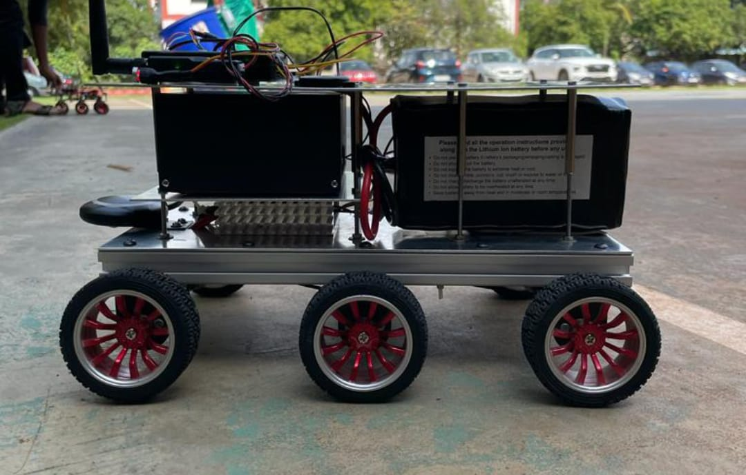
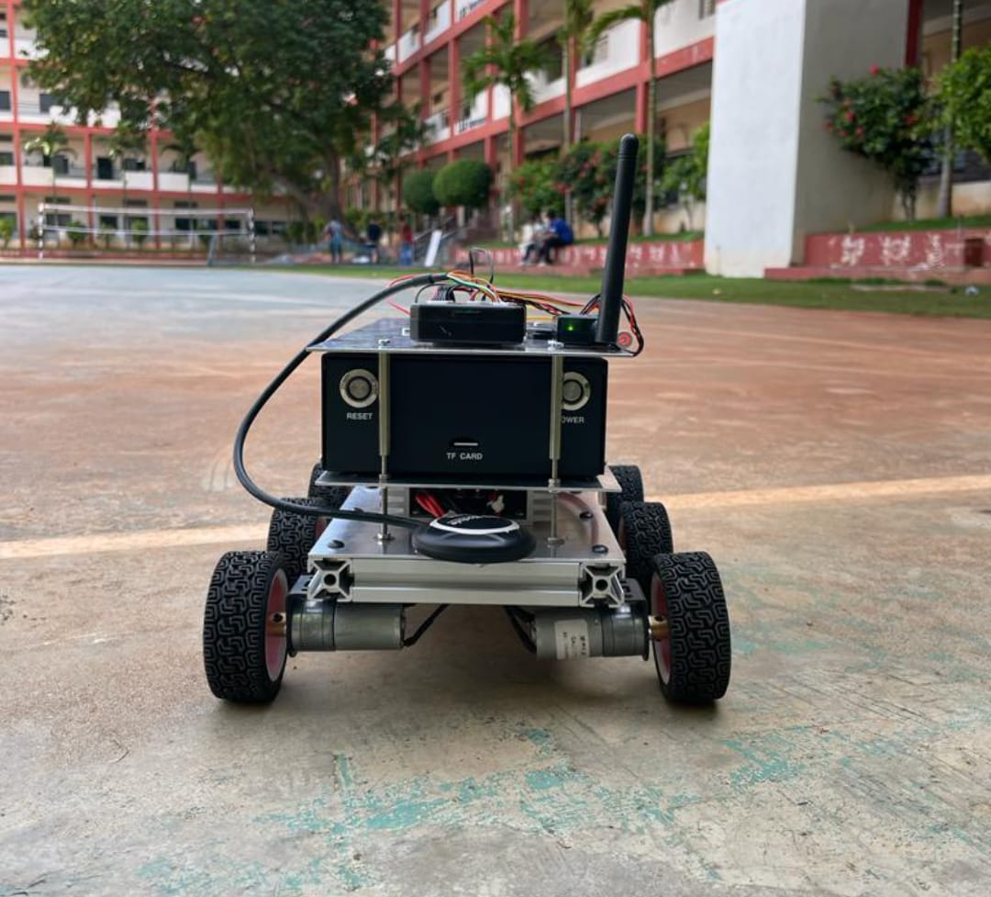
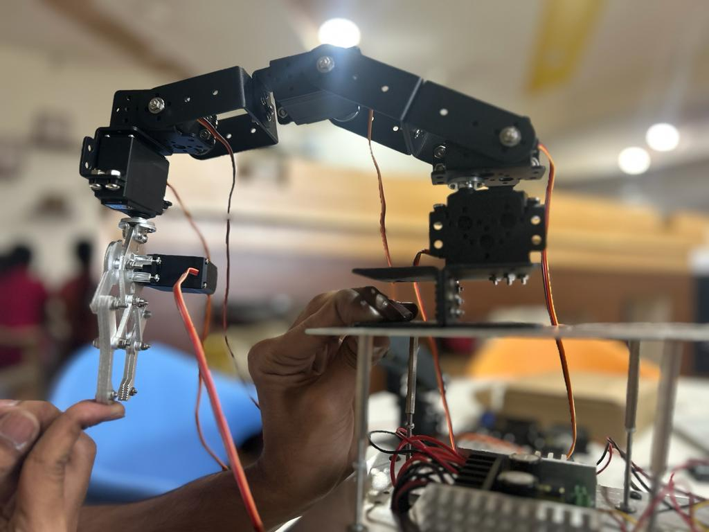

Slide 3
Voice Input
Voice Recognition
Object Detection
Waste Segregation
Robotic Arm Control
Rover Navigation

Slide 4
