Slide 1
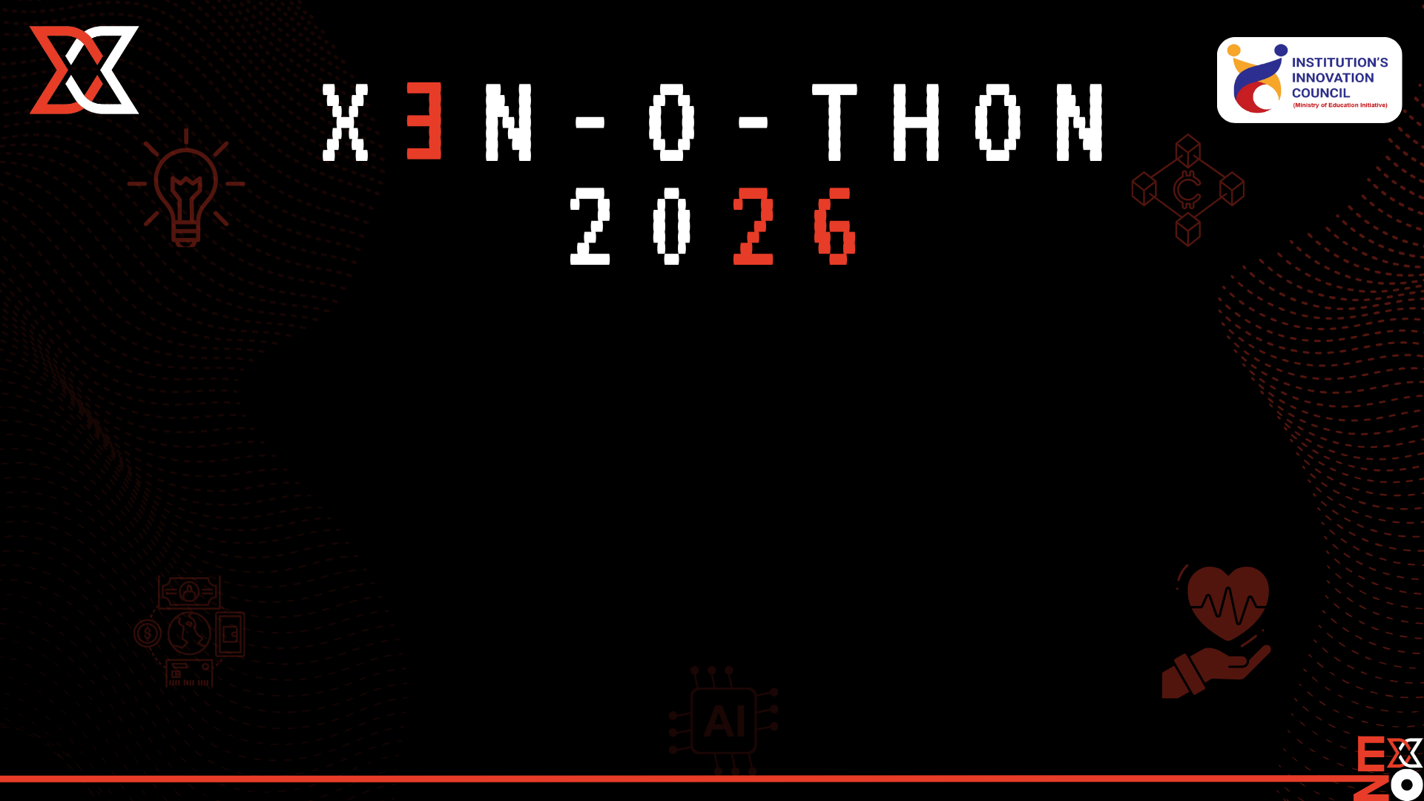

DOMAIN : Healthcare Track
TEAM NAME : SYNAPSE_GTB
CATEGORY : AI/ML-powered Web Application
PROJECT TITLE : Project Chronos

Slide 2

PROBLEM STATEMENT
User Pain Points
Hospitals generate massive amounts of physiological data (vital signs, labs, diagnoses), but most monitoring systems only alert clinicians after a critical threshold is crossed.
Doctors often experience:
Alarm fatigue from too many reactive alerts
Difficulty identifying subtle deterioration patterns
Lack of predictive insights from continuous patient data
As a result, patient deterioration such as sepsis, shock, or cardiac arrest is often detected too late, reducing survival chances.
Technical / Operational Challenges
Current systems face several limitations:
Reactive Monitoring Traditional monitors trigger alerts only when vitals exceed predefined thresholds.
Data Silos Patient data is distributed across multiple hospital systems.
Limited Predictive Intelligence Most hospital systems do not use machine learning to detect early risk patterns.
Cognitive Load on Clinicians Physicians must manually interpret large volumes of patient data under time pressure.
Why This Problem Matters Now
Healthcare systems are becoming increasingly data-rich but insight-poor.
Recent trends driving urgency:
Rising ICU and emergency department load
Increasing clinician burnout
Availability of large clinical datasets like MIMIC-IV
Advances in machine learning for healthcare
AI can now detect patterns invisible to human monitoring, enabling earlier intervention.

Slide 3
PROPOSED SOLUTION
CORE IDEA / CONCEPT
Project Chronos is an AI-driven early warning system that analyzes patient vital signs and clinical data to predict clinical deterioration hours before it occurs.
Instead of reacting to crises, the system anticipates risk and alerts clinicians in advance.
HOW IT ADDRESSES THE CHALLENGES
Challenge | Solution
Reactive monitoring | Predictive machine learning models
Data overload | Automated risk scoring
Alarm fatigue | Intelligent alerts based on trends
Complex data interpretation | Visual dashboards
KEY FEATURES
1. Early Risk Prediction
Machine learning models analyze patient vitals to estimate the probability of deterioration.
2. Continuous Monitoring
The system continuously processes incoming patient data and updates risk scores in real time.
3. Intelligent Alerting
Instead of threshold alarms, the system generates predictive alerts based on risk trajectories.
WHY THIS SOLUTION IS BETTER
Existing hospital monitoring systems mainly rely on fixed thresholds.
Example:
4. Clinical Dashboard
A visualization dashboard displays:
patient risk scores
vitals timeline
predicted deterioration probability
5. Explainable AI
The system highlights which vital signs contributed most to the prediction, improving trust among clinicians.
Alert if heart rate > 130
This allows clinicians to intervene earlier, potentially preventing life-threatening events.
Predict probability of deterioration in next 6 hours

Slide 4
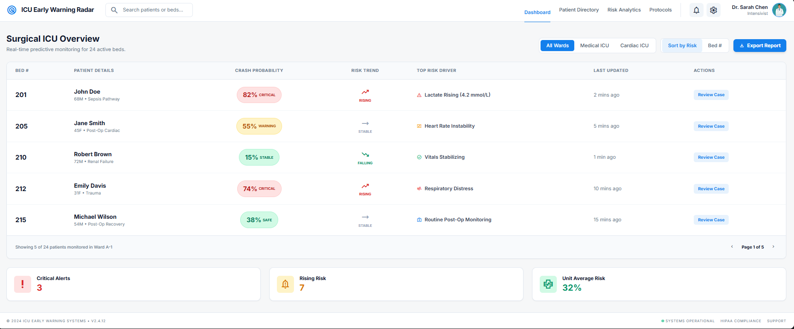
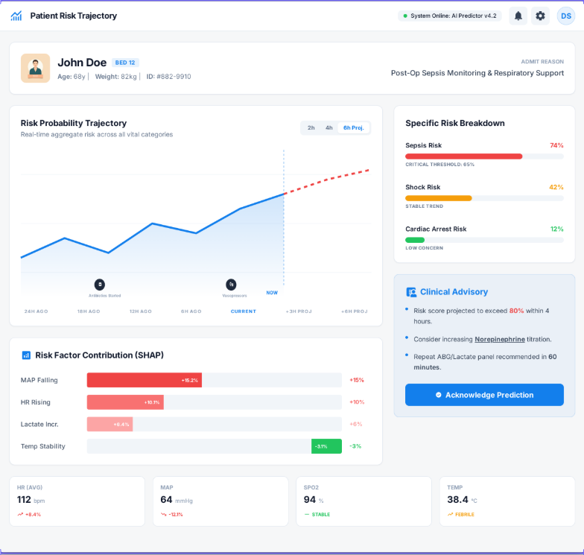
THE INNOVATION
WHAT MAKES IT UNIQUE / ANTI-BORING
Three aspects make the solution stand out:
1. Predictive Healthcare
Moves from reactive medicine → predictive medicine
2. Real Clinical Data
The system is built using the MIMIC-IV-ED dataset, which contains real hospital patient records.
3. Scalable Architecture
The system is designed to integrate with hospital electronic health record systems.

Slide 5

TECHNICAL DESCRIPTION
Category | Technology
Prog.Language | Python
Data Processing | Pandas, NumPy
Machine Learning | Scikit-learn / XGBoost
Visualization | Streamlit
Database | PostgreSQL / BigQuery
Dataset | MIMIC-IV-ED Demo
Deployment | Docker / Cloud
System Components
Data Ingestion Layer Imports clinical data from MIMIC dataset.
Feature Engineering Layer Processes vital signs into ML features.
Prediction Engine Machine learning model predicts risk score.
Alert System Generates alerts if risk crosses threshold.
Visualization Dashboard Displays patient data and predictions.
DATA FLOW
1
2
3
4
5
6
Clinical Data (Vitals, Triage)
Data Processing Pipeline
Feature Engineering
Machine Learning Model
Risk Score Prediction
Alert + Dashboard

Slide 6
IMPACT & BENEFITS
EXPECTED IMPACT
The system could significantly improve clinical decision-making by providing earlier insights into patient deterioration.
Potential impact areas:
ICU monitoring
emergency department triage
remote patient monitoring
MEASURABLE IMPROVEMENTS
Potential measurable improvements include:
earlier detection of deterioration
reduced ICU mortality
reduced emergency response time
improved clinician decision support
SHORT-TERM VS LONG-TERM VALUE
Short Term
Prototype demonstrating predictive monitoring
Decision support for clinicians
Long Term
Integration into hospital monitoring systems
Deployment in ICU and emergency departments
Large-scale predictive healthcare systems
Benefit | Explanation
Speed | Automated real-time risk predictions
Accuracy | Machine learning detects complex patterns
Simplicity | Easy-to-use clinical dashboard
Accessibility | Scalable cloud-based deployment
Early Intervention | Enables preventive treatment

Slide 7
FEASIBILITY & VIABILITY
TECHNICAL FEASIBILITY
The system is technically feasible due to:
publicly available clinical datasets
mature machine learning frameworks
scalable cloud infrastructure
A prototype can be built using the MIMIC-IV demo dataset.
SCALABILITY & FUTURE ENHANCEMENTS
Future extensions may include:
training on full MIMIC-IV dataset
deep learning models (LSTM / Transformers)
real-time hospital data integration
wearable device monitoring
personalized patient risk modeling

Slide 8
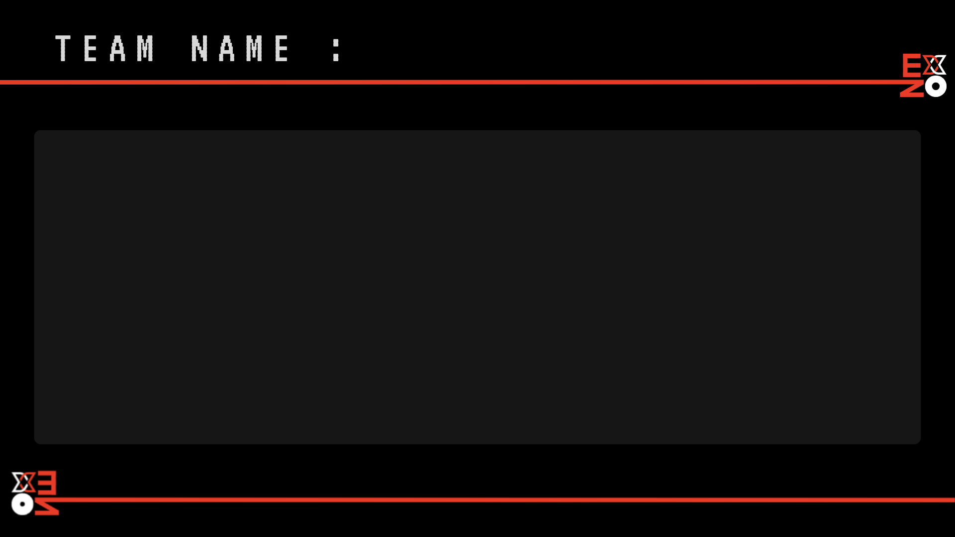
SYNAPSE_GTB
VIDHYADHAR
NIT KKR
THANESAR
TEAM LEADER
MALE
RAVIKANT GUPTA
NIT KKR
THANESAR
TEAM MEMBER
MALE
ANJEET
NIT KKR
THANESAR
TEAM MEMBER
MALE

