Slide 1

Time Series Analysis
IME673A
Ratnesh Argal 17907559
Saroj Anjesh 170634
Guide:
Prof. Veena Bansal
IME Department

Slide 2
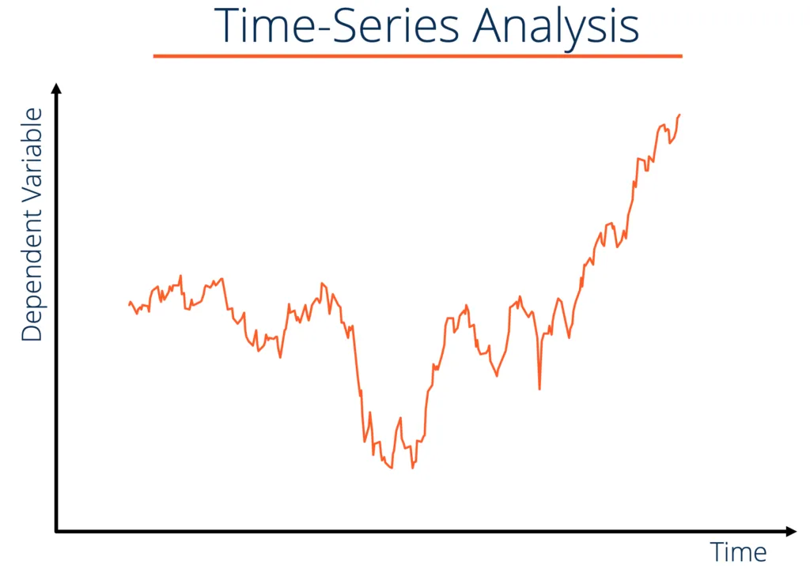
Why Time Series
We already have so many models then why this?
Many Algorithm already exist, then why time series?
Analysis of time series data - gives meaningful statistics
Predicting future: isn’t that awesome

Slide 3


What is Time Series
Example:
You own a coffee shop and you want to know the sales in the next month.
Airline company want to know how many passengers will be travelling next month.
A time series is a set observation on a quantitative variable collected over time
In this analysis you just have one variable
It is used to predict the future values based on the previous observed values
Time series used for :
Business Forecasting
Understanding past behaviour
Plan Future
Evaluate current accomplishment

Slide 4
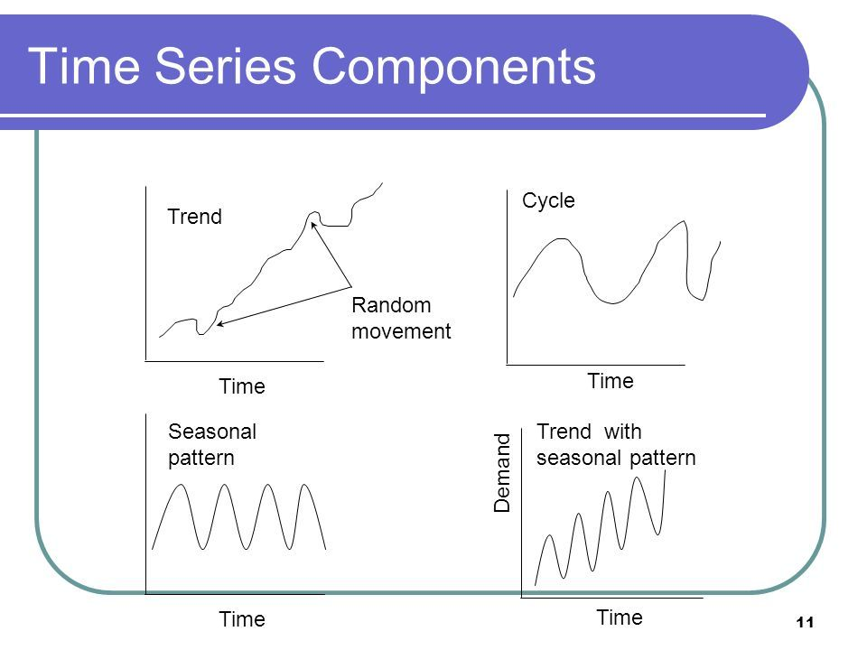
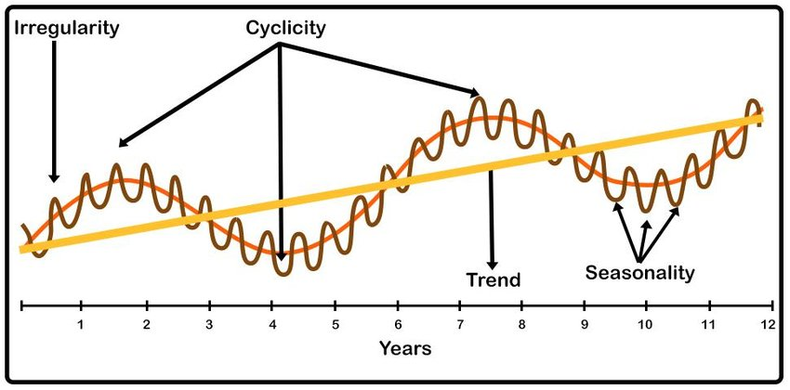
Component Time Series

Slide 5
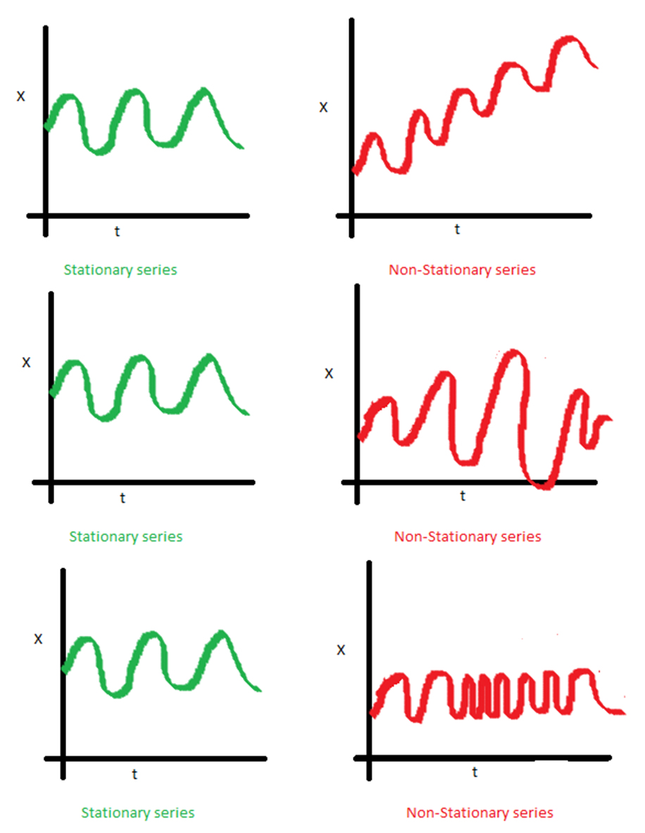

STATIONARITY
Idea: If Time series has a particular behavior over time, there is a high probability that it will follow the same in future
Constant Mean
Stationary time series
Constant Variance
Autocovarince does not depend on time

Slide 6

DEMO TIME
Steps to apply model:
Target 1: Checking Stationarity
ADCF Test
Rolling Statistics
Target 2: Applying time series model
Autoregression Models (AR Models)
Moving averages Models (MA Models)
Autoregression Moving Average (ARMA model)
ARIMA Models

Slide 7
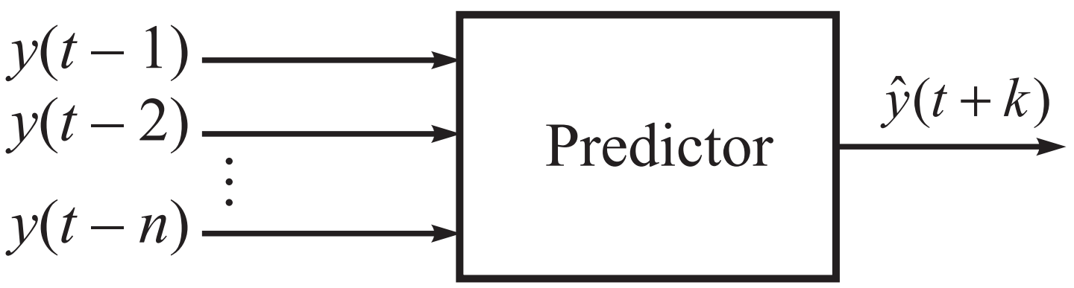
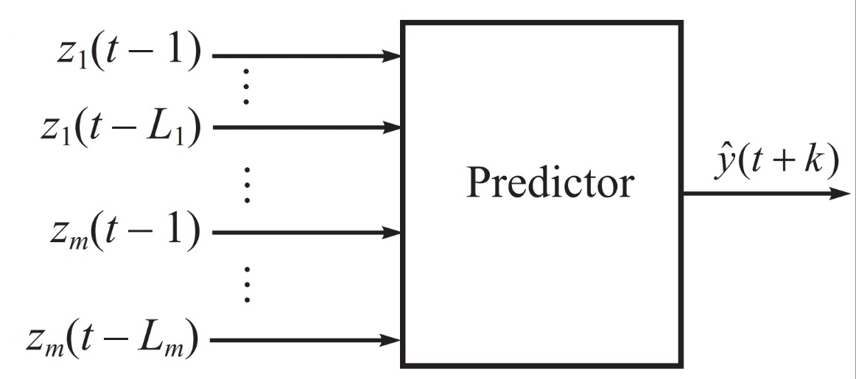
Univariate Vs Multivariate
Univariate
System is dependent on itself
yˆ(t + k) = f(y(t), y(t – 1), …, y(t – n))
AR model
Multivariate
System is dependent on itself
E.g. predicting the value of the Rupee to U.S. dollar exchange rate
Vector Auto Regression (VAR)

Slide 8
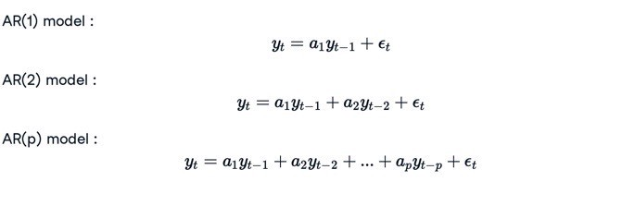
AutoRegression
Order of AR model to be trained: The order of AR model is determined by checking the partial autocorrelation plot. The plot_pacf method of statsmodels.graphics.tsaplots is used to plot.

Slide 9
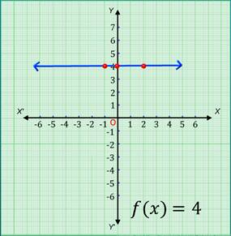
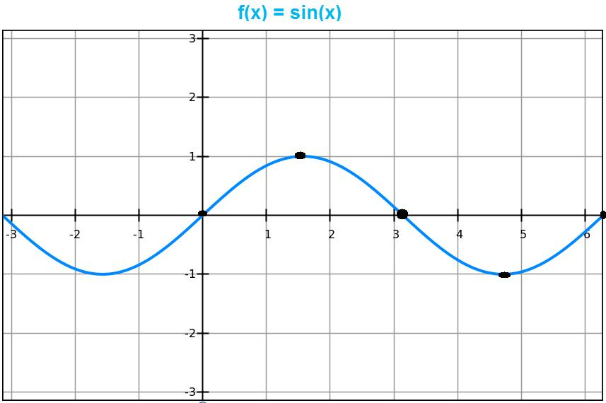
When not to use the time series analysis
Values are constant
2. Values in the form of functions

Slide 10

Take Home Task
(github link)
“Watching someone else eating your favourite food won’t give you the real taste of it”

Slide 11
Acknowledgement
Thank You
We would like to thank our Instructor Prof. Veena Bansal for giving us the chance to present this topic and her valuable guidance. We are also grateful to her for systematic and simplified teaching which made the learning very interesting. Baki sabko sunne k liye thanks Though we were not able to get into the details as it is a big topic, feeling dene me safal rhe

