Slide 1
Book Recommendation System

Slide 2
OUTLINE
Problem Statement
Proposed System/Solution
System Development Approach
Algorithm & Deployment
Result (Output Image)
Conclusion
Future Scope
References

Slide 3
PROBLEM STATEMENT
With the ever-growing number of books being published each year, readers often struggle to find books that match their tastes and preferences. Traditional methods such as best-seller lists or general reviews lack personalization. Hence, there's a need for an intelligent system that helps users discover books based on their interests and reading history.

Slide 4
PROPOSED SOLUTION
The proposed Book Recommendation System leverages collaborative filtering and content-based filtering techniques to suggest books personalized to user preferences.
Data Collection: Used public book datasets including user ratings and metadata.
Filtering Techniques:
  Collaborative Filtering: Based on user similarity and rating patterns.
  Content-Based Filtering: Based on features like author, title, genre, etc.
User Interface: Simple UI to display top 50 books and get personalized recommendations.
Deployment: Hosted using Flask on Render platform.

Slide 5
SYSTEM APPROACH
Technologies Used:
  Python, Pandas, NumPy
  Scikit-learn (for modeling)
  Flask (for backend)
  HTML/CSS (for frontend)
  Render (for deployment)
Libraries:
  pandas, numpy, scikit-learn, flask, pickle, requests, etc.

Slide 6
ALGORITHM & DEPLOYMENT
Algorithm Used:
Collaborative Filtering: Based on cosine similarity between users or items.
Content-Based Filtering: TF-IDF or metadata similarity.
Data Input:
Book titles, user ratings, authors, genres, publication years.
Training Process:
Precomputed similarity matrix based on user ratings and book features.
Model serialized with pickle for quick deployment.

Slide 7
ALGORITHM & DEPLOYMENT
Prediction:
Given a selected book, return the top 3 most similar books.
Deployment:
Web app deployed using Flask.
Hosted on Render using a free tier service.

Slide 8
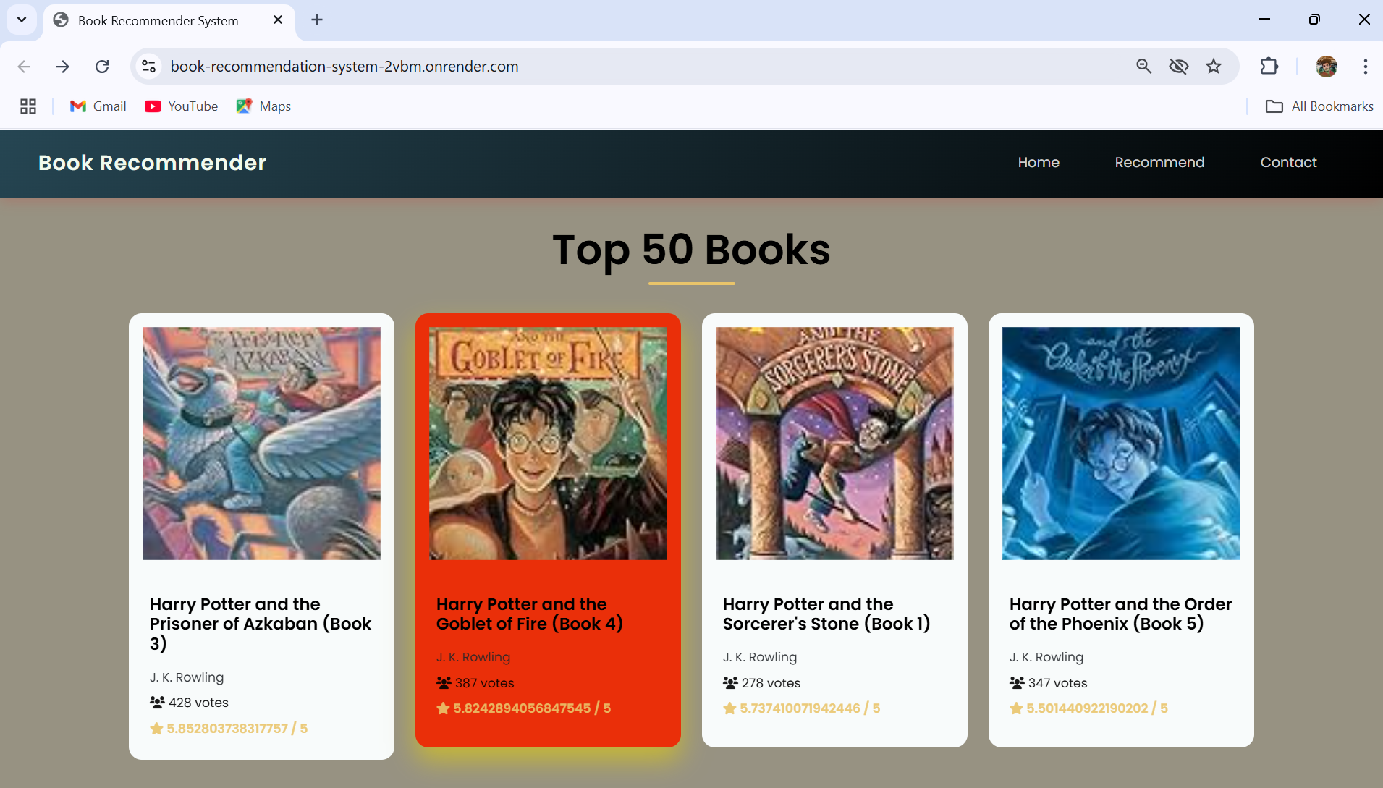
RESULT

Slide 9
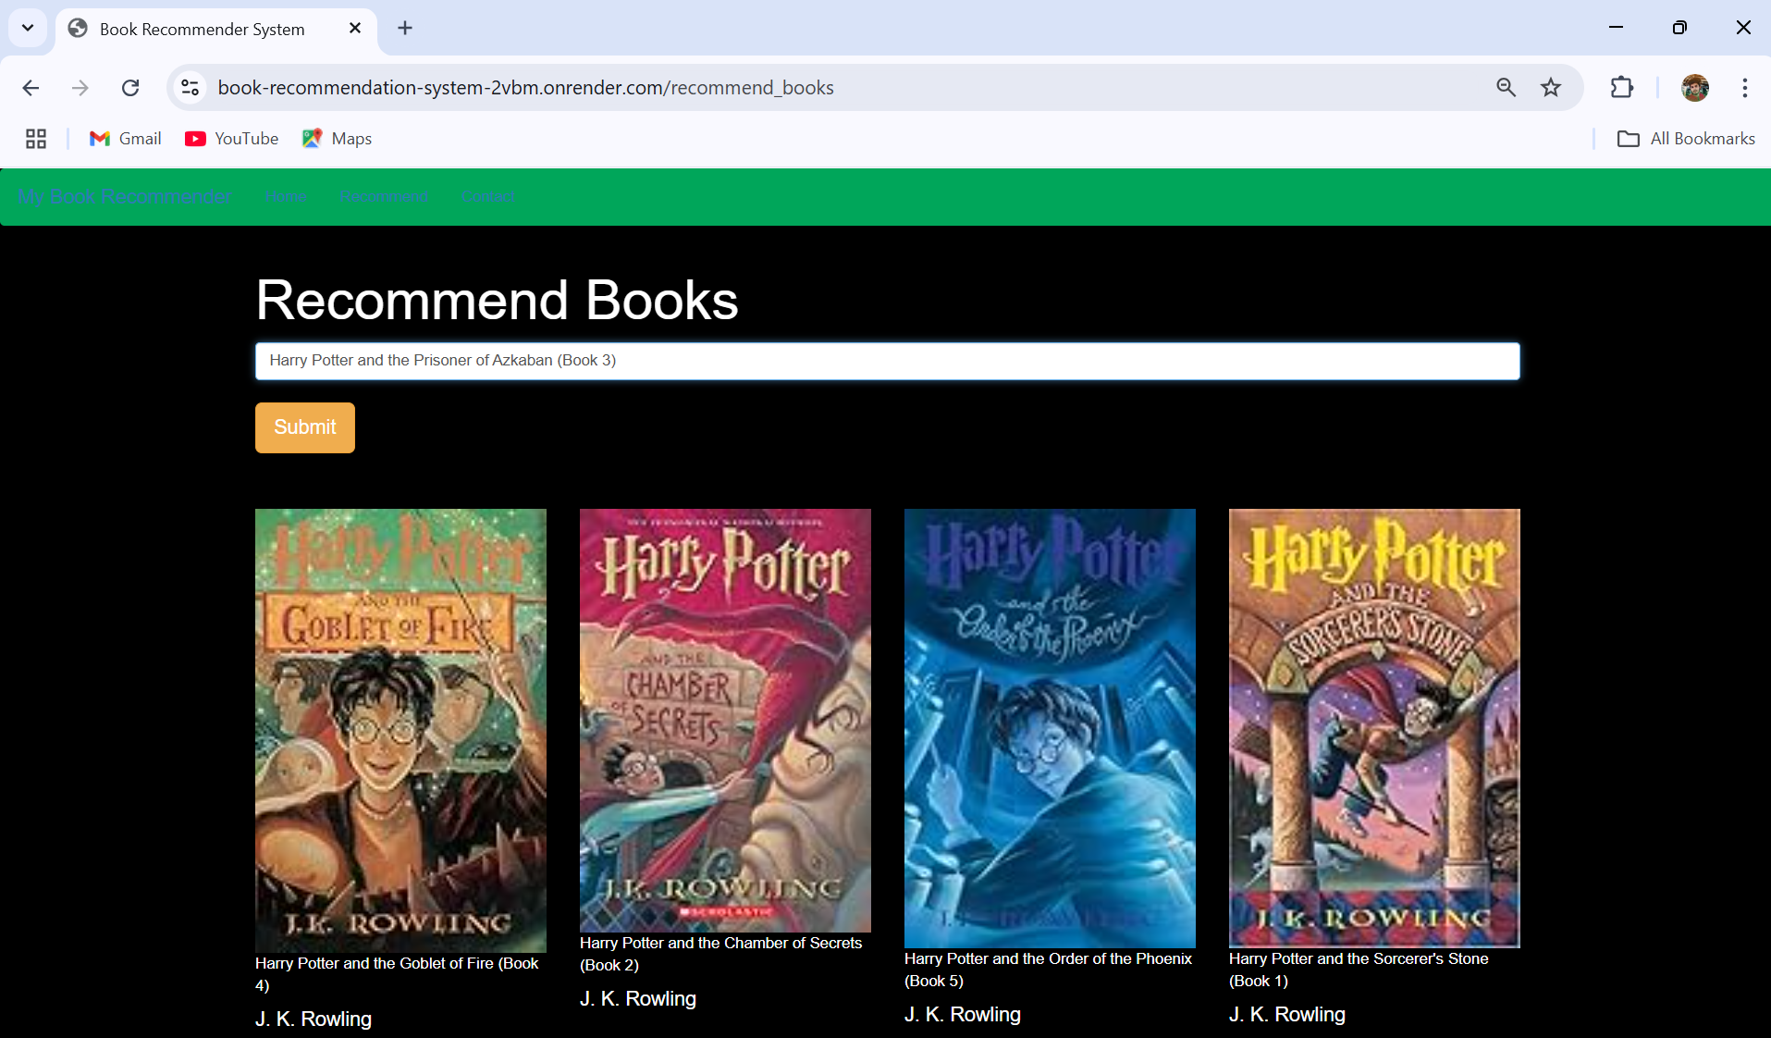
RESULT

Slide 10
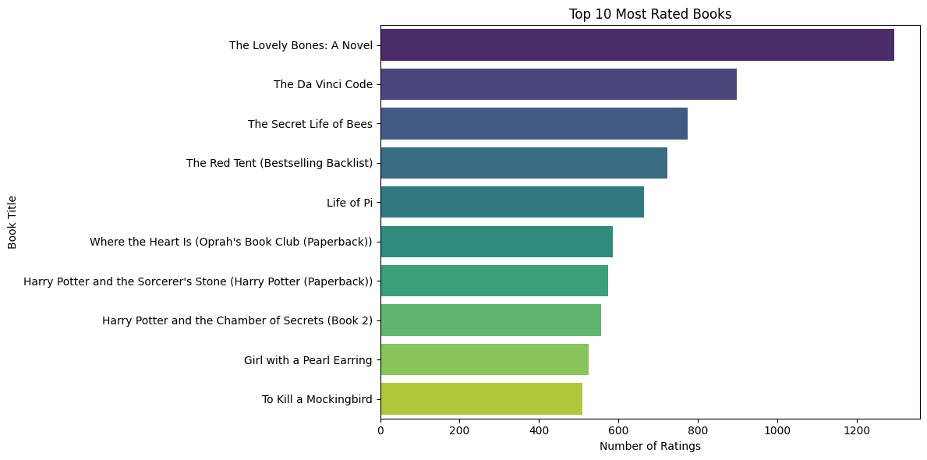
RESULT

Slide 11
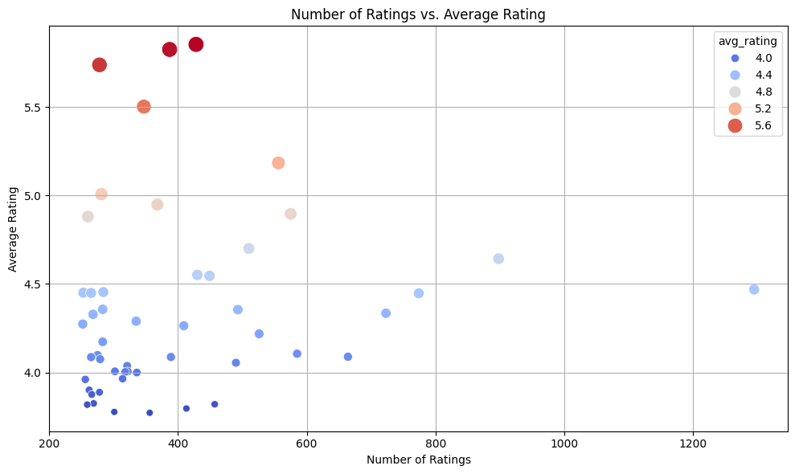
RESULT

Slide 12
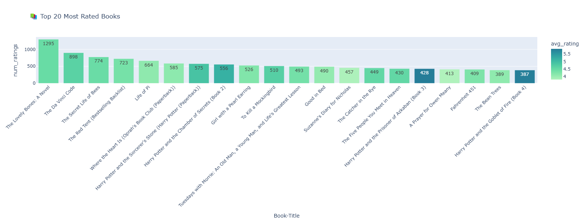
RESULT

Slide 13
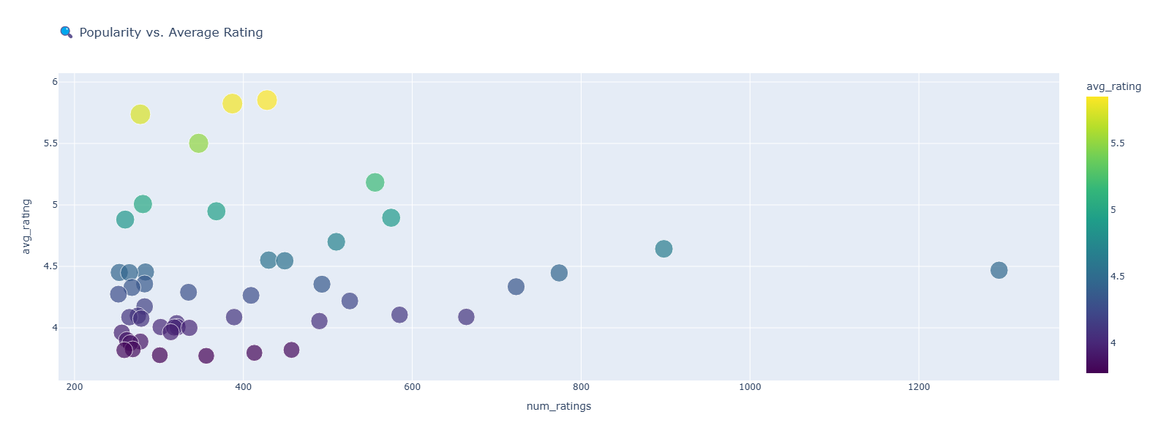
RESULT

Slide 14
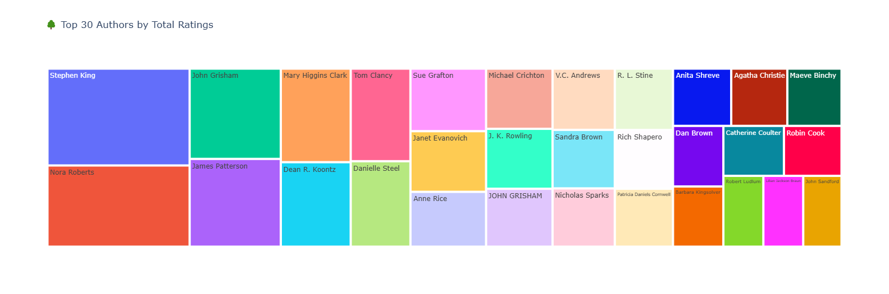
RESULT

Slide 15
RESULT
Please note: The website will take approximately 1 minute to load after clicking 'Show Project'. Kindly wait while the system initializes.
Github link
Show Project

Slide 16
CONCLUSION
The system provides personalized book recommendations using a hybrid filtering approach.
Easy to use, responsive interface hosted online.
Helps readers explore new titles aligned with their interests.
Demonstrated effective performance with a clean UI and relevant suggestions.

Slide 17
FUTURE SCOPE
Incorporate user login and history tracking for dynamic recommendations.
Use deep learning-based models like BERT for better understanding of book content.
Enable multilingual recommendations.
Expand the dataset for broader genre coverage and global reach.
Add features like “Recently Trending”, “Critic’s Picks”, and “User Reviews”.

Slide 18
REFERENCES
Kaggle Datasets (Books, Ratings)
Render Deployment Platform
GitHub Link: Link

Slide 19

Thank you

