Slide 1
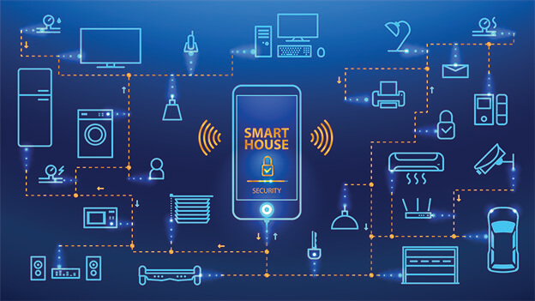
VOICE BASED HOME AUTOMATION
BY
19BPS1081 –J.ANJANI BABU
19BPS1066 -M.HANUMAN SAI

Slide 2
ABSTRACT
The primary objective of our project is to construct a fully functional voice based Home automation system that uses Internet of Things, Artificial Intelligence and Natural Language Processing (NLP) to provide a cost-effective, efficient way to work together with home appliances. There are many smart home solutions in the market that aim to automate the basic operations of these home appliances using various technologies such as GSM (Global System for Mobile), NFC (Near-Field Communication) etc. However, most of these systems focus on mimicking the basic operation of the electrical switch. Our project aims at providing a fully automated voice based solution that our users can rely on, to perform more than just switching on/off the appliances. The user sends a command through speech to the mobile device, which interprets the message and sends the appropriate command to the specific appliance. We plan on implementing four basic home appliances as a “Proof-of-Concept” for this project which includes Fan, Light etc. The voice command given by the user is interpreted by the mobile device using Natural Language processing. The mobile device acts as a central console; it determines what operation must be completed by which appliance to fulfill the user's request. The central console might likewise be either a desktop application, web application or a smart phone application as nearly all of the data transferred can be processed by the cloud. However, for the convenience of the user and increased mobile capabilities we will be using a smart phone in this project. The appliances are associated with the mobile device through an Arduino Board that establishes the concept of Internet of Things. The Arduino Boards are interfaced with the appliances and programmed in a manner that they respond to mobile inputs.

Slide 3
Introduction
The Internet of Things (IoT) is the network of physical objects or "things" embedded with electronics, software, sensors, and network connectivity, which enables these objects to collect and exchange data. IoT allows objects to be sensed and controlled remotely across existing network infrastructure, creating opportunities for more direct integration between the physical world and computer-based systems, and resulting in improved efficiency, accuracy and economic benefit. Home automation is one of the major areas where IoT can have a stronghold.
In the recent years, the Home automation system has seen a rapid change due to introduction of various wireless technologies. The wireless home automation system is an integrated system to facilitate elderly and disabled people with an easy-to-use home automation system that can be fully operated based on speech commands. The system is portable and constructed in a way that is easy to install, configure, run, and maintain.

Slide 4
A typical wireless home automation system allows one to control house hold appliances from a centralized control unit which is wireless. These appliances usually have to be specially designed to be compatible with each other and with the control unit for most commercially available home automation systems. The project demonstrates a system that can be integrated as a single portable unit and allows one to wirelessly control lights, fans, air conditioners, television sets, security cameras, electronic doors, computer systems, audio/visual equipment’s etc. and turn on or off any appliance that is plugged into a wall outlet, get the status of different sensors and take decision accordingly.

Slide 5
WHAT IS HOME AUTOMATION?
Home automation or domotics is building automation for a home, called a smart home or smart house. It involves the control and automation of lighting, heating (such as smart thermostats), ventilation, air conditioning (HVAC), and security, as well as home appliances such as washer/dryers, ovens or refrigerators/freezers. Wi-Fi is often used for remote monitoring and control. Home devices, when remotely monitored and controlled via the Internet, are an important constituent of the Internet of Things. Modern systems generally consist of switches and sensors connected to a central hub sometimes called a "gateway" from which the system is controlled with a user interface

Slide 6
WHY HOME AUTOMATION?
Your security system knows all about your occupancy of the house. With a little more development it can build an intelligent ‘expert system’ to predict your usage.
Your central heating programmer knows the standards of comfort you expect – but doesn’t know which rooms are in use.
By linking just these two you could achieve a reduction in fuel costs and a better match to your requirements

Slide 7
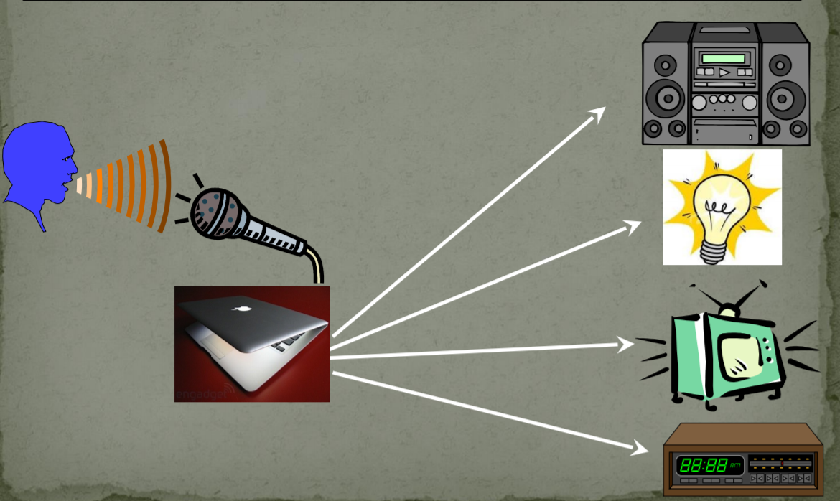
GENERAL WORKING

Slide 8
VOICE RECOGNITION CONCEPT
The way of this concept function is when a user speaks out some command, then the voice is captured through microphone as the input devices.
Once the voice is captured, the usage of a decoding system that will convert the analog (voice) to digital (binary signal).
Later, the input voice is compared with the data stored in the memory early before the testing.
The output of the comparison is the voice matched with any of the command trained and certain signal is produce as the input for the controlling system

Slide 9
components used
1.ARDUINO
2.BLUETOOTH MODULE
3.REALY MODULE
4.FAN
5.LIGHT

Slide 10
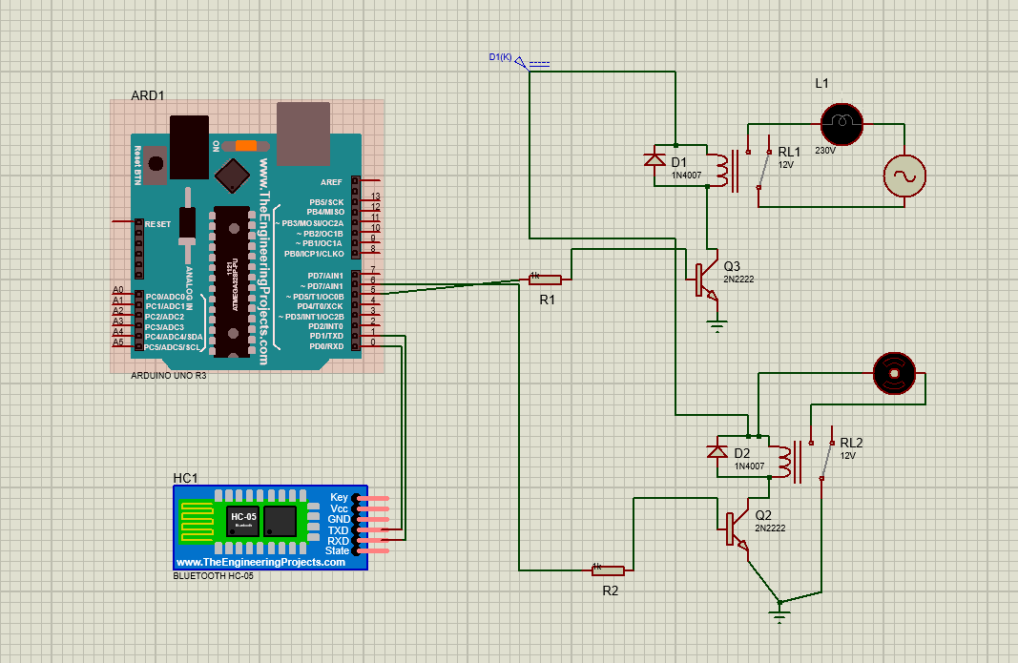
PROTOTYPE OF MODEL

Slide 11
APPLICATIONS
◻ Turning lights down / off at night.
◻ Operating outside lights
◻ Turning lights or radio on / off when someone approaches the house, simulating occupancy
◻ Operating television, hot water heater, kettle, toaster etc. ready for your use.
◻ Optimizing use of low cost electricity.
◻ Working with intelligent electrical white goods e.g. washing machine, fridge, microwave etc.

Slide 12
ADVANTAGES
 Flexibility & Convenience
 Security
Cost Saving
Security
Remote Control

Slide 13
CONCLUSION
In today’s modern technology world, where almost all the electronic devices or appliances can be remotely controlled, our new project which would help an individual to control the lights, fans etc. by just talking to them and will be a boon for physically challenged and disabled people. This project is called ‘Voice Controlled Home Automation project using Arduino’ which enables a user to control the home appliances through voice commands sent to an Android app.
There are some issue that arises when using this system. The problems are the pronunciation of the user when doing the process. For the pronunciation matter, the system takes it at a quite high level of sensitivity. . So when the user wishes to use the system, thus he or she must produce the word with the correct pronunciation as in the training process

Slide 14
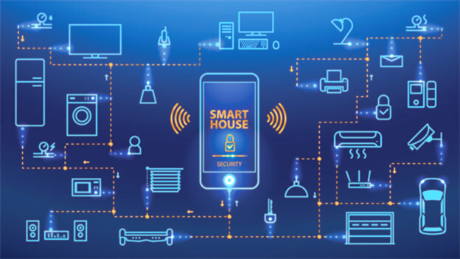
THANK YOU

