Slide 1

Demo of PhoneGap Application
An Jiangze

Slide 2
What is the phoneGap?
PhoneGap is a web-based mobile development framework, based on the open-source Cordova project. PhoneGap allows users to use standard web technologies such as HTML5, CSS3, and JavaScript for cross-platform development, avoiding each mobile platforms' native development language.

Slide 3
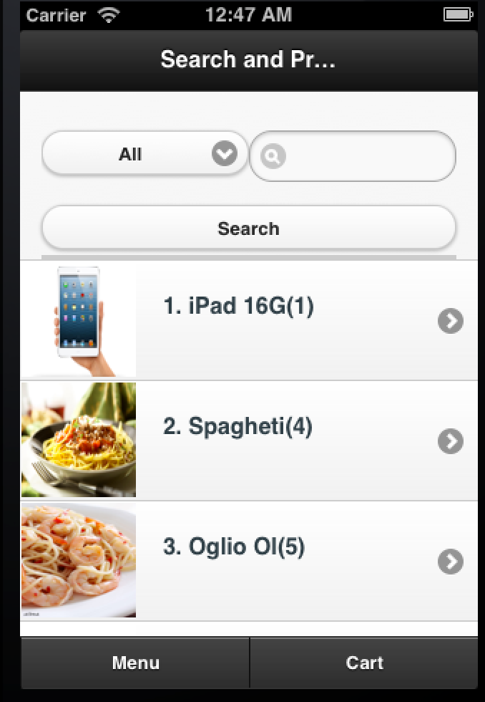
Ordering System
This is the main page of the PhoneGap application named as “Ordering system”. In the main page, user could search for a particular products. Besides, the app would display the promotions products. Users could click the list item and view the details.

Slide 4
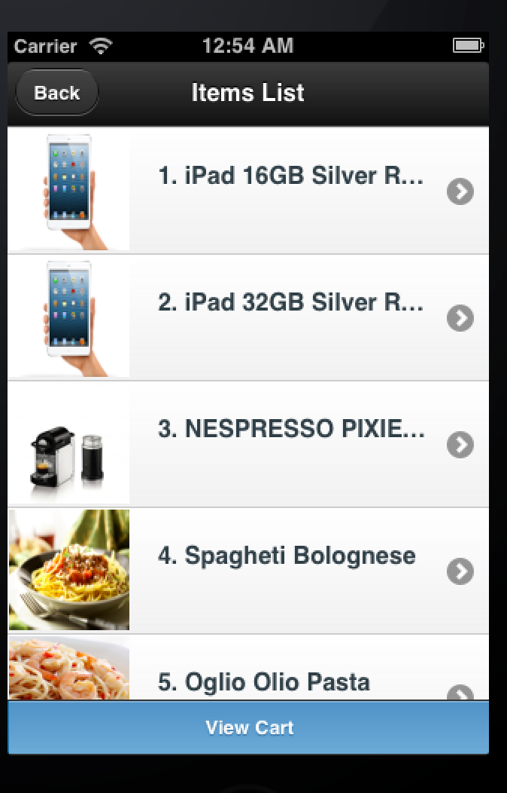
Ordering System
This page is the product menu page. On this page, users could get the list of all products. By clicking the list item, the user could view the details of a particular product and make the booking.

Slide 5
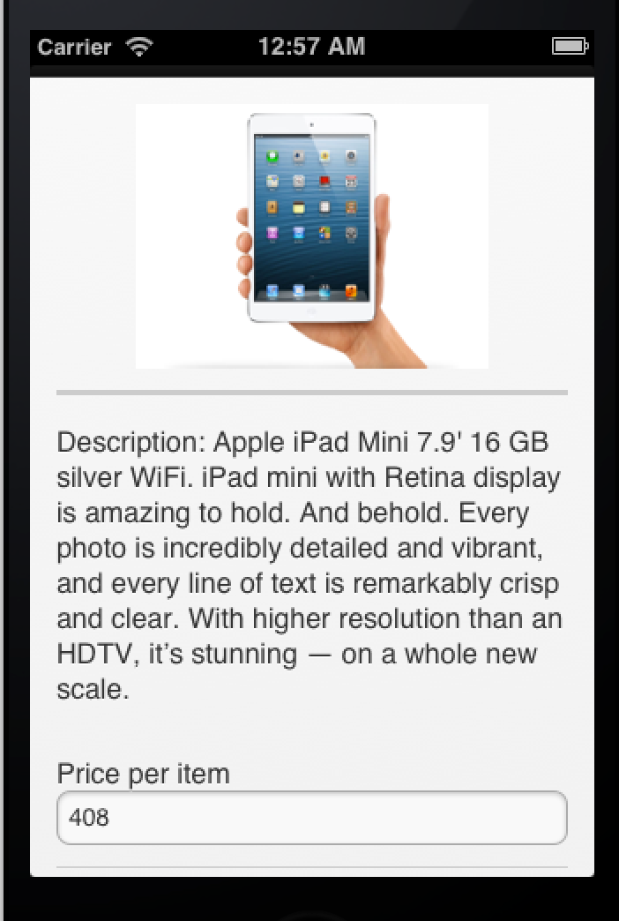
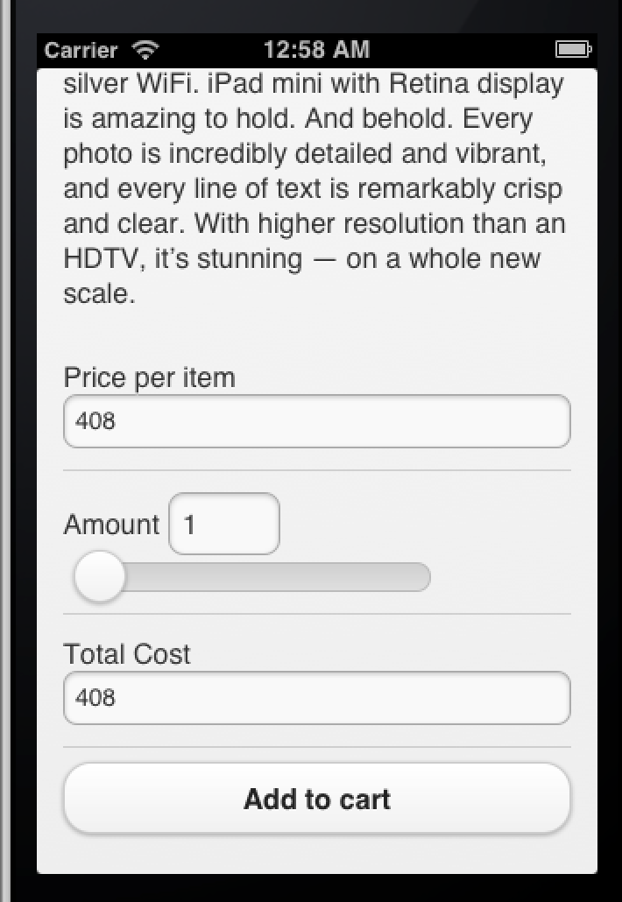
Ordering System
This is a typical page for detail page. The user could view the details of a product. He could select the amount and make the order as well.

Slide 6
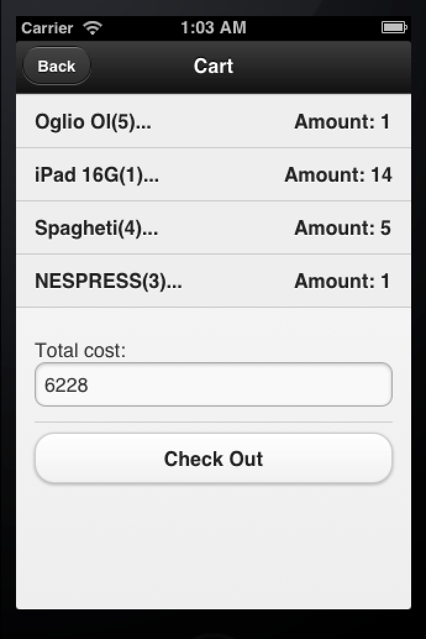
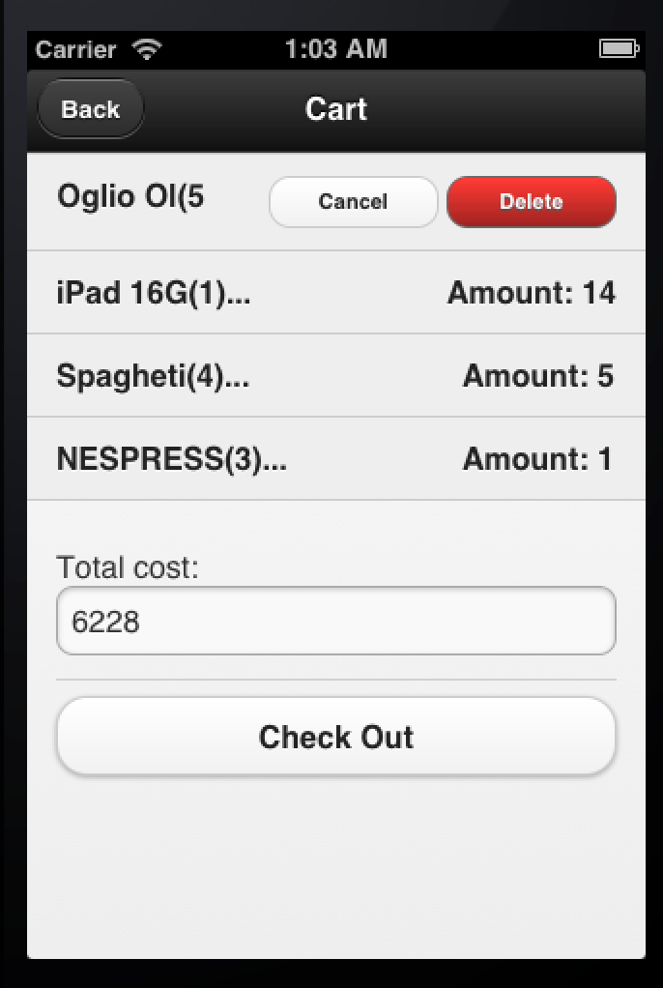
Ordering System
This is a typical layout of cart page. By swiping the list item, the user could make the modification upon the product ordered.

Slide 7
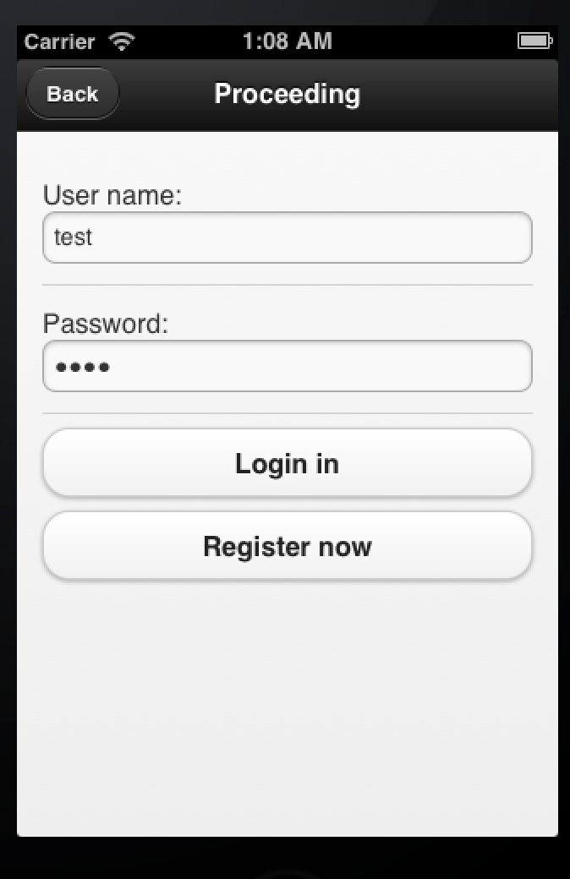
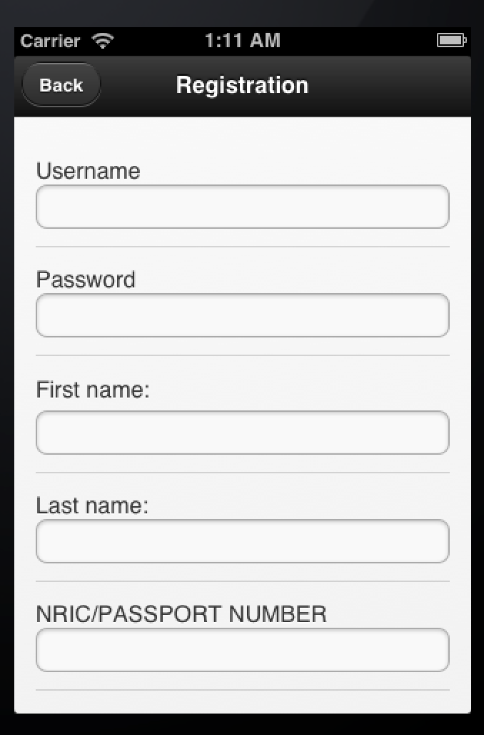
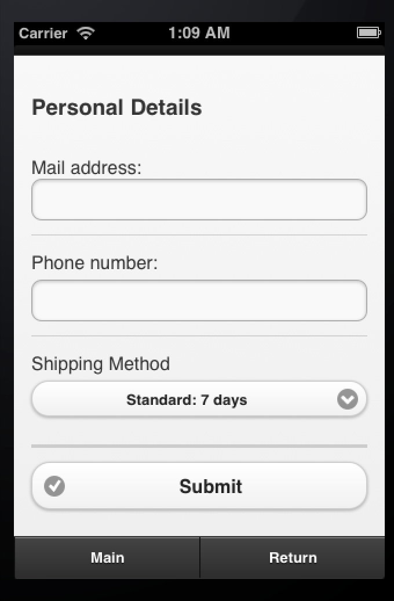
Ordering System
These are the login page, registration page and check out page. Before making payment, the user needs to have a purchase account.

Slide 8
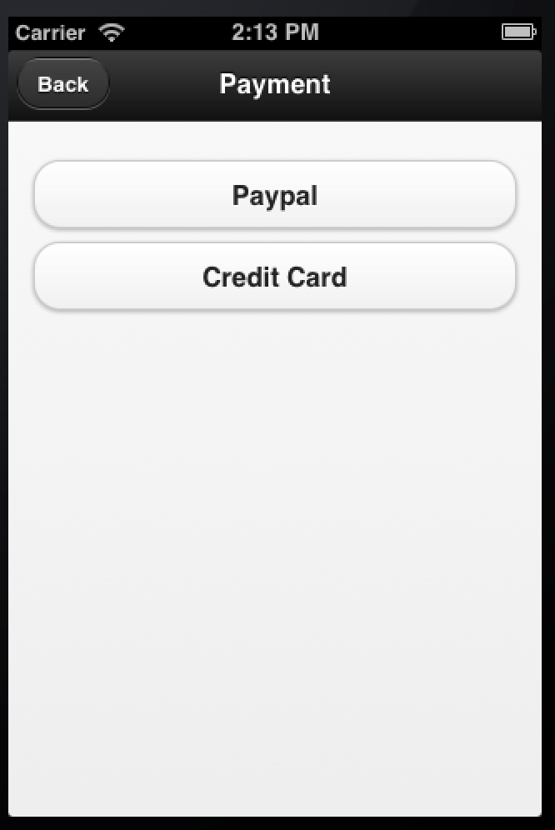
Ordering System
This is the payment page for application. The user could choose to use Paypal or Credit card to finish the payment.

Slide 9
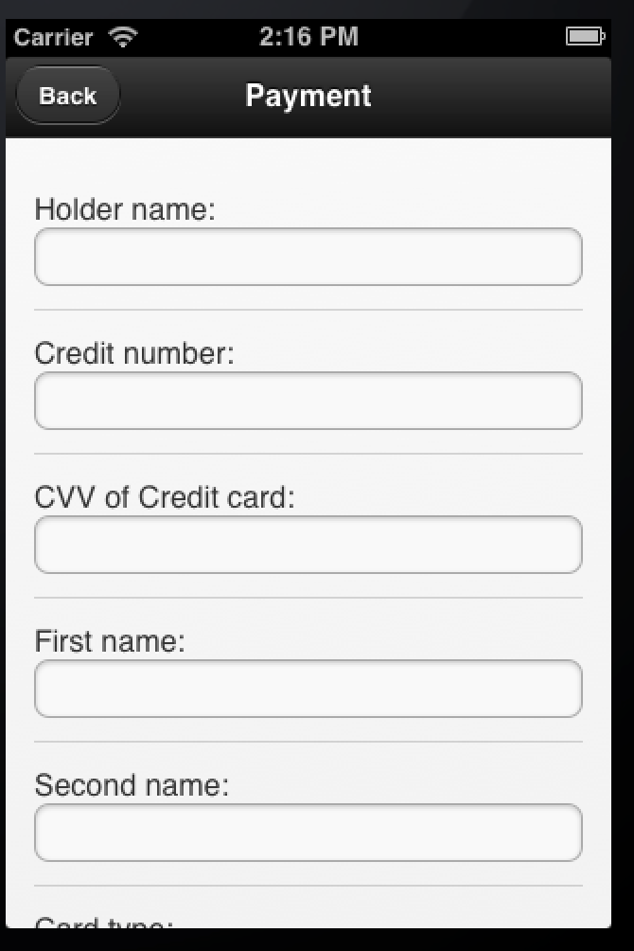
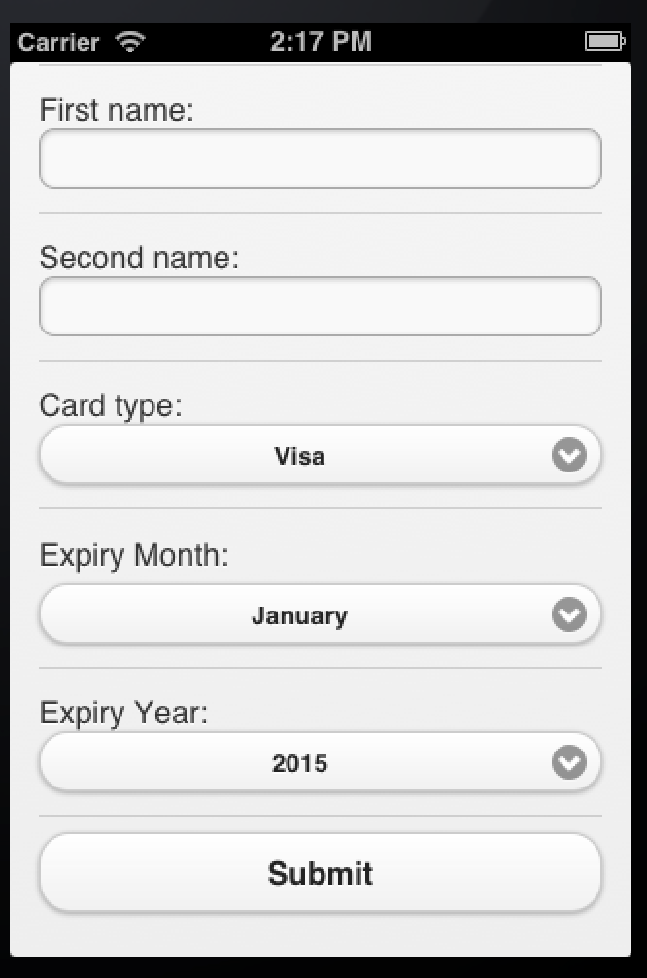
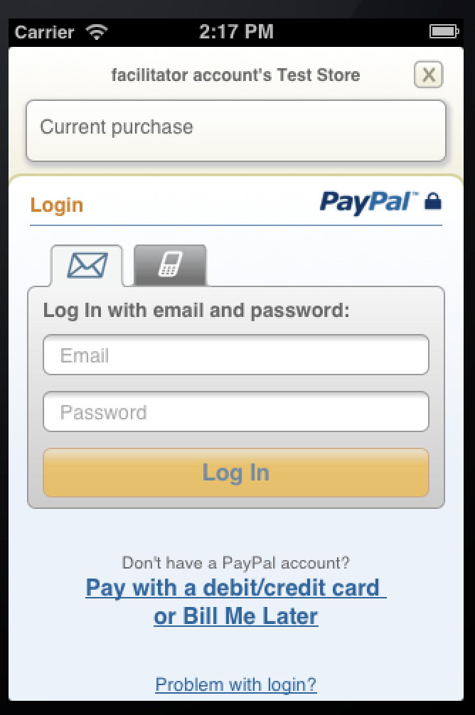
Ordering System
These are the pages for two payments. For the Paypal payment, the mobile application would direct to the Paypal web page to let the user finish payment. For the Credit card payment, user just needs to enter the information about the credit card in order to finish the payment.

Slide 10
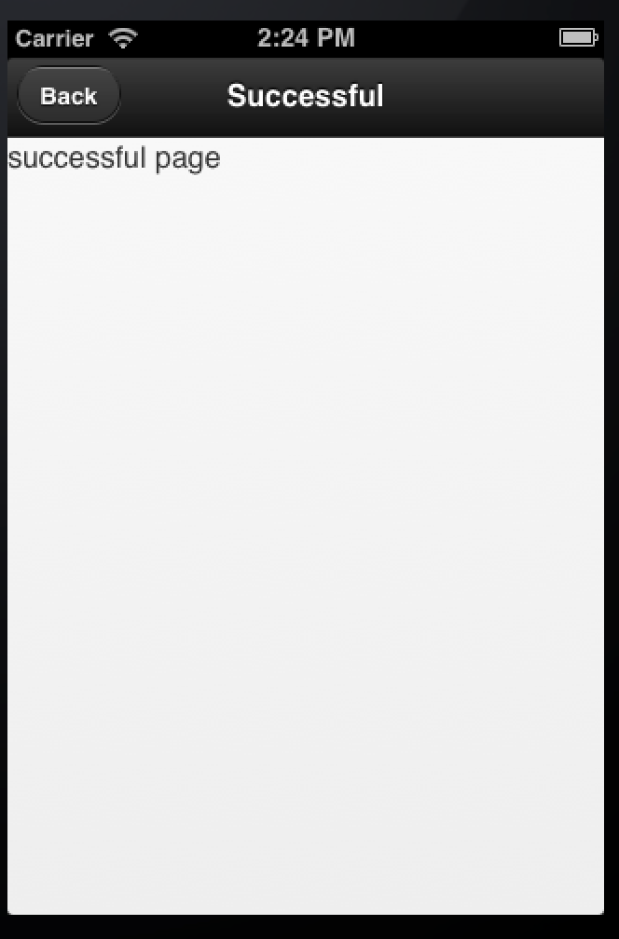
Ordering System
After finishing the payment, the application would show a feedback page. If the transaction is fail, the user could try to enter the information again.

Slide 11
Useful Links
1. PhoneGap website: http://phonegap.com/
2. Cordova website: http://cordova.apache.org/
3. JQuery Mobile website: http://jquerymobile.com/
4. Codiqa website: https://codiqa.com/
5. Paypal developer documentation: https://developer.paypal.com/

Slide 12
Live demo please refer to Youtube video: http://www.youtube.com/watch?v=kNPlU2qk2DQ&feature=youtube_gdata

Slide 13
Thank you!

