Slide 2
ISE G4 – System management
ISE G4 will be managed by a new web based management interface ISE XConsole
ISE XConsole runs as a VM on each ISE G4
XConsole can run in Primary or Managed role
In primary role ISE can be managed individually via the ISE IP address
Each session will display information for the individual ISE and any managed ISE
In managed role Users can manage multiple ISE from the Primary ISE IP address
A single session will show information for all ISE in the management group
User can drill down to get information for individual ISE
XConsole will support management of ISE Generation 3 systems (G3)
G3 ISE can only be managed from a Primary ISE G4 instance of Xconsole

Slide 3
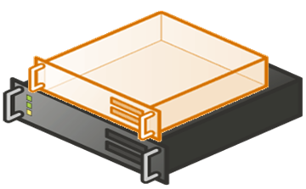
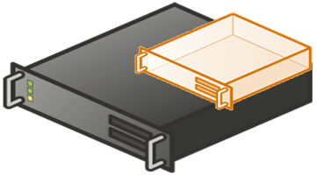
ISE G4 – System management
Primary role ISE Management
Managed role ISE Management
Primary role
Primary role
ip: 1
ip: 1
ip: 2
Primary role
Managed role
ip: 3
Primary role
Managed role

Slide 4
ISE G4 – System management
V1 release supports 10(?) ISE in management group
When initialized each ISE will start with XCon in primary role
From a Primary role ISE user can add additional ISE
When additional ISE are added to primary XCon the additional ISE will switch to Managed role
If a managed ISE is accessed directly it will display a notification with the Primary ISE ip address
Display message with warning that ISE is managed by another primary
Include link to the Primary ISE
User can click link and browser will redirect
User can switch the managed ISE to Primary role
Display warning message with confirmation to take over
(similar to hosts in a vCenter environment)

Slide 5
ISE G4 – System management
For environments with greater than 10(?) systems the VM can be installed onto a separate server
This will allow increased resources to be dedicated to xConsole
For advanced performance management additional database capacity can be provisioned
Managed role ISE Management
Standalone server
running xConsole
ISE managed role
ISE managed role
ip: 1
ISE managed role

