Slide 1
EXECUTIVE PERFORMANCE REVIEW · JAN 2025–JUN 2026
NOVATECH SALES
PERFORMANCE
Where growth is working, and where margin is leaking.
Notes:
Welcome leadership. Today's review analyzes 600 transactions from January 2025 through June 2026 to pinpoint where revenue expansion is solid and where margin discipline must tighten.

Slide 2
01 — EXECUTIVE BRIEFING
FIVE SIGNALS SHOULD GUIDE THE NEXT SALES CYCLE
An audit of 600 transactions across Jan 2025–Jun 2026 establishes clear geographic, product, and channel boundaries.
TRANSACTIONS
LEAD REGIONS
PORTFOLIO MIX
GUARDRAIL
RHYTHM
600
South & West
Dual Core
>10% Cap
Seasonal
Transactions analyzed across the full 18-month baseline period.
Laptops dominate revenue share; Tablets deliver standout margin.
Clear peak and trough months set a predictable operating calendar.
Generate the overwhelming share of regional sales volume.
Discounts above 10% erode profitability and require tight approval.
NovaTech sales performance: where growth is working, and where margin is leaking
2
Notes:
Walk through the five core signals: 600 transactions analyzed, South and West setting the sales pace, Laptops and Tablets dividing volume and margin roles, a 10% discount cap needed to stop margin leakage, and predictable seasonal swings.

Slide 3
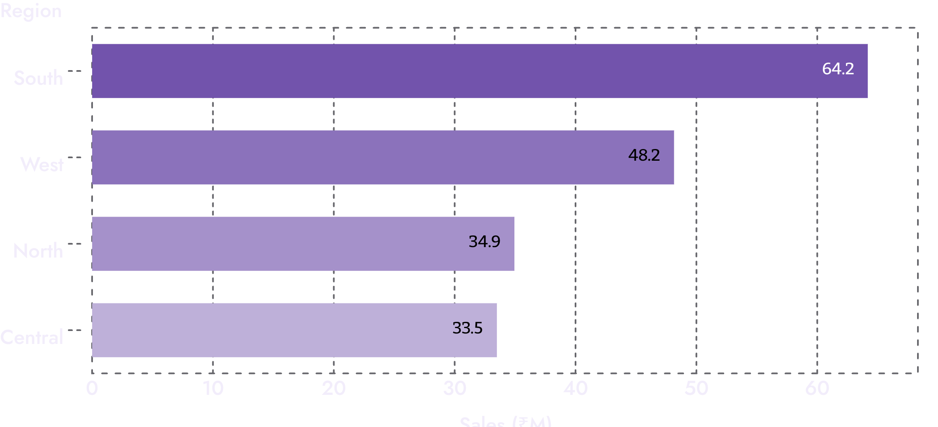
02 — REGIONAL FOOTPRINT
SOUTH LEADS THE MAP
Central and North need a sharper growth plan.
Protect momentum in the leaders while testing targeted marketing in underperforming markets.
South: ₹64.18M in sales · West: ₹48.15M in sales
North: ₹34.94M · Central: ₹33.49M
NovaTech sales performance: where growth is working, and where margin is leaking
3
Notes:
South is the undisputed anchor at ₹64.18M, followed by West at ₹48.15M. North and Central lag closely at ₹34.94M and ₹33.49M, indicating need for dedicated promotional tests rather than unfocused spend.

Slide 4
The portfolio needs a two-speed strategy: scale Laptops, lift margin elsewhere
Laptops
Tablets
Smartphones
51.65% revenue share
Prioritize premium products such as NovaBook Air and NovaBook Pro in incentives.
29.17% profit margin
Use bundles with high-margin Accessories to improve economics.
NovaTech sales performance: where growth is working, and where margin is leaking
4
Notes:
Explain the two-speed dynamic: Laptops generate over half of total revenue (51.65%), so premium models NovaBook Air and NovaBook Pro must lead incentives. Tablets deliver 29.17% margin, while Smartphones require accessory bundling to protect margin.

Slide 5
04 — GO-TO-MARKET EXECUTION
SALES EXECUTION IS A PEOPLE-AND-CHANNEL GAME
Identify which channel and representative combinations create repeatable wins, then replicate the winning playbook.
ONLINE CHANNEL
Digital Direct Velocity
Captures high-frequency catalog orders; ideal for standardized laptop configs and self-serve accessory purchases.
BENCHMARK PERFORMER
₹29.96M
DISTRIBUTOR NETWORK
Geographic Reach & Bulk Flow
Rohit: Top Sales Rep
Powers multi-region coverage across Tier-2 cities; requires strict discount threshold governance.
Leading the sales roster by demonstrating strong deal closing mechanics and disciplined discounting in key accounts.
DIRECT SALES & RETAIL STORES
Enterprise & Premium Touchpoints
Direct Reps and Retail Stores drive high-touch adoption of NovaBook Pro and high-margin Tablet bundles.
NovaTech sales performance: where growth is working, and where margin is leaking
5
Notes:
Rohit leads the entire rep roster at ₹29.96M. Compare execution across Online, Distributor, Direct Sales, and Retail channels to codify what Rohit and the top reps are doing differently to close high-value business.

Slide 6




05 — DEMAND CALENDAR
Seasonality gives NovaTech a practical inventory and promotion calendar
Turn the monthly trend into a simple operating rhythm for inventory, campaigns, and rep focus.
April Peak
June Slow Month
Prepare stock ahead of April peak sales months.
Use targeted promotions in June slow months.
July Peak
November Slow Month
Prepare stock ahead of July peak sales months.
Use targeted promotions in November slow months.
NovaTech sales performance: where growth is working, and where margin is leaking
6
Notes:
Emphasize April and July as the two major sales peaks requiring advance stocking, while June and November represent slower months that call for structured, targeted campaign pushes rather than panicky price slashing.

Slide 7
06 — PROFIT PROTECTION
Discount discipline is the fastest lever to protect profit
Standard discounts
Bulk or clearance
Under 10%
Above 10%
Keep standard discounts under 10% to protect profit margins
Reserve discounts above 10% for bulk or clearance sales
Track discount category against profit so the team can see where volume is being bought at too high a cost.
NovaTech sales performance: where growth is working, and where margin is leaking
7
Notes:
This is the core margin leakage finding. Standard deals must stay capped below 10% discount. Concessions above 10% dilute net profitability and should require formal Deal Desk approval reserved for genuine bulk commitments or clearance runs.

Slide 8
07 — OPERATING ROADMAP
FROM DASHBOARD INSIGHT TO NEXT-QUARTER ACTION
Five targeted initiatives to operationalize sales performance insights and safeguard profitability.
01
02
03
04
05
DEFEND CORE
EXPAND
BUNDLE
CONTROL
PREPARE
Protect South & West
Test North & Central
Smartphones + Add-ons
10% Discount Rule
April–July Rhythm
Set hard approval gates for discounts over 10% to prevent margin dilution.
Align supply chain readiness and promotional campaigns ahead of peak cycles.
Double down on winning reps and flagship product lines in our two lead markets.
Deploy localized marketing sprints to accelerate traction in lagging territories.
Attach high-margin Accessories and incentivize premium NovaBook Air/Pro tiers.
NovaTech sales performance: where growth is working, and where margin is leaking
8
Notes:
Summarize the roadmap into five clear actions: protect South and West, test North and Central, bundle Smartphones with Accessories while incentivizing NovaBooks, enforce the 10% discount threshold, and build inventory ahead of the April-July peaks.

Slide 9
EXECUTIVE TAKEAWAY
GROW FASTER BY BEING MORE SELECTIVE
Scale proven regional and product strengths, tighten discounting, and turn seasonal and rep-level signals into a repeatable operating plan.
Notes:
Conclude with the clear strategic mandate: growth at NovaTech does not mean doing everything everywhere. It means scaling where we win, defending margin with discipline, and aligning inventory with real customer timing.

