Slide 1
EXECUTIVE DATA REPORT
Amazon sales performance
What the data says across 128K+ orders
End-to-end audit: cleaning, revenue quality, category mix, state demand, SKU concentration, and fulfillment channels
1
2
3
Cleaned Data
Core Drivers
Decisions
Notes:
Opening slide sets the scope: an empirical review of recorded Amazon marketplace transactions, addressing scale, channel mix, and revenue vulnerabilities.

Slide 2
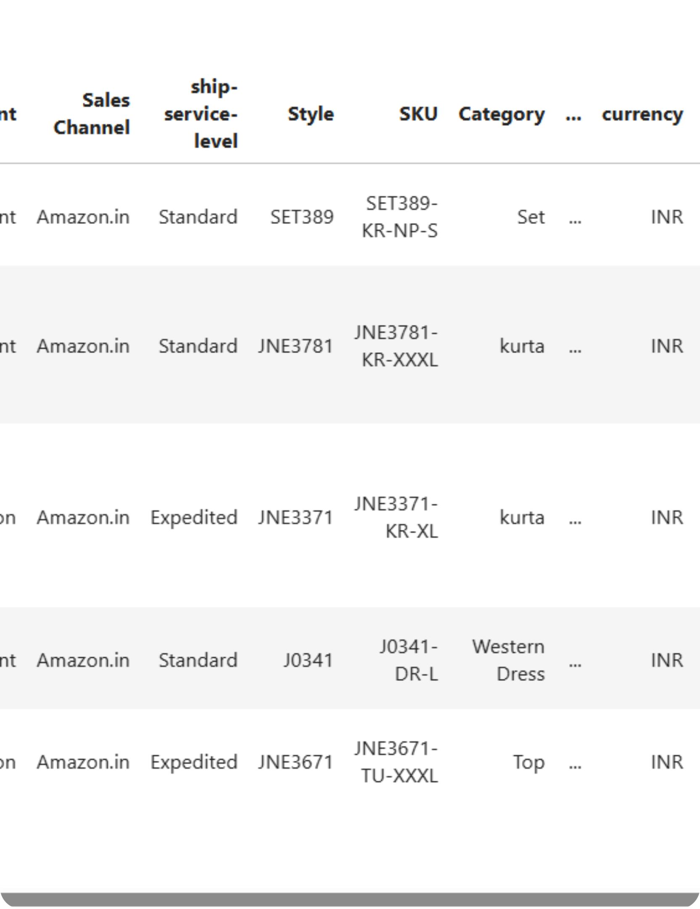
One cleaned dataset supports the full analysis
Source
Amazon Sale Report with 128,975 rows and 24 initial columns.
Cleaning
Reduced to 23 columns, removed an unnecessary field, and standardized missing values and numeric fields.
Workflow
Python and pandas → Excel → PostgreSQL and SQL → Power BI.
Notes:
Raw data had 128,975 rows and 24 initial columns; cleaning reduced it to 23 columns, removed an unnecessary field, and standardized missing values and numeric fields before the workflow through Python and pandas, Excel, PostgreSQL and SQL, and Power BI.

Slide 3
EXECUTIVE KPI SNAPSHOT
The business is large, but revenue quality needs scrutiny
₹78.59M
₹648.56
120.38K
Total recorded sales
Average recorded sales amount
Orders shown in the dashboard
Data caveat: missing Amount values mean revenue reporting should be validated before final decisions.
Notes:
Highlight the high top-line scale of 78.59 million rupees, but immediately emphasize the data quality caveat regarding missing amount rows.

Slide 4
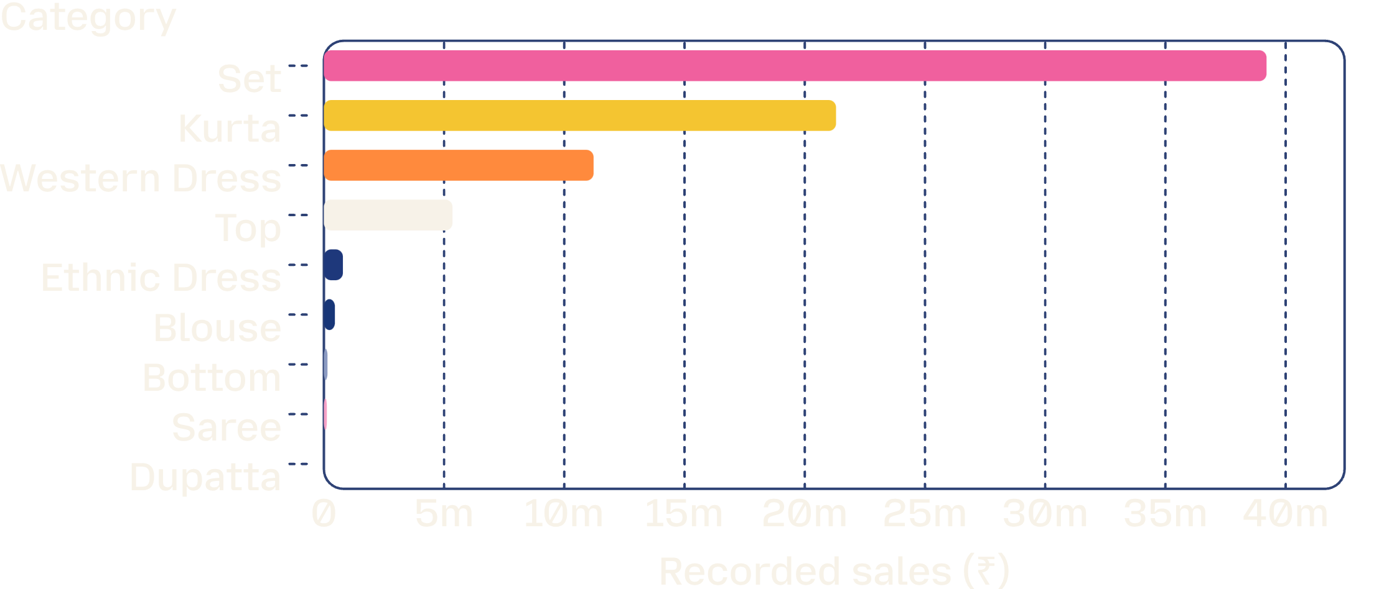
PRODUCT PORTFOLIO
Category mix is concentrated in a few winners
₹71.72M
Top 3 category share
Set (₹39.20M), Kurta (₹21.30M), and Western Dress (₹11.22M) account for the overwhelming majority of recorded category sales.
Strategic priority: protect catalog depth in Set and Kurta while re-evaluating sub-scale lines like Dupatta and Saree.
Notes:
Set and Kurta combine for over 60 million rupees. Focus inventory planning and promotional spend on the top three apparel categories.

Slide 5
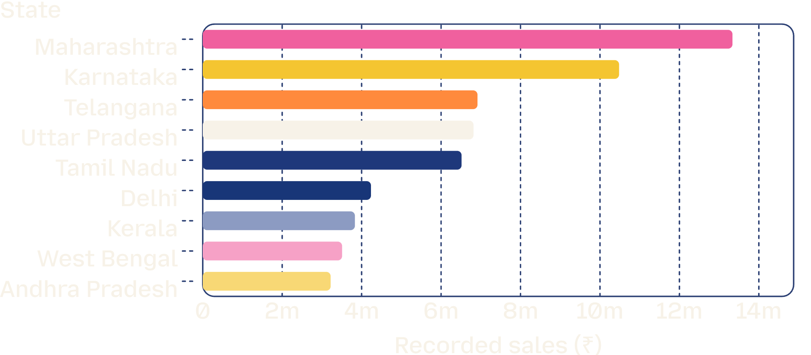
REGIONAL DISTRIBUTION
Maharashtra leads the geographic opportunity
₹23.82M
Top 2 states combined
Maharashtra leads at ₹13.34M, followed by Karnataka at ₹10.48M. Telangana, UP, and Tamil Nadu follow as a solid second tier (~₹6.5M–₹6.9M each).
Recommendation: deploy regional fulfillment nodes and geo-targeted promotions tailored to Maharashtra and Karnataka.
Notes:
Maharashtra and Karnataka anchor total revenue. Fulfillment capacity and inventory positioning in Western and Southern hubs remain critical.

Slide 6
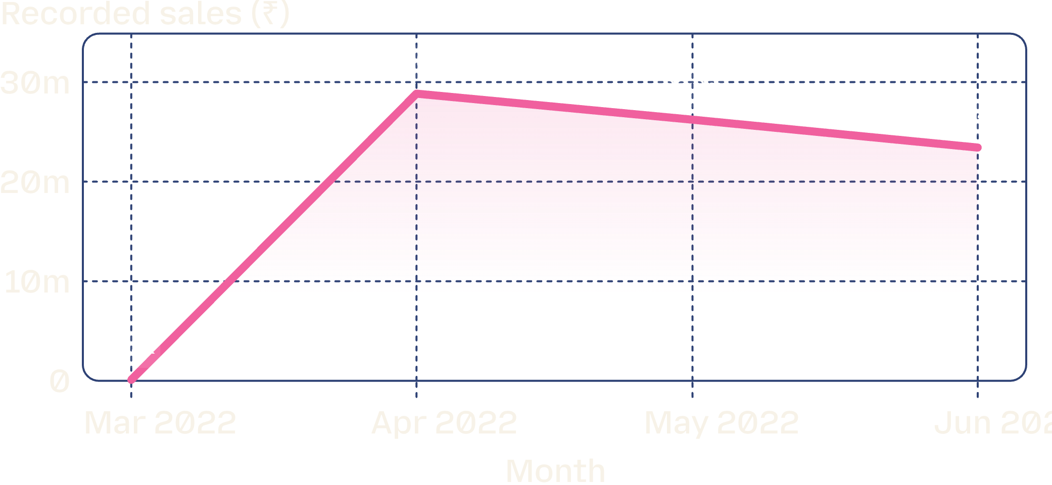
TIME-SERIES PERFORMANCE
April was the inflection point, then sales cooled
₹28.84M
April peak volume
After ramping from ₹0.10M in March, revenue surged in April before declining steadily through May (₹26.23M) and June (₹23.43M).
Use the spike and cooldown pattern to time inventory, promotion, and capacity decisions.
Notes:
Sales spiked aggressively in April, then declined for two consecutive months. Discuss potential seasonality and demand fatigue factors.

Slide 7
PRODUCT REVENUE LEADERS
A small set of SKUs anchors product revenue
SKU identifier | Recorded sales (₹)
J0230-SKD-M | ₹527,699.20
JNE3797-KR-L | ₹524,581.77
J0230-SKD-S | ₹479,937.14
JNE3797-KR-M | ₹454,290.16
JNE3797-KR-S | ₹407,302.57
JNE3797-KR-XL | ₹332,155.24
J0230-SKD-L | ₹305,616.95
JNE3797-KR-XS | ₹303,616.70
SET268-KR-NP-XL | ₹284,058.96
Top SKU: J0230-SKD-M at ₹527.7K
Close second: JNE3797-KR-L at ₹524.6K
The visible top SKUs range from roughly ₹284.1K to ₹527.7K in recorded sales
Pair revenue leaders with quantity leaders for inventory prioritization.
Notes:
Top SKUs range from ₹284.1K to ₹527.7K. Notice how variants of just two product lines (J0230 and JNE3797) capture 8 of the top 9 positions.

Slide 8
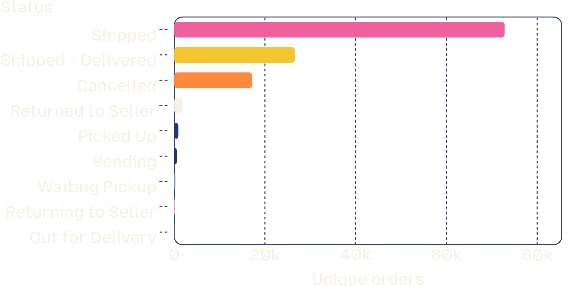
OPERATIONAL VULNERABILITY
Cancellation is the clearest operational risk
17,185
Cancelled orders
Cancellations form a major share of non-completed transactions compared to 26.57K confirmed delivered and 72.83K shipped orders.
Action required: audit cancellation drivers by state, category, promotion, and fulfillment method before scaling demand acquisition.
Notes:
17,185 cancelled orders represent significant lost margin and wasted fulfillment overhead. Investigate cancellation timing and channel differences.

Slide 9
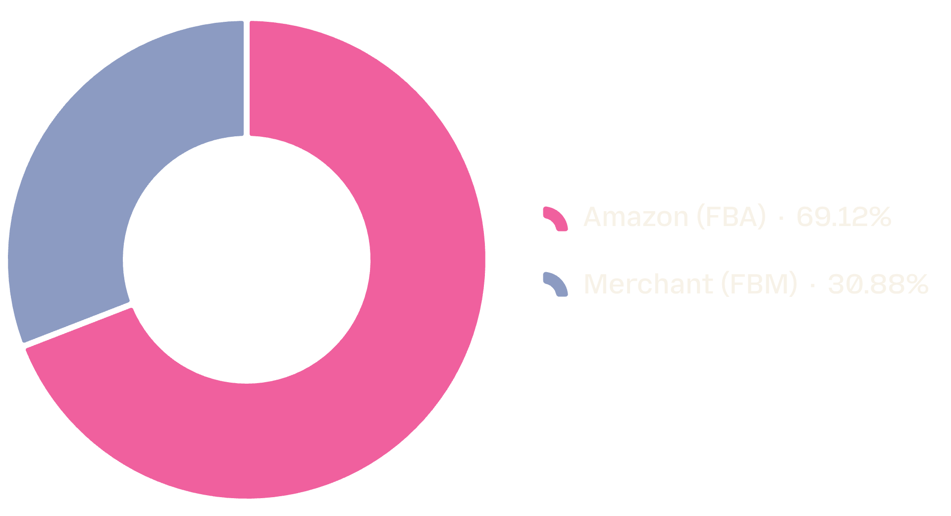
LOGISTICS & CHANNEL MIX
Amazon fulfillment carries most recorded revenue
2.24×
Amazon vs Merchant volume
Amazon fulfillment: ₹54.32M (69.1%)
Merchant fulfillment: ₹24.27M (30.9%)
FBA provides the primary sales engine and customer reach across high-performing categories.
Strategic recommendation: benchmark cancellation and transit rates across both methods before reallocating inventory between FBA and FBM.
Notes:
Amazon FBA drives 2.24x the sales volume of merchant fulfillment. Cross-reference delivery performance with cancellation rates by channel.

Slide 10
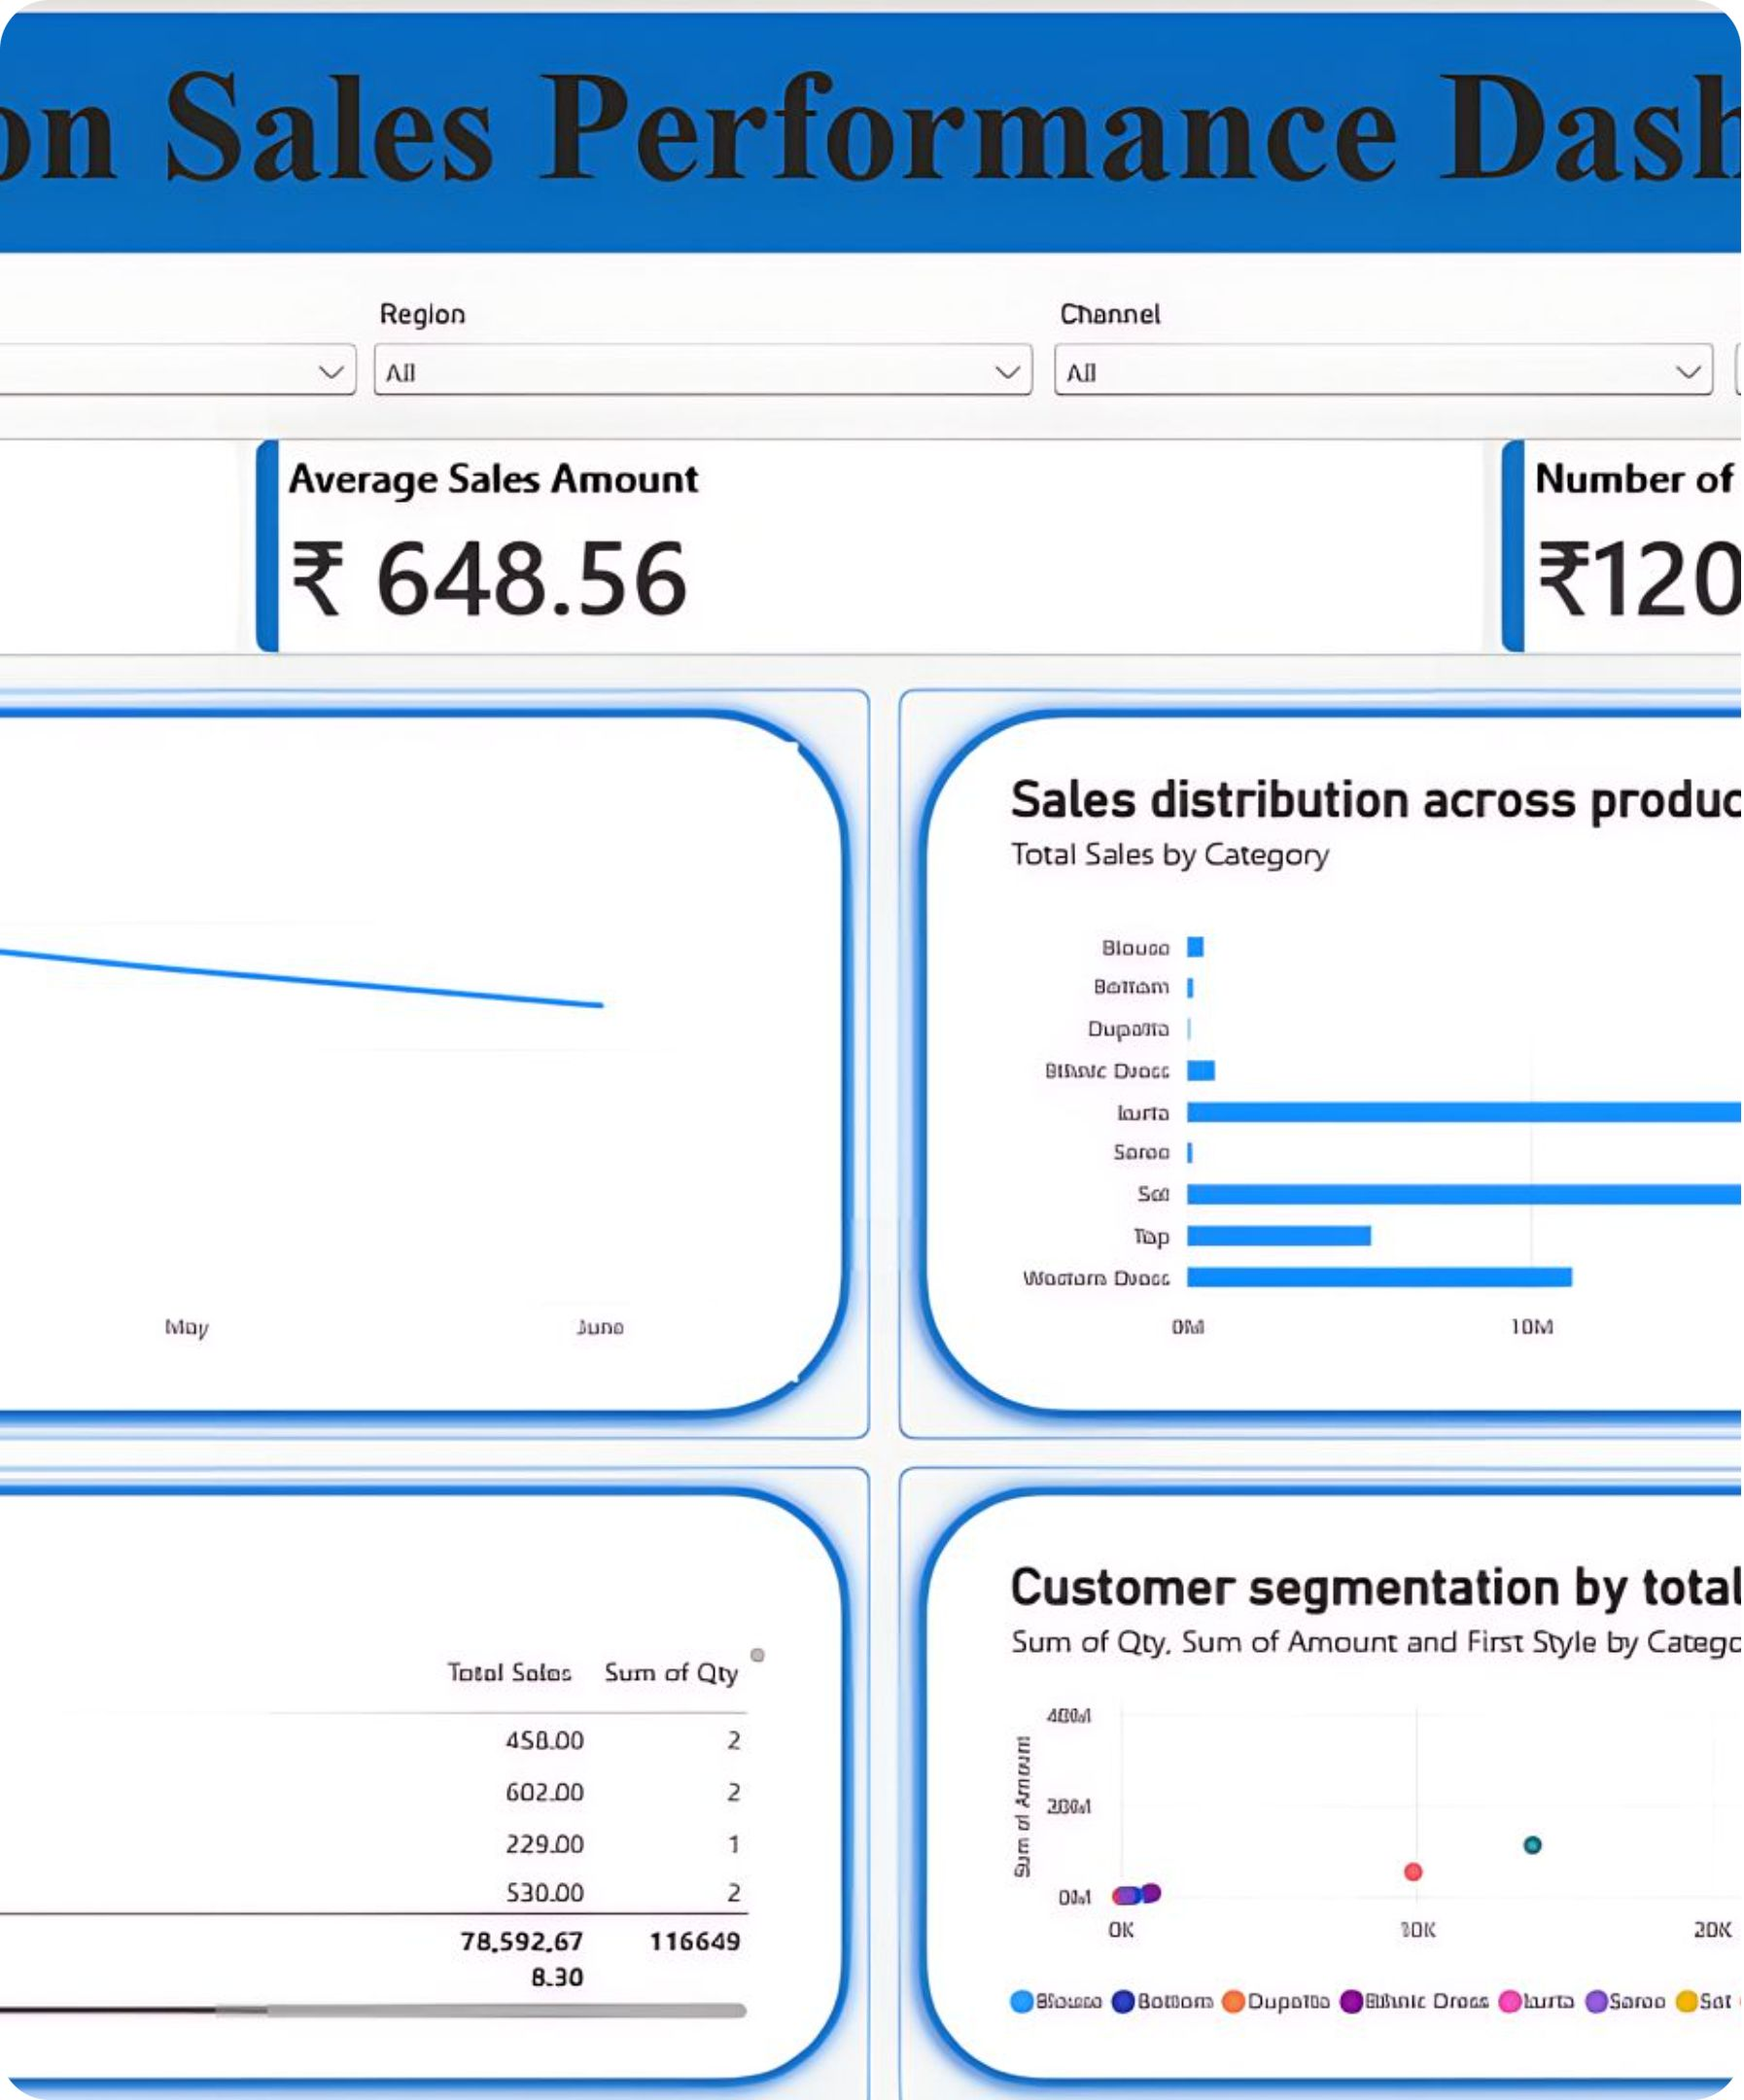
The dashboard turns analysis into a repeatable decision system
Power BI brings monthly trends, category mix, top products, and customer-spend relationships into one interactive view for business follow-up.
Notes:
Conclude the presentation by connecting the static analytical insights to the live Power BI dashboard, establishing a continuous decision loop.

