Slide 1

NIFTY 50 QUANTITATIVE RESEARCH · 2000–2021
What the NIFTY 50 data says about performance and risk
Executive overview of stock behavior, trading activity, and the limits of price forecasting
Historical Dataset Evaluation · 235,192 Daily Observations · PostgreSQL & Analytics Layer
Notes:
Open the executive review: this study examines 21 years of daily NIFTY 50 trading data (235,192 records) across performance, cross-asset correlations, and rigorous out-of-sample time series modeling.

Slide 2
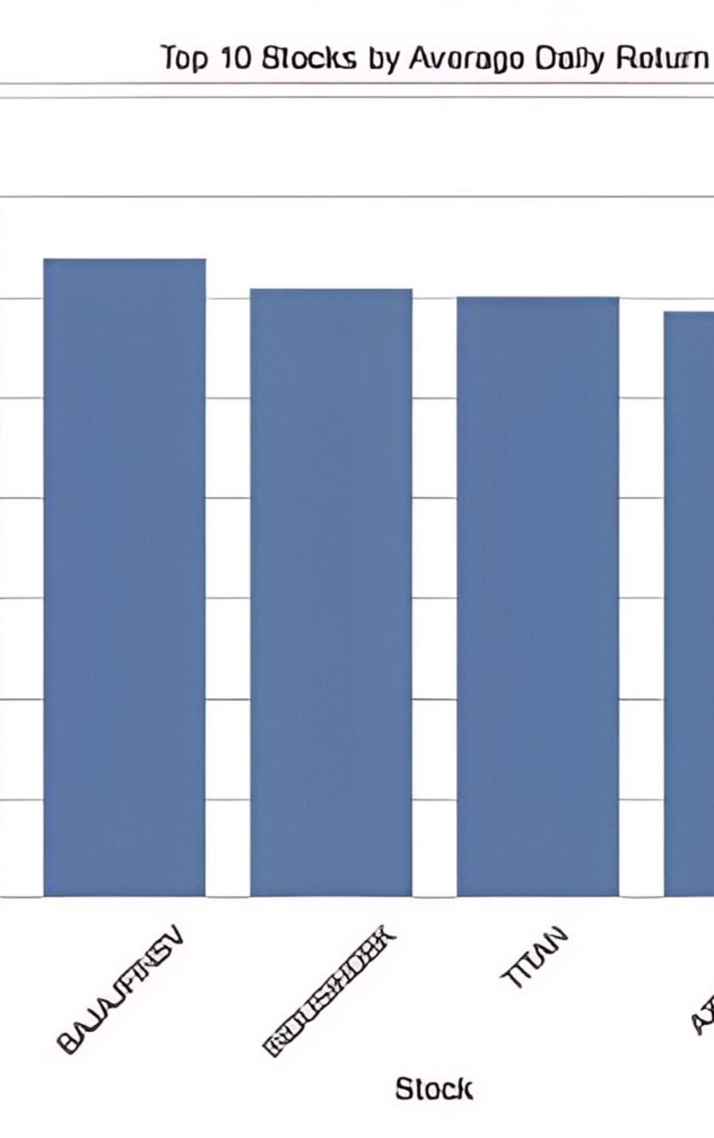
INDEX DISPERSION · 1 JAN 2000 TO 30 APR 2021
Performance is uneven across the index
The combined dataset spans 235,192 rows from 1 January 2000 to 30 April 2021.
Nominal Price Leaders
Average Daily Return Leaders
NESTLEIND, EICHERMOT, and SHREECEM record the highest average closing prices, reflecting heavy share denominations rather than percentage gains.
SHREECEM, EICHERMOT, and BAJAJFINSV lead in compounding daily growth, proving that capital appreciation decouples from base price scale.
Price level alone is not investment performance. Evaluation requires tracking compounding rate of return across long market cycles.
Source: NIFTY 50 historical daily records
02
Notes:
Emphasize that high-value share quotes like Nestle India or Eicher Motors frequently distract from relative percentage return metrics. The dataset proves return leadership requires dedicated rate-of-return evaluation.

Slide 3
RISK-RETURN DYNAMICS
Higher return potential comes with higher volatility
Top return volatility names include EICHERMOT, INFY, and BAJAJFINSV
VEOL, ZEEL, and JINWSTEEL appear among the highest-volatility names in the exploratory analysis
Use returns and volatility together; a high average close is not a risk-adjusted score.
03
Notes:
Point out how constituents like Bajaj Finserv and Eicher Motors show up both in high average returns and high return volatility. Risk adjustment must sit at the center of portfolio screening.

Slide 4
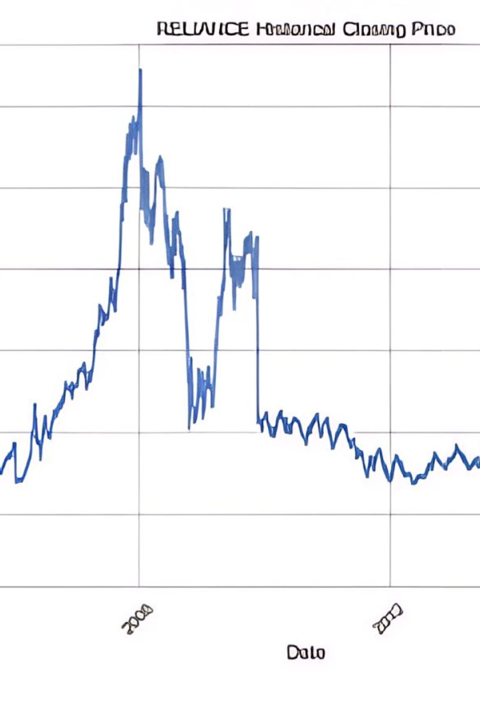
SINGLE-STOCK CASE STUDY · RELIANCE
RELIANCE shows a long-cycle price story, not a straight line
A multi-decade view illustrates structural expansions, prolonged consolidations, and acute liquidity inflection points.
2008 & 2010
2020 Surge
PEAK AND DRAWDOWN
CONSOLIDATION BREAKOUT
Historical closing prices rose steeply into the 2008 commodity expansion before retreating sharply through 2010.
Years of horizontal base-building were followed by rapid acceleration toward 2020 alongside institutional capital inflows.
Trading volume remains subdued during steady accumulation phases, punctuating the timeline with extreme surges in 2005 and 2020.
Source: RELIANCE historical daily transaction records (2000–2021) · NSE India
04
Notes:
Walk through the multi-decade Reliance timeline: rapid growth pre-2008, a decade-long consolidation range, and the massive repricing event into 2020 backed by volume spikes.

Slide 5
Market activity and returns do not move in lockstep
RELIANCE's correlation matrix shows a modest Close–Volume relationship of 0.15
Daily return and price change are strongly related at 0.87
The practical implication: volume is a context signal, not a standalone explanation for price movement.
05
Notes:
Clarify that a 0.15 correlation between volume and closing price proves trading activity cannot be used naively as a bullish or bearish indicator on its own.

Slide 6
OUT-OF-SAMPLE VALIDATION METHODOLOGY
The forecasting test was deliberately chronological
To eliminate lookahead bias, time series testing enforced an absolute sequential split between historical training and unobserved future testing.
1
2
3
Train Phase
Held-Out Test
Evaluation
4,244 observations from Jan 2000 to Jan 2017 fit to ARIMA (5,1,0).
Next 1,062 consecutive trading days through April 2021 strictly isolated.
Predicted paths compared against actual closing marks over the four-year holdout.
Source: ARIMA experimental setup · 80/20 chronological train-test isolation protocol
06
Notes:
Explain why standard random k-fold cross-validation fails in time series finance. Chronological splitting preserves temporal causality and exposes true model degradation.

Slide 7
MODEL PERFORMANCE AUDIT · ARIMA (5,1,0)
ARIMA captures direction imperfectly and underestimates change
23.03%
365.95
489.20
MEAN ABSOLUTE ERROR (MAE)
ROOT MEAN SQUARED ERROR (RMSE)
MEAN ABSOLUTE PERCENTAGE ERROR (MAPE)
Average absolute price discrepancy across test trading periods.
Penalizes large tail errors during volatile regime shifts.
Authoritative evaluation error across the 1,062-day out-of-sample test window.
Key Diagnostic Takeaways
Predictions stay relatively flat across a long, dynamic test period, failing to capture exponential structural trends. Read the model as a statistical benchmark, not as a guaranteed trade signal.
Source: Test set error audit (1,062 predictions) · Authoritative MAPE benchmark
07
Notes:
Highlight the model limitations: classical autoregressive integrated moving average models revert to trend averages and fail to anticipate explosive structural shifts like the 2020 market rally.

Slide 8
What this workflow enables next
Use stock performance, return, and volatility views together in screening and review
Keep PostgreSQL as the analysis layer and Power BI as the decision surface
Extend forecasting with richer features and refreshed data before using it for decisions.
Bottom line
The project is strongest as a repeatable analytics workflow, not a promise of market prediction.
Notes:
Conclude with actionable recommendations: maintain the database and visualization pipeline, expand feature engineering, and emphasize that risk management and disciplined screening provide the real edge.

