Slide 1
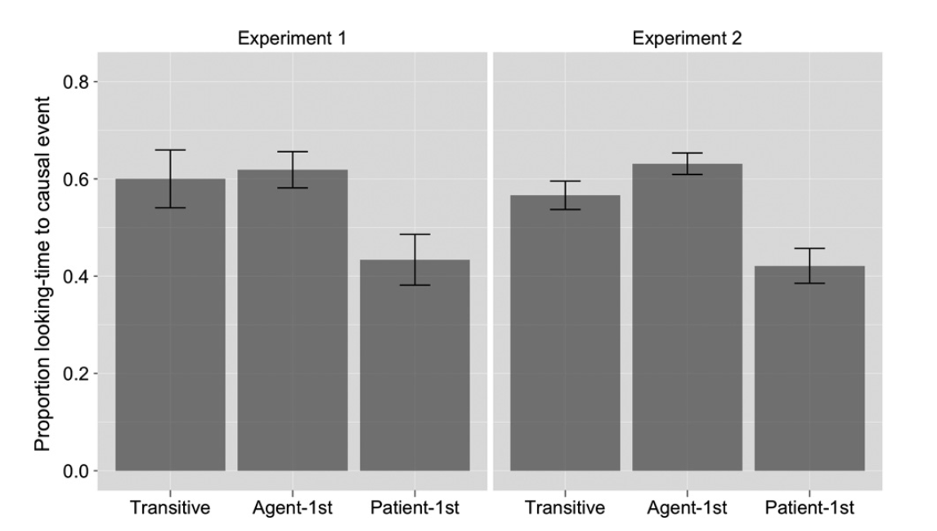
2.49/.24
.15
.22
.12
.09
.8 = 3.32

