Slide 1
Familiarization
Test
background
3 trials
deviant
background
5 trials
deviant
background
7 trials
deviant

Slide 2
Familiarization
Test
background
3 trials
deviant
background
5 trials
deviant
background
7 trials
deviant

Slide 3
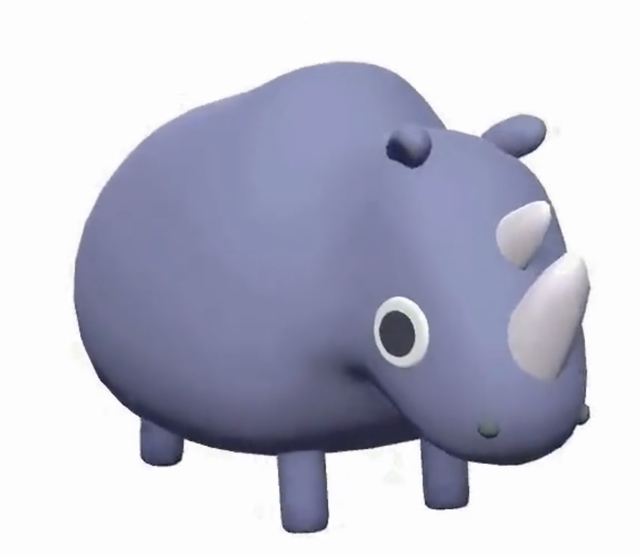





Familiarization
Test
background
1 trial
deviant
background
3 trials
deviant
background
9 trials
deviant

Slide 4
Familiarization
Test
background
3 trials
deviant
7 trials
background
deviant
2x2x2 (fam duration, complexity, background/deviant)

Slide 5


Slide 6


Slide 7


Slide 8


