Slide 1

Now, we are now going to play the Big Circle game.
In this game, you will see two orange circles like these.

Slide 2



To minimize interference, during this game you will not be able to see your cursor around the circles
Cursor invisible
Cursor visible

Slide 3
The game is to find the larger circle between the two.

Slide 4


If you think the orange circle on the right is larger……

Slide 5

If you think the orange circle on the right is larger……
press this key!

Slide 6
OK? Let’s practice the game!

Slide 7
Great!
You are now ready to play the game for real.
You will see many more circles.

Slide 8
Now we’ll try it again, but remember what you need to do. Let’s go over it again together..

Slide 9
If you think the orange circle on this side is larger……

Slide 10
If you think the orange circle on this side is larger……
press this key!

Slide 11
Some maybe difficult, but then you
can make a guess. Ready?

Slide 12
Let’s play the next game.
This game is a little different.

Slide 13

In this game, you will see gray circles around the orange circles.

Slide 14
In this game, you will see gray circles around the orange circles.
Like these

Slide 15
Look carefully at the orange circles in the middle

Slide 16
Look carefully at the orange circles in the middle
Like this one

Slide 17
Look carefully at the orange circles in the middle
Like this one
And this one

Slide 18
If the orange circle on this side is larger…

Slide 19
If the orange circle on this side is larger…
press this key!

Slide 20
If the orange circle on this side is larger…

Slide 21
If the orange circle on this side is larger…
press this key!

Slide 22
Let’s try one.

Slide 23
Great!
You are now ready to play the game for real.

Slide 24
Remember, look at the orange circles in the middle
Like this one
And this one

Slide 25
If the orange circle on this side is larger…

Slide 26
If the orange circle on this side is larger…
press this key!

Slide 27
If the orange circle on this side is larger…

Slide 28
If the orange circle on this side is larger…
press this key!

Slide 29
Now we are going to play a picture game.
I’m going to give you some stickers,
and you can put them together to make a picture.

Slide 30
There is no right way or wrong way to make the picture,
and you can make your picture any way you like!
You can put as many stickers as you want!

Slide 31
This will be a picture of the outside,
so your picture will have a horizon.
Do you know what a horizon is?

Slide 32
When you go outside, you see the sky comes down and meets the ground, and makes one line.
That line is called a horizon.

Slide 33
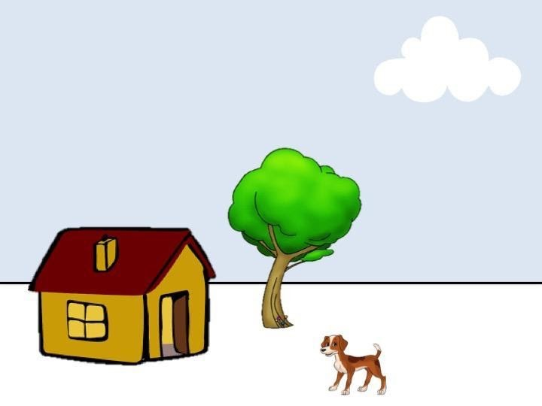
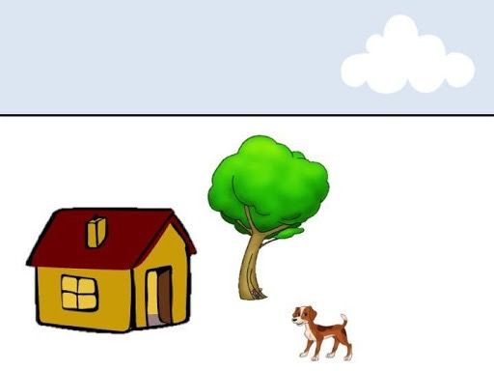
This is a horizon

Slide 34
This is also a horizon

Slide 35
Remember to put a horizon line in your picture!

Slide 36
Now that you know how, you can make your own picture with these stickers!

Slide 37
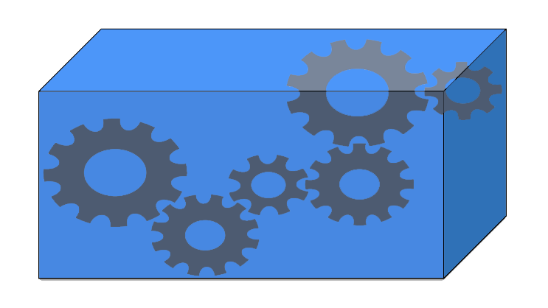
In this game, you'll learn about my toy,
which is a special machine.

Slide 38

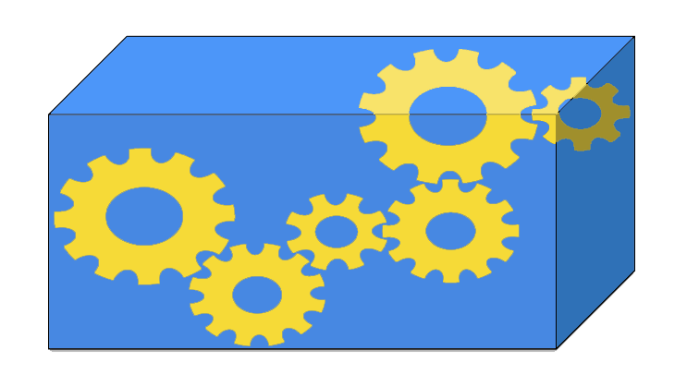
Sometimes when I put things on top of my toy
my toy plays music

Slide 39
and sometimes when I put things on top of my toy,
it does not play music.

Slide 40
We'll try putting different things on my toy.
It's your job to watch and find out which things make my toy play music. Let's see how it works!

Slide 41




Now that you know how my toy works,
my friends need your help finding the things that will make my toy play music!
Can you help us?

Slide 42

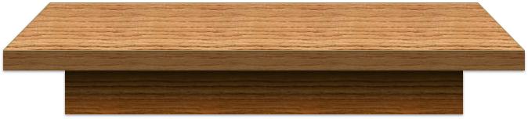
Only one of the trays has the things that will make my toy play music.

Slide 43
Can you help my friends?
Click on the tray that has the things that will make my toy play music.

Slide 44
In this game, I want you to draw yourself and your family members as circles.
Think about the family that you grew up with.
Even if you live with different people now, in this game you should draw the family members that you lived with while you were growing up.

Slide 45
…and label the circles for the people they represent.
Me

Slide 46

To draw a circle, simply click and drag.

Slide 47

To label a circle, click on the circle you just drew.
Add Label Here

Slide 48
Double clicking on “Add Label Here” to enter your label in the textbox.
Add Label Here
Add Label Here

Slide 49

When you are done typing, hit “Enter” on your keyboard. You can edit the label by double clicking on it again.
Me
Me
Add Label Here

Slide 50

If you need to delete a circle or label, right click on it. You will see a delete button.
Me
Delete

Slide 51
Start by drawing a circle for yourself and labeling it “Me”
Me

Slide 52
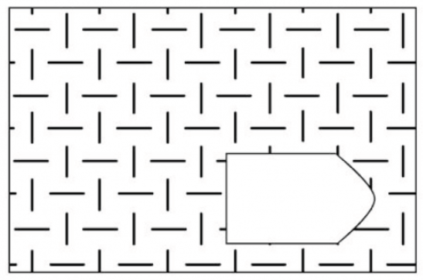
On the following pages, you'll see twelve incomplete pictures, like this.

Slide 53


Each picture has a piece missing.

Slide 54
Each picture has a piece missing.
Below it you will see six different pieces.

Slide 55
All six of the pieces are the right shape, but only one piece correctly completes the pattern.

Slide 56
All six of the pieces are the right shape, but only one piece correctly completes the pattern.
Your job is to decide which of the six pieces is the correct one for completing the pattern.

Slide 57
Please answer as quickly and accurately as possible.
OK? Let’s practice!

Slide 58
Which of these pieces completes the picture?
(Click for the answer.)
1
2
3
4
5
6

Slide 59
Which of these pieces completes the picture?
Number 2 can’t be correct because it’s the same as the missing piece.
1
2
3
4
5
6

Slide 60
Which of these pieces completes the picture?
Numbers 1, 3, and 5 show the wrong pattern.
1
2
3
4
5
6

Slide 61
Which of these pieces completes the picture?
How about number 6?
It shows the right pattern but the
pattern doesn't cover the whole piece, so it wouldn’t complete
the picture.
1
2
3
4
5
6

Slide 62
Which of these pieces completes the picture?
Number 4 is the right answer - it shows the correct pattern across the
whole missing piece.
1
2
3
4
5
6

Slide 63
On the following pages, you will have 90 seconds to choose which piece completes each picture.
The first page will show the example we just saw. Please select #4, then click to continue.
1
2
3
4
5
6

Slide 64
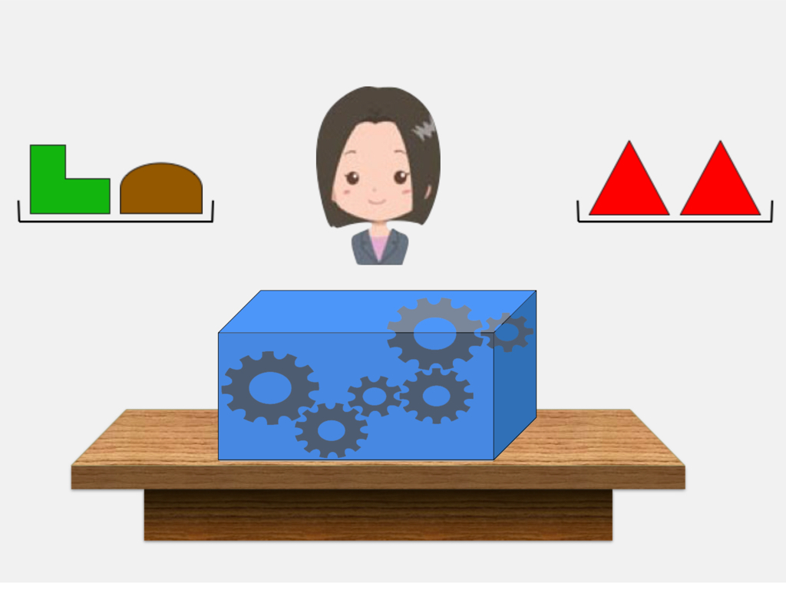
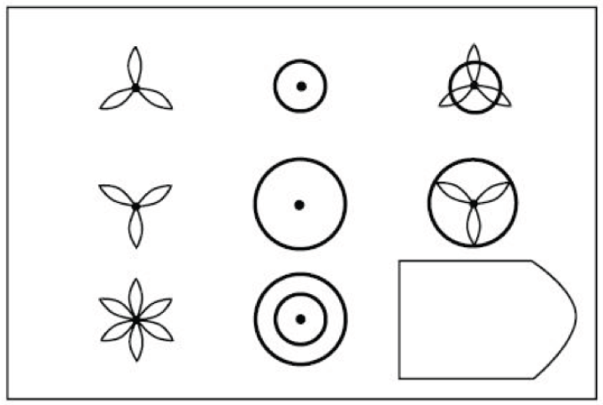
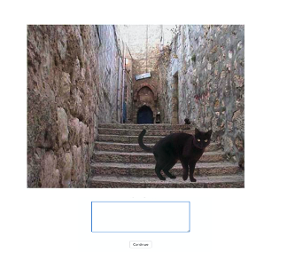
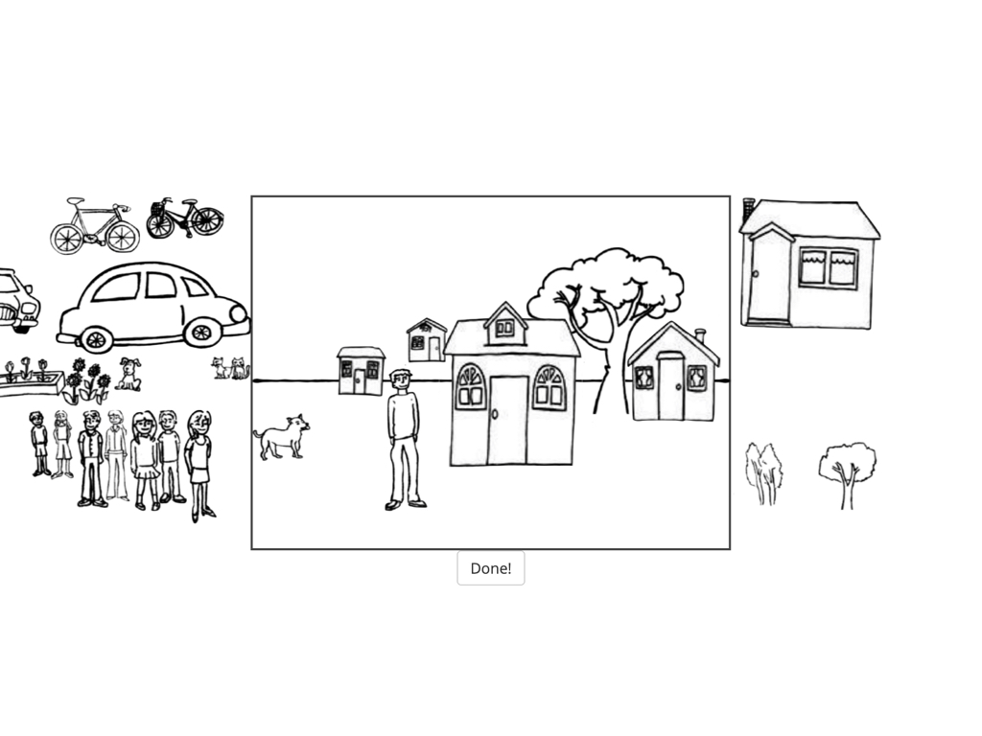
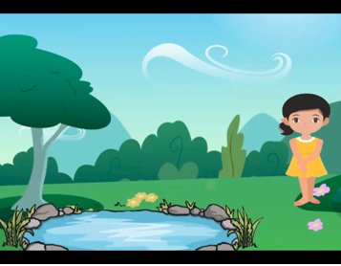
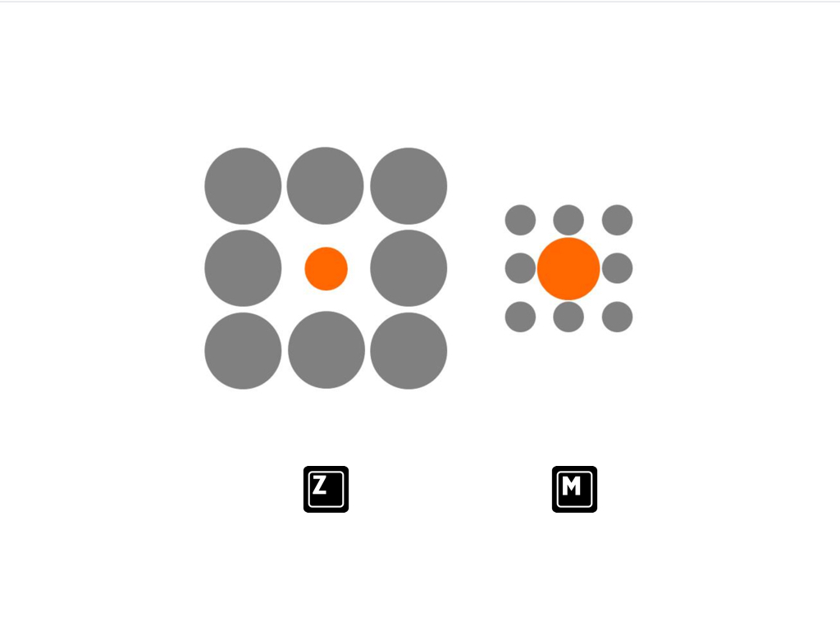
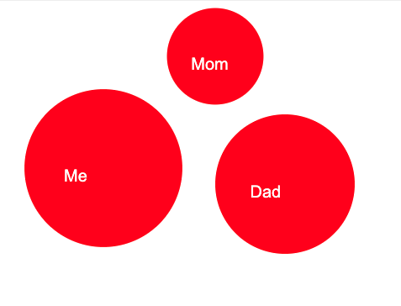

Here we have pictured each of the research games you just played. Have you seen any of these games before today’s study? If you have, please type in the number above each of the games you’ve seen before. (Type “none” if you’ve never seen any of these before today.)
1
2
3
4
5
6
7
8
Mom
Me
Dad

Slide 65
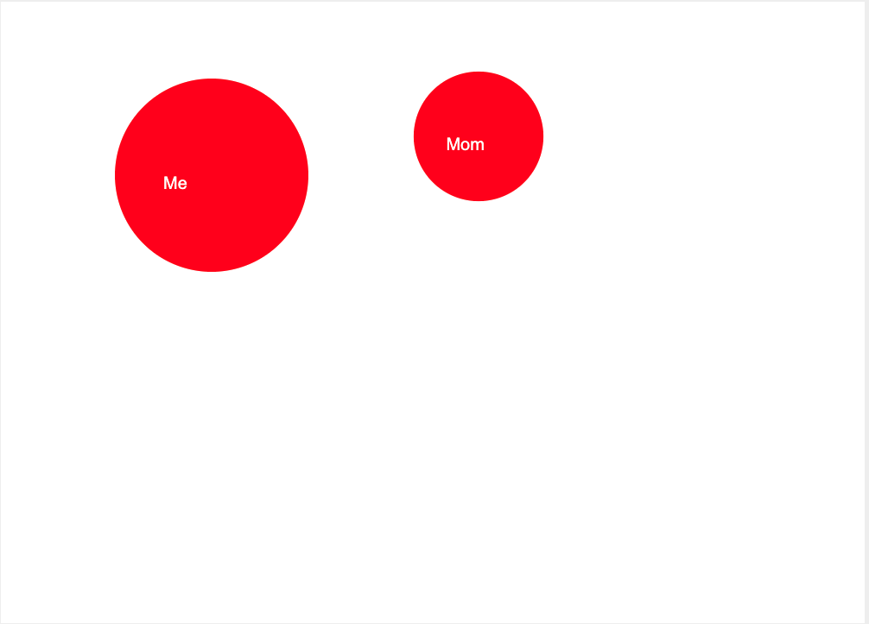
我们在这里重现了你刚刚玩过的每个用于研究的游戏。你在参与今天这个研究前见过其中的任何游戏吗？如果你曾经见过，请输入每个你曾经见过的游戏旁的编号。（如果你在此前从未见过这里的任何游戏，请输入“无”）
1
2
3
4
5
6
7
8
妈
我
爸

Slide 66
