Slide 1


Slide 2




Slide 4



Slide 5


Slide 13


Slide 21
If the orange circle on this side is larger…

Slide 22
Let’s try one.

Slide 29
Now we are going to play a picture game.
I’m going to give you some stickers,
and you can put them together to make a picture.

Slide 30
There is no right way or wrong way to make the picture,
and you can make your picture any way you like!
You can put as many stickers as you want!

Slide 31
This will be a picture of the outside,
so your picture will have a horizon.
Do you know what a horizon is?

Slide 33
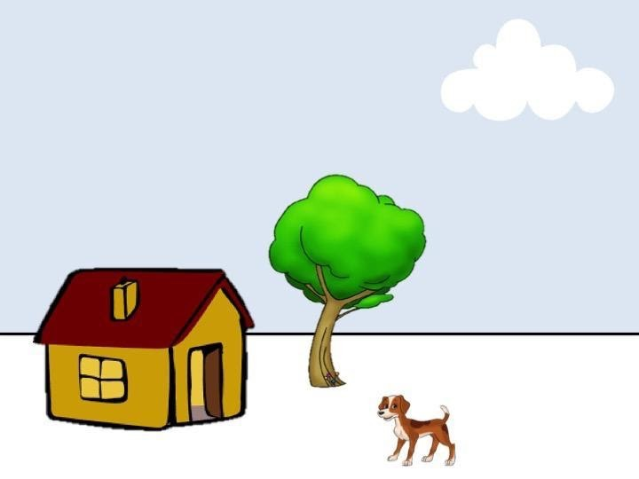
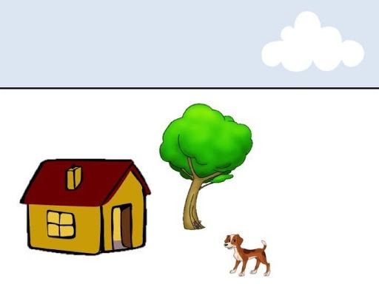

Slide 36
Now that you know how, you can make your own picture with these stickers!

Slide 37
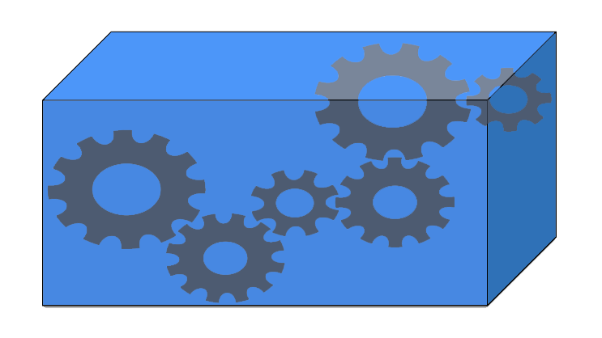

Slide 38



Slide 41






Slide 42

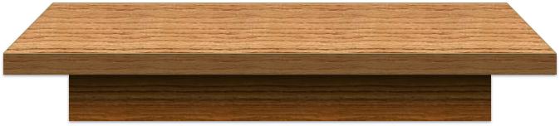

Slide 45
?

Slide 46


Slide 47


Slide 48
Double clicking on “Add Label Here” to enter your label in the textbox.
Add Label Here
Add Label Here

Slide 49

When you are done typing, hit “Enter” on your keyboard. You can edit the label by double clicking on it again.
Me
Me
Add Label Here

Slide 50

If you need to delete a circle or label, right click on it. You will see a delete button.
Me
Delete

Slide 51
Start by drawing a circle for yourself and labeling it “Me”
Me

Slide 52
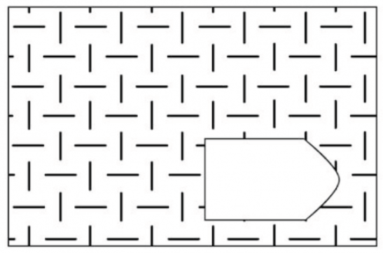

Slide 53

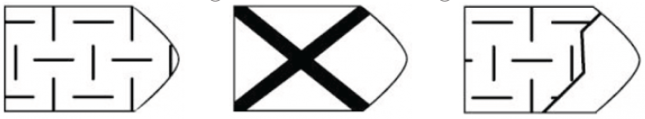

Slide 57
Please answer as quickly and accurately as possible.
OK? Let’s practice!

Slide 58
1
2
3
4
5
6

Slide 59
1
2
3
4
5
6

Slide 60
1
2
3
4
5
6

Slide 61
1
2
3
4
5
6

Slide 62
1
2
3
4
5
6

Slide 63
1
2
3
4
5
6

Slide 64
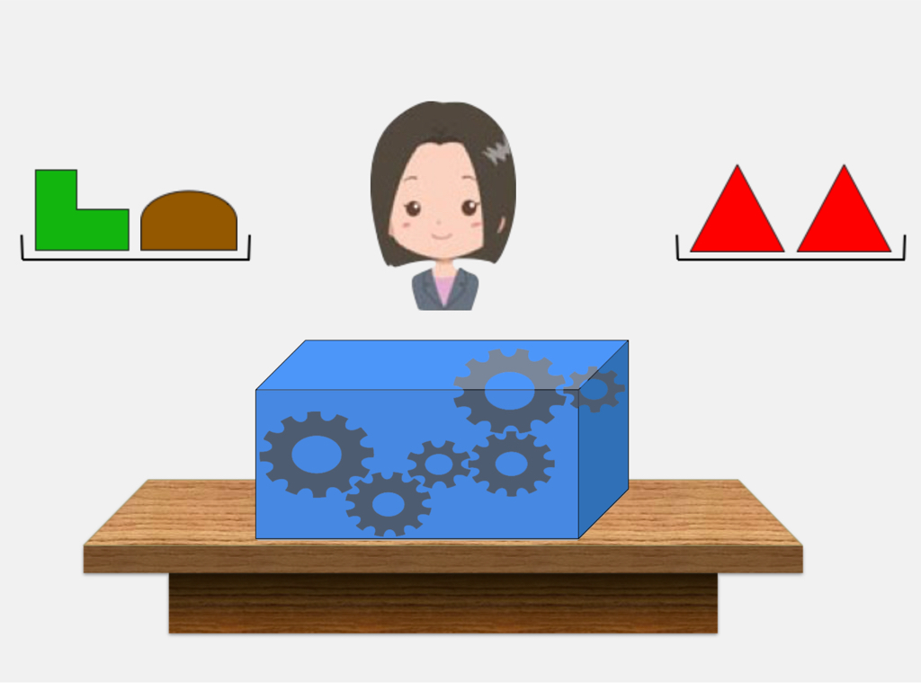

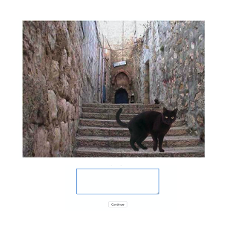
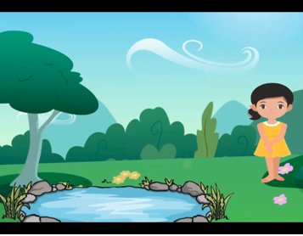
Here we have pictured each of the research games you just played. Have you seen any of these games before today’s study? If you have, please type in the number above each of the games you’ve seen before. (Type “none” if you’ve never seen any of these before today.)
1
2
3
4
Mom
Me
Dad

Slide 65
我们在这里重现了你刚刚玩过的每个用于研究的游戏。你在参与今天这个研究前见过其中的任何游戏吗？如果你曾经见过，请输入每个你曾经见过的游戏旁的编号。（如果你在此前从未见过这里的任何游戏，请输入“无”）
1
2
3
4
Mom
Me
Dad

Slide 66
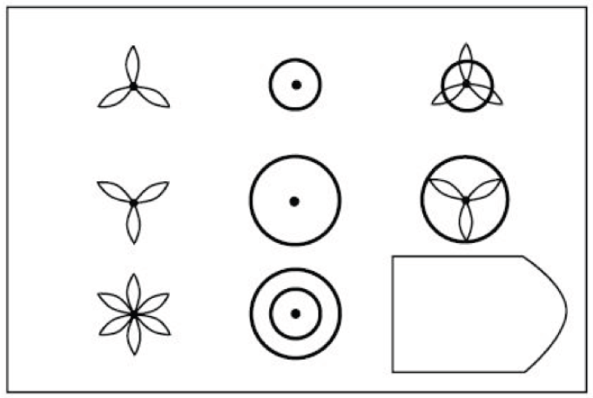
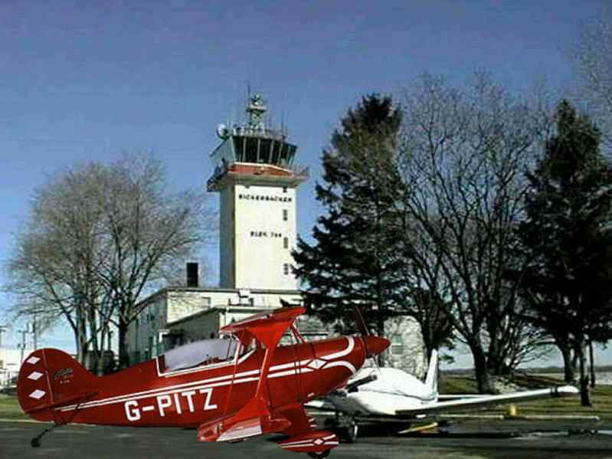
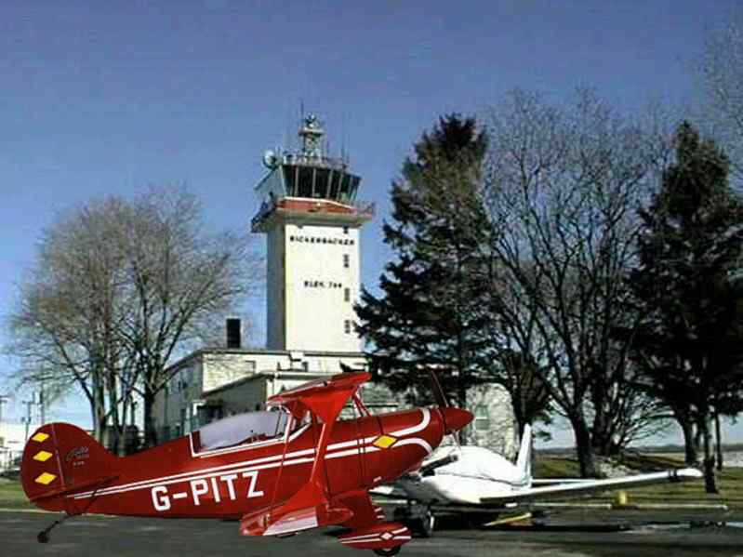
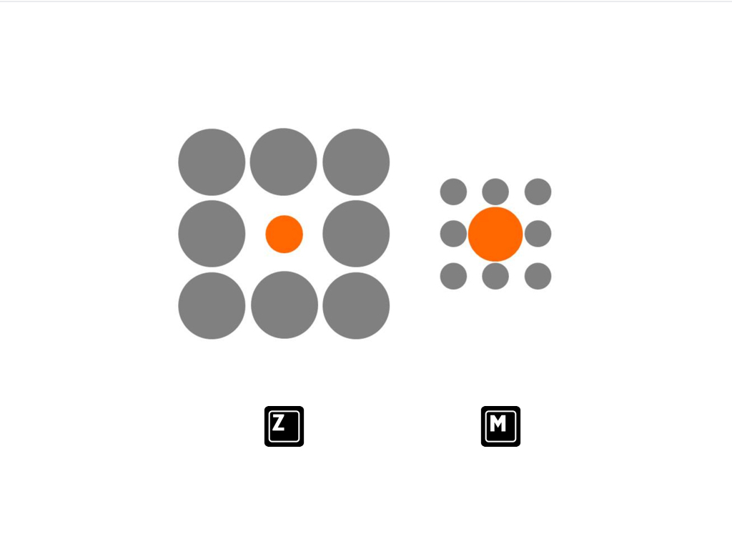
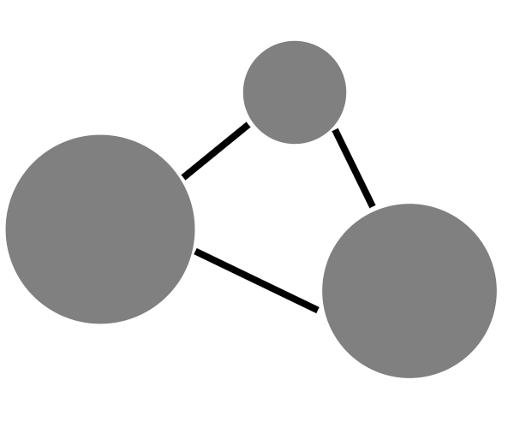
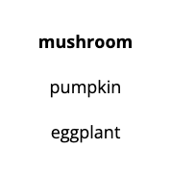
我们在这里重现了你刚刚玩过的每个用于研究的游戏。你在参与今天这个研究前见过其中的任何游戏吗？如果你曾经见过，请输入每个你曾经见过的游戏旁的编号。（如果你在此前从未见过这里的任何游戏，请输入“无”）
1
2
3
4
5
6
7
8
Who did what
?
tom
Why did they do it?
tom
me
Understanding murder
lucy
Story Comprehension

Slide 67
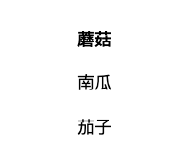
我们在这里重现了你刚刚玩过的每个用于研究的游戏。你在参与今天这个研究前见过其中的任何游戏吗？如果你曾经见过，请输入每个你曾经见过的游戏旁的编号。（如果你在此前从未见过这里的任何游戏，请输入“无”）
1
2
3
4
5
6
7
8
为什么他们这么做？
谁做了什么
?
tom
小红
我
理解谋杀
小明
故事理解

Slide 68
