Slide 1
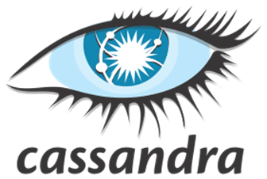

Slide 2
Outline
Introduction
Background
Use Cases
Data Model & Query Language
Architecture
Conclusion

Slide 3
Cassandra Background

Slide 4
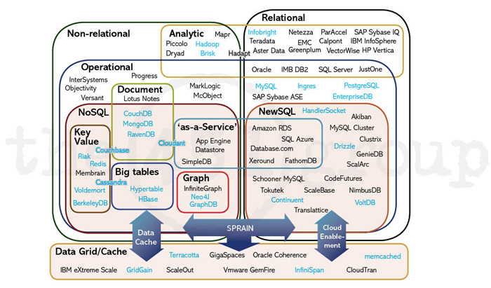
What is Cassandra?
Open-source database management system (DBMS)
Several key features of Cassandra differentiate it from other similar systems

Slide 5
The ideal database foundation for today’s modern applications
“Apache Cassandra is renowned in the industry as the only NoSQL solution that can accommodate the complex requirement of today’s modern line-of-business applications. It’s architected from the ground up for real-time enterprise databases that require vast scalability, high-velocity performance, flexible schema design and continuous availability.”
-DataStax
Notes:
Apache Cassandra is renowned in the industry as the only NoSQL solution that can accommodate the complex requirements of today’s modern line-of-business applications. It’s architected from the ground up for real-time enterprise databases that require vast scalability, high-velocity performance, flexible schema design and continuous availability.
The ideal database foundation for today’s modern applications.

Slide 6

History of Cassandra
Cassandra was created to power the Facebook Inbox Search
Facebook open-sourced Cassandra in 2008 and became an Apache Incubator project
In 2010, Cassandra graduated to a top-level project, regular update and releases followed
Notes:
It combines Amazon Dynamo’s fully distributed design with Google Bigtable’s column-oriented data model.

Slide 7
Motivation and Function
Designed to handle large amount of data across multiple servers
There is a lot of unorganized data out there
Easy to implement and deploy
Mimics traditional relational database systems, but with triggers and lightweight transactions
Raw, simple data structures
Notes:
designed to handle large amounts of data across many commodity servers, providing high availability with no single point of failur

Slide 8
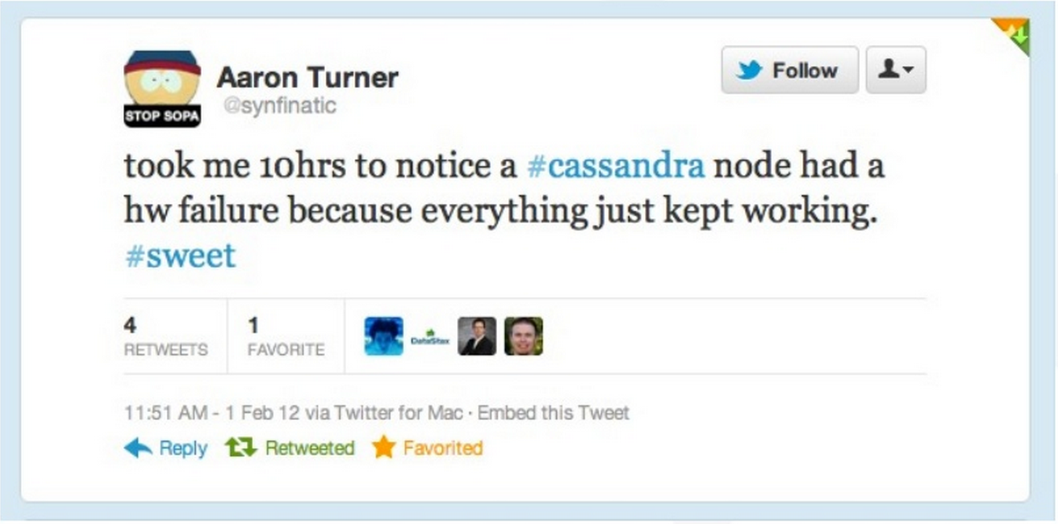
Availability
“There is no such thing as standby infrastructure: there is stuff you always use and stuff that won’t work when you need it.” -Ben Black, Founder, Boundary

Slide 9
General Design Features
Emphasis on performance over analysis
Still has support for analysis tools such as Hadoop
Organization
Rows are organized into tables
First component of a table’s primary key is the partition key
Rows are clustered by the remaining columns of the key
Columns may be indexed separately from the primary key
Tables may be created, dropped, altered at runtime without blocking queries
Language
CQL (Cassandra Query Language) introduced, similar to SQL (flattened learning curve)

Slide 10
Peer to Peer Cluster
Decentralized design
Each node has the same role
No single point of failure
Avoids issues of master-slave DBMS’s
No bottlenecking

Slide 11
Fault Tolerance/Durability
Failures happen all the time with multiple nodes
Hardware Failure
Bugs
Operator error
Power Outage, etc.
Solution: Buy cheap, redundant hardware, replicate, maintain consistency

Slide 12
Fault Tolerance/Durability
Replication
Data is automatically replicated to multiple nodes
Allows failed nodes to be immediately replaced
Distribution of data to multiple data centers
An entire data center can go down without data loss occurring

Slide 13
Performance
Core architectural designs allow Cassandra to outperform its competitors
Very good read and write throughputs
Consistently ranks as fastest amongst comparable NoSql DBMS’s with large data sets
“In terms of scalability, there is a clear winner throughout our experiments. Cassandra achieves the highest throughput for the maximum number of nodes…” - University of Toronto

Slide 14
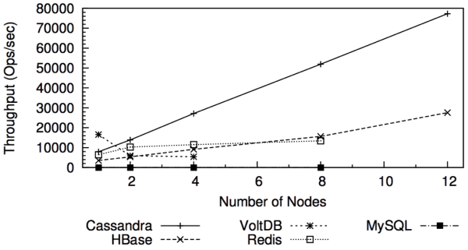
Scalability
Read and write throughput increase linearly as more machines are added
“In terms of scalability, there is a clear winner throughout our experiments. Cassandra achieves the highest throughput for the maximum number of nodes…” - University of Toronto

Slide 15
Comparisons
 | Apache Cassandra | Google Big Table | Amazon DynamoDB
Storage Type | Column | Column | Key-Value
Best Use | Write often, read less | Designed for large scalability | Large database solution
Concurrency Control | MVCC | Locks | ACID
Characteristics | High Availability Partition Tolerance Persistence | Consistency High Availability Partition Tolerance Persistence | Consistency High Availability
Key Point – Cassandra offers a healthy cross between BigTable and Dynamo.

Slide 16
Cassandra Use Cases

Slide 17

Netflix
online DVD and Blu-Ray movie retailer
Nielsen study showed that 38% of Americans use or subscribe to Netflix
Notes:
offering streaming movies through video game consoles, Apple TV, TiVo and more
http://www.usatoday.com/story/life/tv/2013/09/18/netflix-hulu-amazon-nielsen-viewership-data/2831535/

Slide 18

Netflix: Why Cassandra
Using a central SQL database negatively impacted scalability and availability
International Expansion required Multi-Datacenter solution
Need for configurable Replication, Consistency, and Resiliency in the face of failure
Cassandra on AWS offered high levels of scalability and availability
Jason Brown, Senior Software Engineer at Netflix
Notes:
Central Oracle database -> everything in one place, convenient until it fails
Schema changes required downtime
Cassandra stores 3 local copies, 1 per zone
Synchronous access, durable
Replicates at destination
Global Coverage
business agility
Local Access
better latency
fault isolation

Slide 19

Spotify
Streaming digital music service
Music for every moment on computer, phone, tablet, and more

Slide 20

Spotify: Why Cassandra
With more users, scalability problems arised using postgreSQL
With multiple data centers, streaming replication in postgreSQL was problematic
ex: high write volumes
Chose Cassandra
lack of single points of failure
no data loss confidence
Big Table design
Axel Liljencrantz,
Backend Developer at Spotify

Slide 21
Spotify: Why Cassandra
Cassandra behaves better in specific use cases:
better replication (especially writes)
better behavior in the presence of networking issues and failures, such as partitions or intermittent glitches
better behavior in certain classes of failure, such as server dies and network links going down

Slide 22

Hulu
a website and a subscription service offering on-demand streaming video media
~30 million unique viewers per month

Slide 23

Hulu: Why Cassandra
need for Availability
need for Scalability
Good Performance
Nearly Linear Scalability
Geo-Replication
Minimal Maintenance Requirements
Andres Rangel, Senior Software Engineer at Hulu
Notes:
Geo-Replication – distribution of data across multiple regions

Slide 24
Reasons for Choosing Cassandra
Value availability over consistency
Require high write-throughput
High scalability required
No single point of failure

Slide 25
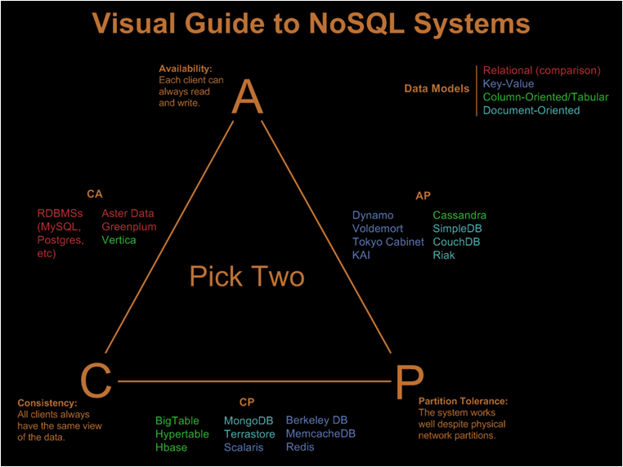
CAP Theorem

Slide 26
Eventual Consistency
BASE – Basically Available Soft-state Eventual consistency (versus ACID)
If all writers stop (to a key), then all its values (replicas) will converge eventually.
If writes continue, then system always tries to keep converging.
Moving “wave” of updated values lagging behind the latest values sent by clients, but always trying to catch up
Converges when R + W > N
R = # records to read, W = # records to write, N = replication factor
Consistency Levels:
ONE -> R or W is 1
QUORUM -> R or W is ceiling (N + 1) / 2
ALL -> R or W is N
If you want to write with Consistency Level of ONE and get the same data when you read, you need to read with Consistency Level of ALL
Notes:
Consistency describes how and whether a system is left in a consistent state after an operation.
In distributed data systems like Cassandra, this usually means that once a writer has written, all readers will see that write.
While most relational databases guarantee ACID properties - (Atomicity, Consistency, Isolation, Durability) , Cassandra
Is at the other end of the spectrum. It offers BASE properties (Basically Available Soft-state Eventual consistency).
Cassandra weak consistency comes in the form of eventual consistency which means the database eventually reaches
A consistent state.
As the data is replicated, the latest version of something is sitting on some node in the cluster, but older versions are still
Out there on other nodes. Eventually, all nodes will see the latest version.
Specifically, you get consistency when R + W > N (R is the number of records to read, W is the number of records to write,
And N is the replication factor).
A ConsistencyLevel of ONE means R or W is 1. A ConsistencyLevel of QUORUM means R or W is ceiling((N+1)/2).
A ConsistencyLevel of ALL means R or W is N. So if you want to write with a ConsistencyLevel of ONE and then get
the same data when you read, you need to read with ConsistencyLevel ALL.

Slide 27
Cassandra’s Data Model

Slide 28
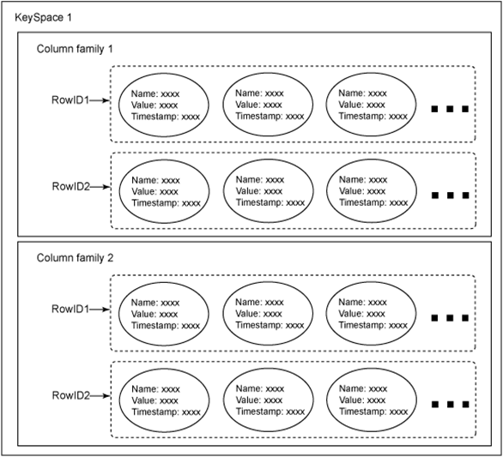
Key-Value Model
Cassandra is a column oriented NoSQL system
Column families: sets of key-value pairs
column family as a table and key-value pairs as a row (using relational database analogy)
A row is a collection of columns labeled with a name

Slide 29
Cassandra Row
the value of a row is itself a sequence of key-value pairs
such nested key-value pairs are columns
key = column name
a row must contain at least 1 column

Slide 30
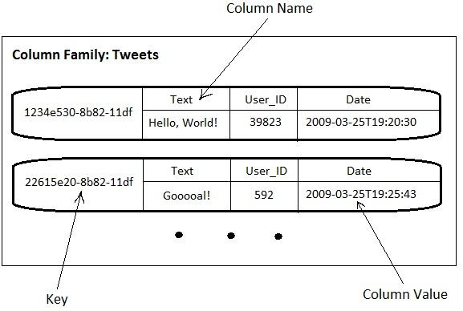
Example of Columns

Slide 31
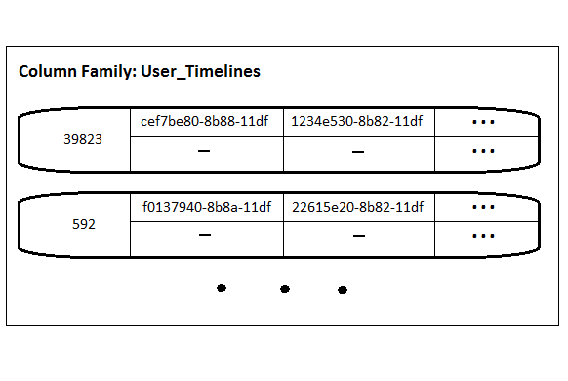
Column names storing values
key: User ID
column names store tweet ID values
values of all column names are set to “-” (empty byte array) as they are not used

Slide 32
Key Space
A Key Space is a group of column families together. It is only a logical grouping of column families and provides an isolated scope for names

Slide 33
Comparing Cassandra (C*) and RDBMS
with RDBMS, a normalized data model is created without considering the exact queries
SQL can return almost anything though Joins
with C*, the data model is designed for specific queries
schema is adjusted as new queries introduced
C*: NO joins, relationships, or foreign keys
a separate table is leveraged per query
data required by multiple tables is denormalized across those tables

Slide 34
Cassandra Query Language - CQL
creating a keyspace - namespace of tables
CREATE KEYSPACE demo
WITH replication = {‘class’: ’SimpleStrategy’,
replication_factor’: 3};
to use namespace:
USE demo;
Notes:
SimpleStrategy is a replication strategy. There are two:
SimpleStrategy and NetworkTopologyStrategy.
SimpleStrategy is used for simple data center clusters. It is default.
NetworkTopologyStrategy is used for multi-datacenter deployments

Slide 35
Cassandra Query Language - CQL
creating tables:
CREATE TABLE users( CREATE TABLE tweets(
email varchar, email varchar,
bio varchar, time_posted timestamp,
birthday timestamp, tweet varchar,
active boolean, PRIMARY KEY (email, time_posted));
PRIMARY KEY (email));
Notes:
Table – when schema is static
Column Family – when schema is dynamic

Slide 36
Cassandra Query Language - CQL
inserting data
INSERT INTO users (email, bio, birthday, active)
VALUES (‘john.doe@bti360.com’, ‘BT360 Teammate’,
516513600000, true);
** timestamp fields are specified in milliseconds since epoch

Slide 37
Cassandra Query Language - CQL
querying tables
SELECT expression reads one or more records from Cassandra column family and returns a result-set of rows
SELECT * FROM users;
SELECT email FROM users WHERE active = true;

Slide 38
Cassandra Architecture

Slide 39
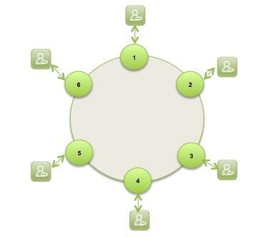
Cassandra Architecture Overview
Cassandra was designed with the understanding that system/ hardware failures can and do occur
Peer-to-peer, distributed system
All nodes are the same
Data partitioned among all nodes in the cluster
Custom data replication to ensure fault tolerance
Read/Write-anywhere design
Google BigTable - data model
Column Families
Memtables
SSTables
Amazon Dynamo - distributed systems technologies
Consistent hashing
Partitioning
Replication
One-hop routing

Slide 40
Transparent Elasticity
Nodes can be added and removed from Cassandra online, with no downtime being experienced.
1
12
2
1
11
3
6
2
10
4
5
3
9
5
4
8
6
7

Slide 41
Transparent Scalability
Addition of Cassandra nodes increases performance linearly and ability to manage TB’s-PB’s of data.
1
12
2
1
11
3
6
2
Performance throughput = N
10
Performance throughput = N x 2
4
5
3
9
5
4
8
6
7

Slide 42

High Availability
Cassandra, with its peer-to-peer architecture has no single point of failure.

Slide 43



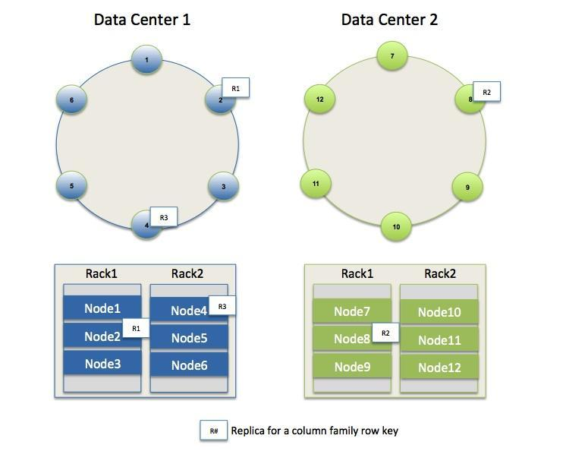
Multi-Geography/Zone Aware
Cassandra allows a single logical database to span 1-N datacenters that are geographically dispersed. Also supports a hybrid on-premise/Cloud implementation.

Slide 44
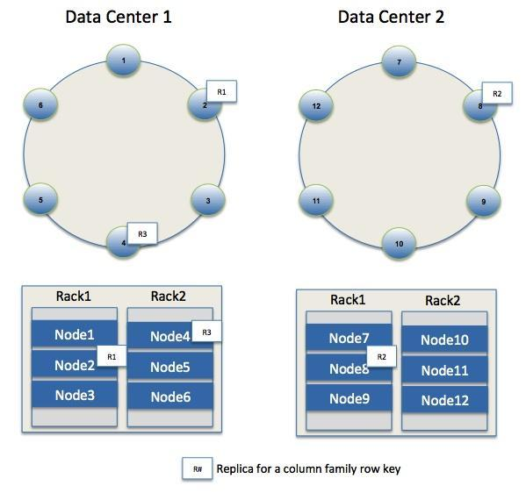
Data Redundancy
Cassandra allows for customizable data redundancy so that data is completely protected. Also supports rack awareness (data can be replicated between different racks to guard against machine/rack failures).
uses ‘Zookeeper’ to choose a leader which tells nodes the range they are replicas for
Notes:
ZooKeeper is a centralized service for maintaining configuration information, naming, providing distributed synchronization, and providing group services

Slide 45
Partitioning
Nodes are logically structured in Ring Topology.
Hashed value of key associated with data partition is used to assign it to a node in the ring.
Hashing rounds off after certain value to support ring structure.
Lightly loaded nodes moves position to alleviate highly loaded nodes.

Slide 46
Partitioning & Replication
h(key1)
1
0
E
A
N=3
C
h(key2)
F
B
D
1/2
Notes:
46

Slide 47
Gossip Protocols
Used to discover location and state information about the other nodes participating in a Cassandra cluster
Network Communication protocols inspired for real life rumor spreading.
Periodic, Pairwise, inter-node communication.
Low frequency communication ensures low cost.
Random selection of peers.
Example – Node A wish to search for pattern in data
Round 1 – Node A searches locally and then gossips with node B.
Round 2 – Node A,B gossips with C and D.
Round 3 – Nodes A,B,C and D gossips with 4 other nodes ……
Round by round doubling makes protocol very robust.
Notes:
Bootstrapping

Slide 48
Failure Detection
Gossip process tracks heartbeats from other nodes both directly and indirectly
Node Fail state is given by variable Φ
tells how likely a node might fail (suspicion level) instead of simple binary value (up/down).
This type of system is known as Accrual Failure Detector
Takes into account network conditions, workload, or other conditions that might affect perceived heartbeat rate
A threshold for Φ tells is used to decide if a node is dead
If node is correct, phi will be constant set by application.
Generally Φ(t) = 0

Slide 49
Write Operation Stages
Logging data in the commit log
Writing data to the memtable
Flushing data from the memtable
Storing data on disk in SSTables

Slide 50
Write Operations
Commit Log
First place a write is recorded
Crash recovery mechanism
Write not successful until recorded in commit log
Once recorded in commit log, data is written to Memtable
Memtable
Data structure in memory
Once memtable size reaches a threshold, it is flushed (appended) to SSTable
Several may exist at once (1 current, any others waiting to be flushed)
First place read operations look for data
SSTable
Kept on disk
Immutable once written
Periodically compacted for performance

Slide 51
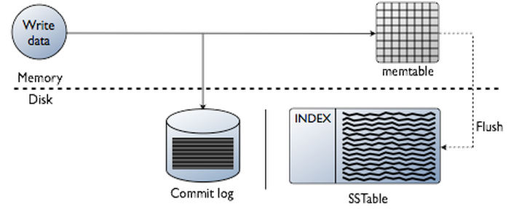
Write Operations

Slide 52
Consistency
Read Consistency
Number of nodes that must agree before read request returns
ONE to ALL
Write Consistency
Number of nodes that must be updated before a write is considered successful
ANY to ALL
At ANY, a hinted handoff is all that is needed to return.
QUORUM
Commonly used middle-ground consistency level
Defined as (replication_factor / 2) + 1

Slide 53
Write Consistency (ONE)
0
R1
Node 6
Node 1
R2
Node 5
Node 2
replication_factor = 3
Client
Node 4
Node 3
R3
INSERT INTO table (column1, …) VALUES (value1, …) USING CONSISTENCY ONE

Slide 54
Write Consistency (QUORUM)
0
R1
Node 6
Node 1
R2
Node 5
Node 2
replication_factor = 3
Client
Node 4
Node 3
R3
INSERT INTO table (column1, …) VALUES (value1, …) USING CONSISTENCY QUORUM

Slide 55
Write Operations: Hinted Handoff
Write intended for a node that’s offline
An online node, processing the request, makes a note to carry out the write once the node comes back online.

Slide 56
Hinted Handoff
0
R1
Node 6
Node 1
replication_factor = 3
and
hinted_handoff_enabled = true
R2
Node 5
Node 2
Client
Node 4
Node 3
R3
Write locally: system.hints
INSERT INTO table (column1, …) VALUES (value1, …) USING CONSISTENCY ANY
Note: Doesn’t not count toward consistency level (except ANY)
Notes:
write_request_timeout_in_ms – memory pressure on coordinator node

Slide 57
Delete Operations
Tombstones
On delete request, records are marked for deletion.
Similar to “Recycle Bin.”
Data is actually deleted on major compaction or configurable timer

Slide 58
Compaction
Compaction runs periodically to merge multiple SSTables
Reclaims space
Creates new index
Merges keys
Combines columns
Discards tombstones
Improves performance by minimizing disk seeks
Two types
Major
Read-only

Slide 59
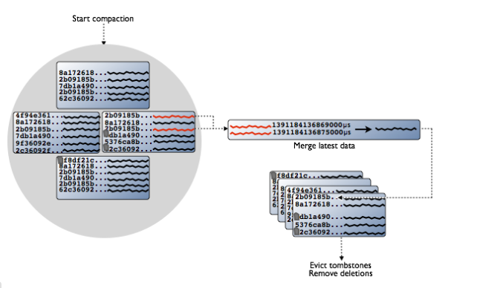
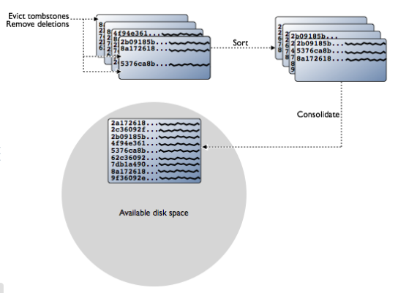
Compaction

Slide 60
Anti-Entropy
Ensures synchronization of data across nodes
Compares data checksums against neighboring nodes
Uses Merkle trees (hash trees)
Snapshot of data sent to neighboring nodes
Created and broadcasted on every major compaction
If two nodes take snapshots within TREE_STORE_TIMEOUT of each other, snapshots are compared and data is synced.

Slide 61
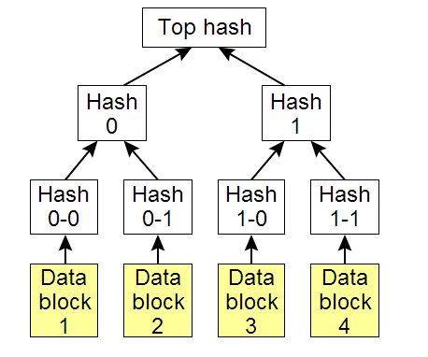
Merkle Tree

Slide 62
Read Operations
Read Repair
On read, nodes are queried until the number of nodes which respond with the most recent value meet a specified consistency level from ONE to ALL.
If the consistency level is not met, nodes are updated with the most recent value which is then returned.
If the consistency level is met, the value is returned and any nodes that reported old values are then updated.

Slide 63
Read Repair
0
R1
Node 6
Node 1
R2
replication_factor = 3
Node 5
Node 2
Client
Node 4
Node 3
R3
SELECT * FROM table USING CONSISTENCY ONE

Slide 64
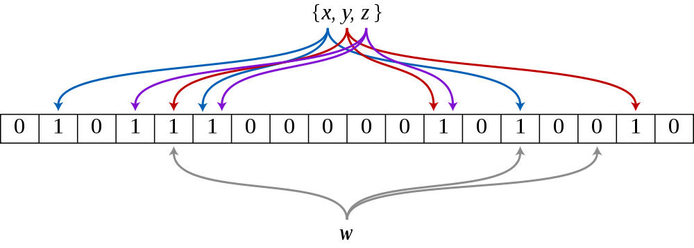
Read Operations: Bloom Filters
Bloom filters provide a fast way of checking if a value is not in a set.

Slide 65
Read
key_cache_size_in_mb > 0
Bloom Filter
Key Cache
Cache Hit
Cache Miss
index_interval = 128 (default)
Partition Summary
Compression Offsets
Memory
Disk
Partition Index
Data
= Off-heap

Slide 66
Cassandra: Conclusion

Slide 67
Cassandra Advantages
perfect for time-series data
high performance
Decentralization
nearly linear scalability
replication support
no single points of failure
MapReduce support

Slide 68
Cassandra Weaknesses
no referential integrity
no concept of JOIN
querying options for retrieving data are limited
sorting data is a design decision
no GROUP BY
no support for atomic operations
if operation fails, changes can still occur
first think about queries, then about data model
Notes:
No join or subquery support, and limited support for aggregation. This is by design, to force you to denormalize into partitions that can be efficiently queried from a single replica, instead of having to gather data from across the entire cluster.
Ordering is done per-partition, and is specified at table creation time. Again, this is to enforce good application design; sorting thousands or millions of rows can be fast in development, but sorting billions in production is a bad idea.

Slide 69
Cassandra: Points to Consider
Cassandra is designed as a distributed database management system
use it when you have a lot of data spread across multiple servers
Cassandra write performance is always excellent, but read performance depends on write patterns
it is important to spend enough time to design proper schema around the query pattern
having a high-level understanding of some internals is a plus
ensures a design of a strong application built atop Cassandra
Notes:
It’s important to analyze how you are going to query your data. Spending time to design your schema around your query pattern can save a lot of hassle debugging performance issues while also ensuring that you can scale easily. Additionally, having a high-level understanding of some of the internals such has how deletions are implemented, how secondary indices operate, and when to use the row cache can go a long way in designing a strong application built atop Cassandra.

Slide 70
Questions?

Slide 71
References
Lakshman, Avinash, and Prashant Malik. "Cassandra: a decentralized structured storage system." ACM SIGOPS Operating Systems Review 44.2 (2010): 35-40.
Hewitt, Eben. Cassandra: the definitive guide. O'Reilly Media, 2010.
http://www.datastax.com/documentation/cassandra/2.0/cassandra/architecture/architectureTOC.html
http://www.slideshare.net/planetcassandra/a-deep-dive-into-understanding-apache-cassandra
http://www.slideshare.net/DataStax/evaluating-apache-cassandra-as-a-cloud-database
http://planetcassandra.org/functional-use-cases/
http://marsmedia.info/en/cassandra-pros-cons-and-model.php
http://www.slideshare.net/adrianco/migrating-netflix-from-oracle-to-global-cassandra
http://wiki.apache.org/cassandra/CassandraLimitations

