Slide 1
Oozie
Mr. Sriram
Email: hadoopsrirama@gmail.com

Slide 2

Objectives
Implement Flume and Sqoop
Understand Oozie
Schedule Job in Oozie
Implement Oozie Workflow
Implement Oozie Coordinator

Slide 3
Oozie Concepts
Implement Flume and Sqoop
Understand Oozie
Schedule Job in Oozie
Implement Oozie Workflow
Implement Oozie Coordinator

Slide 4
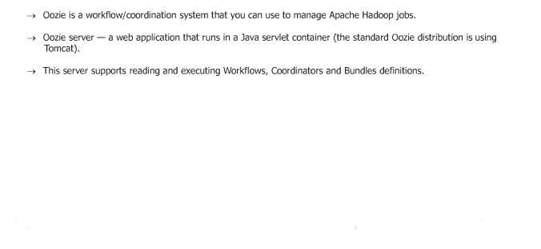
What is Oozie?

Slide 5
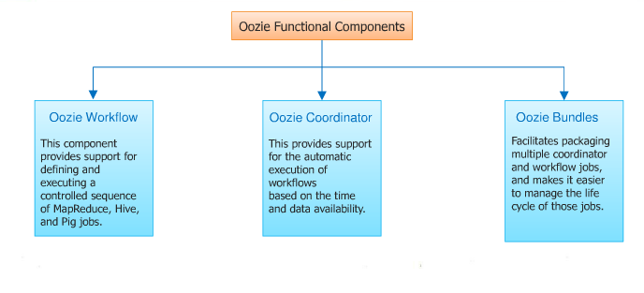
Oozie Functional Components

Slide 6
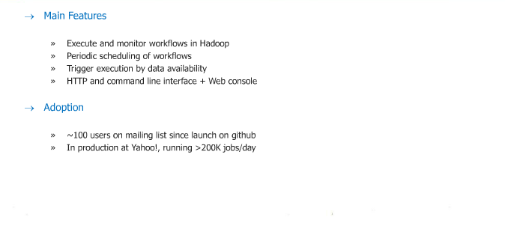
Oozie Overview

Slide 7
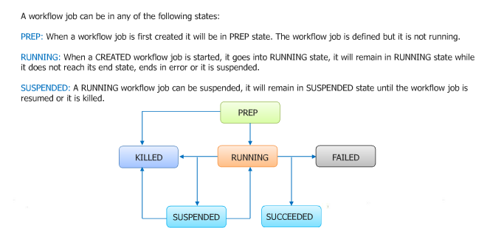
Oozie Workflow

Slide 8
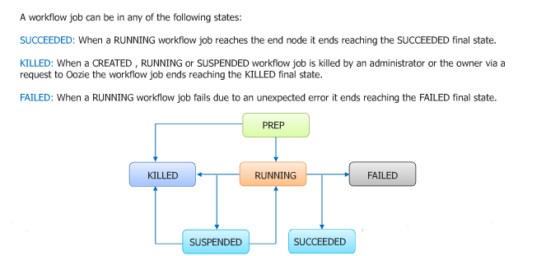
Oozie Workflow..

Slide 9
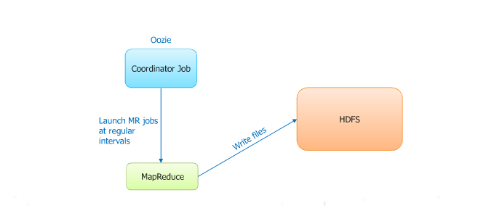
Scheduling with Oozie

Slide 10
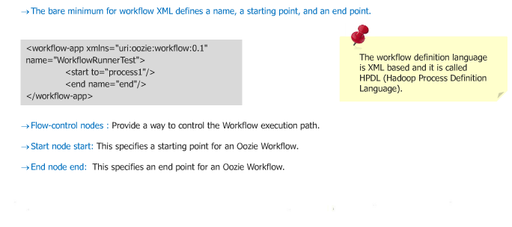
Oozie - workflow .xml

Slide 11
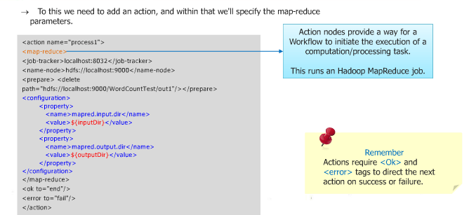
Oozie - workflow .xml

Slide 12
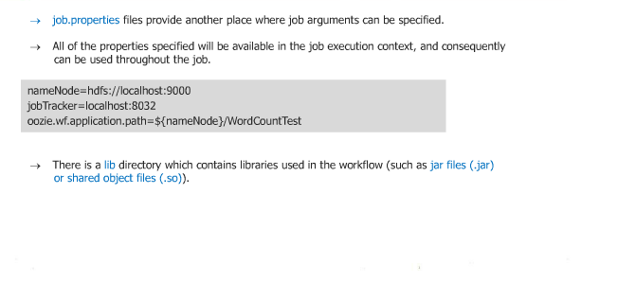
Oozie – job.properties and lib

Slide 13
Demo
Demo on Oozie Workflow Program

Slide 14
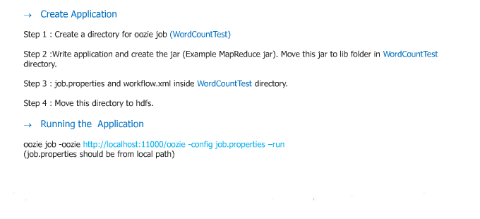
Running Oozie application

Slide 15
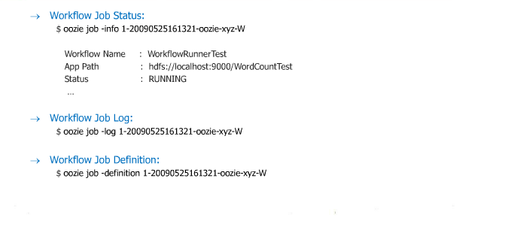
Monitoring an Oozie Workflow Job

Slide 16
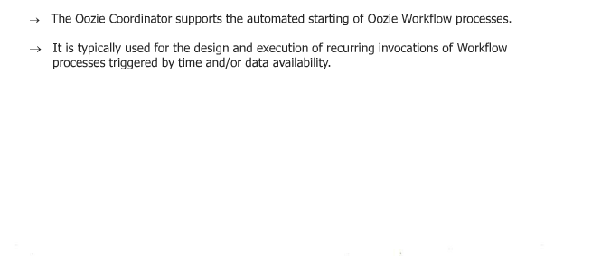
Oozie Coordinator

Slide 17
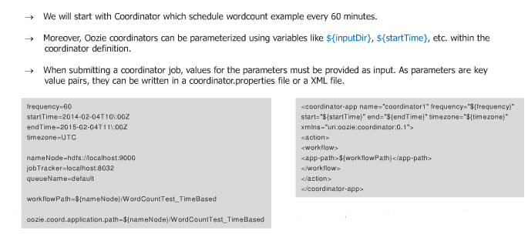
Oozie Coordinator Properties and XML

Slide 18
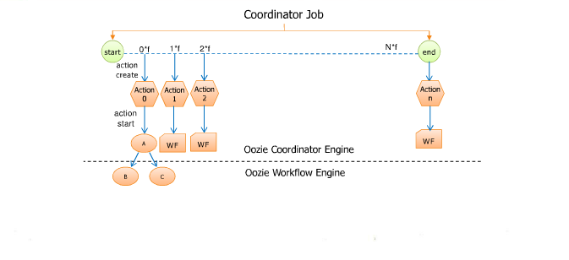
Oozie Application Life Cycle

Slide 19
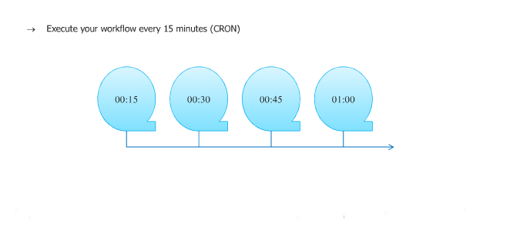
Use Case – 1 Time Triggers

Slide 20
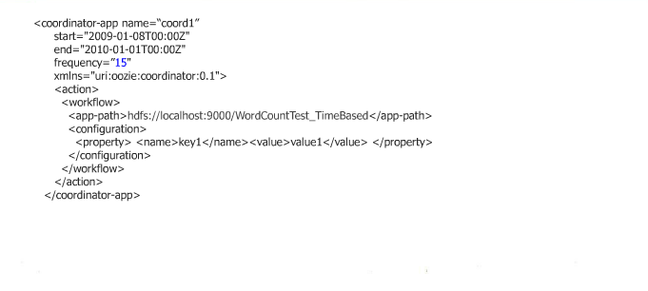
Run Workflow every 15 seconds

Slide 21
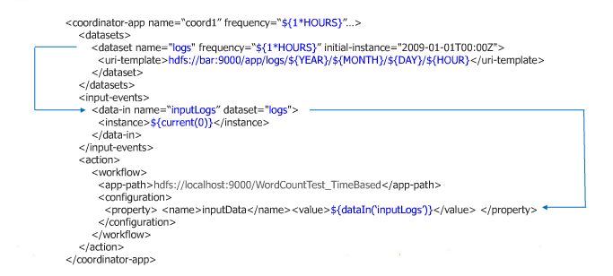
Example 2: Data Triggers

Slide 22
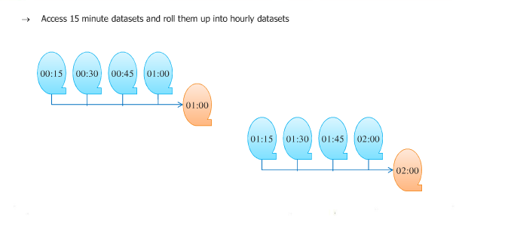
Use Case 2: Rolling Windows

Slide 23
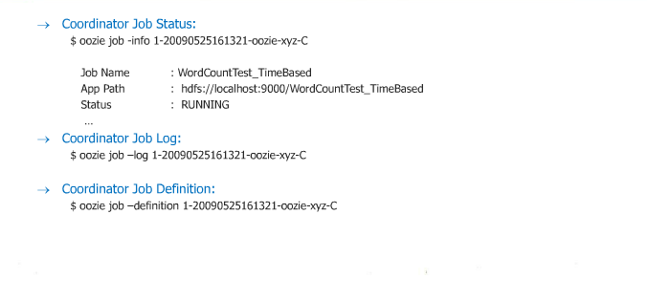
Monitoring an Oozie Coordinator Job

Slide 24
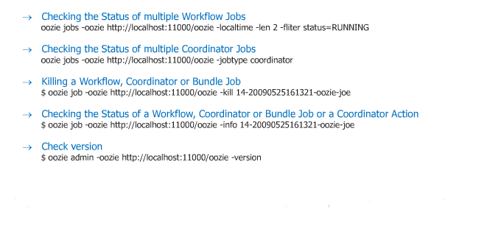
Oozie Commands

Slide 25
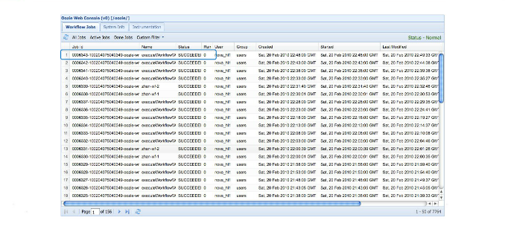
Oozie Web Console: List Jobs

Slide 26
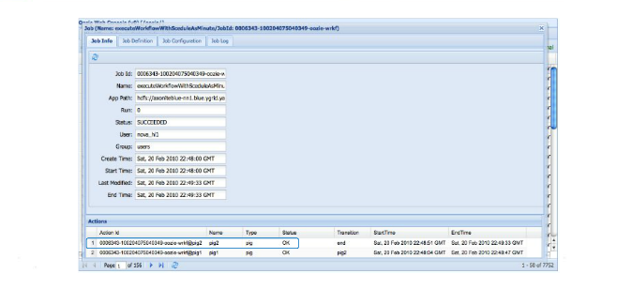
Oozie Web Console: Job Details

Slide 27
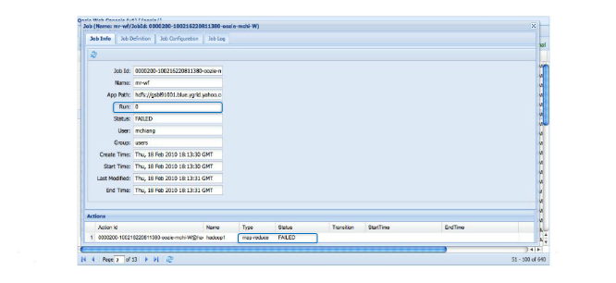
Oozie Web Console: Failed Actions

Slide 28
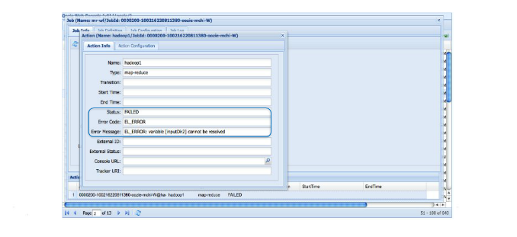
Oozie Web Console: Error Messages

Slide 29
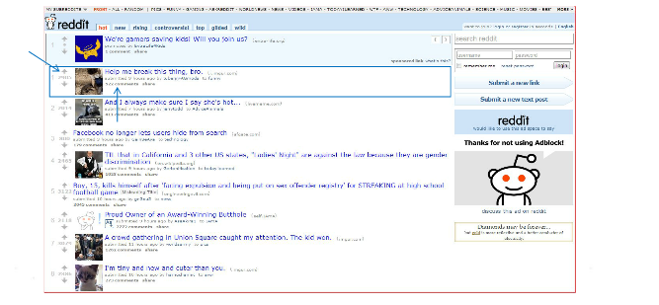
Project – Use Case: How do I find out the best

Slide 30
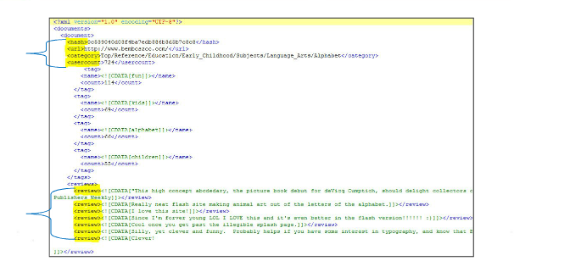
Project – Use Case: The type of data we are dealing with

Slide 31
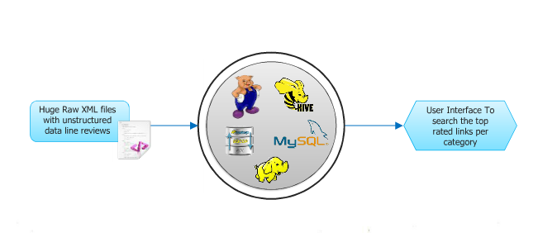
Project – Abstract Flow Diagram

Slide 32
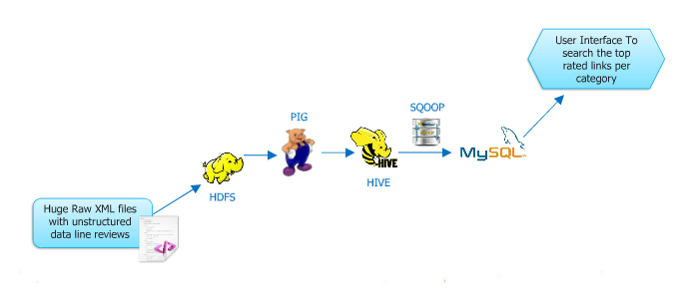
Project – Flow Diagram

Slide 33
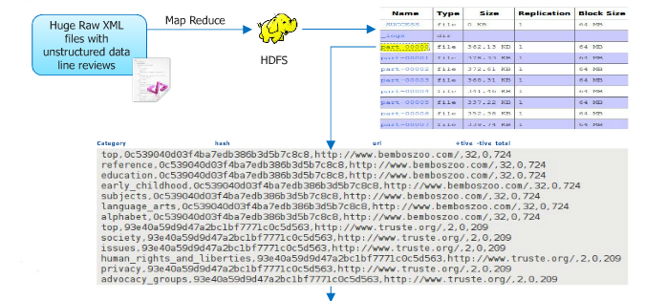
Project – MapReduce Phase

Slide 34
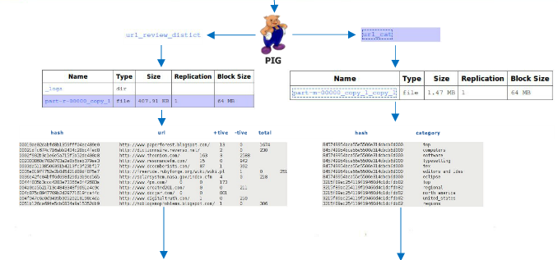
Project – MapReduce to Pig Phase

Slide 35
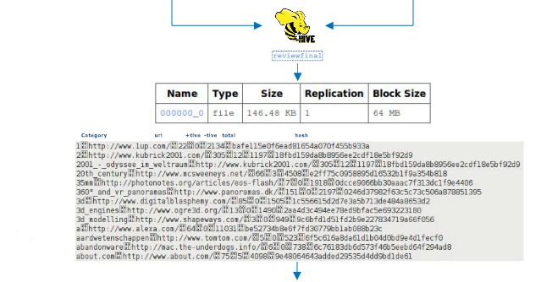
Project – Pig to Hive Phase

Slide 36
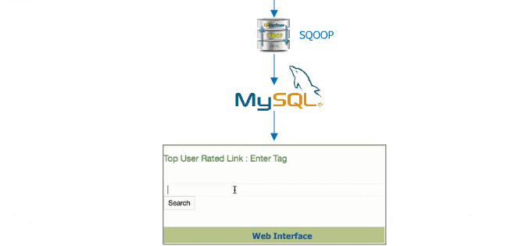
Project – Hive to Sqoop Phase : Dumping data to MySQL

Slide 37
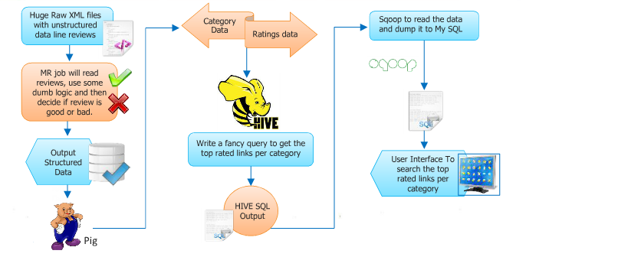
Project – Nut Shell

Slide 38
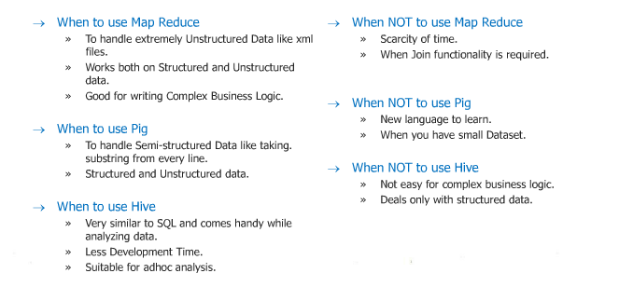
Project - Essence

Slide 39
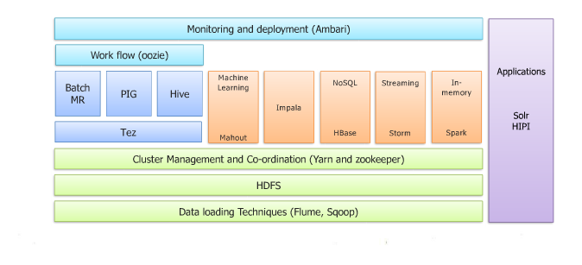
Project – Hadoop Ecosystem

Slide 40

Thank You !!!!!!!!!!!

