Slide 1
Apache Oozie
Shalish.V.J
Notes:
1

Slide 2
Introduction
Apache Oozie is a system for running workflows of dependent jobs.
2 main parts :
workflow engine :
stores and runs workflows composed of different types of Hadoop jobs
coordinator engine :
runs workflow jobs based on predefined schedules and data availability.
Notes:
2

Slide 3
WorkFlow
Workflow constitutes of Action nodes and Control flow nodes
Action nodes :
performs a workflow task
Control flow nodes :
governs the workflow execution between actions
Notes:
3

Slide 4
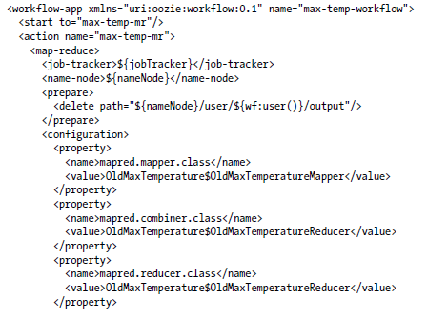
Oozie workflow definition : Max temperature MR Job
Notes:
4

Slide 5
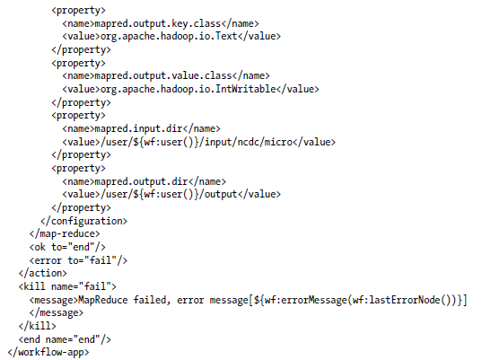
Oozie workflow definition : Max temperature MR Job contd..
Notes:
5

Slide 6
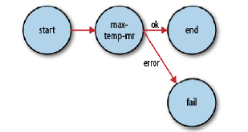
Transition Diagram of Oozie workflow

Slide 7

Oozie workflow Application: Packaging and Deploying

Slide 8
Oozie workflow Application : Running
export the OOZIE_URL environment variable to tell the oozie command which Oozie server to use
-config option specifies a local Java properties file containing definitions for the parameters in the workflow XML file
Notes:
8

Slide 9

Properties File

Slide 10
Workflow job Status: Command line
output shows the status: RUNNING, KILLED, or SUCCEEDED
Notes:
10

Slide 11
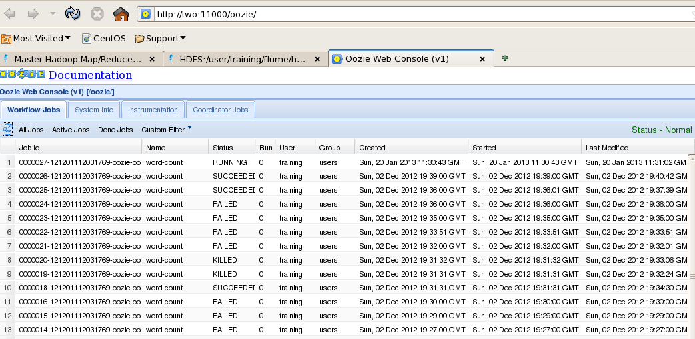
Workflow job Status : Web UI
Oozie’s web UI available at http://localhost:11000/oozie
Notes:
11

Slide 12
Oozie Coordinator Engine
The Oozie Coordinator system allows the user to define and execute recurrent and interdependent workflow jobs
Notes:
12

Slide 13
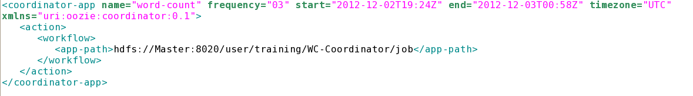
Coordinator.xml
The Oozie Coordinator system allows the user to define and execute recurrent and interdependent workflow jobs
Job runs every 3 minutes between start and end time
Notes:
13

Slide 14
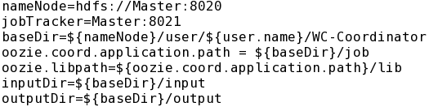
Properties File
Notes:
14

Slide 15
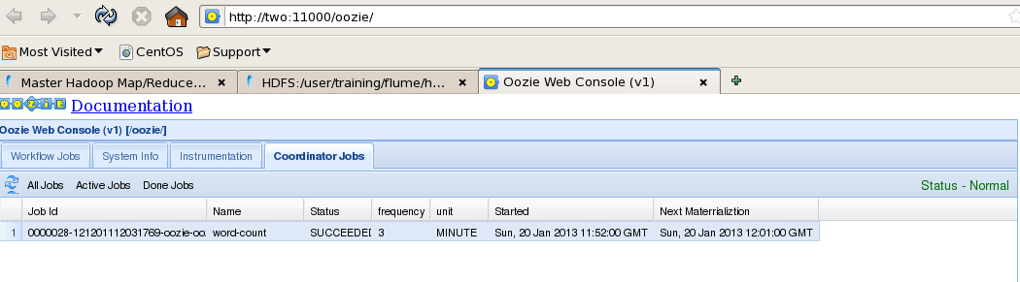
Workflow job Status : Web UI
Oozie’s web UI available at http://localhost:11000/oozie
Notes:
15

Slide 16
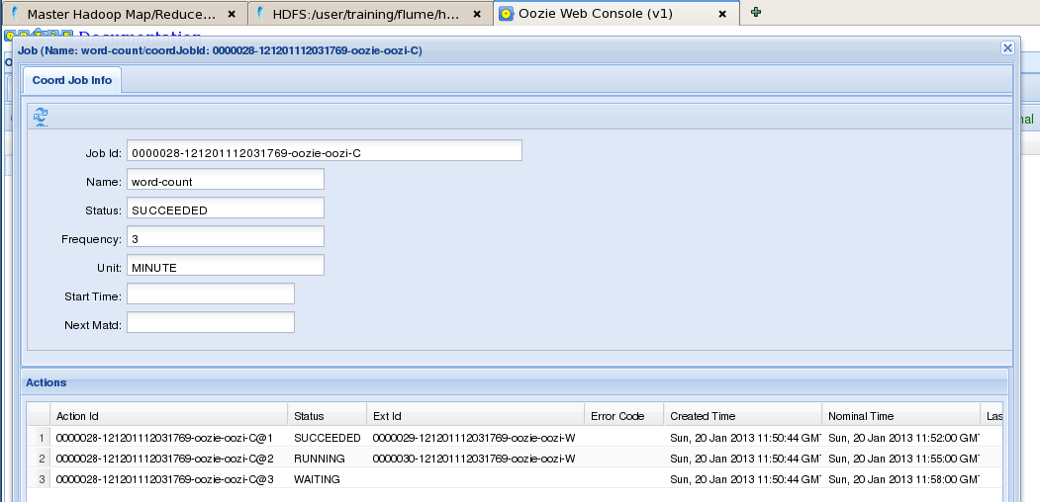
Workflow job Status : Web UI
Notes:
16

Slide 17
Thank YOU !!!
Notes:
17

