Slide 1
Apache Kafka
Rahul Jain
Software Engineer
www.linkedin.com/in/rahuldausa

Slide 2
Agenda
Why Kafka
Introduction
Design
Q&A

Slide 3




Why Kafka? When we have…. Aren’t they Good?
*Apache ActiveMQ, JBoss HornetQ, Zero MQ, RabbitMQ are respective brands of Apache Software Foundation, JBoss Inc, iMatix Corporation and Vmware Inc.

Slide 4
They all are Good But not for all use-cases.

Slide 5
So what are my Use-cases…
Transportation of logs
Activity Stream in Real time.
Collection of Performance Metrics
CPU/IO/Memory usage
Application Specific
Time taken to load a web-page.
Time taken by Multiple Services while building a web-page.
No of requests.
No of hits on a particular page/url.

Slide 6
What is Common?
Scalable: Need to be Highly Scalable. A lot of Data. It can be billions of message.
Reliability of messages, What If, I loose a small no. of messages. Is it fine with me ?.
Distributed : Multiple Producers, Multiple Consumers
High-throughput: Does not require to have JMS Standards, as it may be overkill for some use-cases like transportation of logs.
As per JMS, each message has to be acknowledged back.
Exactly one delivery guarantee requires two-phase commit.

Slide 7
Introduction
An Apache Project, initially developed by LinkedIn's SNA team.
A High-throughput distributed Publish-Subscribe based messaging system.
A Kind of Data Pipeline
Written in Scala.
Does not follow JMS Standards, neither uses JMS APIs.
Supports both queue and topic semantics.

Slide 8
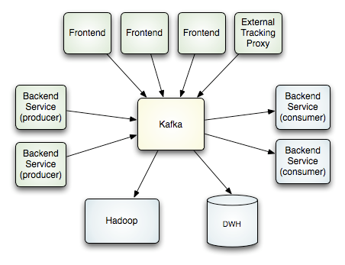
How it works
Credit : http://kafka.apache.org/design.html

Slide 9
How it works
Producer
Handshake
Zookeeper
Store Consumed Offset and Watch for Cluster event
Consumer
Event Push
Producer
Kafka Broker
Coordination
Handshake
Producer
.
.
.
.
.
Consumer
Event Push
Event Polling
Producer
Event Push
Kafka Broker

Slide 10
How it works (Queue)
Coordination
Producer
Handshake
Zookeeper
Store Consumed Offset and Watch for Cluster event
Consumer 1
(groupId1)
Event Push
Producer
Handshake
Kafka Broker
(Partition 1)
Consumer 2
(groupId1)
Producer
.
.
.
.
.
Event Push
Event Polling
Producer
Event Push
Kafka Broker
(Partition 2)
*
Consumer 3
(groupId1)
* Consumer 3 would not receive any data, as number of consumers are more than number of partitions.

Slide 11
Design Elements
Filesystem Cache
Zero-copy transfer of messages
Batching of Messages
Batch Compression
Automatic Producer Load balancing.
Broker does not Push messages to Consumer, Consumer Polls messages from Broker.
And Some others.
Cluster formation of Broker/Consumer using Zookeeper, So on the fly more consumer, broker can be introduced. The new cluster rebalancing will be taken care by Zookeeper
Data is persisted in broker and is not removed on consumption (till retention period), so if one consumer fails while consuming, same message can be re-consume again later from broker.
Simplified storage mechanism for message, not for each message per consumer.

Slide 12
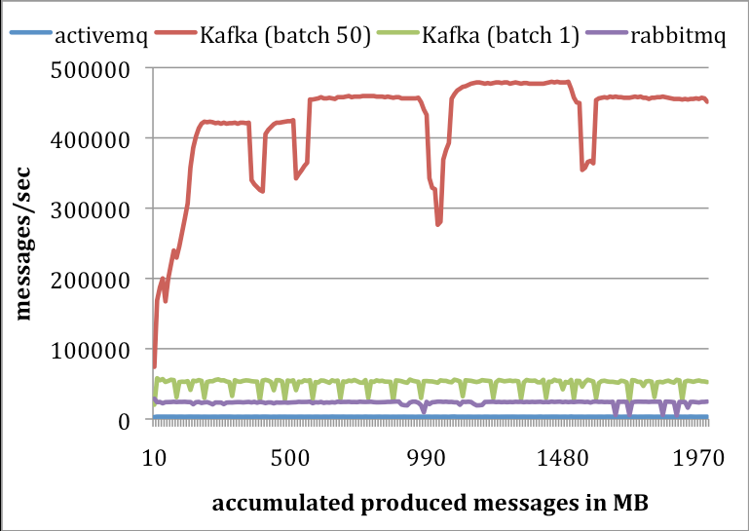
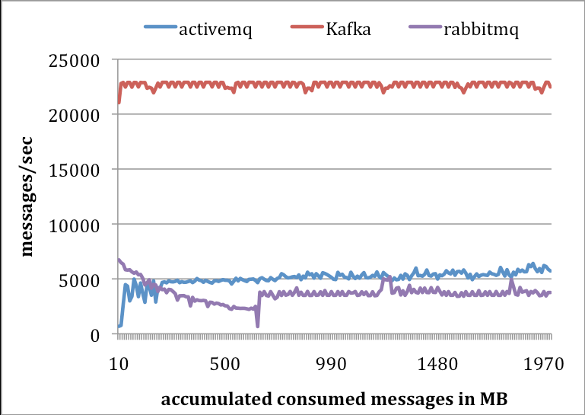
Performance Numbers
Producer Performance
Consumer Performance
Credit : http://research.microsoft.com/en-us/UM/people/srikanth/netdb11/netdb11papers/netdb11-final12.pdf

Slide 13
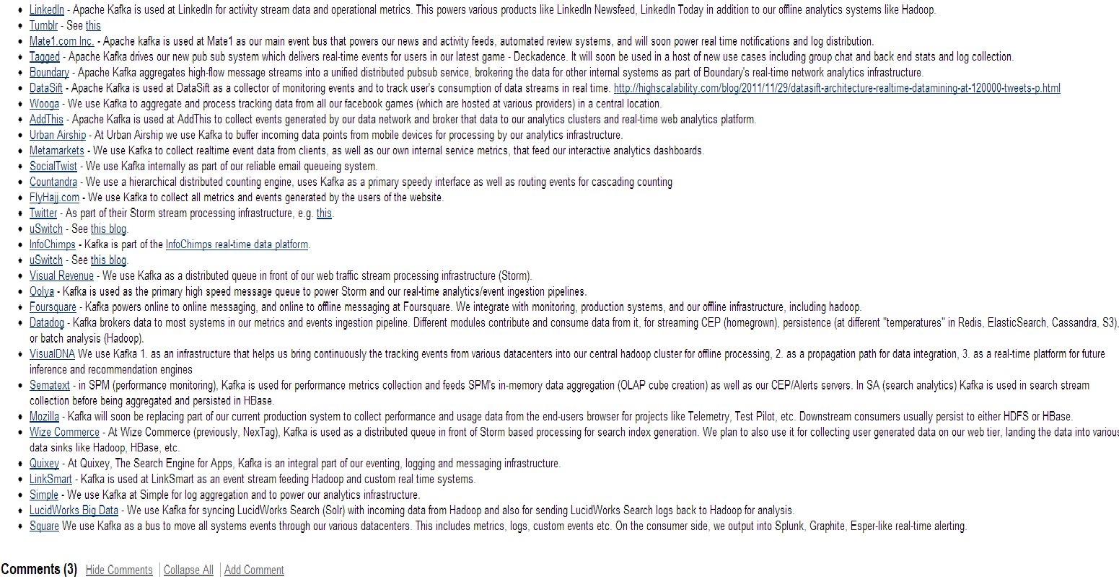
Powered By
Credit: https://cwiki.apache.org/confluence/display/KAFKA/Powered+By

Slide 14
Questions ?

