Slide 1

Introduction to Kafka and Zookeeper June Hadoop Meetup
Rahul Jain
@rahuldausa

Slide 2
Who am I?
Software Engineer
Member of Core technology @ IVY Comptech, Hyderabad, India
6 years of programming experience
Areas of expertise/interest
High traffic web applications
JAVA/J2EE
Big data, NoSQL
Information-Retrieval, Machine learning

Slide 3
Agenda
Overview
Zookeeper
Messaging System (Basic Concepts)
Kafka
Q&A

Slide 4

Apache Zookeeper TM

Slide 5
What is a Distributed System
“A Distributed system consists of multiple computers that communicate and coordinate their actions by passing messages. The components interact with each other in order to achieve a common goal. ”
- Wikipedia

Slide 6

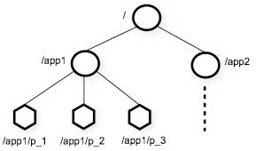
What is Zookeeper
An Open source, High Performance coordination service for distributed applications
Centralized service for
Configuration Management
Locks and Synchronization for providing coordination between distributed systems
Naming service (Registry)
Group Membership
Features
hierarchical namespace
provides watcher on a znode
allows to form a cluster of nodes
Supports a large volume of request for data retrieval and update
http://zookeeper.apache.org/
Source : http://zookeeper.apache.org

Slide 7
Zookeeper Use cases
Configuration Management
Cluster member nodes Bootstrapping configuration from a central source
Distributed Cluster Management
Node Join/Leave
Node Status in real time
Naming Service – e.g. DNS
Distributed Synchronization – locks, barriers
Leader election
Centralized and Highly reliable Registry

Slide 8
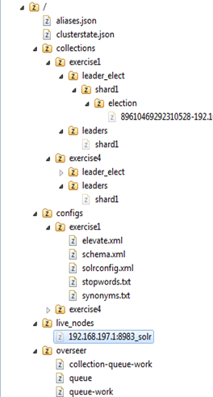
Zookeeper Data Model
Hierarchical Namespace
Each node is called “znode”
Each znode has data(stores data in byte[] array) and can have children
znode
Maintains “Stat” structure with version of data changes , ACL changes and timestamp
Version number increases with each changes

Slide 9
Let’s recall basic concepts of Messaging System

Slide 10
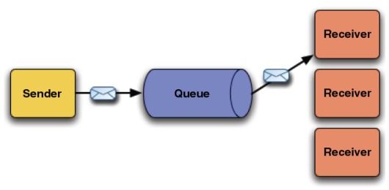
Point to Point Messaging (Queue)
Credit: http://fusesource.com/docs/broker/5.3/getting_started/FuseMBStartedKeyJMS.html

Slide 11
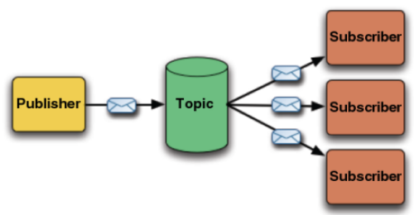
Publish-Subscribe Messaging (Topic)
Credit: http://fusesource.com/docs/broker/5.3/getting_started/FuseMBStartedKeyJMS.html

Slide 12
Apache Kafka

Slide 13
Overview
An apache project initially developed at LinkedIn
Distributed publish-subscribe messaging system
Designed for processing of real time activity stream data e.g. logs, metrics collections
Written in Scala
Does not follow JMS Standards, neither uses JMS APIs
Features
Persistent messaging
High-throughput
Supports both queue and topic semantics
Uses Zookeeper for forming a cluster of nodes (producer/consumer/broker)
and many more…
http://kafka.apache.org/

Slide 14
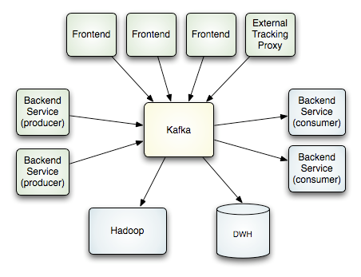
How it works
Credit : http://kafka.apache.org/design.html

Slide 15
Real time transfer
Zookeeper
Update Consumed
Message offset
Consumer1
(Group1)
get Kafka broker address
Queue
Topology
Consumer2
(Group1)
Producer
Kafka Broker
Consumer3
(Group2)
Kafka Broker
Streaming
Topic
Topology
Fetch messages
Consumer4
(Group2)

Slide 16
Design Elements
Uses Filesystem Cache
Zero-copy transfer of messages
Batching of Messages
Batch Compression
Automatic Producer Load balancing.
Broker does not Push messages to Consumer, Consumer Polls messages from Broker.

Slide 17
Design Elements (Contd.)
Cluster formation of Broker/Consumer using Zookeeper,
So on the fly more consumer, broker can be introduced. The new cluster rebalancing will be taken care by Zookeeper
Data is persisted in broker
But not removed on consumption (till retention period), so if one consumer fails while consuming, same message can be re-consumed again later from broker.
Simplified storage mechanism for message,
not for each message per consumer.

Slide 18
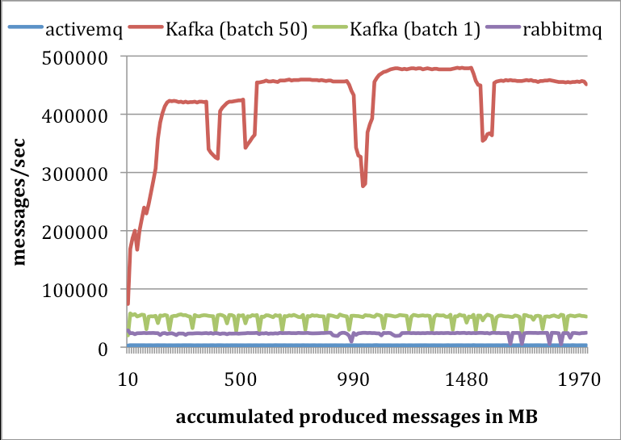
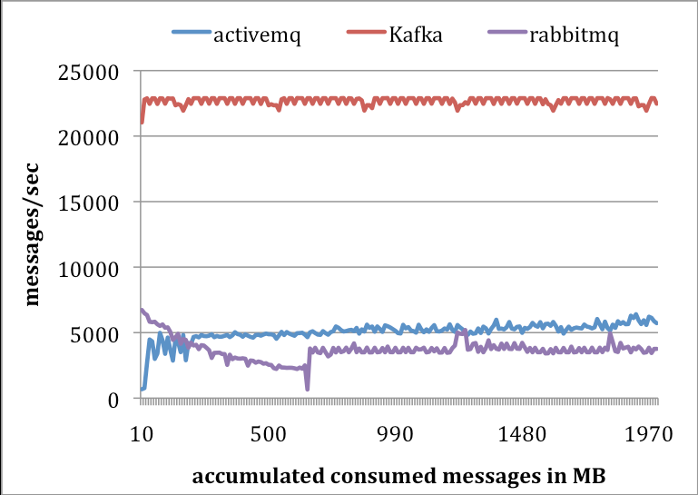
Performance Numbers
Producer Performance
Consumer Performance
Credit : http://research.microsoft.com/en-us/UM/people/srikanth/netdb11/netdb11papers/netdb11-final12.pdf

Slide 19
Questions ? @rahuldausa on twitter and slideshare http://www.linkedin.com/in/rahuldausa

