Slide 1
Some Important selection before starting project
Model = LLAMA2 7B (HF api)
Dataset = MedQuAD (Medical Question Answering Dataset)
Machine = Free colab

Slide 2
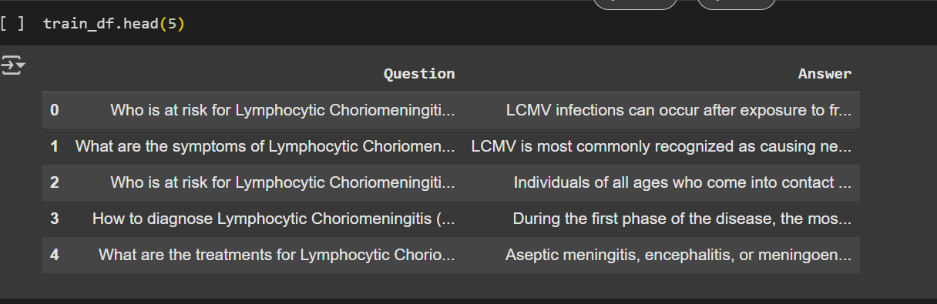
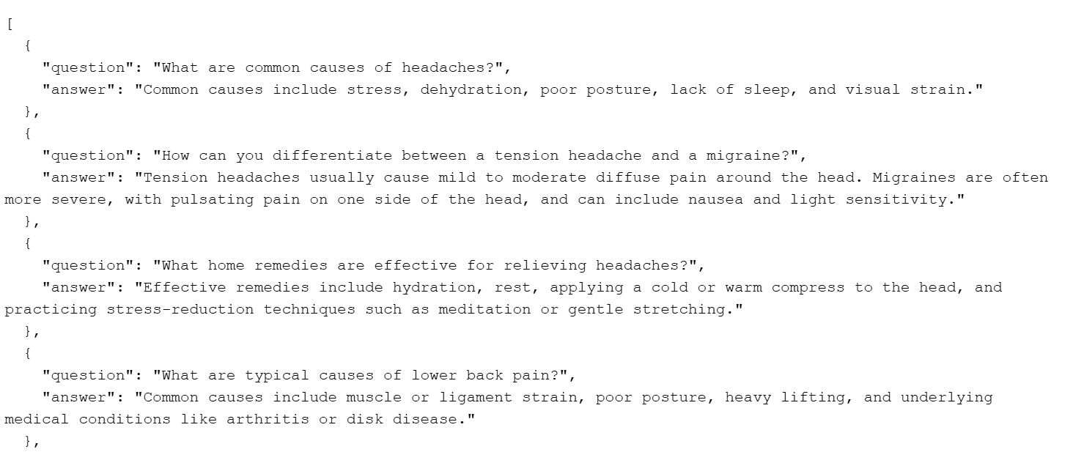
Dataset
Benchmarking Dataset

Slide 3
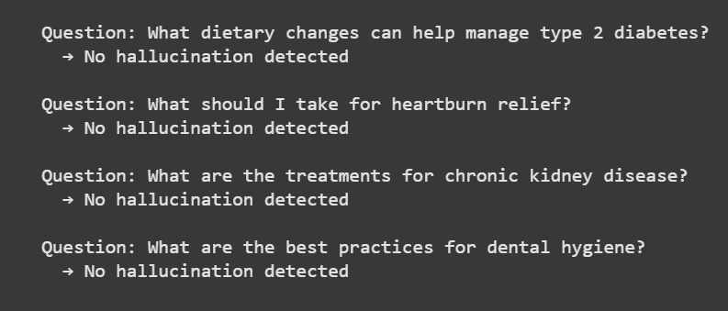
Natural Language Inference (NLI)
A custom function detect_hallucinations splits each generated answer into sentences.
Each sentence is paired with the corresponding standard answer and passed into an NLI model from Hugging Face (roberta-large-mnli).
The model outputs a label (ENTAILMENT, NEUTRAL, CONTRADICTION) and a confidence score.
Results are aggregated per question:
CONTRADICTION → Hallucination detected
NEUTRAL only → Potentially uncertain
ENTAILMENT only → No hallucination detected

Slide 4
self-consistency approach
I re-generated 5 answers per question at different temperatures: 0.5, 0.6, 0.7, 0.8, and 0.9.
Each generated answer was compared to the standard (gold) answer.
The average similarity per question and across all questions was calculated.
Overall Average Across 10 Questions: 0.346

Slide 5
I repeated the same process, but this time used a benchmarking dataset as the trusted reference.
Again, 5 answers were generated for each question across the same temperature values.
Overall Average similarity: 0.289

Slide 6
After 2 methods I moved to fine tune part

Slide 7
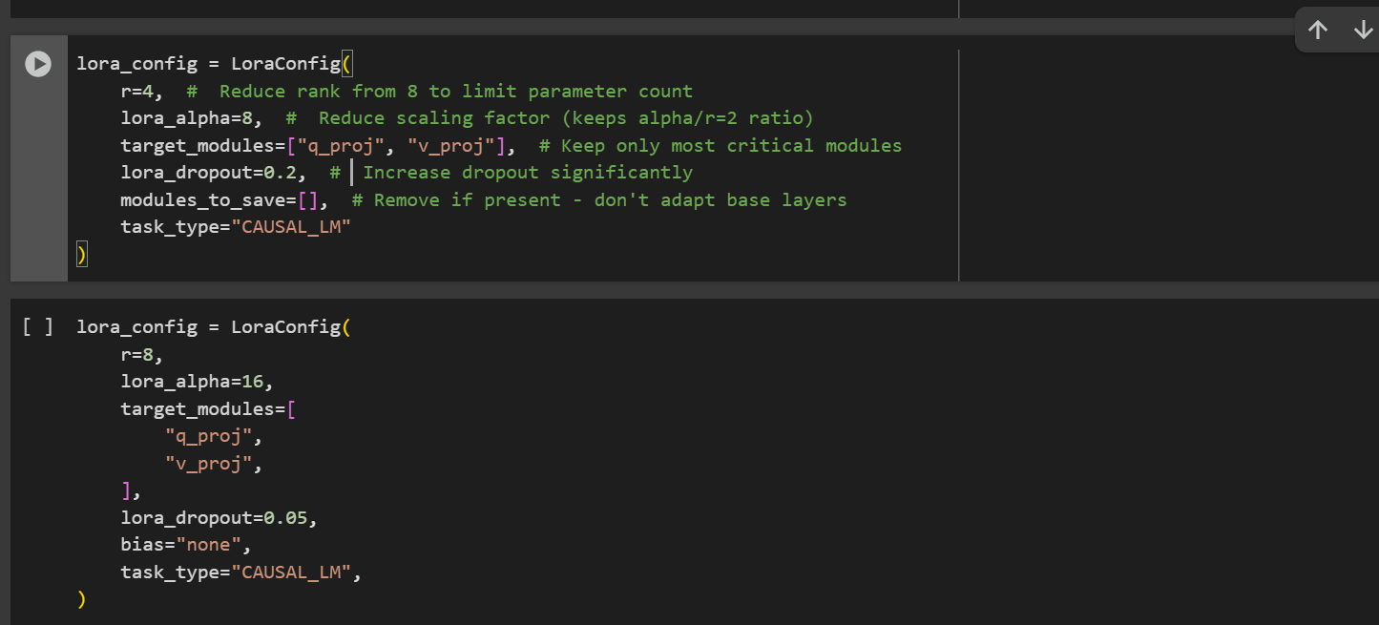
LoRA (Low-Rank Adaptation)
Finetune with data.

Slide 8
Again same self-consistency approach with finetune model
Overall Average Across 10 Questions: 0.700
Overall Average Across Benchmarking Questions: 0.585
Fine-tuning doubled the similarity scores
0.346 → 0.700 on the small set
0.289 → 0.585 on the benchmark set

Slide 9
Apply RAG on Fine Tune Model
Selected 2,000 samples for RAG knowledge base
Generated sentence embeddings using sentence-transformers/all-MiniLM-L6-v2
Stored embeddings in a FAISS vector database for later use

Slide 10
RAG + Fact-Checking Hallucination Detection (Post Fine-Tune)

Slide 11
RAG + Fact-Checking Hallucination Detection (Post Fine-Tune)
I tried with self consistency but due to lack of GPU i wasnt able to apply
Even 10 question has 50 answers

Slide 12
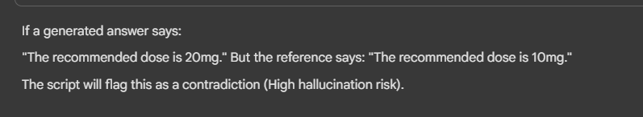
custom fact-checking detector

Slide 13
Applied a custom fact-checking detector
extract_medical_facts() pulls likely factual sentences (heuristics: medical terms and factual patterns like “is used”, “should be”, “dose”, etc.).
supports(f1,f2) marks support via word-overlap ratio (>0.5).
contradicts(f1,f2) flags contradictions via negation mismatch (same content with/without “not”) and numeric conflicts (e.g., “10 mg” vs “20 mg” within similar word context).
A hallucination score is computed from unsupported/contradictory facts and mapped to levels: Low / Medium / High.

Slide 14


