Slide 1
Using AWS EFS as Persistent Volumes with AWS EKS
Kirk Kalvar
Senior Software Engineer/Principal
KAL Technology
@kskalvar
kirk.kalvar@kal.technology

Slide 2
Introduction
Kubernetes has fast established itself as the leading platform for managing containerized workloads and services.
Run Anywhere
57% of Kubernetes workloads run on AWS today – Cloud Native Computing Foundation
So What Do You Do When Your Use Case Requires Persistent Storage when running Kubernetes on AWS?
Are there AWS Any Managed Services I Can Use?

Slide 3
Why AWS EFS?
Amazon EFS automatically and instantly scales your file system storage capacity up or down as you add or remove files without disrupting your applications
Amazon EFS provides secure access for thousands of connections
With Amazon EFS storage, you pay only for what you use. There is no need to provision storage in advance and there are no minimum commitments or up-front fees
Amazon EFS is a fully managed service providing shared file system storage for Linux workloads
Can Be Configured as Persistent Volumes when using Kubernetes

Slide 4
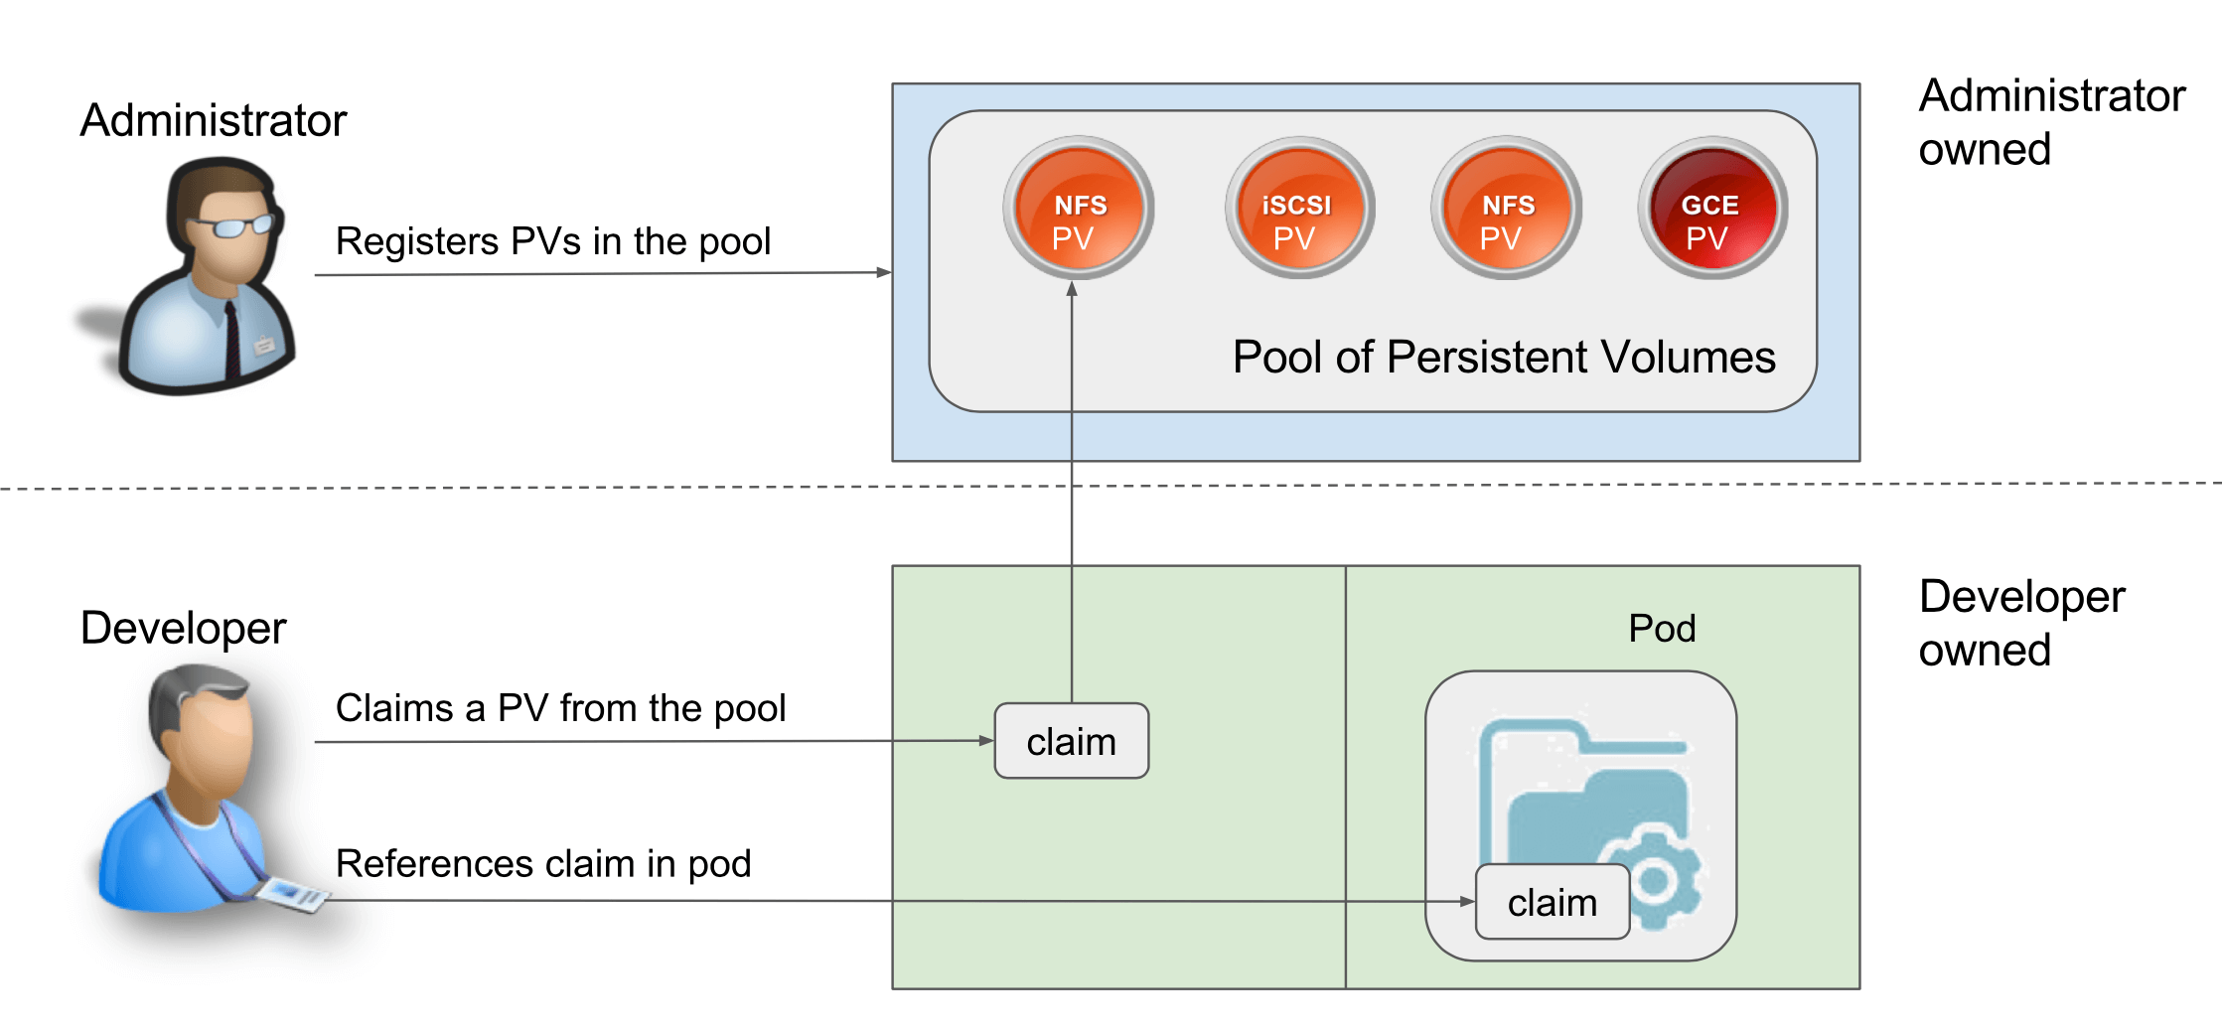
Persistent Volumes

Slide 5
Quick Demo
To save time an AWS EKS Cluster has been configured and an EC2 Instance with kubectl as well as created an AWS EFS File System
We’ll:
Create
Attach to each pod in the service and verify the persistent storage is shared across pods/nodes/availability zones
Notes:
Send a simple text message
Use representative website
Use phone dialer
Use web browser

Slide 6
Conclusions
Cons
EFS is a AWS Managed Service, so it won’t be available across cloud platforms
Pros
No 3rd Party Products to Install, Configure, and Manage
Fast Provisioning
Persistent Volumes across Nodes and Availability Zones
Notes:
Send a simple text message
Use representative website
Use phone dialer
Use web browser

Slide 7
Questions?

Slide 8
References
AWS Elastic Kubernetes Service (EKS) QuickStart
https://github.com/kskalvar/aws-eks-cluster-quickstart
Kubernetes efs-provisioner
https://github.com/kubernetes-incubator/external-storage/tree/master/aws/efs
Kubernetes Persistent Volumes
https://kubernetes.io/docs/concepts/storage/persistent-volumes/

