Slide 1
AWS EKS with AWS EFS as Persistent Volumes
Kirk Kalvar
Senior Software Engineer/Principal
KAL Technology
@kskalvar
kirk.kalvar@kal.technology

Slide 2
Introduction
Kubernetes has fast established itself as the leading platform for managing containerized workloads and services.
Run Anywhere
57% of Kubernetes workloads run on AWS today – Cloud Native Computing Foundation

Slide 3
Why AWS EKS?
AWS Managed Services enables you to quickly and easily deploy your cloud infrastructure
Amazon EKS runs up-to-date versions of the open-source Kubernetes software. Currently 1.12
This means that you can easily migrate any standard Kubernetes application to Amazon EKS without any code modification required
On Demand

Slide 4
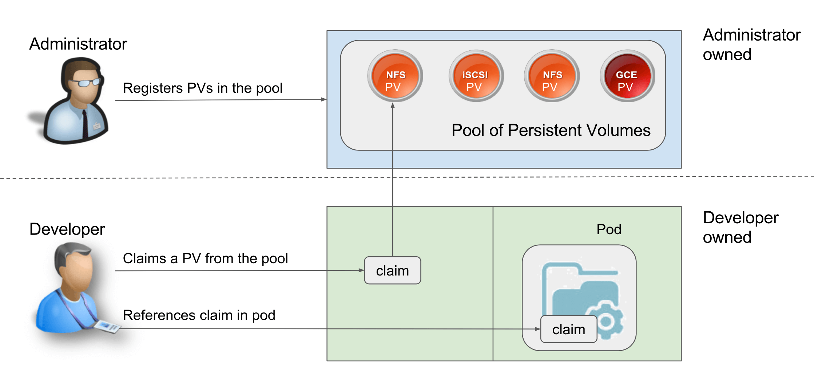
Persistent Volumes

Slide 5
Quick Demo
To save time an AWS EKS Cluster has been configured and an EC2 Instance with kubectl
We’ll:
Attach to each pod in the service and verify the persistent storage shared across pods/nodes/availability zones
Notes:
Send a simple text message
Use representative website
Use phone dialer
Use web browser

Slide 6
Conclusions
Cons
EFS is a AWS Managed Service, so it won’t be available across cloud platforms
Pros
No 3rd Party Products to Install and Configure
Fast Provisioning
Persistent Volumes across Nodes and Availability Zones
Notes:
Send a simple text message
Use representative website
Use phone dialer
Use web browser

Slide 7
Questions?

Slide 8
References
AWS Elastic Kubernetes Service (EKS) QuickStart
https://github.com/kskalvar/aws-eks-cluster-quickstart
Kubernetes efs-provisioner
https://github.com/kubernetes-incubator/external-storage/tree/master/aws/efs
Kubernetes Persistent Volumes
https://kubernetes.io/docs/concepts/storage/persistent-volumes/

