Slide 1
Balancing Security & Usability
The link between interface and security
Justin C. Klein Keane
jukeane@sas.upenn.edu
Justin@MadIrish.net
http://www.MadIrish.net
Twitter: madirish2600
Copyright 2010 Justin C. Klein Keane <justin@MadIrish.net>

Slide 2
About Me
I assume you don't care because you're already here
I suck at creating slide decks
I suck at design
Why should I be qualified to talk about UI then?
  I use UI flaws to develop attacks all the time >:)
Copyright 2010 Justin C. Klein Keane <justin@MadIrish.net>

Slide 3
How to Use UI for Security
Because <blink> is deprecated:
<style type="text/css">
<!--
p#blinking {text-decoration: blink;}
-->
</style>
Copyright 2010 Justin C. Klein Keane <justin@MadIrish.net>

Slide 4
Outline
Attacks that leverage UI
How to use UI to your advantage
  For end users
  For application administration
  Pitfalls!
Overall architectural approaches
Copyright 2010 Justin C. Klein Keane <justin@MadIrish.net>

Slide 5
User Interface (UI) and Security
Two Points:
  Security is very much related to usability
  Web applications follow models of user expectations (common web paradigms)
In this talk I'd like to highlight
  How attackers are exploiting UI
  Importance of UI in application security
Copyright 2010 Justin C. Klein Keane <justin@MadIrish.net>

Slide 6
Principles of Good Web Application User Interface
“Don't make me think” - Steve Krug's first law of usability
Use of web pages should be self evident
Easily recognizable page elements
Intuitive navigation
Conformity to user expectations
Copyright 2010 Justin C. Klein Keane <justin@MadIrish.net>

Slide 7
Where this falls down
Attackers know that your efforts to enhance usability utilize accepted conventions
Attackers will exploit these conventions to their advantage
Classic confidence trick
Copyright 2010 Justin C. Klein Keane <justin@MadIrish.net>

Slide 8
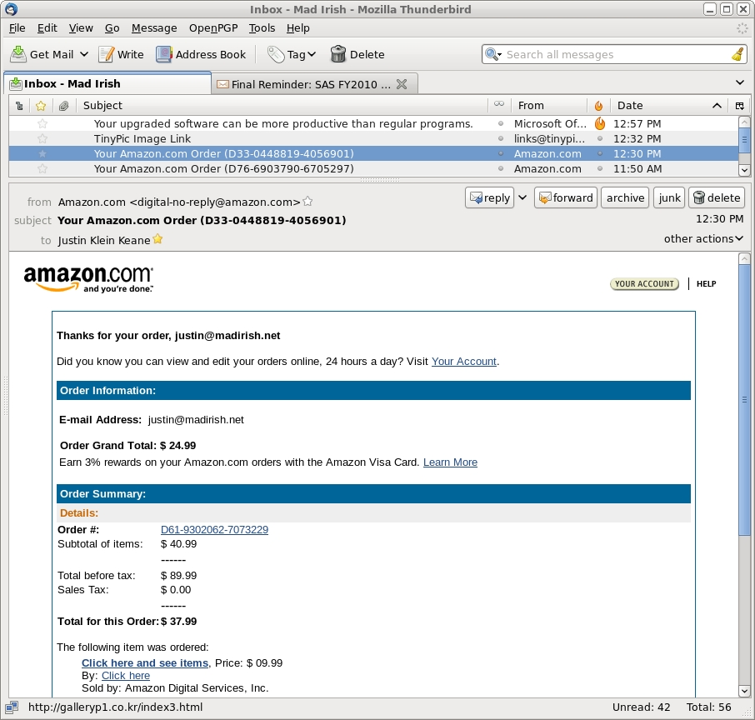
Example 1 - Phishing
Copyright 2010 Justin C. Klein Keane <justin@MadIrish.net>

Slide 9
Example 2 – Fake Websites
Attackers clone your site using a tool like the Social Engineering Toolkit (SET)
Attackers trick victims into visiting the site
The site looks exactly like the legitimate one
Victims enter their credentials, which are stored
Victim is then redirected to your site
Attacking the users rather than the auth mechanism
Copyright 2010 Justin C. Klein Keane <justin@MadIrish.net>

Slide 10
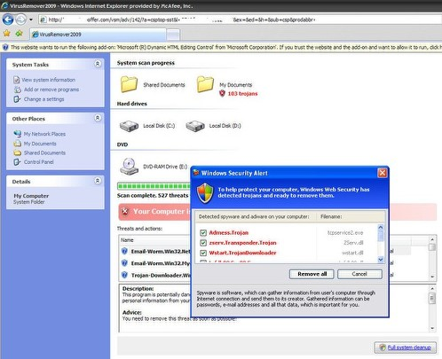
Abuse of UI
Example 3 – Rogue AV
Copyright 2010 Justin C. Klein Keane <justin@MadIrish.net>

Slide 11
UI Problems
Unfortunately the UI problems in these scenarios exist in the application, not your site
Clues to users aren't obvious or can be spoofed
  Use lock as the favicon
  Use deeply nested domain name http://www.google.com.evilsite.cn
  DNS spoofing
The user can authenticate to your app, but can your app authenticate to the user?
Copyright 2010 Justin C. Klein Keane <justin@MadIrish.net>

Slide 12
Solutions don't involve UI
The solution to many of these issues is SSL
Normal users have no idea what SSL is (or how it works)
There are no easy visual clues to help users leverage SSL
Properly used SSL requires users to type domain names in, using SSL prefix 'https://'
For more check out the OWASP TLS Cheat Sheet
Copyright 2010 Justin C. Klein Keane <justin@MadIrish.net>

Slide 13
Failed Attempts to Use UI
Secondary mechanisms
  “Your icon” picture recognition
  Onscreen keyboard
  Third party authentication (OpenID)
Why they fail
  Will users realize it isn't there?
  Malware adapts to do screen captures or intercept DNS calls
Can these help? Sure, but they're not a solution
Copyright 2010 Justin C. Klein Keane <justin@MadIrish.net>

Slide 14
XSS – the UI Problem
Cross site scripting (XSS) is probably the most dangerous vulnerability in web apps today
It is also the most underrated
What is cross site scripting
  Arbitrary script injection
  Stored, Reflected, DOM
Interface created from user input can become dangerous! Consider content your users provide
Copyright 2010 Justin C. Klein Keane <justin@MadIrish.net>

Slide 15
What is XSS
User supplied data is displayed in the web application
The app fails to strip out content that could be used to alter display properties
Typical example is that the user causes Javascript to execute when page is rendered
Controls to limit users ability to manipulate content interface are missing
Copyright 2010 Justin C. Klein Keane <justin@MadIrish.net>

Slide 16
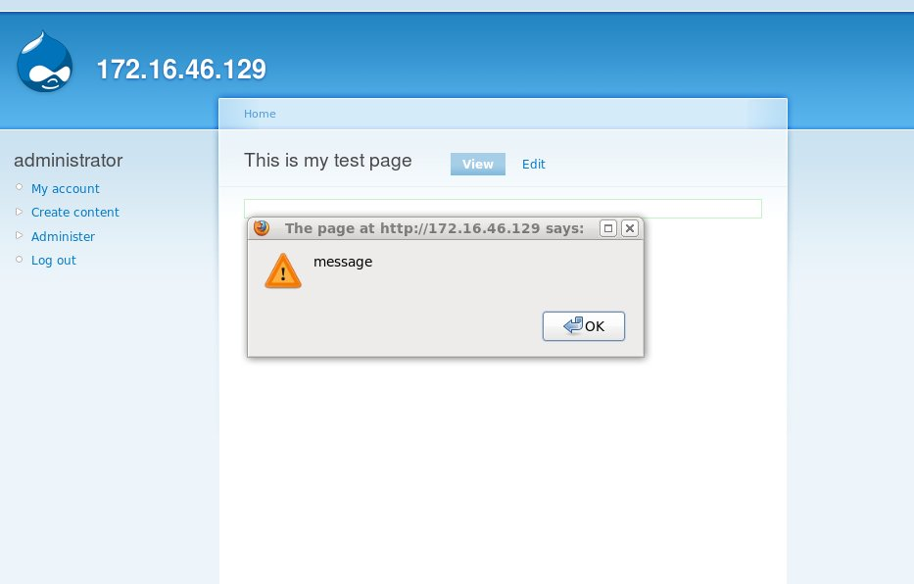
OMFG!!!
Copyright 2010 Justin C. Klein Keane <justin@MadIrish.net>

Slide 17
Consequences of XSS
What is possible with XSS?
  Annoying JavaScript pop-up
  Arbitrary script injection!
    Steal the user cookies
    Inject an iframe to a remote source
    Reference a (vulnerable) third party plugin
      Flash object, Java applet, PDF
    XSS can quickly become a client side exploitation attempt!
Copyright 2010 Justin C. Klein Keane <justin@MadIrish.net>

Slide 18
What can we do?
There are steps you can take to
enhance security using UI
Copyright 2010 Justin C. Klein Keane <justin@MadIrish.net>

Slide 19
Building UI to Enhance Security
Despite these problems, UI can be used to enhance security
Security and usability are often expressed as dichotomous
Good security starts with good usability
Copyright 2010 Justin C. Klein Keane <justin@MadIrish.net>

Slide 20
Psychological Acceptability
Saltzer & Schroeder 1975 The Protection of Information in Computer Systems
Examined several 'design principles' associated with security
Psychological acceptability is the principle that the closer security conforms to user expectations the better
Copyright 2010 Justin C. Klein Keane <justin@MadIrish.net>

Slide 21
To Quote:
h) Psychological acceptability: It is essential that the human interface be designed for ease of use, so that users routinely and automatically apply the protection mechanisms correctly. Also, to the extent that the user's mental image of his protection goals matches the mechanisms he must use, mistakes will be minimized. If he must translate his image of his protection needs into a radically different specification language, he will make errors.
Copyright 2010 Justin C. Klein Keane <justin@MadIrish.net>

Slide 22
Psychological Acceptability Means
Users won't jump through hoops if they don't understand why such measures are necessary
Users will take advantage of security that doesn't impede their work
Subtext – make your users allies in maintaining a secure application
Copyright 2010 Justin C. Klein Keane <justin@MadIrish.net>

Slide 23
Strategies
Copyright 2010 Justin C. Klein Keane <justin@MadIrish.net>

Slide 24
UI, Trust, and Security
Trust is an essential element of security
To encourage user trust be sure to:
  Use good design
  Ensure ease of use
  Provide a professional image
  Don't try and deceive users with ad content
  Be consistent
  Provide explanations about your security and privacy practices
Copyright 2010 Justin C. Klein Keane <justin@MadIrish.net>

Slide 25
Make Users into Allies
Provide simple mechanisms for users to assist with security
Let users audit their own activity:
  Your last login was at 12:34 PM on April 1, 2010 from yourmachine.dhcp-phila.verizon.net
Users will audit their own activity a lot more aggressively than you will
Copyright 2010 Justin C. Klein Keane <justin@MadIrish.net>

Slide 26
Make Security Easy
Expectations should be clear
Sometimes users will default to patterns of behavior
  I see an account provisioning form
  I fill out the form and hit submit
  I probably don't read any of the fine print
Don't confound users choices or they'll choose worse ones!
Provide (dynamic) suggestions
Copyright 2010 Justin C. Klein Keane <justin@MadIrish.net>

Slide 27
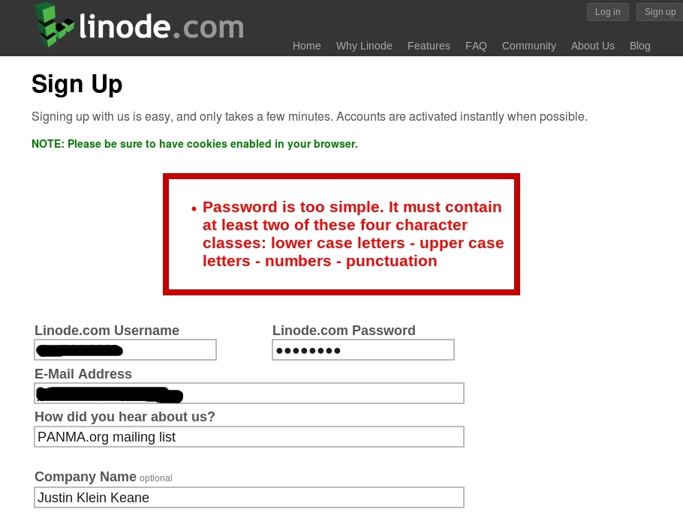
Example
Copyright 2010 Justin C. Klein Keane <justin@MadIrish.net>

Slide 28
A Word (Rant) on Cookies
Don't request your users have cookies enabled
Check for cookies yourself
  If they're enabled save the text
  If they're not enabled let the user know politely
Cookies, like SSL, is one of those technologies most people shouldn't be expected to understand
Copyright 2010 Justin C. Klein Keane <justin@MadIrish.net>

Slide 29
Keys to Success
Make feedback immediate
Make feedback clear and easy to understand
Try to accommodate users
  Check permutations to cut down on back/forth
Give hints to help users
  Password security display
If you do HCI testing – include security!
Copyright 2010 Justin C. Klein Keane <justin@MadIrish.net>

Slide 30
Use UI to Protect
Don't provide unnecessary information to unauthenticated users
Make security context clear
  Change UI elements when users authenticate
Protect services with authentication
  “You must log in to search for other users”
Stagger responsiveness to protect against automation
Copyright 2010 Justin C. Klein Keane <justin@MadIrish.net>

Slide 31
Provide Users with Security Controls
Provide users with easy methods to delegate and revoke access and authority
For instance, allow users to configure permission to view content or profile information
Make such security controls obvious and easy to use
Such controls promote ownership
Copyright 2010 Justin C. Klein Keane <justin@MadIrish.net>

Slide 32
Enumerate Consequences
If users make a choice that will have security consequences make sure those consequences are clearly enumerated
Be judicious though, avoid warning fatigue!
Don't provide interface for options that are not allowed, this will frustrate users
Use proximity rather than aggressiveness
Copyright 2010 Justin C. Klein Keane <justin@MadIrish.net>

Slide 33
Remediate Rather than Warn
“Warning: you are about to download a file that might contain a virus or other executable content”
“Warning: you are about to view content which could contain malicious scripts”
Don't expose your users to risk, fix the problems or don't include the features
Copyright 2010 Justin C. Klein Keane <justin@MadIrish.net>

Slide 34
Error Messages
Error message should be
  Helpful
  Actionable
Good error messages help your users debug your applications
Bad error messages enable attackers
Copyright 2010 Justin C. Klein Keane <justin@MadIrish.net>

Slide 35
Example: Bad Error Message
An error occurred – Error code 15123. Please contact an administrator with details of this message.
Copyright 2010 Justin C. Klein Keane <justin@MadIrish.net>

Slide 36
Example: Worse Error Message
Warning: mysql_connect(): Can't connect to local MySQL server through socket '/var/lib/mysql/mysql.sock' (2) in /var/www/html/test.php on line 9 Call Stack: 0.0002 619784 1. {main}() /var/www/html/test.php:0 0.0002 620776 2. mysql_connect() /var/www/html/test.php:9 Can't connect to local MySQL server through socket '/var/lib/mysql/mysql.sock' (2)
Copyright 2010 Justin C. Klein Keane <justin@MadIrish.net>

Slide 37
Example: Good Error Message
There was a problem processing your request. A notice has been sent to the server administrators about this issue. If you would like further details about this error or to provide further details please e-mail support@yourapp.tld. We apologize for the inconvenience.
The data you submitted was invalid, it must be in an integer format, you supplied 'chars'
Copyright 2010 Justin C. Klein Keane <justin@MadIrish.net>

Slide 38
Beware: Don't Provide too Much
“The username you entered does not exist”
“The password you entered does not match”
“The password for this account has been mailed to joe@somemailserver.tld”
Copyright 2010 Justin C. Klein Keane <justin@MadIrish.net>

Slide 39
Application Administration
Recognize that in most applications there are two classes of users:
  End users
  Application administrators
So far we've mostly discussed the former, now let's discuss the latter
Copyright 2010 Justin C. Klein Keane <justin@MadIrish.net>

Slide 40
Make Security Configuration Easy
If your application has a complex security configuration model try to simplify it
Too many options confound administrators and they tend to 'fail open'
Provide tools to help make your tool secure!
Copyright 2010 Justin C. Klein Keane <justin@MadIrish.net>

Slide 41
Group Security UI Thoughtfully
Providing security may mean adding extra controls
Take special care to group these controls in meaningful (and obvious ways)
Obscure or difficult UI can guarantee that controls are not utilized
If possible, provide help in the application itself such as context specific help links or FAQ's
Use expressive icons or other UI elements
Copyright 2010 Justin C. Klein Keane <justin@MadIrish.net>

Slide 42
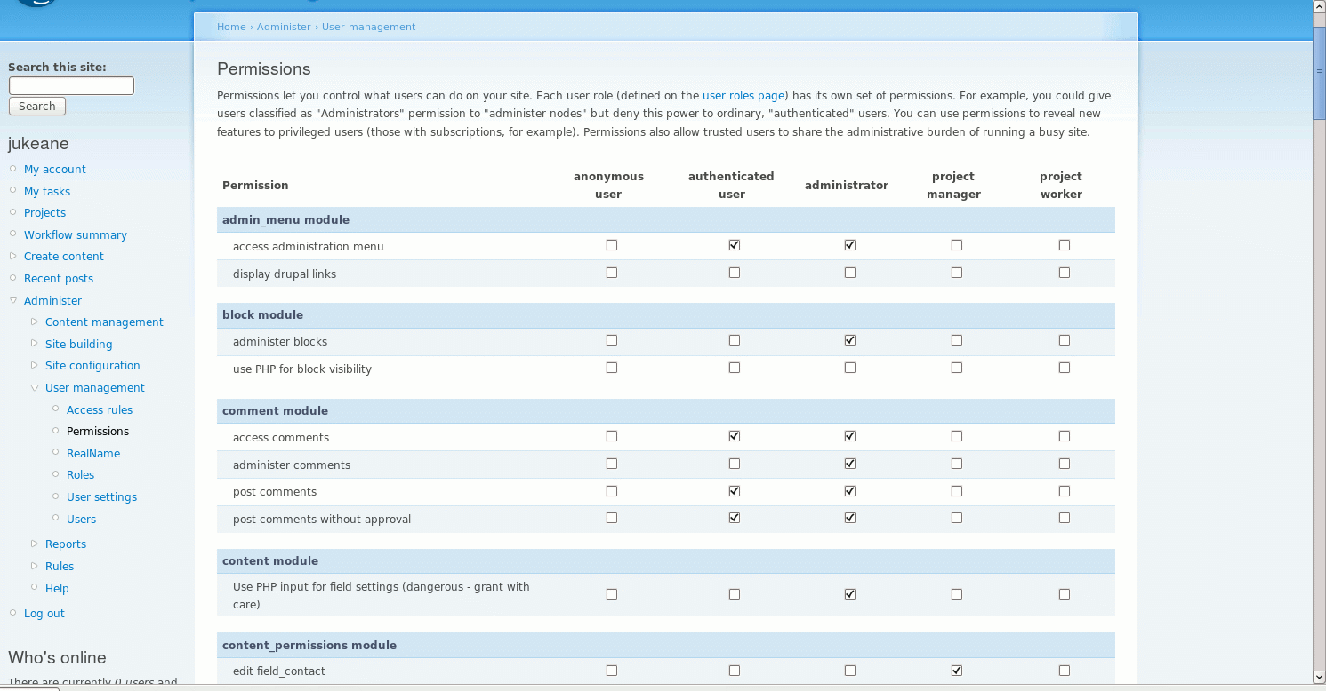
What the?!?
Copyright 2010 Justin C. Klein Keane <justin@MadIrish.net>

Slide 43
Provide Security Interfaces
Build easy to use reporting mechanisms for administrators
Don't track security data in difficult to review places (dusty log files)
Make important security events visually apparent
Provide tools with easy to use UI to aid in security, reporting, and investigation
Copyright 2010 Justin C. Klein Keane <justin@MadIrish.net>

Slide 44
Pitfalls
Copyright 2010 Justin C. Klein Keane <justin@MadIrish.net>

Slide 45
Onerous is the Enemy of Security
Forcing users to change their passwords
Making password complexity requirements that contravene chosen passwords
Making users think up wacky questions
Asking user to remember “the chicken”
Overloading users with messages
On, and on
Copyright 2010 Justin C. Klein Keane <justin@MadIrish.net>

Slide 46
Results of Confounding Users
If users are not clear about security requirements or they feel they are onerous
  Users will ignore security (reuse bad passwords)
  Users will forget security (raising help calls)
  Users may get confused and degrade your security (leaving post-it notes or posting details to public forums)
  Ultimately security will fail in it's functional purpose
Copyright 2010 Justin C. Klein Keane <justin@MadIrish.net>

Slide 47
Don't Revoke User Controls!
Users exercise a certain level of control over applications via their browsers
Don't revoke these controls or you risk degrading trust
Allow users to use browser buttons
Allow users to raise, lower, resize, close windows and view window toolbars
Don't block page elements with invisible divs
Copyright 2010 Justin C. Klein Keane <justin@MadIrish.net>

Slide 48
Don't Forget Accessibility
Be sure any security feature you implement is 508 compliant
If it isn't you may alienate users
Be sure though that mechanisms are backwards vulnerable!
If accessibility features are less secure guess which version attackers will target?
Copyright 2010 Justin C. Klein Keane <justin@MadIrish.net>

Slide 49
Architecture
Security from the top down
Copyright 2010 Justin C. Klein Keane <justin@MadIrish.net>

Slide 50
Principle of Least Privilege
Don't give users any more privilege than required
This limits damage a user can do
It also makes for a cleaner interface, without useless elements cluttering up display
Copyright 2010 Justin C. Klein Keane <justin@MadIrish.net>

Slide 51
Make Secure the Default
If you design applications that implement security mechanisms, make sure they install with these mechanisms enabled
Don't rely on users to have to configure security, make all reasonable configurations first, then allow admins to relax security posture
Copyright 2010 Justin C. Klein Keane <justin@MadIrish.net>

Slide 52
Make Security Open
Provide an easy security contact for your application
Encourage feedback on security from your users
Engage security researchers or vulnerability discoverers, maintain communication, and elicit help in resolution
Copyright 2010 Justin C. Klein Keane <justin@MadIrish.net>

Slide 53
When Security Fails
Trust is a key component of any application security
In the face of security breach try to be transparent with your users
Inform users about what went wrong and how you are correcting the issue
Copyright 2010 Justin C. Klein Keane <justin@MadIrish.net>

Slide 54
Bake Security In
It is critical to the success of any security feature that it be included by design
Don't bolt security on once you're done
  Doing so will probably result in interrupting flow to enforce security (not psychologically acceptable)
Include security in your initial information architecture (IA) and design
Consult with a security specialist if possible to develop threat models and countermeasures
Copyright 2010 Justin C. Klein Keane <justin@MadIrish.net>

Slide 55
References
W3C Web Security Context: User Interface Guidelines http://www.w3.org/TR/wsc-ui/
The Protection of Information in Computer Systems by Jerome Saltzer and Michael Schroeder http://web.mit.edu/Saltzer/www/publications/protection/
Social Engineering Toolkit -
http://www.social-engineer.org/framework/Computer_Based_Social_Engineering_Tools:_Social_Engineer_Toolkit_%28SET%29
Cranor & Garfinkle eds. Security and Usability,Cambridge: O'Reilly, 2005
OWASP TLS Protection Cheat Sheet - http://forum.owasp.org/index.php/Transport_Layer_Protection_Cheat_Sheet
Copyright 2010 Justin C. Klein Keane <justin@MadIrish.net>

Slide 56
Thank you
Questions?
Copyright 2010 Justin C. Klein Keane <justin@MadIrish.net>

